Slide 1
Computer Systems
Exercise 2

Slide 2
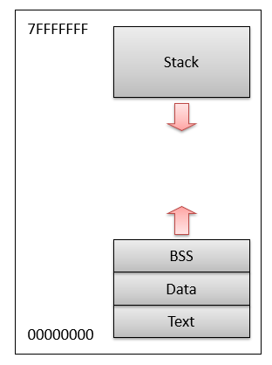
Process
Instance of a program
Ingredients of a process:
Virtual processor (address space, registers, program counter, instruction pointer)
Program text (code)
Program data (heap, stack)
OS stuff (open files, sockets, CPU shares, security rights)
Executed in an “execution environment” (virtual address space, available system calls, etc.)
Purpose of process concept
Protection of program data
Running of program
Identified by PID (process ID)
Software = running processes + kernel

Slide 3
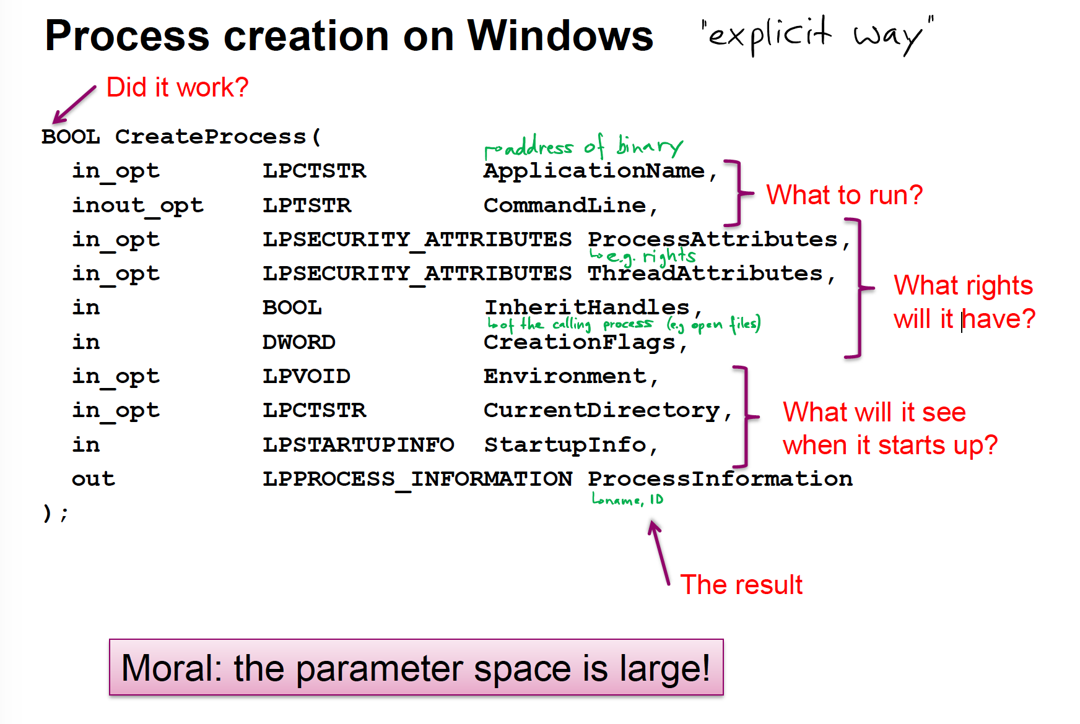
Process creation – spawning new process

Slide 4
Process creation – fork() and exec()
Simplifies creating processes:
Fork creates a copy of the current process, same only that child has return value of fork() = 0 and parent has return value of fork() = PID of child
Exec() replaces text of calling process with new program.
→ Creates tree of processes

Slide 5
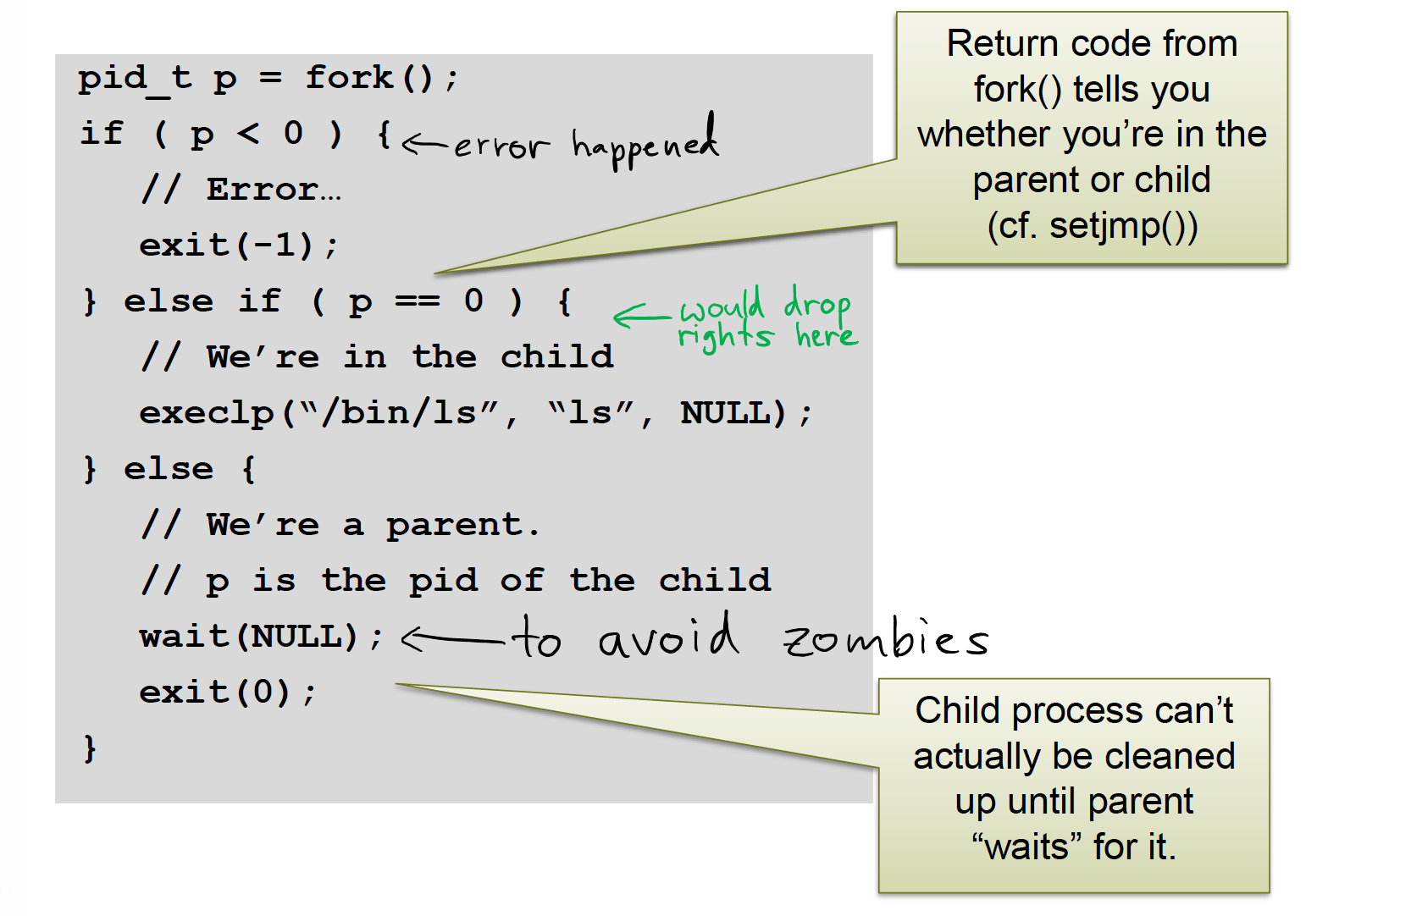
Example fork(), exec()

Slide 6
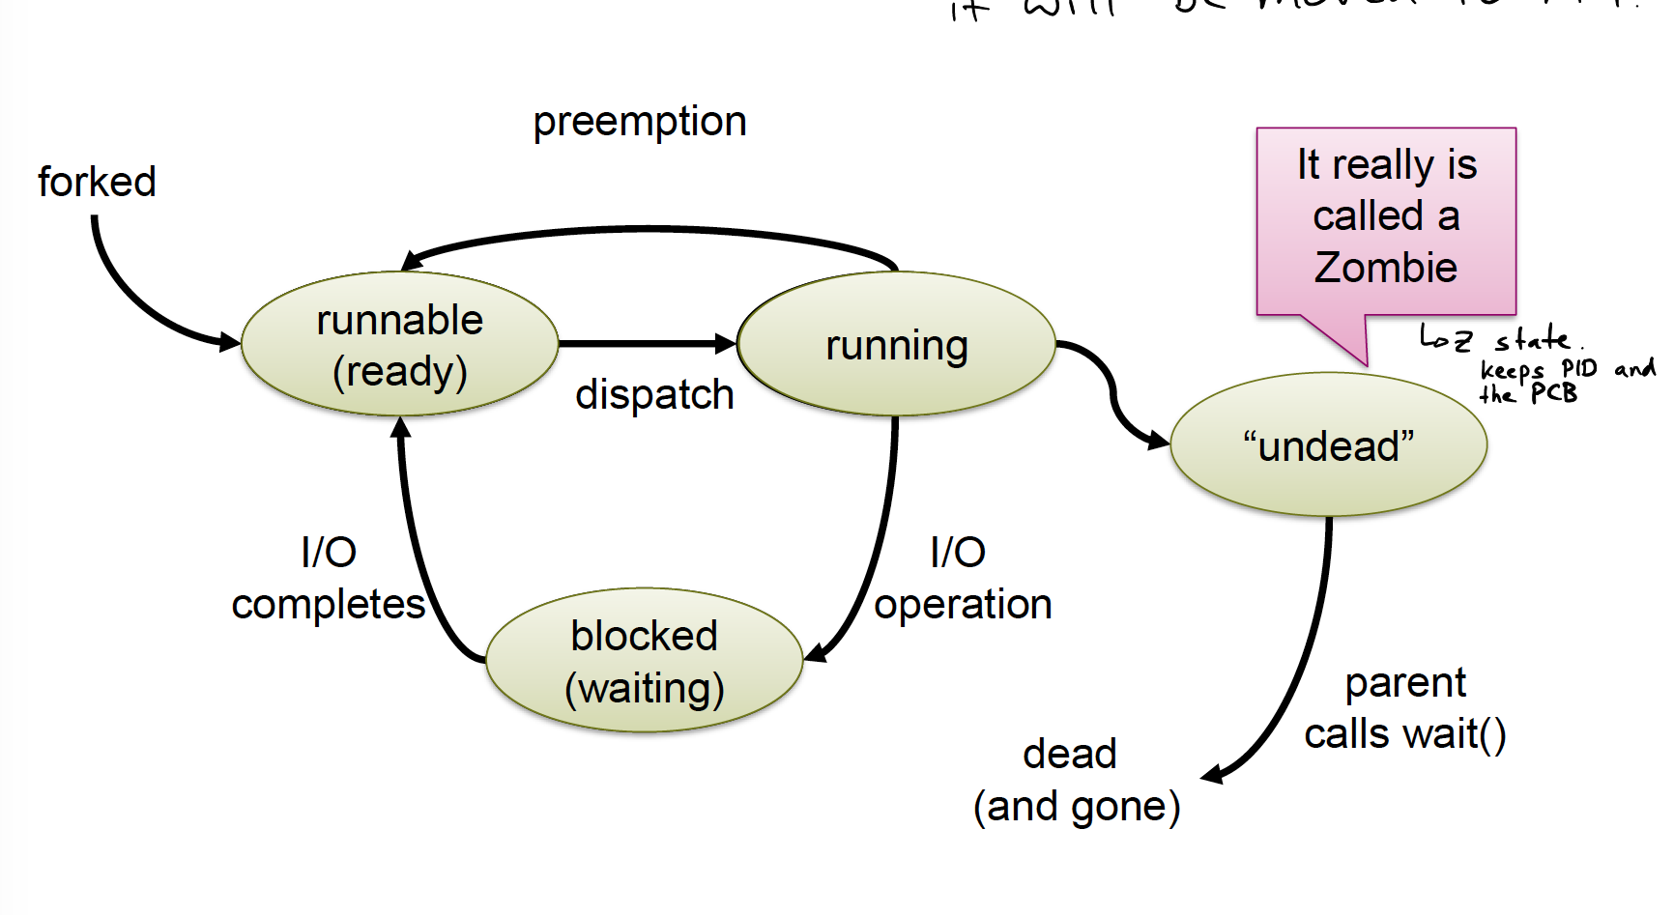
Process lifecycle
Notes:
Not same as in script

Slide 7
Zombies & Orphans
Why Zombies?
If no Zombies, child process could fail and nobody would know because parent has no chance to catch exit status
What happens with child process whose parents have exited?
They are called orphans and get “adopted” by the init process (PID = 1)

Slide 8
Coroutines
Concurrency without parallelism
Basically two functions that call each other (symmetric relationship)

Slide 9
Threads
A thread is part of a process. Multiple threads can exist in one process and share resources such as memory.
Process – unit of resources, thread – unit of scheduling/execution
User threads (lightweight processes)
Kernel is unaware of them, scheduled in user space
Fast to create and manage, but can’t make use of multithreading
Kernel threads
At least on kernel thread exists for each process
One kernel thread can be mapped to each logical core and can be swapped once it gets blocked, but takes long to swap

Slide 10
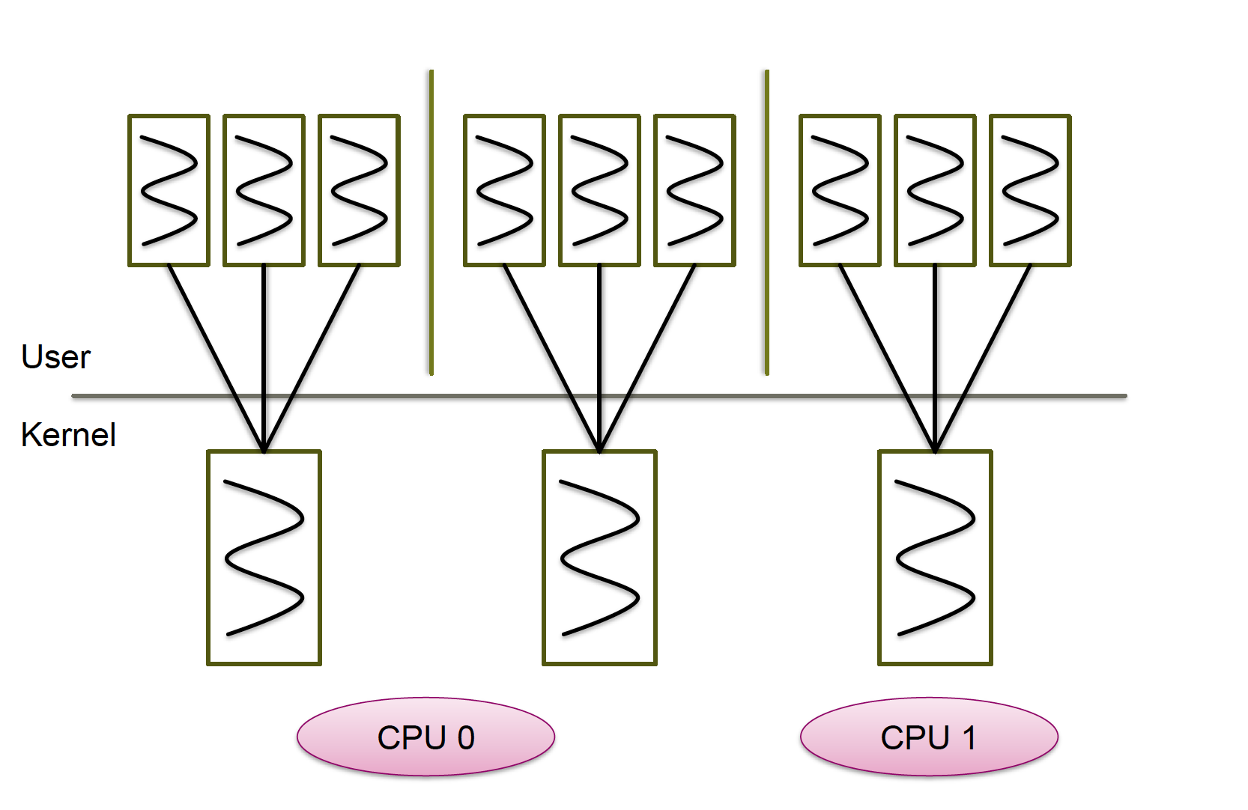
User vs. Kernel Threads

Slide 11
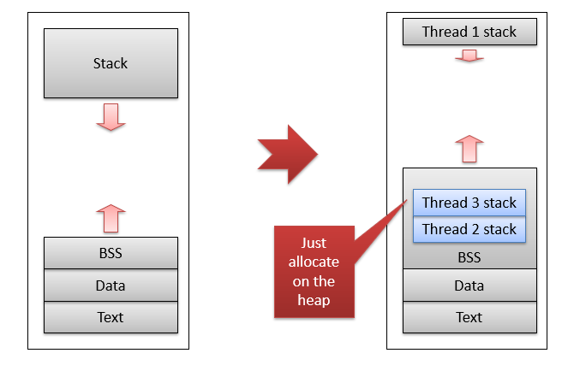
Address space for user-level threads

Slide 12
How do processes communicate?
Shared Memory
Semaphores/Locks
Synchronization instructions (CAS, TAS, LL/SC)
Transactional Memory
Message passing
Asynchronous/Synchronous
Blocking/non-blocking
Pipes
Named/unnamed
Upcalls/Signals
SIGSEGV from memory management
SIGKILL from other process
RPC

Slide 13
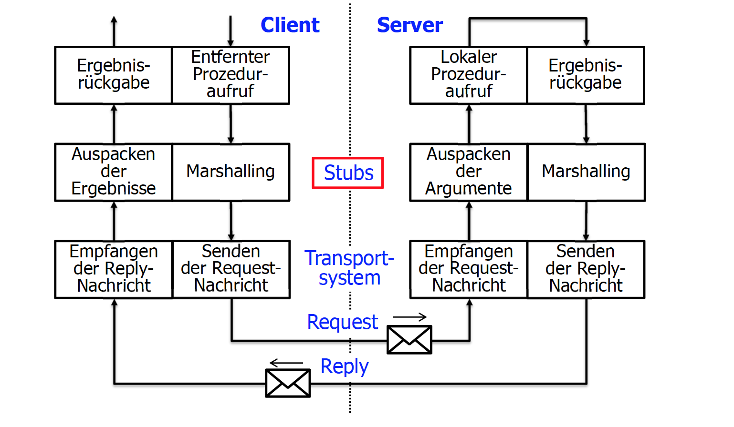
RPC
The magic line

Slide 14
Quiz
What is the relation between a process and a program?
A process is a running instance of a program
How are processes identified?
By the process ID (PID)
In what state is a process after it exited?
Zombie state
Are user threads or kernel threads easier to switch?
User space threads
How long should you spin for waiting for a lock?
One context switch time

