Slide 1
Computer Systems
Exercise Session 3

Slide 2
Last exercise
Create a program which forks itself once. The parent process should output 100 times «I’m the parent and my child's PID is <pid>». The child should output 100 times «I'm the child and my PID is <pid>».
Do the PIDs match?
Answer: No, the PIDs are not matching.

Slide 3
Last exercise
What do you expect to happen here? Please explain what you think will happen.
int main(int argc, char **argv){
while(1) {
fork();
}
}
Answer: If you execute this code, your computer will be (almost) dead. Every child forks new children in a loop and this new children fork new children in a loop as well. This consumes too many resources in a very short time. Not only memory, but also CPU cycles, page table entries,
descriptors...

Slide 4
Last exercise
Write a simple program (main function) which executes the ls program. Lookup the manual page for the exec family (man 3 exec). After the exec call in you main function, have a printf which tells that you have called exec now. What do you notice?
Answer: The line after exec of your program will not be executed. exec replaces the currently executed program by a new one. It does not automatically fork a new process to execute ls -l.
How can you fix that?
Answer: First fork, one child does exec and the other waits for it and prints text.

Slide 5
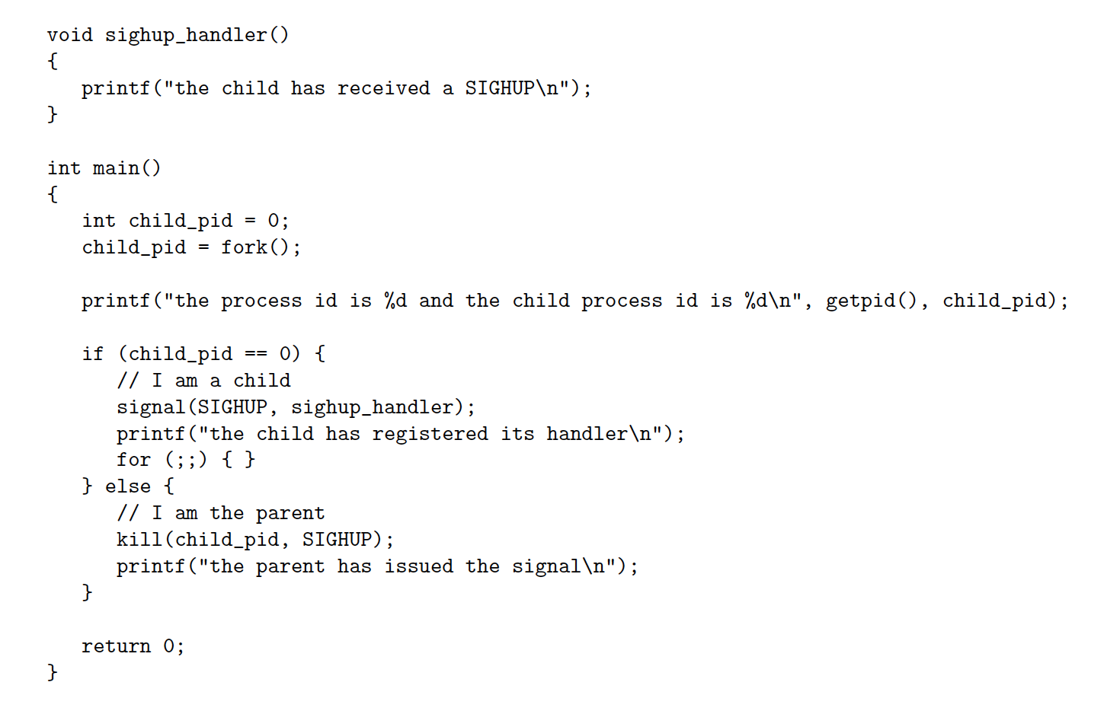
Last exercise

Slide 6
Last exercise
Write a program that registers a signal handler, forks 10 child processes which send signals to the parent and then terminate. In the parent, count the number of signals that you got and print them to the screen. Is this a valid implementation of a counter? Why not and which behavior of signals is problematic?
Answer: No, because signal handler does not count how many signals of the same type it receives, once it is invoked it discards further incoming signals.

Slide 7
Fault-Tolerance in Distributed Systems
Various problems can occur in practice:
Messages may be lost
Nodes (client or server) may crash
Variable message transmission times
One fundamental goal: state replication
Same sequence of commands in the same order
First step to this: one command only
Task: make sure that all servers execute this same command

Slide 8
First approaches for state replication
Server sends acknowledgement message
Reasonable with one client
Inconsistent state with multiple clients and servers
Choose one server as a Serializer
Single point of failure
Two-Phase Protocol and variants
How to handle server crashes?
How to avoid deadlock with locks?

Slide 9


Distributed Systems

Slide 10
Message Loss
1
ACK 1
2
2
This is how TCP works
ACK 2

Slide 11

Serializer
1:C2
C1
2:C1
2:C1
C2
1:C2

Slide 12

Using Locks?
Lock?
Lock?

Slide 13
Using Locks?

Slide 14
Using Locks?
C1
C1

Slide 15
Not if nodes crash
Lock?
Lock?

Slide 16
Paxos – main ideas
Servers hand out tickets
”Weak lock”, which can be overwritten by a later ticket
Only requires the majority of servers to agree
Already ensures that there is at most one accepted command
Servers notify clients about their stored command
Client can then switch to supporting this stored command
A video explaining paxos quite nicely with slightly different terminology
https://www.youtube.com/watch?v=d7nAGI_NZPk

Slide 17
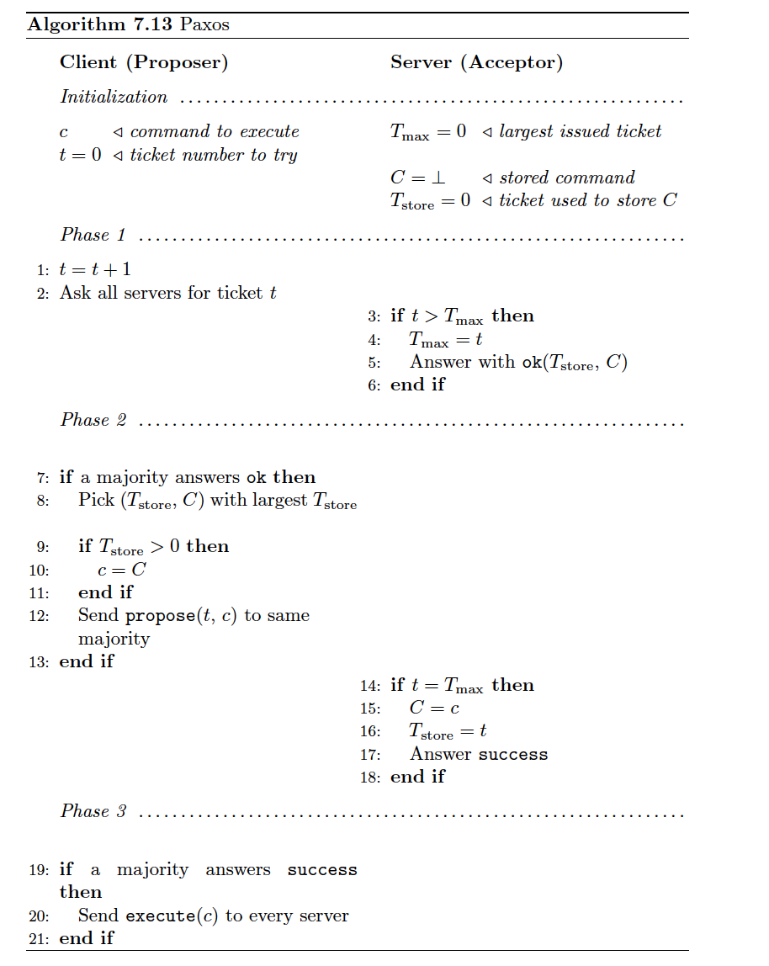
Clients asks for a specific ticket t
Server only issues ticket t if t is the largest ticket requested so far
If client receives majority of tickets, it proposes a command
When a server receives a proposal, if the ticket of the client is still valid, the server stores the command and notifies the client
If a majority of servers store the command, the client notifies all servers to execute the command

Slide 18
Paxos
Servers (Acceptors)
Clients (Proposers)
T_max: 0
C: null
T_store: 0
C: C1
t: 0
T_max: 0
C: null
T_store: 0
C: C2
t: 0
T_max: 0
C: null
T_store: 0

Slide 19
Paxos
Servers (Acceptors)
Clients (Proposers)
T_max: 0
C: null
T_store: 0
Ticket t=1?
C: C1
t: 1
Ticket t=1?
T_max: 0
C: null
T_store: 0
Ticket t=1?
C: C2
t: 0
T_max: 0
C: null
T_store: 0

Slide 20
Paxos
Servers (Acceptors)
Clients (Proposers)
T_store=0,C=null
T_max: 1
C: null
T_store: 0
C: C1
t: 1
T_store=0,C=null
T_max: 1
C: null
T_store: 0
C: C2
t: 0
T_max: 1
C: null
T_store: 0

Slide 21
Paxos
Servers (Acceptors)
Clients (Proposers)
T_max: 1
C: null
T_store: 0
Propose(t=1,C=C1)
C: C1
t: 1
Propose(t=1,C=C1)
T_max: 1
C: null
T_store: 0
C: C2
t: 0
T_max: 1
C: null
T_store: 0

Slide 22
Paxos
Servers (Acceptors)
Clients (Proposers)
success
T_max: 1
C: C1
T_store: 1
C: C1
t: 1
success
T_max: 1
C: C1
T_store: 1
C: C2
t: 0
T_max: 1
C: null
T_store: 0

Slide 23

Paxos
Servers (Acceptors)
Clients (Proposers)
T_max: 1
C: C1
T_store: 1
C: C1
t: 1
Ticket(t=1)?
Becomes really slow
T_max: 1
C: C1
T_store: 1
Ticket(t=1)?
C: C2
t: 1
Ticket(t=1)?
T_max: 1
C: null
T_store: 0

Slide 24
Clients asks for a specific ticket t
Server only issues ticket t if t is the largest ticket requested so far
If client receives majority of tickets, it proposes a command
When a server receives a proposal, if the ticket of the client is still valid, the server stores the command and notifies the client
If a majority of servers store the command, the client notifies all servers to execute the command

Slide 25
Paxos
Servers (Acceptors)
Clients (Proposers)
T_max: 1
C: C1
T_store: 1
C: C1
t: 1
Ticket(t=2)?
Becomes really slow
T_max: 1
C: C1
T_store: 1
Ticket(t=2)?
C: C2
t: 2
Ticket(t=2)?
T_max: 1
C: null
T_store: 0

Slide 26
Paxos
Servers (Acceptors)
Clients (Proposers)
T_max: 2
C: C1
T_store: 1
C: C1
t: 1
T_store=1,C=C1
Becomes really slow
T_max: 2
C: C1
T_store: 1
T_store=1,C=C1
C: C2
t: 2
T_store=0,C=null
T_max: 2
C: null
T_store: 0

Slide 27
Clients asks for a specific ticket t
Server only issues ticket t if t is the largest ticket requested so far
If client receives majority of tickets, it proposes a command
When a server receives a proposal, if the ticket of the client is still valid, the server stores the command and notifies the client
If a majority of servers store the command, the client notifies all servers to execute the command

Slide 28
Paxos
Servers (Acceptors)
Clients (Proposers)
T_max: 2
C: C1
T_store: 1
C: C1
t: 1
Propose(t=2,C=C1)
Becomes really slow
T_max: 2
C: C1
T_store: 1
Propose(t=2,C=C1)
C: C1
t: 2
Propose(t=2,C=C1)
T_max: 2
C: null
T_store: 0

Slide 29
Paxos
Servers (Acceptors)
Clients (Proposers)
T_max: 2
C: C1
T_store: 2
C: C1
t: 1
success
Becomes really slow
T_max: 2
C: C1
T_store: 2
success
C: C1
t: 2
success
T_max: 2
C: C1
T_store: 2

Slide 30
Paxos
Servers (Acceptors)
Clients (Proposers)
T_max: 2
C: C1
T_store: 2
C: C1
t: 1
Execute(c=C1)
Becomes really slow
T_max: 2
C: C1
T_store: 2
Execute(C=C1)
C: C1
t: 2
Execute(C=C1)
T_max: 2
C: C1
T_store: 2

Slide 31
Clients asks for a specific ticket t
Server only issues ticket t if t is the largest ticket requested so far
If client receives majority of tickets, it proposes a command
When a server receives a proposal, if the ticket of the client is still valid, the server stores the command and notifies the client
If a majority of servers store the command, the client notifies all servers to execute the command

Slide 32
Consensus
We want:
Agreement: all (correct) nodes decide for the same value
Termination: all (correct) nodes terminate (violated by Paxos)
Validity: the decision value is the input value of at least one node
Impossibility:
Consensus cannot be solved deterministically in the asynchronous model.

Slide 33
Randomized Consensus
Easy cases:
All inputs are equal (all 0 or 1)
Almost all input values equal
Otherwise:
Choose a random value locally. → expected time O(2^n) until all agree (once)
Wouldn’t it be useful if the nodes could all toss the same coin? → Shared Coin.

Slide 34
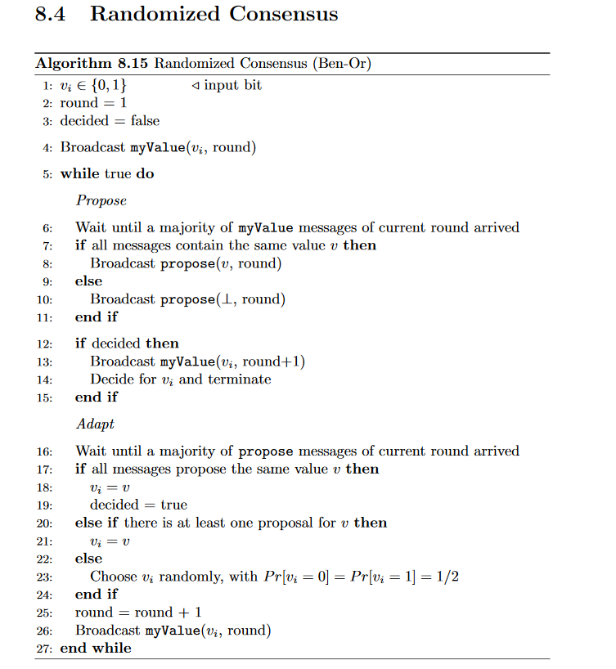
Majority has seen a majority ->
At least someone has seen majority ->
No majority seen ->

Slide 35
Randomized Consensus
Easy cases:
All inputs are equal (all 0 or 1)
Almost all input values equal
Otherwise:
Choose a random value locally. → expected time O(2^n) until all agree (once)
Wouldn’t it be useful if the nodes could all toss the same coin? → Shared Coin.

Slide 36
Shared Coin
The algorithm stays exactly the same except the standard coin flip is replaced by a call to the shared coin algorithm
Proofs for validity and agreement still hold (since it is still the same algorithm)
The proof for termination has to be changed slightly to account for the changed probability that all coins will give the same result
With a shared coin the runtime goes from exponential down to constant!
But we can only tolerate f < n/3 crash failures as opposed to f < n/2

Slide 37
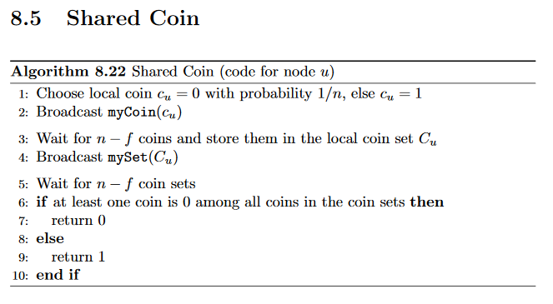

Slide 38
Quiz
How does a node in Paxos know if a majority answered with ok?
All nodes must know how many servers are in the system
Does the Paxos algorithm in the script achieve state replication?
No it only shows one instance, for subsequent commands it would need to be restarted
be restarted
How many nodes could crash so that Paxos still works?
less than half
Does Paxos solve consensus?
No, termination is not given

Slide 39
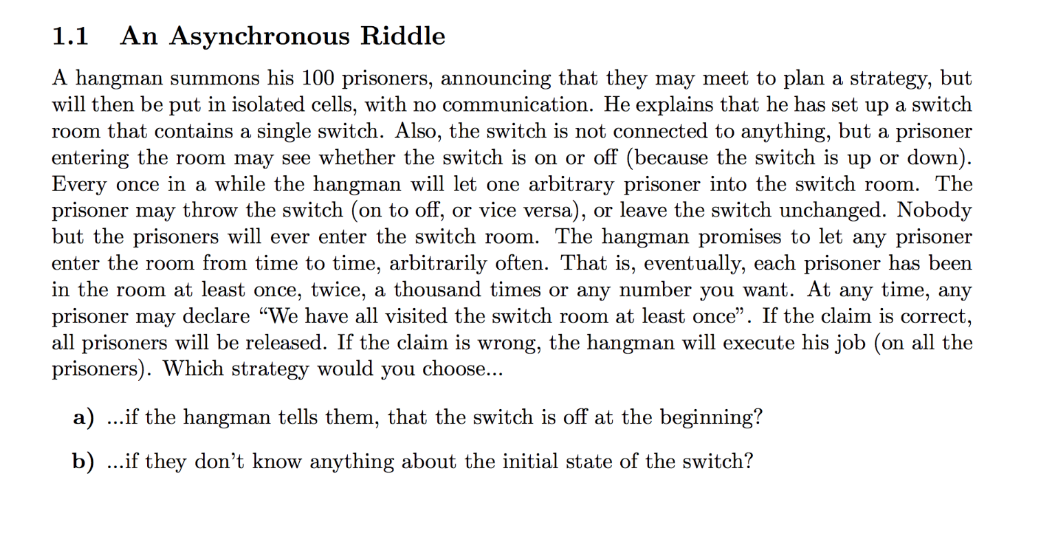

Slide 40
