Slide 1
Computer Systems
Exercise Session 4

Slide 2
Agenda
Bonus Task (Deadlines are anounced)
Last Weeks Exercise (Paxos, Consensus)
Scheduling
I/O
Interrupts
DMA
New exercise

Slide 3
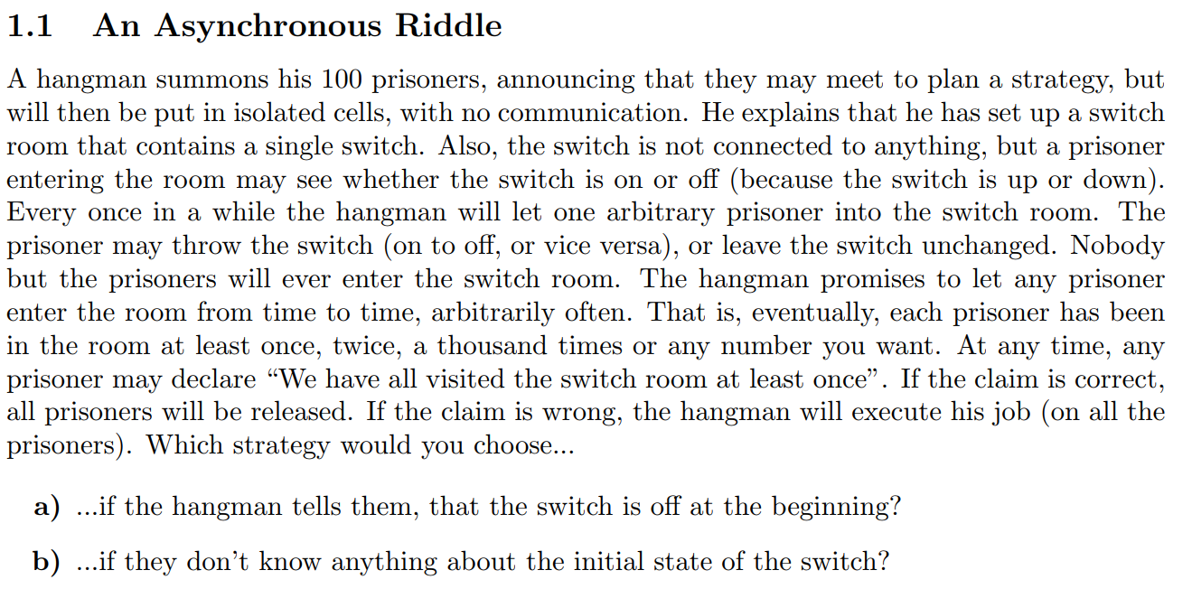

Slide 4
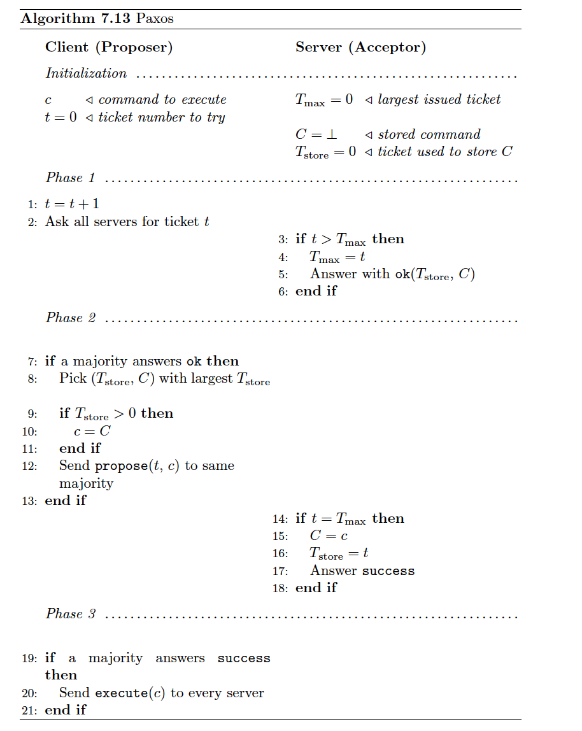
Clients asks for a specific ticket t
Server only issues ticket t if t is the largest ticket requested so far
If client receives majority of tickets, it proposes a command
When a server receives a proposal, if the ticket of the client is still valid, the server stores the command and notifies the client
If a majority of servers store the command, the client notifies all servers to execute the command

Slide 5
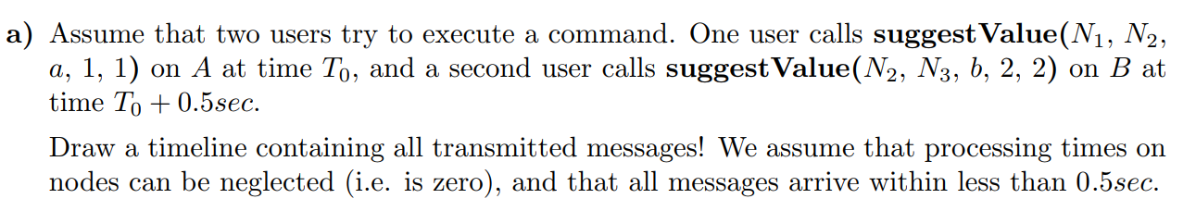
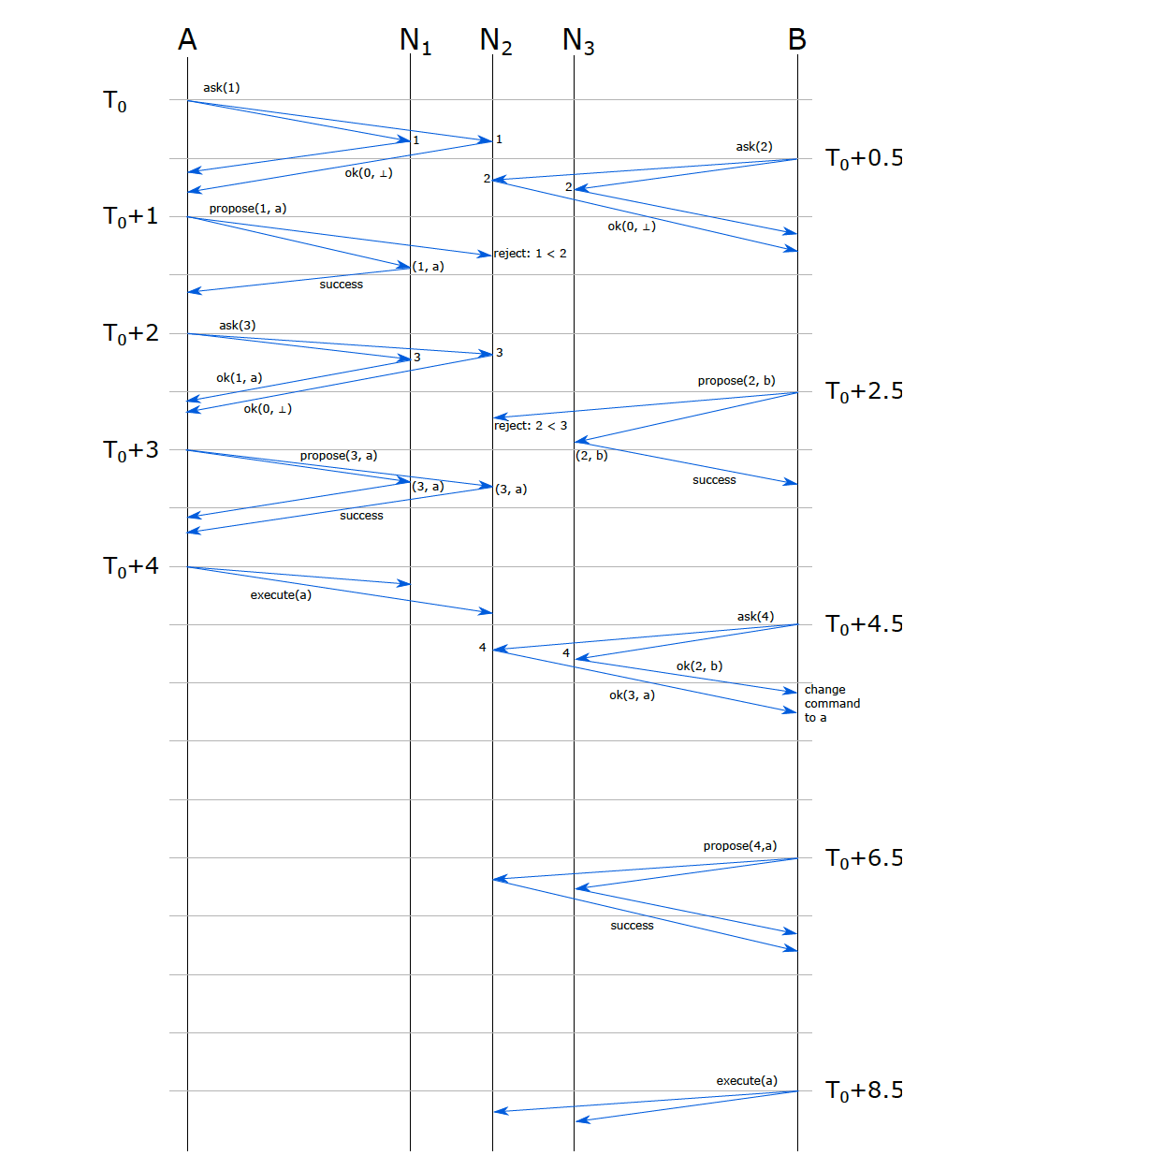

Slide 8
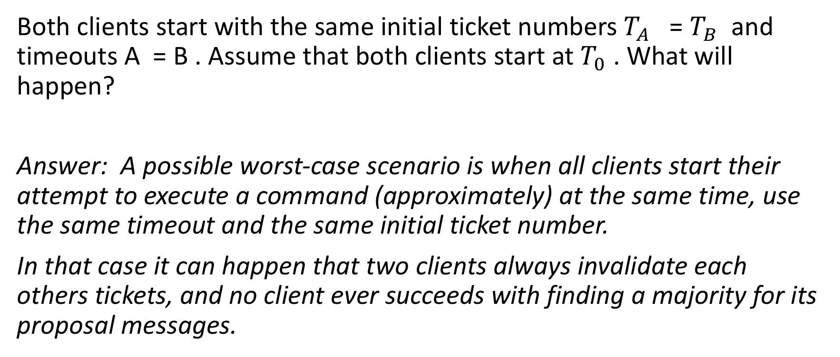
Last exercise
Both clients start with the same initial ticket numbers $T_{A}$ = $T_{B}$ and timeouts A = B . Assume that both clients start at $T_{0}$ . What will happen?
Answer: A possible worst-case scenario is when all clients start their attempt to execute a command (approximately) at the same time, use the same timeout and the same initial ticket number.
In that case it can happen that two clients always invalidate each others tickets, and no client ever succeeds with finding a majority for its proposal messages.

Slide 9
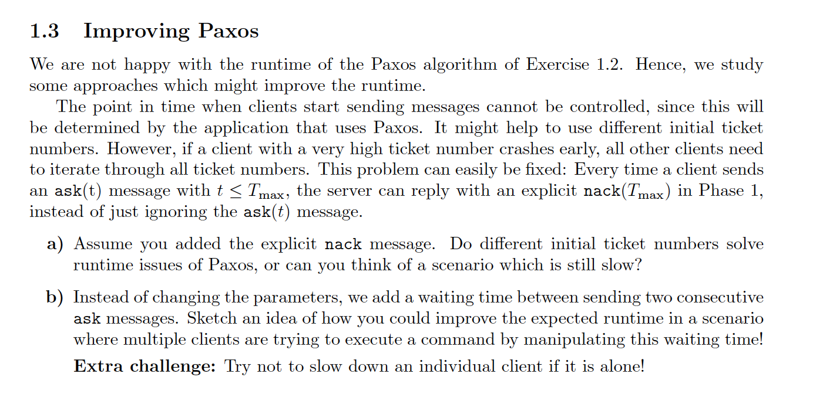

Slide 10


Paxos
Servers (Acceptors)
Clients (Proposers)
T_max: 99
C: C1
T_store: 99
C: C1
t: 99
Ticket(t=1)?
Becomes really slow
T_max: 99
C: C1
T_store: 99
Ticket(t=1)?
C: C2
t: 1
Ticket(t=1)?
T_max: 99
C: C1
T_store: 99

Slide 11

Paxos
Servers (Acceptors)
Clients (Proposers)
T_max: 99
C: C1
T_store: 99
C: C1
t: 99
NACK(99)
Becomes really slow
T_max: 99
C: C1
T_store: 99
NACK(99)
C: C2
t: 1
NACK(99)
T_max: 99
C: C1
T_store: 99

Slide 12
Paxos
Servers (Acceptors)
Clients (Proposers)
T_max: 99
C: C1
T_store: 99
C: C1
t: 99
Ticket(t=100)?
Becomes really slow
T_max: 99
C: C1
T_store: 99
Ticket(t=100)?
C: C2
t: 100
Ticket(t=100)?
T_max: 99
C: C1
T_store: 99

Slide 13
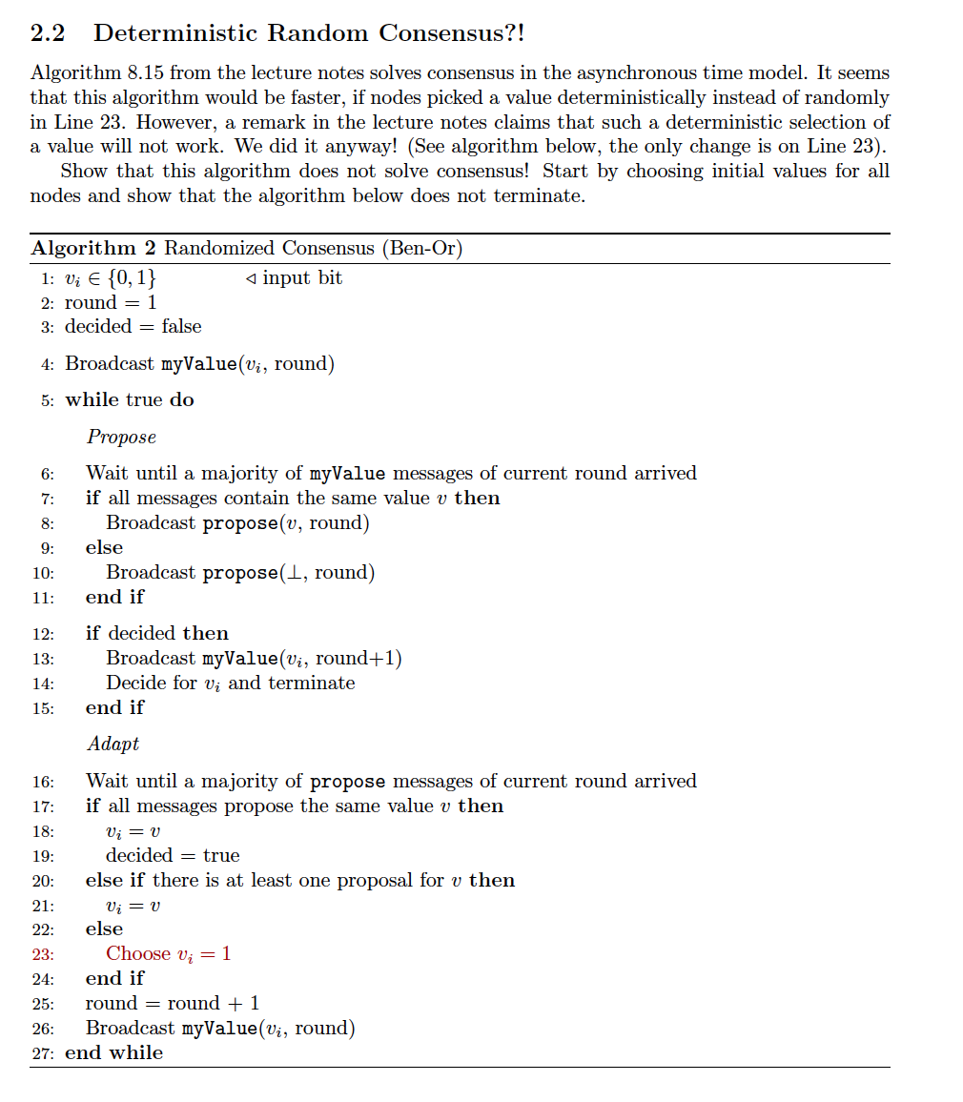
B
A
0
1
0
1
0
Node u
Example might be wrong !

Slide 14
Example might be wrong !
0
1
0
1
0
Everyone broadcasts their value, node u receives only messages from region A

Slide 15
0
1
Propose(0, i)
0
1
Propose(0, i)
0
Example might be wrong !

Slide 16
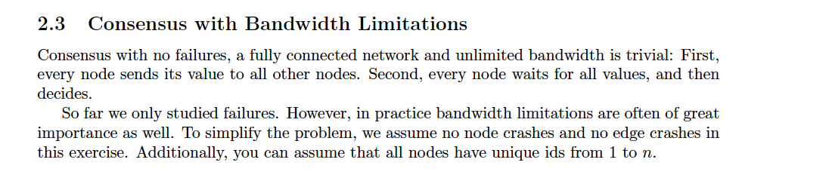
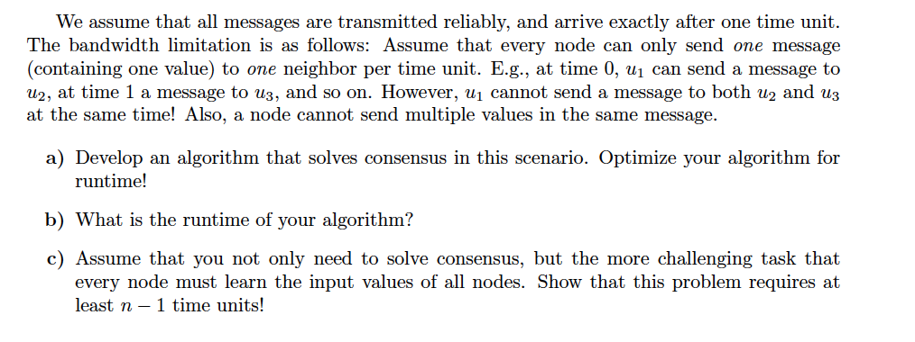
Last exercise

Slide 17
Last exercise

Slide 18
Last exercise

Slide 19
Last exercise

Slide 20
Last exercise

Slide 21
Last exercise

Slide 22
Last exercise
Answers:
b) log(n)
c) Each node needs to learn n-1 values,
so it needs to receive at least n-1 messages.
So in total there need to be n(n-1) messages
received. Because every received message
has been sent at some point, n(n-1) need to get sent
which requires n-1 rounds.

Slide 23
Scheduling
Question: Deciding how to allocate a single resource among multiple clients.
In what order
How long

Slide 24
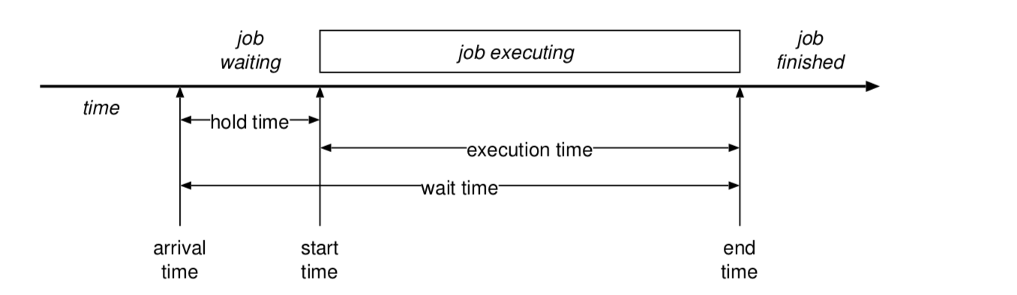
Scheduling Terminology
= turnaround time
Response time: The time taken to respond to a request for service

Slide 25
Different kinds of workloads
Batch workload
“Run this job to completion and tell me when you’re done”
Main goals: throughput (jobs per hour), wait time, turnaround time, utilization
Interactive workloads
“Wait for external events and react before the user gets annoyed”
Main goals: Response time, proportionality, fairness
Soft realtime workloads
“This task must complete in less than 50ms” or “This program must get 10ms CPU every 50 ms”
Main goals: deadlines, guarantees, predictability
Hard realtime workloads
“Ensure the plane’s control surface moves correctly in response to the pilot’s actions”
Embedded Systems

Slide 26
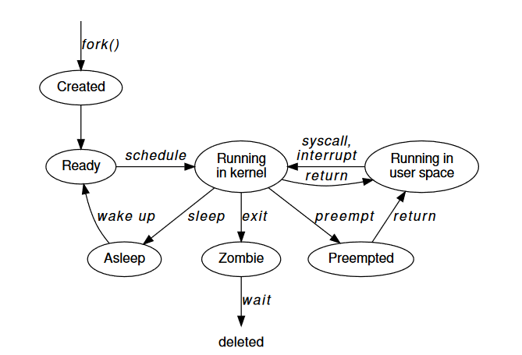
Preemptive vs non-preemptive
Preemptive:
Processes dispatched and de-scheduled without warning
Non-preemptive
Process explicitly has to give up the resource
Soft-realtime systems are usually pre-emptive
Hard-realtime systems are often not!

Slide 27
When to schedule
A running process blocks (or calls yield)
A blocked process unblocks
A running or waiting process terminates
An interrupt occurs (preemption)

Slide 28
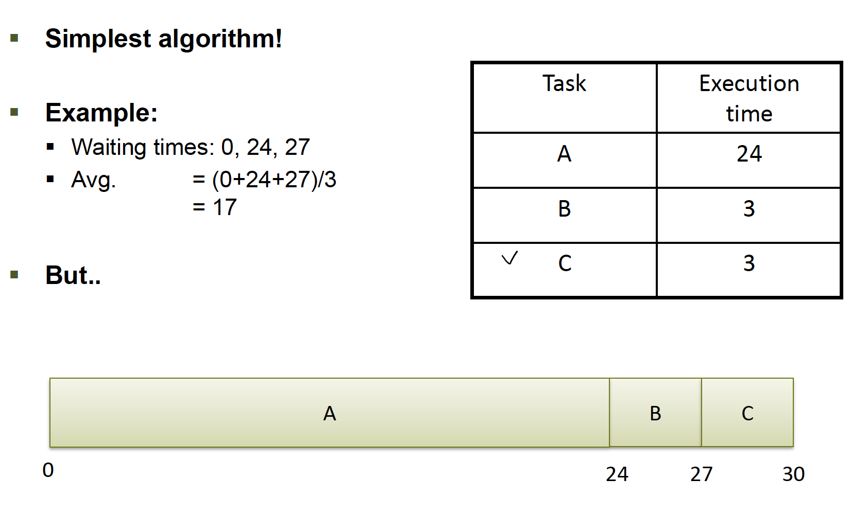
FIFO (Batch scheduling)

Slide 29
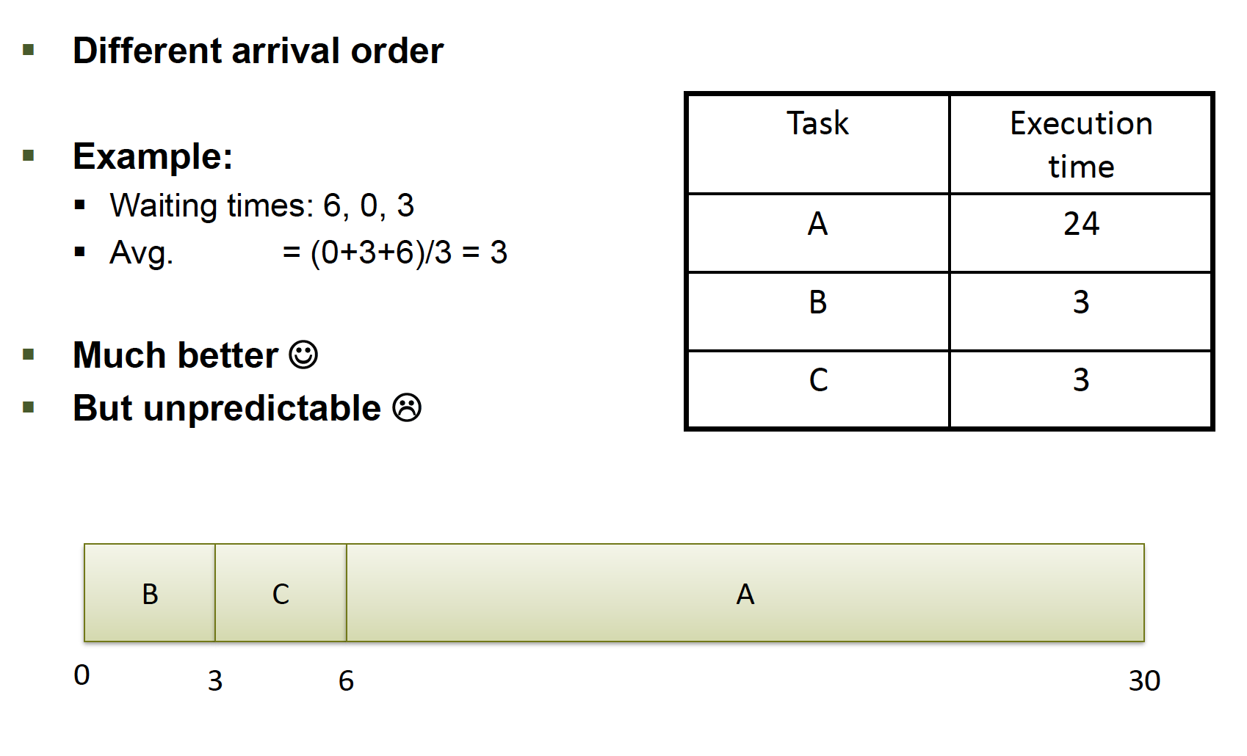
FIFO - Problem
Short jobs queue up behind long-running jobs!

Slide 30
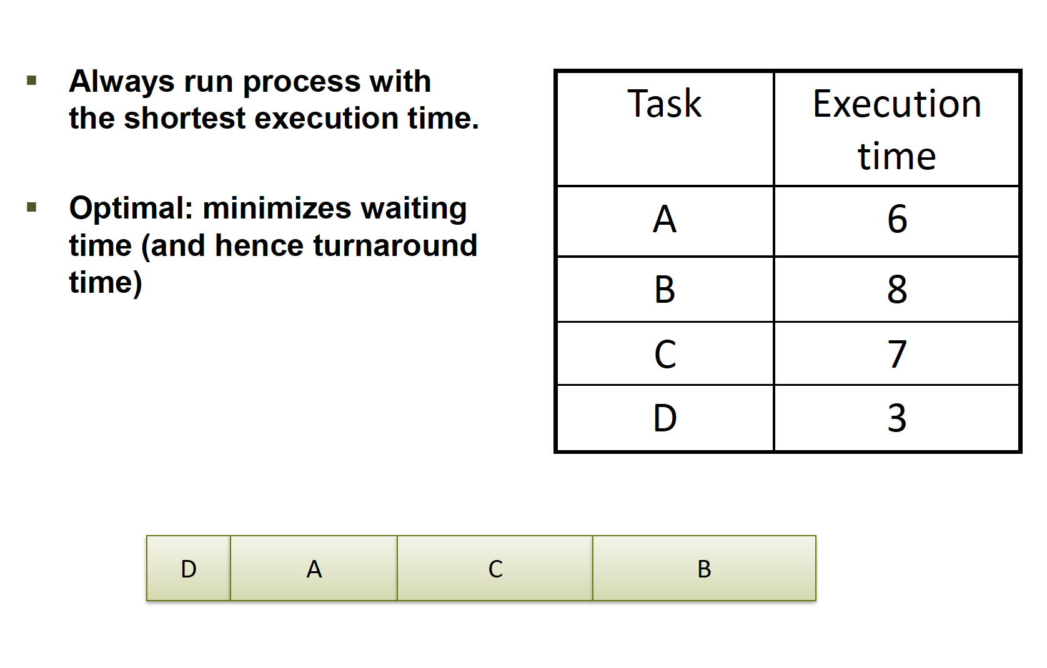
Shortest job first (Batch scheduling)
→ With preemption: shortest remaining time first

Slide 31
SJF & preemption
Problem: jobs arrive all the time
“Shortest remaining time next”
New, short jobs may preempt longer jobs already running
Still not an ideal match for dynamic, unpredictable workloads
In particular, interactive ones.

Slide 32
Execution time estimation
Problem: what is the execution time?
For mainframes, could punt to user
And charge them more if they were wrong
For non-batch workloads, use CPU burst times
Keep exponential average of prior bursts
Or just use application information
Web pages: size of web page

Slide 33
Round robin (interactive workloads)
Process | Execution time (ms)
A | 2
B | 3
C | 4
Maintains a queue of jobs and schedules them in order
Higher turnaround than shortest job first, but better response time (goal of interactive workloads)
 | 1 | 2 | 3 | 4 | 5 | 6 | 7 | 8 | 9
A
B
C

Slide 34
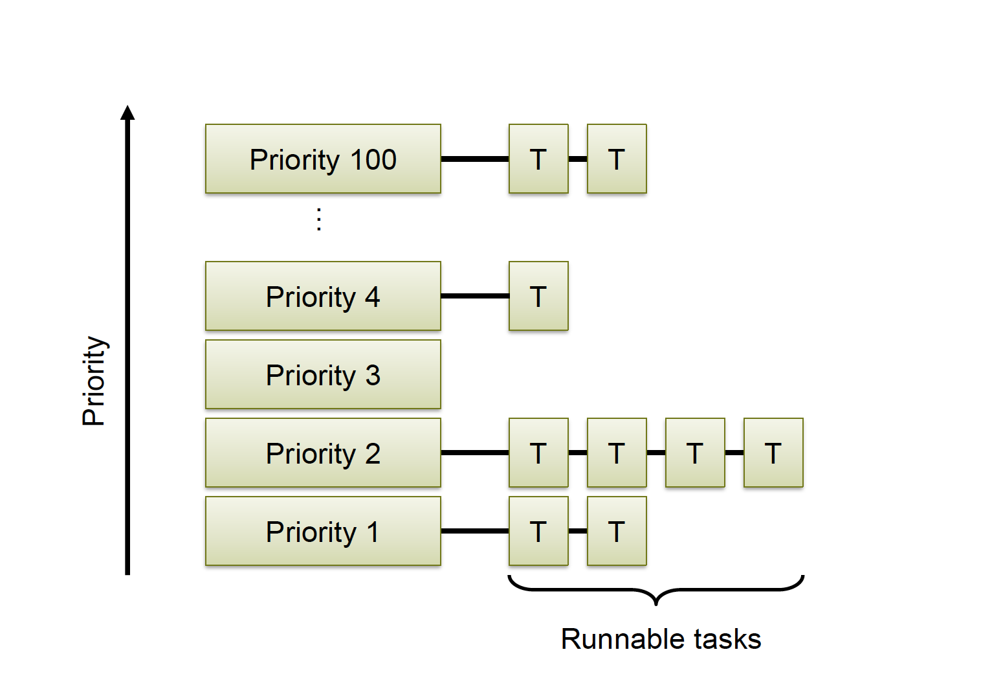
Priority Queues (interactive workloads)
Can schedule differently on different levels, eg. round robin and shortest job first

Slide 35
Priority Queues – Problem
Starvation– jobs with low priority never get scheduled
Solution: jobs gain priority with time, so called “ageing”
Reset original priority after being scheduled

Slide 36
Priority Inversion
Can not take Mutex → blocks and allows other T2 to run
T3
Preemption
Priority
T2
Takes Mutex
T1
Time

Slide 37
Multilevel Feedback Queues (interactive workloads)
Same idea as priority queues
Idea: prioritize I/0 tasks
Solution: use priority queue and reduce priority of processes which use their entire quantum
I/0 bound processes tend to only use part of their quantum, so remain high priority

Slide 38
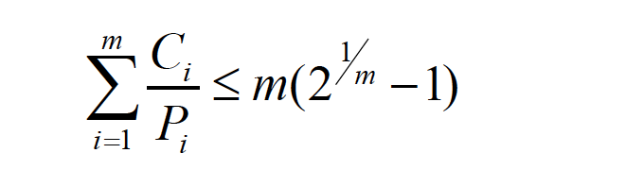
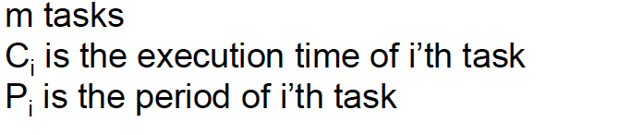
Rate monotonic scheduling (real time scheduling)
Schedule periodic tasks by always running task with shortest period first.
Will find schedule if:

Slide 39
Earliest Deadline First
Schedule task with earliest deadline first (duh..)
Dynamic, online.
Tasks don’t actually have to be periodic…
More complex - o(n) – for scheduling decisions
EDF will find a feasible schedule if:
Which is very handy. Assuming zero context switch time…

Slide 40
Earliest Deadline First
Process | Arrival | Duration | Deadline
A | 0 | 10 | 25
B | 4 | 3 | 8
C | 8 | 10 | 18
0
4
7
8
18
23
A
B
A
C
A

Slide 41
What is a device?
Specifically, to an OS programmer:
Piece of hardware visible from software
Occupies some location on a bus
Set of registers
Memory mapped or I/O space
Source of interrupts
May initiate Direct Memory Access transfers

Slide 42
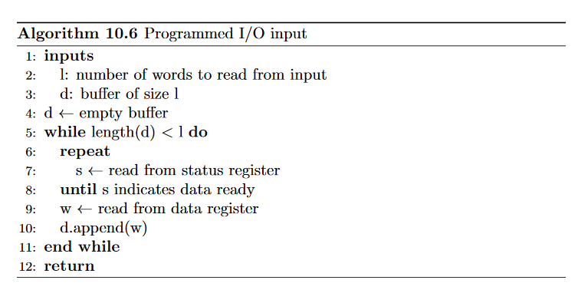

Slide 43
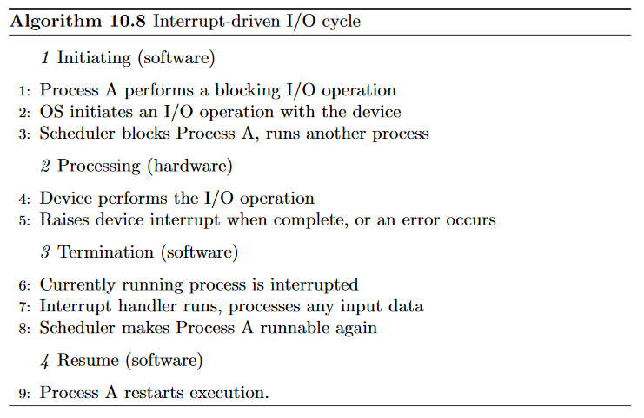

Slide 44
Direct Memory Access (DMA)
Avoid programmed I/O for lots of data (requires CPU)
Device needs to be able to do DMA (DMA controller)
Generally built-in these days
Bypasses CPU to transfer data directly between I/O device and memory
Doesn’t take up CPU time
Can save memory bandwidth
Only one interrupt per transfer

Slide 45
Very simple DMA transfer
CPU
OS requests DMA transfer from disk controller:
buffer address A
size S
DMA controller transfers word to address A, increments A, decrements S.
Cache
Main memory
DMA/PCI
controller
Frontside (memory) bus
Buffer
When S == 0, DMA controller interrupts CPU to indicate transfer complete
PCI bus
Disk controller starts DMA transfer of S bytes
IDE disk controller
Disk controller initiates bus request for each data byte from disk
PC, circa 1986

Slide 46
I/O Protection
DMA operations can be dangerous to normal system operations because they directly access memory!
⇒ need IOMMU (I/O Memory Management Unit) to ensure that devices only access memory that they’re supposed to access
Need to invalidate cache before transfer

Slide 47
Evolution of device I/O
Programmed I/O with polling.
Polling is too slow (CPU cycles, response latency)
⇒ Interrupts notify CPU device needs attention
Programmed I/O with interrupts.
CPU spends too much time copying data
⇒ DMA allows CPU and device to operate in parallel
DMA

