Slide 1
Computer Systems
Exercise 7

Slide 2
Agenda
Last Weeks Exercise (Byzantine Agreement)
Consistency Models & Logical Clocks
Clock Synchronization & GPS
This weeks exercise

Slide 3
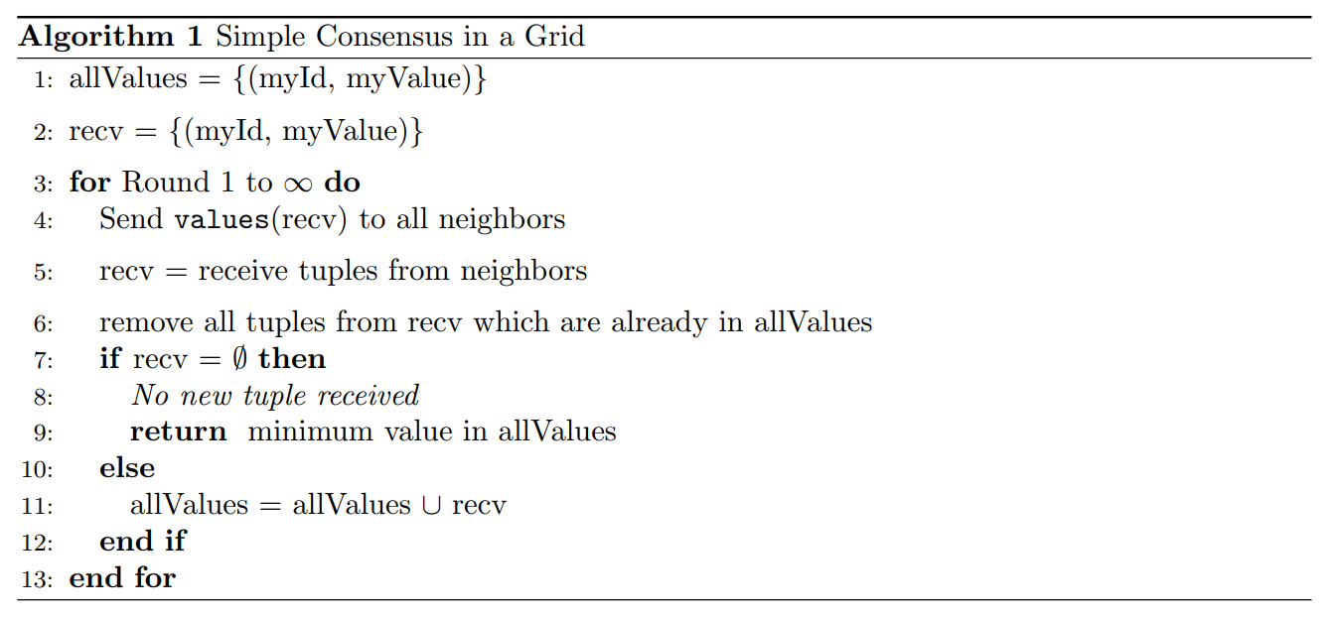
Last Exercise

Slide 4
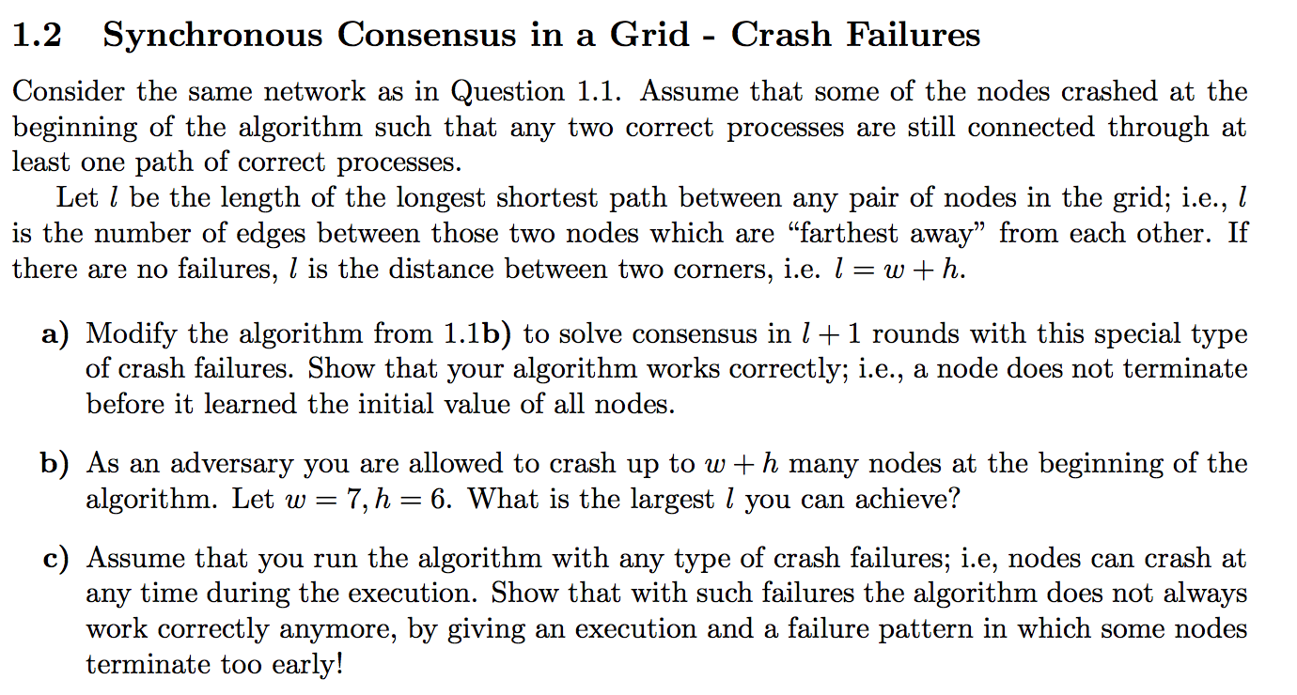
Last Exercise
(2 dimensional grid)
Answer: keep the exact same algorithm as we discussed last time (forward everything, decide when you don‘t learn anything new in one round, because it means you learned everything).
Correctness: In round i a node receives all values from neighbors of distance i, it will keep receiving new values every round until it has all
Termination: After at most l+1 rounds all information will have propagated through the grid

Slide 5
Last Exercise

Slide 6
Optimal if w ≈ h, gives longest distance of about 3(w+h)

Slide 7
Possible also in a general case, gives longest distance of about 2(w+h)

Slide 8
Last Exercise

Slide 9
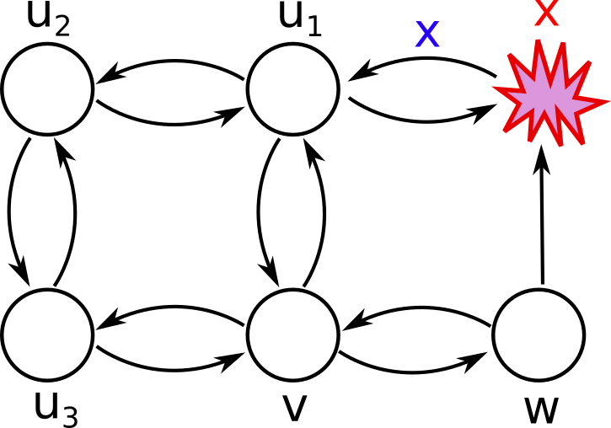
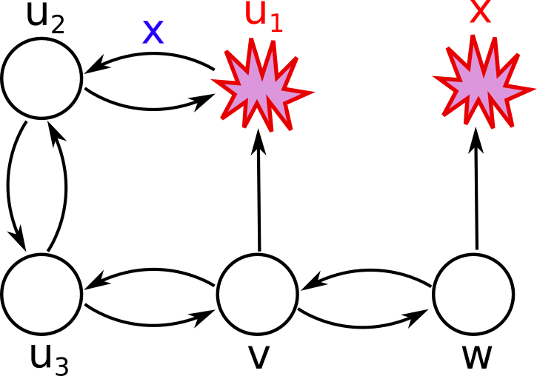
1. Node x crashes, u1 learns value, w does not
u3, w, u1
2. Node u1 crashes, u2 learns value, v does not
u3, w, u1, u2
3. After 2 rounds, v will have learned the values of all nodes except x. In round 3 the value of x is at node u3, therefore v does not learn anything new and will terminate prematurely
u3, w, u1, u2

Slide 10
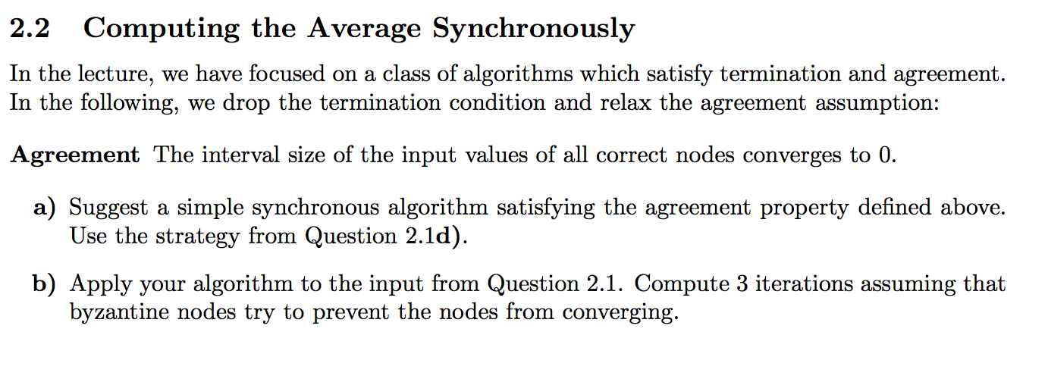
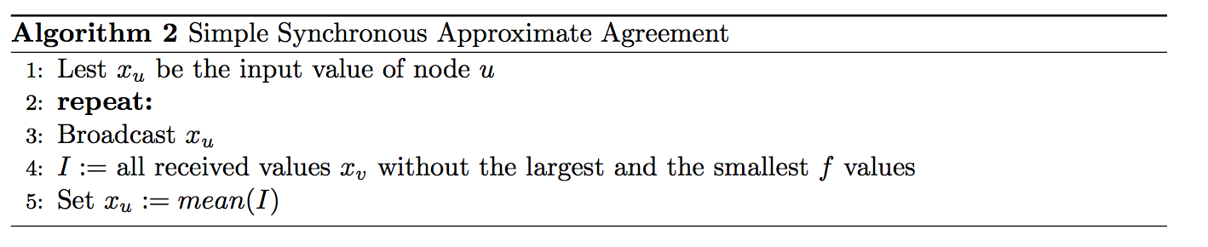
Last Exercise

Slide 11
Last Exercise
{-3,-2,-1,0,1,2,3}

Slide 12
[-4, -4, -3, -2, -1, 0, 1, 2, 3]
[ -4, -3, -2, -1, 0, 1, 2, 3, -4]
[ -3, -2, -1, 0, 1, 2, 3, 4, 4]
{-1,-1,-1,0,1,1,1}
[-4, -4, -1, -1, -1, 0, 1, 1, 1]
[ -4, -1, -1, -1, 0, 1, 1, 1, -4]
[ -1, -1, -1, 0, 1, 1, 1, 4, 4]
{-2/5, -2/5, -2/5, 0, 2/5, 2/5, 2/5}
[-4, -4, -2/5, -2/5, -2/5, 0, 2/5, 2/5, 2/5]
[ -4, -2/5, -2/5, -2/5, 0, 2/5, 2/5, 2/5, -4]
[ -2/5, -2/5, -2/5, 0, 2/5, 2/5, 2/5, 4, 4]
{-4/25, -4/25, -4/25, 0, 4/25, 4/25, 4/25}

Slide 13
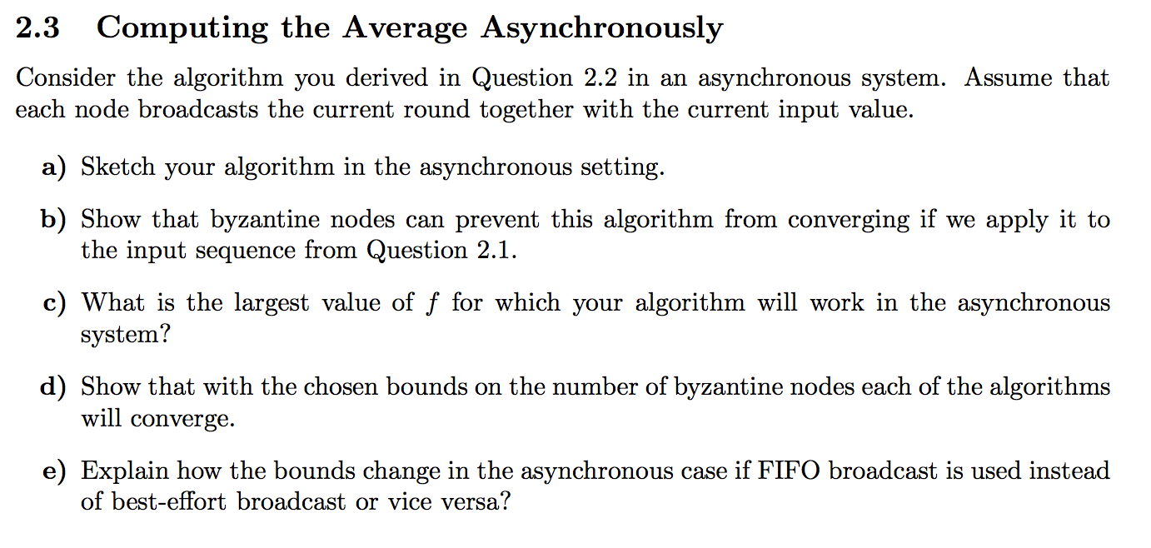
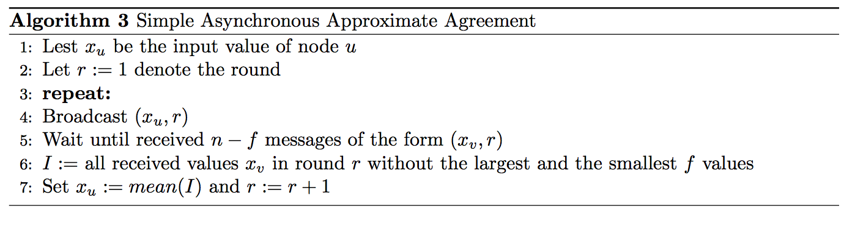
Last Exercise

Slide 14
Last Exercise
[-4, -4, -3, -2, -1, 0, 1]
[ -3, -2, -1, 0, 1, 2, 3]
[-1, 0, 1, 2, 3, 4, 4]
{-2,-2,-2,0,2,2,2}
[-4, -4, -2, -2, -2, 0, 2]
[ -3, -2, -2, 0, 2, 2, 2]
[-2, 0, 2, 2, 2, 4, 4]
{-2,-2,-2,0,2,2,2}

Slide 15
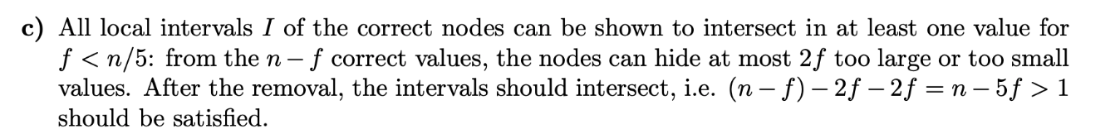
Last Exercise

Slide 16
Last Exercise
In every round, all nodes will have a least one common value inside the intervals. Therefore, the nodes will converge.

Slide 17
Last Exercise
Now the byzantine nodes can only use scheduling to hide values. So now the byzantine nodes can only make the
nodes see 2f different values from each side, so f < n/4

Slide 18
Consistency Models
Linearizability (implies both others)
Sequential Consistency
Quiescent Consistency
If you are confused or need an overview:
http://coldattic.info/post/88/

Slide 19
Linearizability
“one global order”
Linearizability -> put points on a “line”
Strongest assumption, implies other two
write x = 1
write x = 3
read x = 2
read x = 1
write y = 1
write x = 2
read y = 1
write x = 1 < read x = 1 < write x= 3 < write y = 1 < write x = 2 < read x = 2 < read = 1

Slide 20
Sequential Consistency
similar as linearizability, but can ”shift” and “squeeze” threads compared to each other
sequential consistency -> build “sequences”
write x = 1
read x = 2
read y = 2
write x = 2
write y = 1
write y = 2
read y = 2

Slide 21
Sequential Consistency
similar as linearizability, but can ”shift” and “squeeze” threads compared to each other
sequential consistency -> build “sequences”
write x = 1
read x = 2
read y = 2
write x = 2
write y = 1
write y = 2
read y = 2
write x = 1 < write x = 2 < write y = 3 < read x = 2 < read y = 2 < read y = 2 < write y = 1

Slide 22
Quiescent Consistency
synchronizes all threads whenever there is a time when there is no possible execution
quiescent -> “Quietschente”
read x = 1
read y = 1
write x = 1
write y = 1
write x = 2
read y = 1
write x = 2 < write x = 1 < write y = 1 < read y = 1 < read x = 1 < read y = 1

Slide 23
Composable (applies to consistency models)
Definition: If you only look at all operations concerning any object and the execution is consistent, then also the whole execution is consistent
sequential consistency is not composable
linearizability is composable
quiescent consistency is composable
write x = 1
write x = 3
read x = 2
read x = 1
write y = 1
write x = 2
read y = 1

Slide 24
Logical Clocks
happened before relation „->“ holds:
If f < g on the same node
Send happens before receive
If f -> g and g -> h then f -> h (Transitivity)
c(a) means timestamp of event a
logical clock: if a -> b, then c(a) < c(b)
strong logical clock: if c(a) < c(b), then a -> b (in addition)

Slide 25
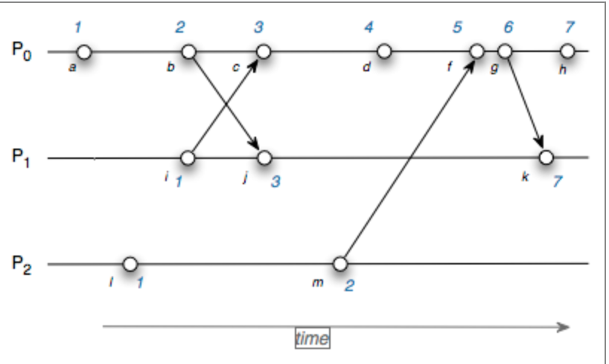
Lamport Clock
+1
max(1,2) + 1
send current timestamp
store own clock
https://www.cs.rutgers.edu/~pxk/rutgers/notes/clocks/index.html

Slide 26
Lamport Clock
Is a logical clock (so if a -> b then c(a) < c(b))
but the reverse does not hold, so not a strong logical clock

Slide 27
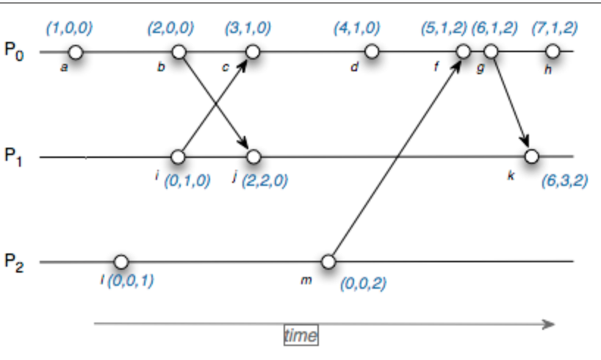
Vector Clock
now vector of clocks
increase own clock for event
send current timestamp
increase own by one and
take max of received and own
for every other one

Slide 28

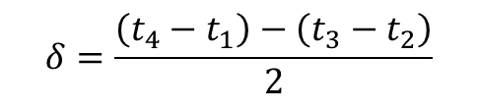



Propagation Delay Estimation (NTP)
Measuring the Round-Trip Time (RTT)
Propagation delay and clock skew can be calculated
$$t_{2}$$
Time accor-
ding to B
$$t_{3}$$
B
Request
from A
Answer
from B
A
$$t_{1}$$
$$t_{4}$$
Time accor-
ding to A
$$δ=\frac{\left(t_{4}−t_{1}\right)−\left(t_{3}−t_{2}\right)}{2}$$
$$Θ=\frac{\left(t_{2}−\left(t_{1}+δ\right)\right)−\left(t_{4}−\left(t_{3}+δ\right)\right)}{2}=\frac{\left(t_{2}−t_{1}\right)+\left(t_{3}−t_{4}\right)}{2}$$
Notes:
28
We have to assume that sending/receiving takes the same amount of time!
NTP is usually implemented such that packets are time stamped on a high layer (application?)
http://www.fsmlabs.com/blog/choosing-between-ptp-and-ntp

Slide 29







Clock Synchronization Tricks in Wireless Networks
$$t_{2}$$
Reference Broadcast Synchronization (RBS) ↔ Synchronizing atomic clocks
Sender synchronizes set of clocks
Time-sync Protocol for Sensor Networks (TPSN) ↔ Network Time Protocol
Estimating round trip time to sync more accurately
Flooding Time Synchronization Protocol (FTSP) ↔ Precision Time Protocol
Timestamp packets at the MAC Layer to improve accuracy
A
$$Θ$$
S
B
$$t_{1}$$
0
$$t_{2}$$
B
$$t_{3}$$
1
1
2
$$t_{1}$$
$$t_{4}$$
A
2
2
0
5
4
1
7
6
3
2
Notes:
Similar in how propagation delay is estimated, not so similar in the mode of operation. Ntp calculates propagation delay/rtt in each sync step. PTP splits synchronization (Server send current time to clients) and RTT estimation into two different operations.
29

Slide 30
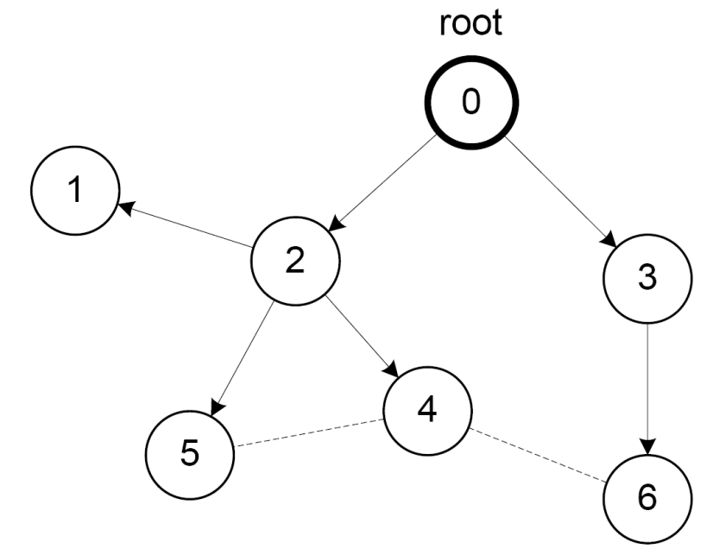
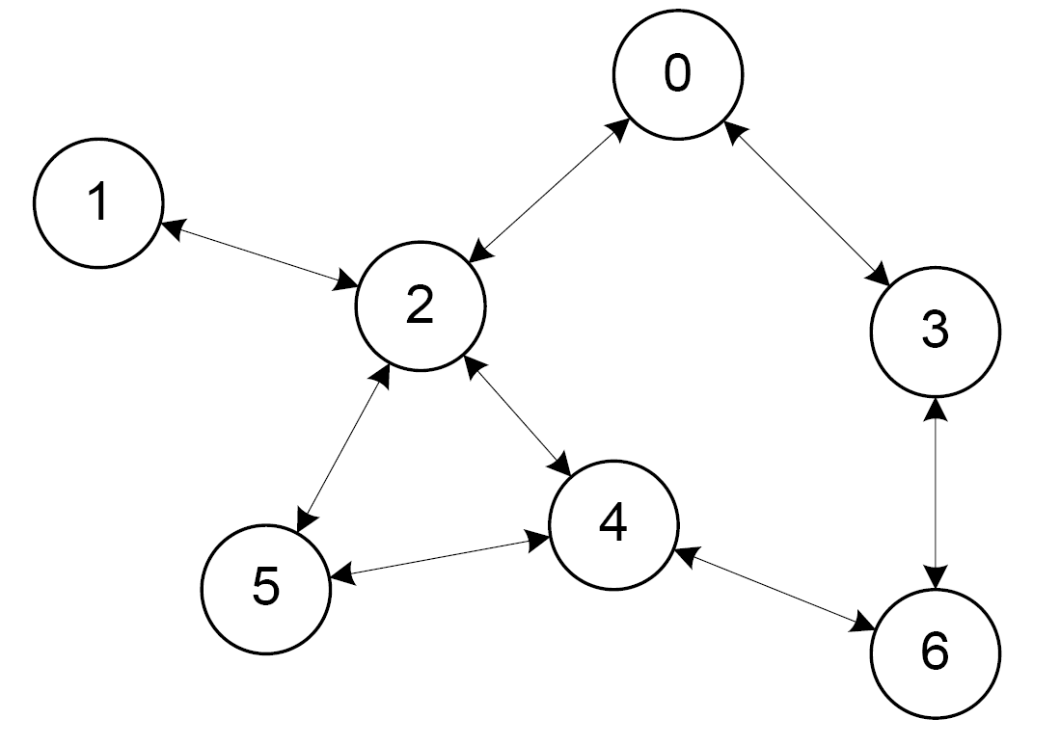
Variants of Clock Synchronization Algorithms
Tree-like Algorithms Distributed Algorithms
e.g. FTSP e.g. GTSP
Bad local skew
All nodes consistently average errors to all neigbhors
Notes:
30

Slide 31
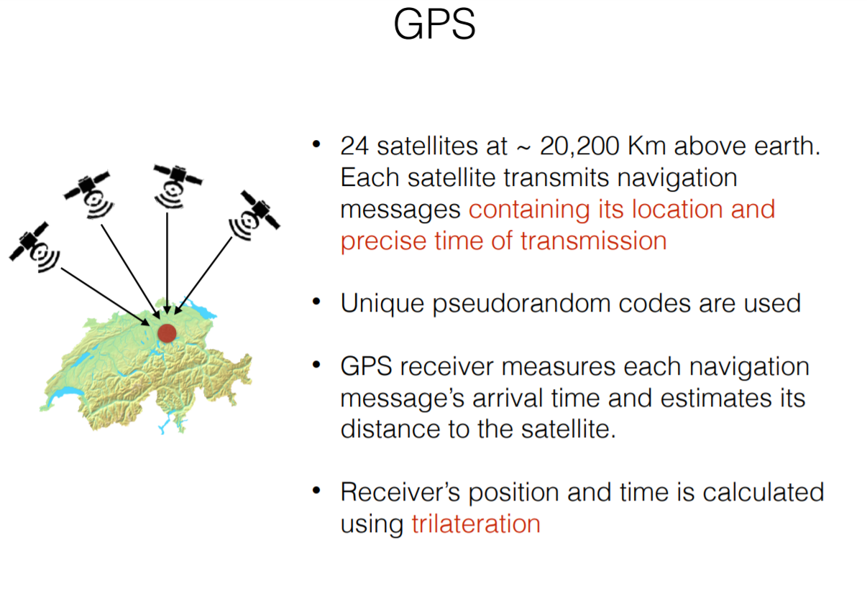

Slide 32
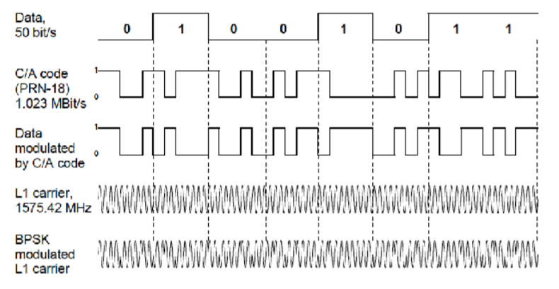
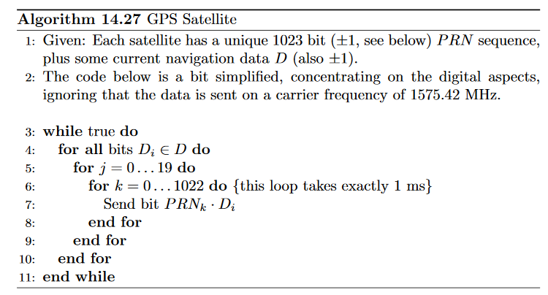
Generating the GPS signal

Slide 33
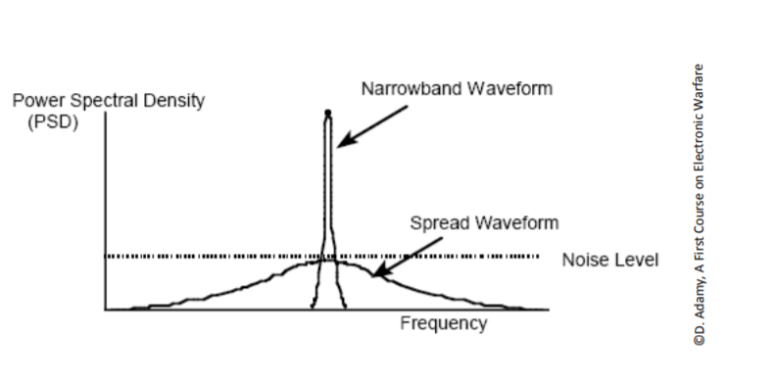
DSSS
+ allows transmitters to share the same frequency band
+ little interference from noise and other signals
+ with secret codes: hard to detect and jam

Slide 34
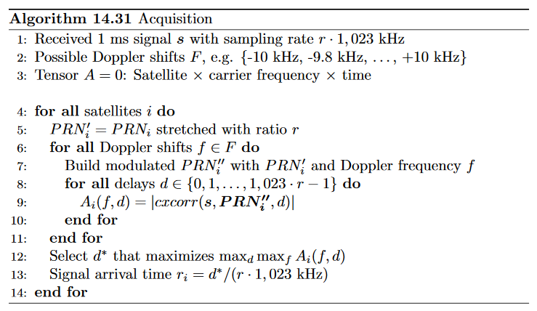
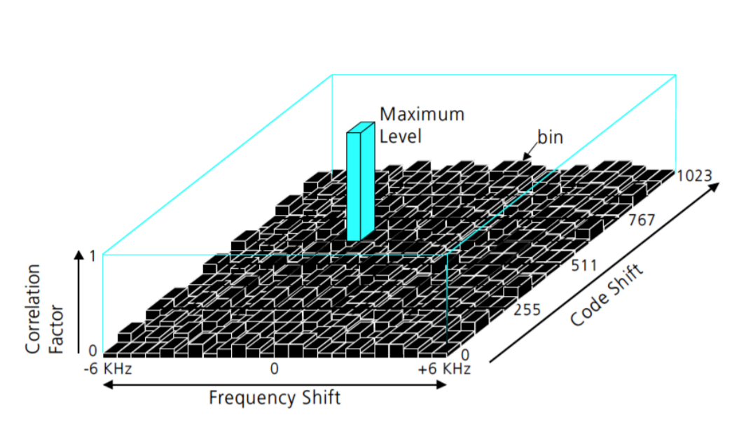
Signal Aquisition

Slide 35
























GPS Localization
Assuming that time of GPS satellites is correctly synchronized…
Notes:
35
The red stuff is known (satellite locations, relative reception times, relative transmission times)
t = r_1 ? Yes and no. if satellite and receiver clocks were synchronized that would be true. But since they are not, r_1 is the arrival time at the receiver measured in the receiver time. whereas t is the same arrival time in the t_SV reference frame. If we know both, we know the skew!

Slide 36
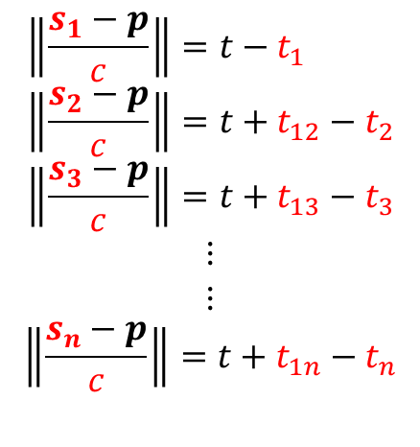
GPS Localization
c = speed of light
Find least squares solution in t and p
Notes:
36
Propagation delay x of reference satellite is part of the localization solution. The satellites send timestamps, so we can accurately synchronize!

