Slide 1
Computer Systems
Exercise 8

Slide 2
Agenda
Last Week’s Exercise (Quorum Systems, Bitcoin)
Virtual Memory
Segmentation
Paging
TLB
Demand Paging
Page Replacement

Slide 3
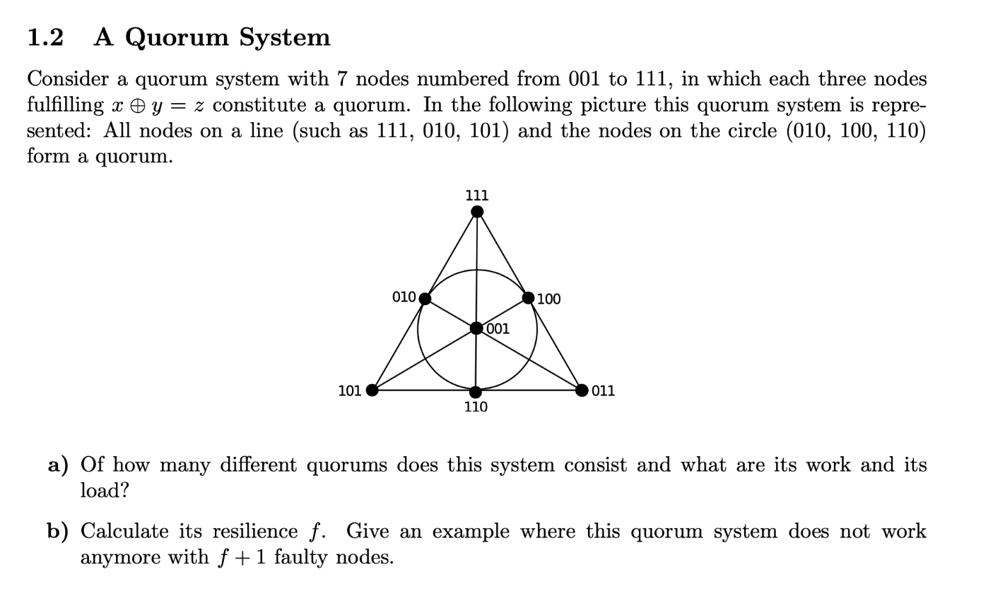
Last exercise
Quorums: 7 Work: 3 Load: 3/7

Slide 4
Last exercise
Quorums: 7 Work: 3 Load: 3/7
Resilience: 2, because every
node is in 3 quorums, so two
nodes can be contained in at most 2*3 quorums

Slide 5
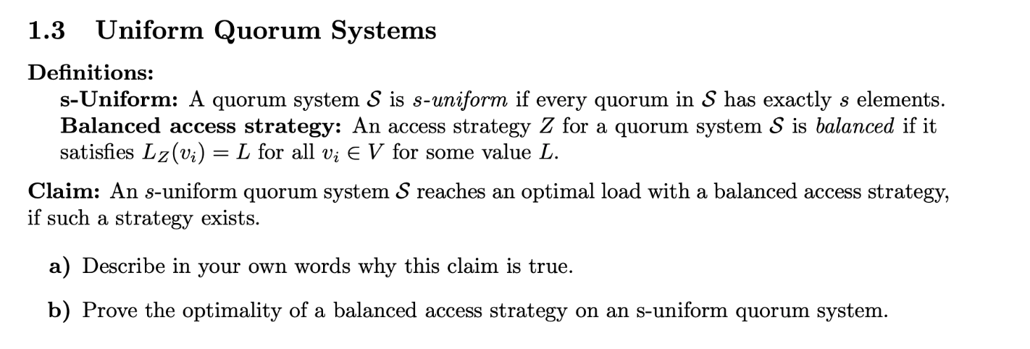
Last exercise
Idea: Load induced by access strategy is maximal load of all the servers. Since all quorums have the same size, it does
not matter which quorum gets accessed. So it is best to spread all the work across the servers to achieve a optimal
load.

Slide 6
Last exercise

Slide 7
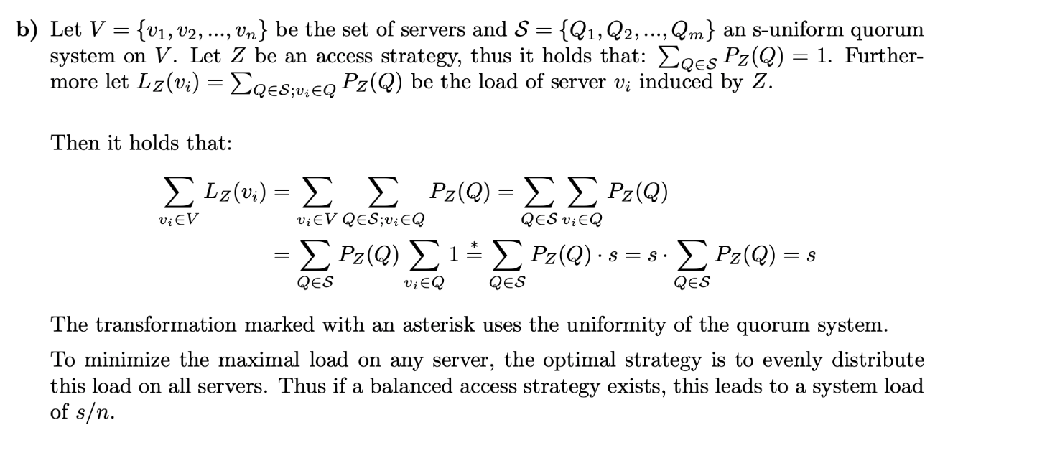
Last exercise

Slide 8
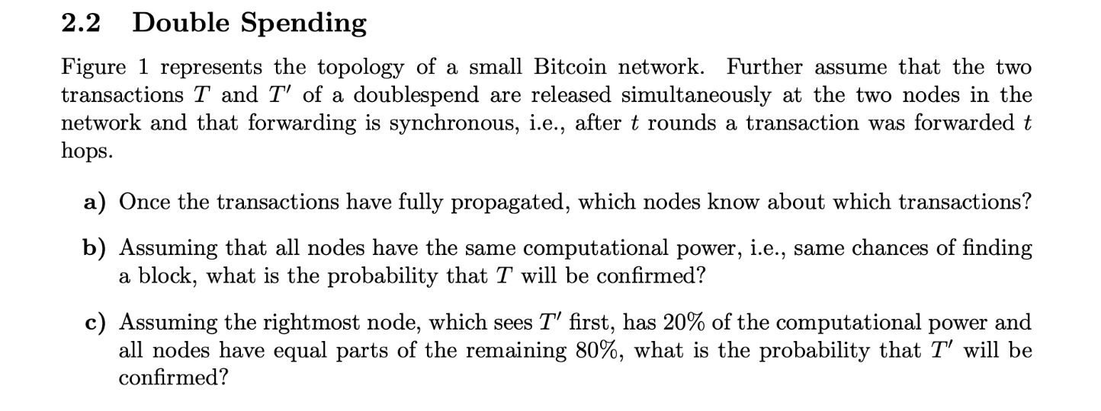
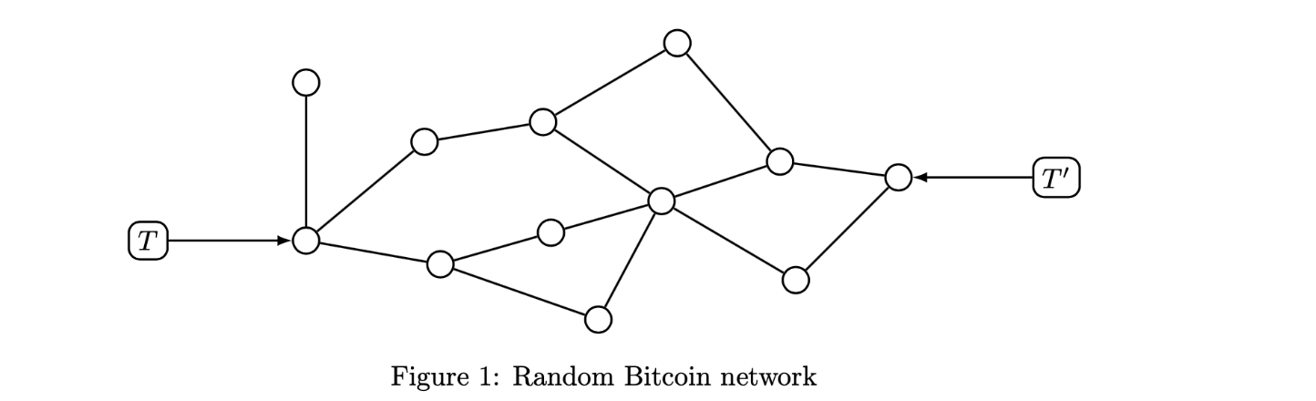


Last exercise
$$\frac{7}{12}$$
20+4* $\frac{1}{11}\frac{8}{10}=49\%$

Slide 9
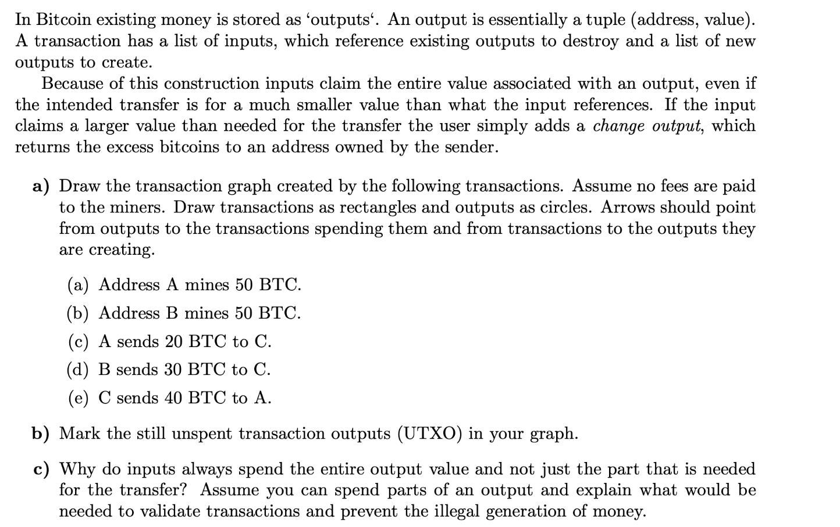
Last exercise

Slide 10
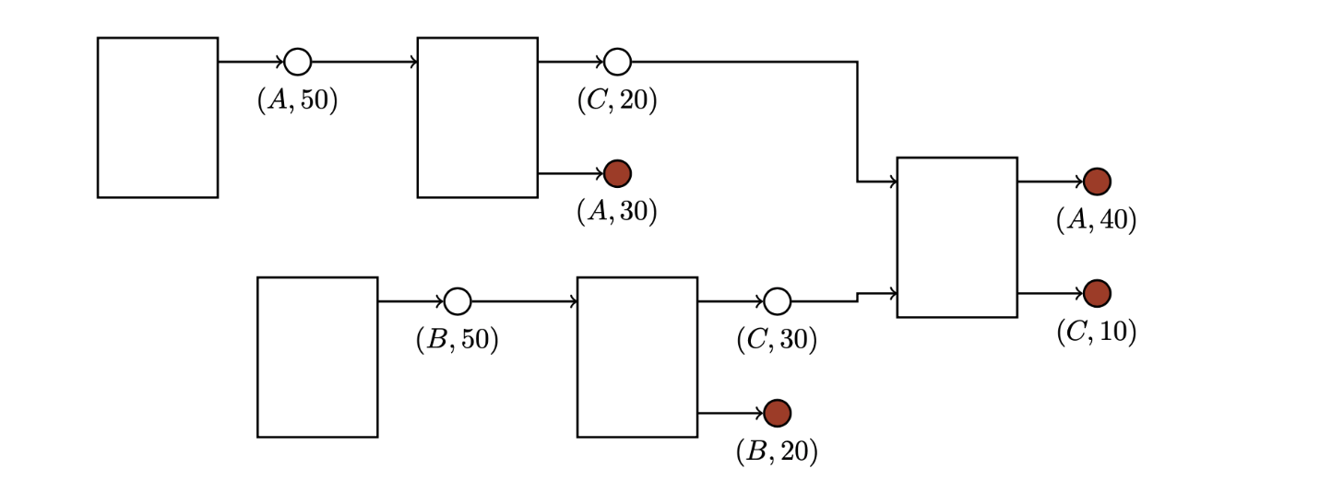
Last exercise

Slide 11
Last exercise

Slide 12

Last exercise

Slide 13
Last exercise

Slide 14
Last exercise

Slide 15
Last exercise

Slide 16
Last exercise

Slide 17
Last exercise

Slide 18
Last exercise

Slide 19
Last exercise

Slide 20
Last exercise
For simplicity reasons, would need to handle a partially spent output.
For more details, refer to the master solution

Slide 21
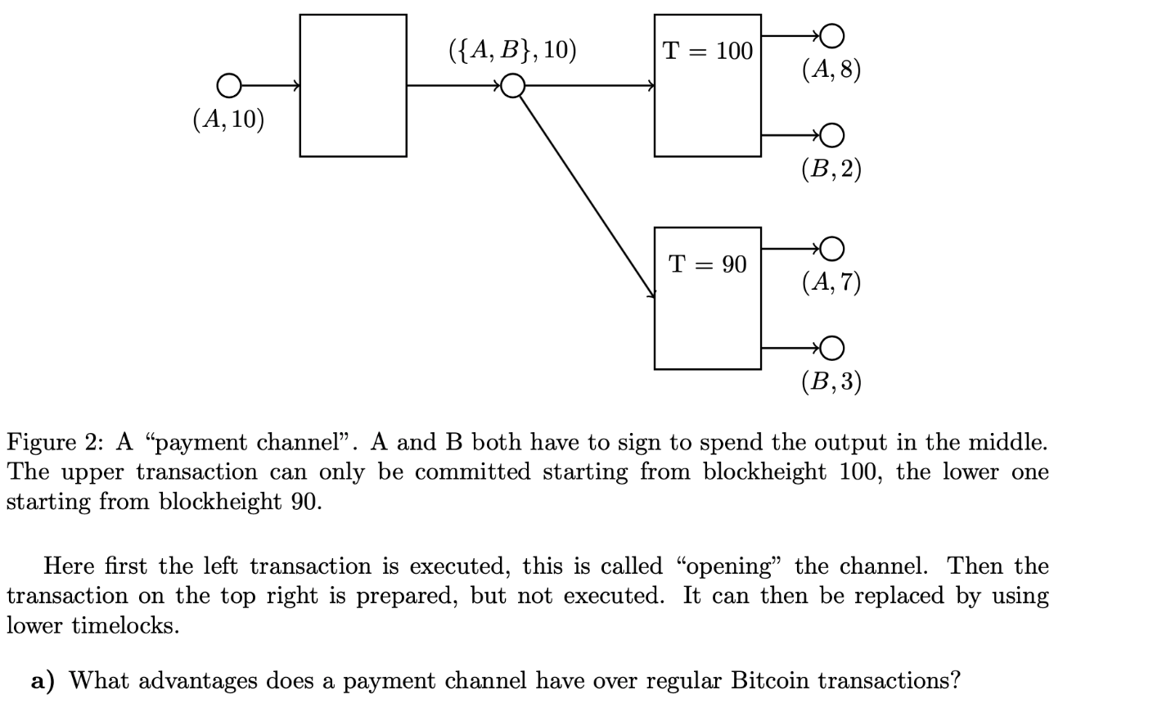
Last exercise
Transactions are instantly finalized, so large
confirmation delay of blockchain is irrelevant.
Parties do not have to pay transaction fee for
every transaction.

Slide 22
Last exercise
Without needing B’s signature, A could just
transfer the whole shared output to itself before the timelock expires

Slide 23
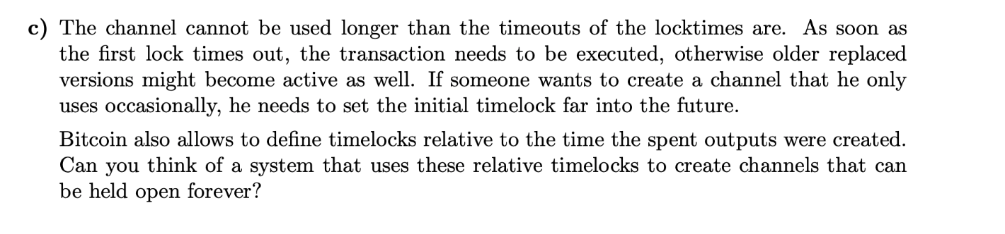
Last exercise
Idea: Create an opening transaction (as usual) and a “kickoff” transaction that creates a new output. Only the opening one gets send to the blockchain, but both parties hold fully signed copies of the kickoff. Each transaction in the payment channel does not spend the output of the opening transaction, but instead the output of the ”kickoff” transaction that does not exist yet. If some partner wants to close the channel, he executes the kickoff transaction together with the last state. This starts the timer.

Slide 24
Memory management and virtual memory
Goal: Allocate memory for every process. Memory allocation should be efficient and memory should be fast to access.

Slide 25
Terminology
Physical address: address as seen by the memory unit
Virtual or Logical address: address issued by the processor
Loads
Stores
Instruction fetches
Possible others (e.g. TLB fills)…

Slide 26
Memory management
Allocating physical addresses to applications
Managing the name translation of virtual addresses to physical addresses
Performing access control on memory access
Functions 2 & 3 usually involve the hardware Memory Management Unit (MMU)

Slide 27
Segmentation

Slide 28
Segmentation
Generalize base + limit:
Physical memory divided into segments
Logical address = (segment id, offset)
Segment identifier supplied by:
Explicit instruction reference
Explicit processor segment register
Implicit process state

Slide 29
User’s View of a Program
shared library
stack
symbol table
heap
main program
logical address

Slide 30
Segmentation reality
1
3
1
2
3
2
0
4
4
0
logical address
physical memory

Slide 31
Segmentation Hardware
limit
base
Memory
segment
table
CPU
s
d
Physical address
<
yes
+
no
trap: addressing error

Slide 32
Segmentation reality
6000
1
5000
3
1
2
4600
limit
base
0
1
2
3
4
300 1000
400
400
1000
1500 5000 3400 4600 1800
3800
3
2
3400
0
segment table
2800
4
4
1800
0
1500
logical address
physical memory

Slide 33
Segmentation Architecture
Segment table – each entry has:
base – starting physical address of segment
limit – length of the segment
Segment-table base register (STBR)
Current segment table location in memory
Segment-table length register (STLR)
Current size of segment table
segment number s is legal if s < STLR

Slide 34
Paging

Slide 35
Paging
Solves contiguous physical memory problem
Process can always fit if there is available free memory
Divide physical memory into frames
Size is power of two, e.g. 4096 bytes
Divide logical memory into pages of the same size
For a program of n pages in size:
Find and allocate n frames
Load program
Set up page table to translate logical pages to physical frames

Slide 36
Page table jargon
Page tables maps VPNs to PFNs
Page table entry = PTE
VPN = Virtual Page Number
Upper bits of virtual or logical address
PFN = Page Frame Number
Upper bits of physical or logical address
Same number of bits (usually).

Slide 37
x86-64 Paging
9
9
9
9
12
VPN1
VPN2
VPN3
VPN4
VPO
Page
Directory
Pointer
Table
Virtual address
Page
Directory
Table
Page Map
Table
Page
Table
PM4LE
PDPE
PDE
PTE
BR
40
12
PPN
PPO
Physical address

Slide 38
Copy on write (COW)
Have shared memory until one process writes to memory, then copy it
How:
forking process, change rights of both processes to READONLY
if one process tries write to memory, copy page and add it to process’s page table as WRITEABLE
mark page in other process’s page table as WRITEABLE
makes fork much faster, since you don’t need to copy whole address space

Slide 39
Caching

Slide 40
Cache operations
invalidate
makes content of cache (or cache line) invalid
clean
writes any dirty data in cache line back to memory
flush (=clean + invalidate)
writes back any dirty data an invalidates cache line

Slide 41
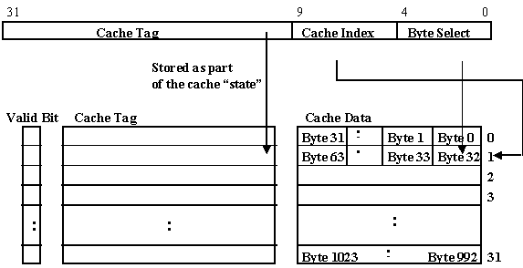
Cache types
virtually indexed, virtually tagged
suffers from homonyms, because same virtual
address can mean different physical address in
different processes
address-space tags can prevent that by adding to a cache line which address space it belongs to
fast
physically indexed, physically tagged
good for context switches
slow, since address needs to be translated before lookup
virtually indexed, physically tagged
good if it works
complicated
physically indexed, virtually tagged
not really useful

Slide 42
Translation Lookaside Buffer (TLB)

Slide 43
Problem: performance
Every logical memory access needs two physical memory accesses
Load page table entry → PFN
Load desired location
Performance ⇒ half as fast as with no translation
Solution: cache page table entries

Slide 44
Translating with the P6 TLB
Partition VPN into TLBT and TLBI.
Is the PTE for VPN cached in set TLBI?
Yes: Check permissions, build physical address
No: Read PTE (and PDE if not cached) from memory and build physical address
CPU
20
12
virtual address
VPN
VPO
16
4
TLBT
TLBI
1
2
TLB
miss
TLB
hit
PDE
PTE
3
...
20
12
partial
TLB hit
PPN
PPO
physical address
page table translation
4

Slide 45
Demand Paging

Slide 46
Demand Paging
Bring a page into memory only when it is needed
Less I/O needed
Less memory needed
Faster response
More users
Turns RAM into a cache for processes on disk!

Slide 47
Recall: handling a page fault
Exception
Page fault handler
4
CPU Chip
2
Cache/
Memory
Disk
MMU
PTEA
New page
1
5
CPU
VA
PTE
6
7
3
1) Processor sends virtual address to MMU
2-3) MMU fetches PTE from page table in memory
4) Valid bit is zero, so MMU triggers page fault exception
5) Handler finds a frame to use for missing page
6) Handler pages in new page and updates PTE in memory
7) Handler returns to original process, restarting faulting instruction

Slide 48
Page Replacement

Slide 49
What happens if there is no free frame?
Page replacement – find “little used” resident page to discard or write to disk
“victim page”
algorithm
performance – want an algorithm which will result in minimum number of page faults
Same page may be brought into memory several times

Slide 50
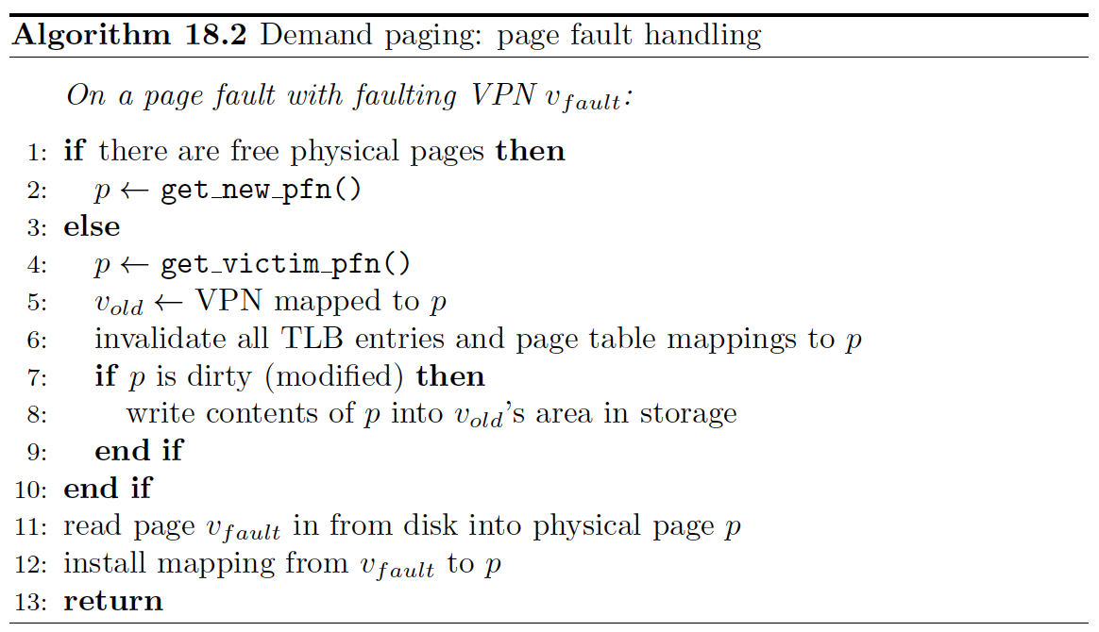
On demand paging
Idea: only page in page into main memory when needed.

Slide 51
FIFO (First-In-First-Out) page replacement
reference string:
7
0
1
2
0
3
0
4
2
3
0
3
2
1
2
0
1
7
0
1
3 page
frames:

Slide 52
FIFO (First-In-First-Out) page replacement
reference string:
7
0
1
2
0
3
0
4
2
3
0
3
2
1
2
0
1
7
0
1
3 page
frames:
7

Slide 53
FIFO (First-In-First-Out) page replacement
reference string:
7
0
1
2
0
3
0
4
2
3
0
3
2
1
2
0
1
7
0
1
3 page
frames:
7
7
0

Slide 54
FIFO (First-In-First-Out) page replacement
reference string:
7
0
1
2
0
3
0
4
2
3
0
3
2
1
2
0
1
7
0
1
3 page
frames:
7
7
7
0
0
1

Slide 55
FIFO (First-In-First-Out) page replacement
reference string:
7
0
1
2
0
3
0
4
2
3
0
3
2
1
2
0
1
7
0
1
3 page
frames:
7
7
7
2
0
0
0
1
1

Slide 56
FIFO (First-In-First-Out) page replacement
reference string:
7
0
1
2
0
3
0
4
2
3
0
3
2
1
2
0
1
7
0
1
3 page
frames:
7
7
7
2
2
0
0
0
3
1
1
1

Slide 57
FIFO (First-In-First-Out) page replacement
reference string:
7
0
1
2
0
3
0
4
2
3
0
3
2
1
2
0
1
7
0
1
3 page
frames:
7
7
7
2
2
2
4
4
4
0
0
0
0
3
3
3
2
2
2
1
1
1
0
0
0
3
3

Slide 58
FIFO (First-In-First-Out) page replacement
reference string:
7
0
1
2
0
3
0
4
2
3
0
3
2
1
2
0
1
7
0
1
3 page
frames:
7
7
7
2
2
2
4
4
4
0
0
0
0
0
0
3
3
3
2
2
2
1
1
1
1
1
0
0
0
3
3
3
2

Slide 59
FIFO (First-In-First-Out) page replacement
reference string:
7
0
1
2
0
3
0
4
2
3
0
3
2
1
2
0
1
7
0
1
3 page
frames:
7
7
7
2
2
2
4
4
4
0
0
0
7
7
7
0
0
0
3
3
3
2
2
2
1
1
1
0
0
1
1
1
0
0
0
3
3
3
2
2
2
1
Here, 15 page faults.

Slide 60
Least Recently Used (LRU) algorithm
Reference string: 1 2 3 4 1 2 5 1 2 3 4 5 4 frames
Counter implementation
Every page entry has a counter; every time page is referenced through this entry, copy the clock into the counter
When a page needs to be changed, look at the counters to determine which are to change
1
1
1
1
5
2
2
2
2
2
3
5
5
4
4
4
4
3
3
3

Slide 61
LRU page replacement
reference string:
7
0
1
2
0
3
0
4
2
3
0
3
2
1
2
0
1
7
0
1
3 page
frames:
7
7
7
2
2
4
4
4
0
1
1
1
0
0
0
0
0
0
3
3
3
0
0
1
1
3
3
2
2
2
2
2
7
Here, 12 page faults.

Slide 62
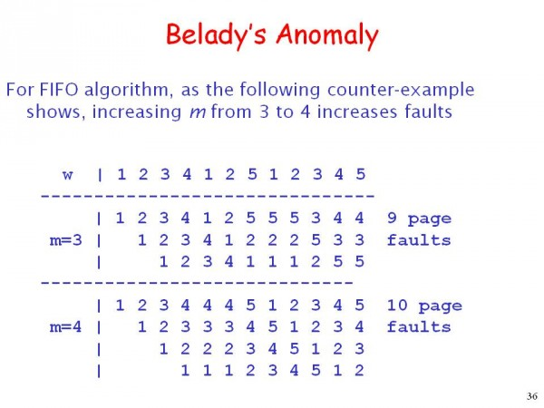

Slide 63
Optimal algorithm
Replace page that will not be used for longest period of time
4 frames example:
1 2 3 4 1 2 5 1 2 3 4 5
How do you know this? – you can’t!
Used for measuring how well your algorithm performs
1
1
4
2
2
2
⇒ 6 page faults
3
3
3
4
5
5

