Slide 1
Exercise Session 9 Computer Systems
© Systems Group | Department of Computer Science | ETH Zürich

Slide 2
Agenda
Previous exercise
File System Abstraction
Operations
Access control
File System Implementation
FAT
FFS
NTFS

Slide 3
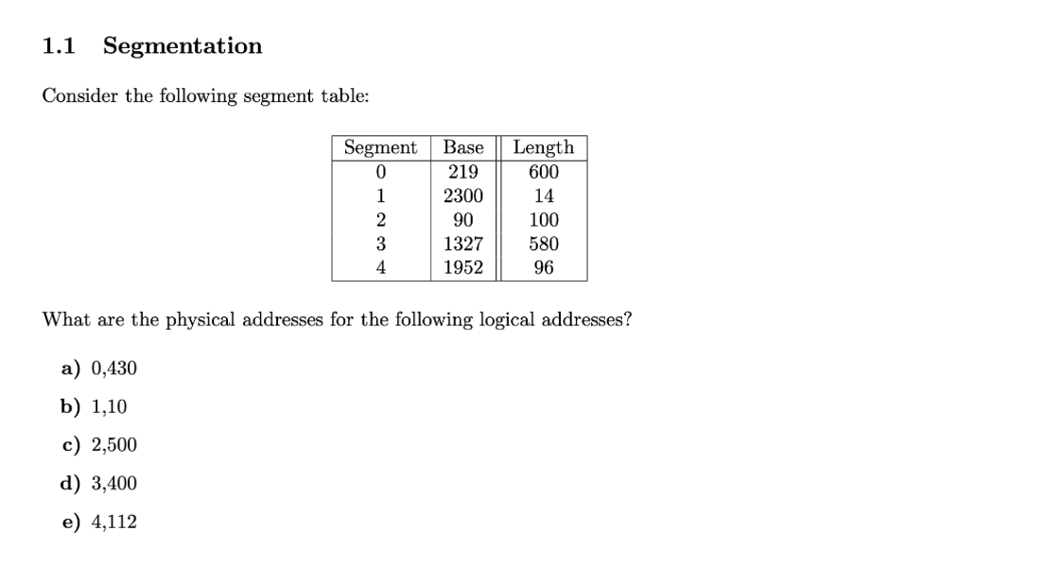

Last Exercsie
1.) 430 < 600?
2.) 219 + 430 = 649

Slide 4

Last Exercsie
1.) 500 < 100?

Slide 5
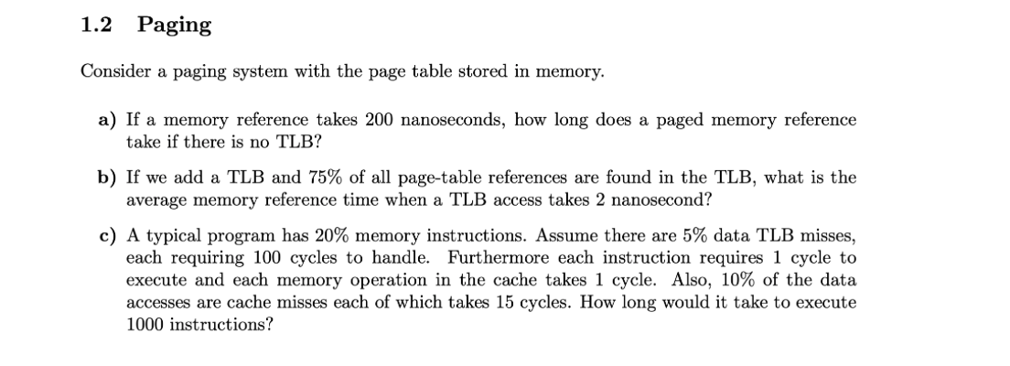
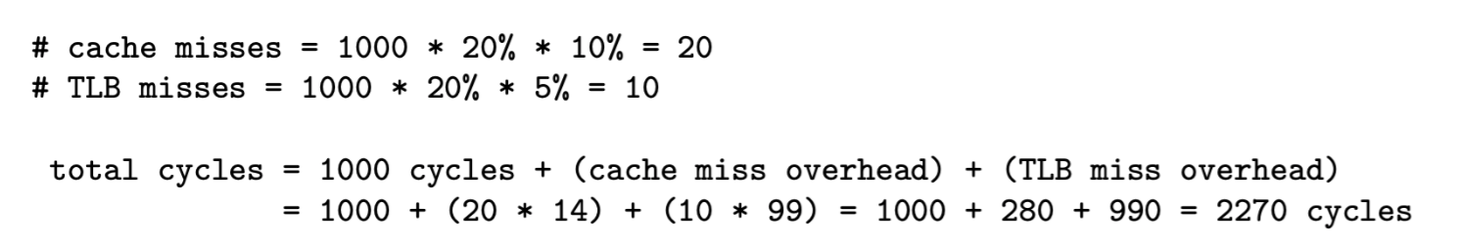
Last Exercise
No TLB: one access for page, one access for page table: 200 + 200 = 400
(2+200)*0.75 + (2+200+200)*0.25 = 252ns
Idea: calculate the overhead

Slide 6
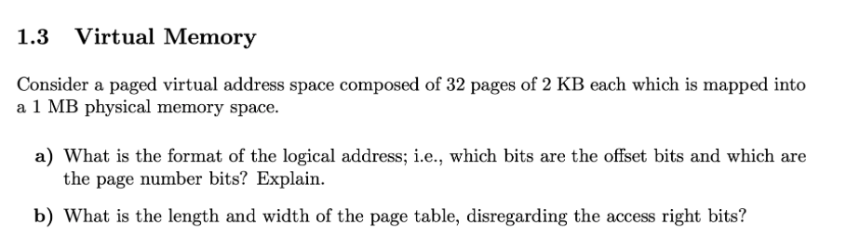
Last exercise
offset: each byte needs to get accessed
2KB = $2^{11}$ bytes -> 11 offset bits
page number: each page needs to get accessed
32 pages = $2^{5}$ pages -> 5 page number bits
b) length of page table: for each page one entry
32 entries
width of page table: each entry contains one physical address
size of physical address: 1MB = $2^{20}$ bytes. So 20 bits to represent address
Length = 32, width = 20

Slide 7
File Systems

Slide 8
What the file system builds on
Application
Library
File system
File system API and implementation
Block cache
Block device interface
Device driver
I/O system
I/O, DMA, Interrupts
Physical device

Slide 9
File system operations
Directory (name space) operations:
Link (bind a name)
Unlink (unbind a name)
Rename
List entries

Slide 10
File metadata
Metadata: important concept!
Data about an object, not the object itself
File metadata examples:
Name
Location on disk
Times of creation, last change, last access
Ownership, access control rights File type, file structure
Arbitrary descriptive data (used for searching)

Slide 11
Protection
File owner/creator should be able to control:
what can be done
by whom
Types of access
Read
Write
Execute
Append
Delete
List

Slide 12
Access control matrix
For a single file or directory:
Principals
 | A | B | C | D | E | F | G | H | J | …
Read | ☑ | ☑ | ☑ |  |  | ☑ | ☑
Write | ☑ | ☑ |  | ☑ |  |  | ☑
Append | ☑ |  |  |  | ☑
Execute | ☑ | ☑ | ☑ | ☑
Delete | ☑
List | ☑ |  |  |  | ☑
…
Rights
Problem: how to scalably represent this matrix?

Slide 13
Row-wise: ACLs
Access Control Lists
For each right, list the principals
Store with the file
Good:
Easy to change rights quickly
Scales to large numbers of files
Bad:
Doesn’t scale to large numbers of principals

Slide 14
“Files” vs. “Open Files”
Typical operations on files:
Rename, stat, create, delete, etc.
Open
Open creates an “open file handle”
Different class of object
Allows reading and writing of file data

Slide 15
File System Implementation

Slide 16
Implementation aspects
Directories and indexes
Where on the disk is the data for each file?
Index granularity
What is the unit of allocation for files?
Free space maps
How to allocate more sectors on the disk?
Locality optimizations
How to make it go fast in the common case

Slide 17
File system implementations
 | FAT | FFS | NTFS
Index structure | Linked list | Fixed, assymetric tree | Dynamic tree
Index granularity: | Block | Block | Extent
Free space management | FAT Array | Fixed bitmap | Bitmap in file
Locality heuristics | Defragmentation | Block groups, Reserve space | Best fit, Defragmentation

Slide 18
FAT

Slide 19
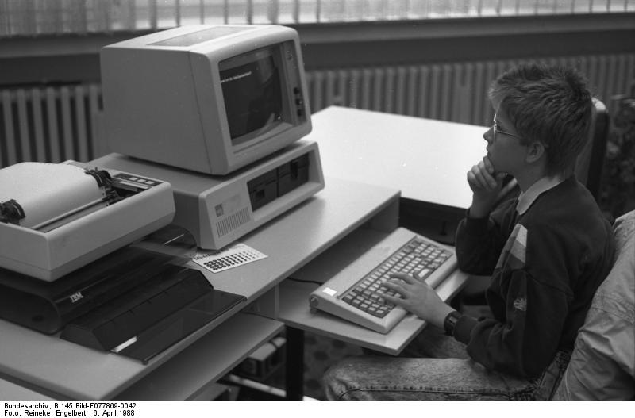
FAT background
Very old – dates back to 1970s!
No access control
Very little metadata
Limited volume size
No support for hard links
BUT still extensively used ☹
Flash devices, cameras, phones

Slide 20
FAT file system
FAT
Data blocks
0
1
2
Directory
3
file 9 block 3
Foo
.exe
9
4
5
Bar
.doc
12
6
7
8
9
file 9 block 0
10
file 9 block 1
11
file 9 block 2
12
file 12 block 0
13
14
15
16
file 12 block 1
17
18
file 9 block 4
19

Slide 21
FAT file system
FAT
Data blocks
Free space:
Linear search through FAT
0
Slow random access: need to traverse linked list for file block
1
2
3
file 9 block 3
4
Very little support for reliability: lose the FAT and it’s game over
5
6
7
8
9
Poor locality: files can end up fragmented on disk
file 9 block 0
10
file 9 block 1
11
file 9 block 2
12
file 12 block 0
13
14
15
16
file 12 block 1
17
18
file 9 block 4
19

Slide 22
FFS

Slide 23
Unix Fast File System (FFS)
First appeared in BSD in the mid 1980’s
Based on original Unix FS, with performance optimizations
Basis for Linux ext{2,3} file systems

Slide 24
FFS uses indexed allocation
Inode array
Inode
Metadata
Data block
Data block
Data block
Block pointers
Data block
File inode number from directory entry
File is represented by an index block or inode
File metadata
List of blocks for each part of file
Directory contains pointers to inodes

Slide 25
Inode and file size in FFS
Example:
Inode is 1 block = 4096 bytes
Block addresses = 8 bytes
Inode metadata = 512 bytes
Hence:
(4096-512) / 8 = 448 block pointers
448 * 4096 = 1792kB max. file size

Slide 26
Unix file system inode format (simplified)
Inode:
(all blocks 4kB)
File mode
Data block
Owner/group
Data block
Timestamps
Data block
Size
…
<other metadata>
Data block
12 direct block pointers
Question:
How to extend file size if there are no more block pointers in the Inode?
…

Slide 27
Unix file system inode format (simplified)
Inode:
File mode
(all blocks 4kB)
Data block
Owner/group
Data block
Timestamps
Data block
Size
…
Data block
<other metadata>
Data block
…
12 direct block pointers
Data block
indirect block
…
Data block
…
indirect block
Data block
Single indirect
Double indirect
…
indirect block
Data block
indirect block
…
Triple indirect
Data block
4k / 8 = 512 block pointers

Slide 28
NTFS

Slide 29
NFTS Master file table
MFT
Lots of options for what goes in here
MFT record:
Std. info
Attributes, data, metadata
free
1 kB fixed size

Slide 30
NTFS small files
Small file fits into MFT record:
Hard links (multiple names) stored in MFT:
Std. info
Filename
File data
free
“resident” data
Std. info
Filename1
Filename2
File data
free

Slide 31
NTFS normal files
MFT holds list of extents:
Std. info
Filename
Start, length
Start, length
Start, length
free
Data (extent 0)
Data (extent 1)
Data (extent 2)

Slide 32
Too many attributes?
Attribute list holds list of attribute locations
MFT entry
Std. info
Attr. list
Filename 1
Filename 2
name
name
data
2nd MFT entry
Std. info
Start, length
Start, length
Start, length
free
In addition, attributes can also be stored in extents ⇒ very large scaling (see book)

Slide 33
Metadata files
File system metadata in NTFS is held in files!
File num. | Name | Description
0 | $MFT | Master file table
1 | $MFTirr | Copy of first 4 MFT entries
2 | $Logfile | Transaction log of FS changes
3 | $Volume | Volume information & metadata
4 | $AttrDef | Table mapping numeric IDs to attributes
5 | . | Root directory
6 | $Bitmap | Free space bitmap
7 | $Boot | Volume boot record
8 | $BadClus | Bad cluster map
9 | $Secure | Access control list database
10 | $UpCase | Filename mappings to DOS
11 | $Extend | Extra file system attributes (e.g. quota)
Question:
Huh?
Where is it then?
Answer:
First sector of volume points to first block of MFT

