Slide 1
Computer Systems
Exercise Session 1

Slide 2
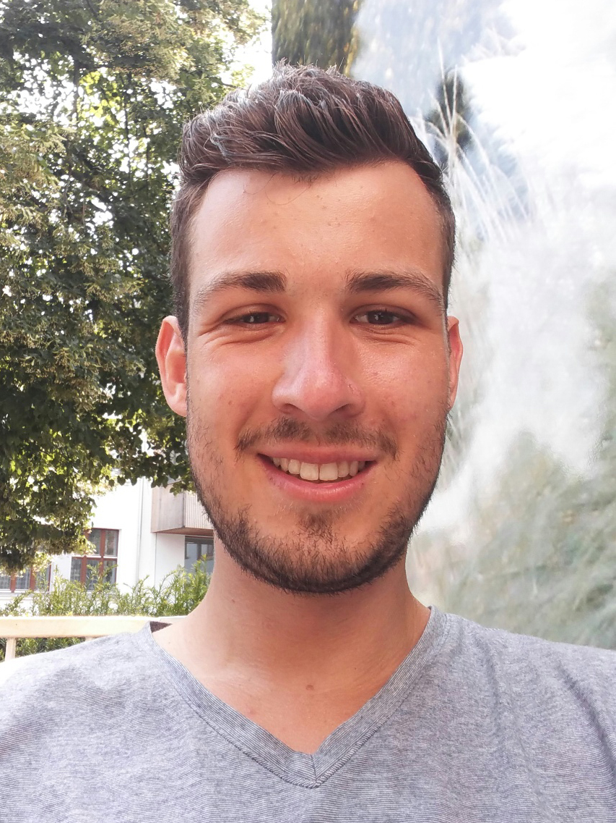
About me
Jonas Gude
jgude@student.ethz.ch
Master’s Student at ETHZ, focus on Distributed Systems and Information Security
I’m here to help you to understand the course and to pass the exam :)

Slide 3
Organization
Course is loosely divided into two parts:
Operating Systems (Prof. Roscoe)
Distributed Computing (Prof. Wattenhofer)
Submit Exercises to: jgude@student.ethz.ch
If you have questions email me or ask me during/after the exercise sessions
Bonus Task (design an exam Question)
Submit to: manuelei@ethz.ch
Deadline 1st attempt: somewhere in November
Deadline 2nd attempt: Probably end of semester

Slide 4
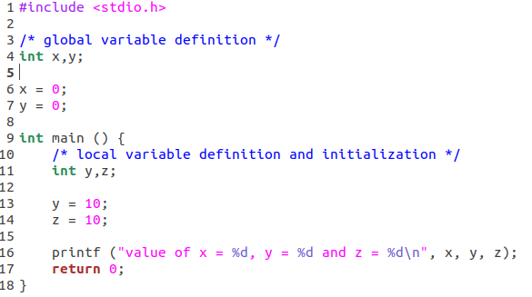
Naming Basics
Name
Object
Object my_object = new Object();
Global scope
Function scope
Binding

Slide 5


Naming Networks
etc/
Desktop/
/
home/
compsys/
Documents/
usr/
Downloads/
link
Context matters:
cd Desktop
cd home
cd /home/compsys/Downloads
cd /link/Downloads
cd Desktop/../Downloads
Create SymLink: ln -s /home/compsys /link

Slide 6
Search Paths
compSys@ubuntu:~$ echo $PATH
/usr/local/sbin:/usr/local/bin:/usr/sbin:/usr/bin:/sbin:/bin:
compSys@ubuntu:~$ ln -ls
…
compSys@ubuntu:~$ custom_command
custom_command: command not found

Slide 7
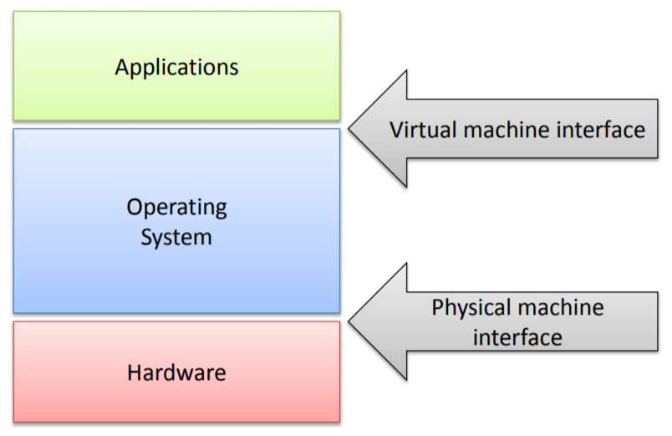
The Role of the OS
Referee:
Ensure resource sharing
Ensure protection (mem protection, process isolation)
Ensure Inter-process communication
Illusionist:
provide virtual resources to user-space processes
Virtual Memory (full address space)
Shared network interface
Glue:
Provide high-level abstraction to user-space applications

Slide 8
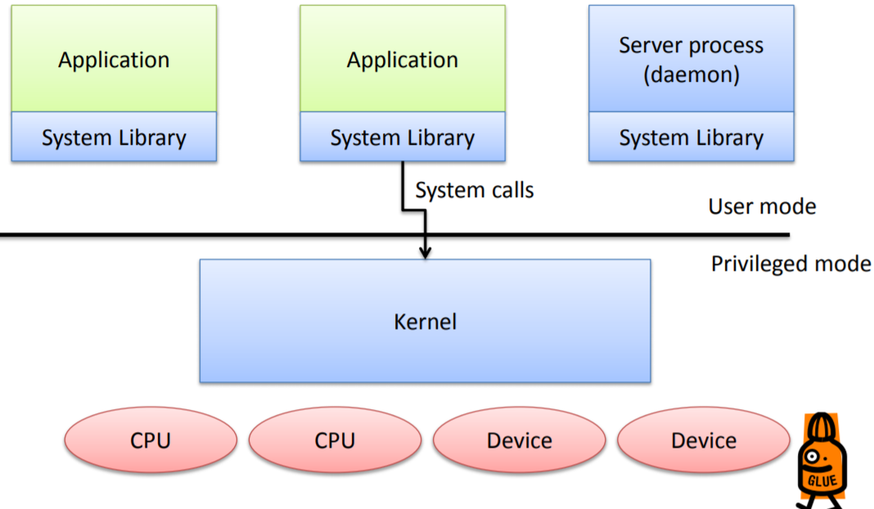
General OS Structure
Kernel:
Special process that runs in privileged mode
Typically event driven server
SysLib:
Provide convenience functions and sysCall wrappers
Deamon:
Processes which are part of the kernel but live in user-space
Provides modularity, fault-tolerance

Slide 9
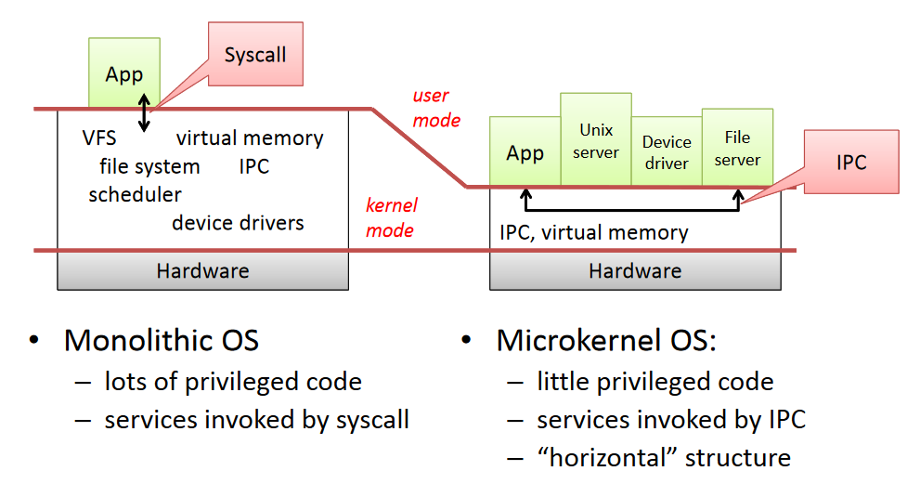
Monolithic vs. Microkernel
Exokernel: move functionality into system libraries instead of user-space
Multikernel: run different kernels on different cores (e.g. Barrelffish)

Slide 10
Bootstrapping
Power on
Load BIOS from ROM to memory
BIOS loads boot loader into memory
boot loader loads OS (kernel) from disk
Transfer control to OS
ROM
BIOS
Disk
2.
memory
boot loader
3.
OS
4.
Illustration adapted from Maegan Pitman

Slide 11
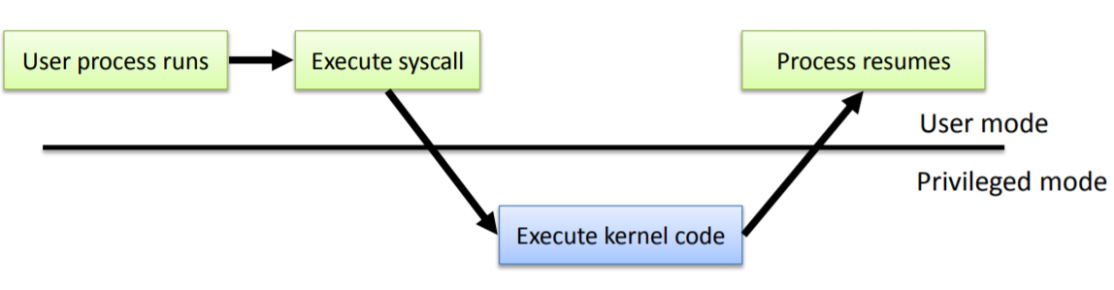
Entering and Leaving the Kernel
on Start-Up
Exception occurs(caused by program )
Interrupt occurs (caused by “something else)
upon a System Call

