Slide 1

The World of Tennis

Slide 2

Tennis Dataset Recognition and Exploration
To analyze the Tennis dataset, the first step involves reading the table names to identify the available data structures. Once the tables are loaded, we can examine their content and data types using functions like head() and info(). This helps in understanding the key features and their distributions.
Since some of the features are domain-specific (e.g., tennis statistics or performance metrics), additional research may be required to interpret them accurately. Tools like Google search and AI-assisted explanations can help clarify unfamiliar terms. However, certain columns remain ambiguous—for example, the 'value' column in the 'power' dataframe lacks clear documentation, making its purpose unclear without further context.
To improve clarity, future steps could include:
Consulting domain experts for insights on ambiguous features.
Cross-referencing with tennis analytics resources to validate assumptions.
Exploring correlations between unknown features and known performance metrics.
This structured approach ensures a deeper and more accurate understanding of the dataset.

Slide 3
Analysis and Conclusions

Slide 4
Basic Player and Match Information
Player Demographics
The dataset contains 596 unique tennis players, with the following handedness distribution:
Right-handed players: 244 (88.4% of known handedness)
Left-handed players: 32 (11.6% of known handedness)
Right-handed players outnumber left-handed players by a ratio of 7.6:1, which aligns with general population trends in tennis.
Height vs. Ranking Analysis
Our investigation into potential correlation between player height and ranking yielded the following findings:
Statistical Test: A hypothesis test (Spearman correlation) showed no significant relationship (p = [0.164])
Visual Analysis: The scatter plot visualization (see next slide) confirms this lack of correlation, with data points showing no discernible pattern
Conclusion: Player height does not appear to be a determining factor in competitive ranking within this dataset.

Slide 5
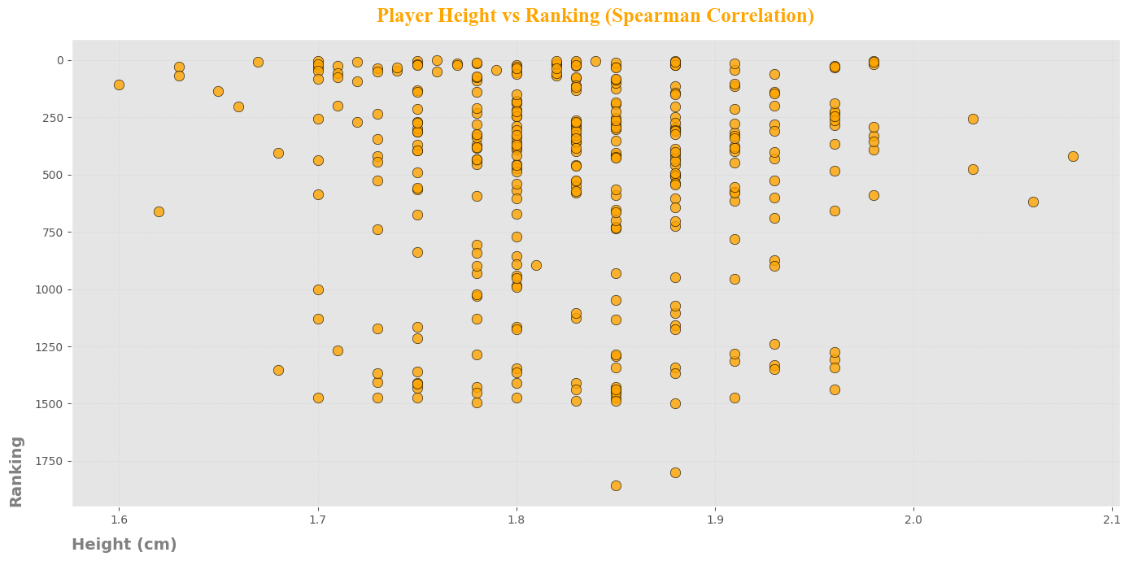

Slide 6
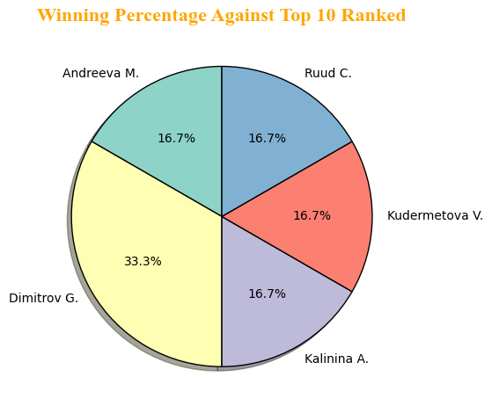
Player Performance
Top Performers by Total Wins: Three players are tied for the highest number of wins (3 each):
Milushev Plamen
Panaras Adam
Kalina Vit
Best Win Rate Against Top 10 Ranked Players: Among players who competed against top 10 opponents, Dimitrov G. leads with 2 wins, achieving the highest winning percentage in this category. Additional details on other players can be found in the accompanying chart.
Recent Success: Players Who Turned Pro in 2019
Three players turned pro in 2019:
Musetti L. (Current Rank: 27)
Davidovich Fokina A. (Current Rank: 26)
Cozbinov A. (Current Rank: 543)
While Musetti and Davidovich Fokina hold strong rankings, Cozbinov A. is the only one in this group with a recorded match win.

Slide 7
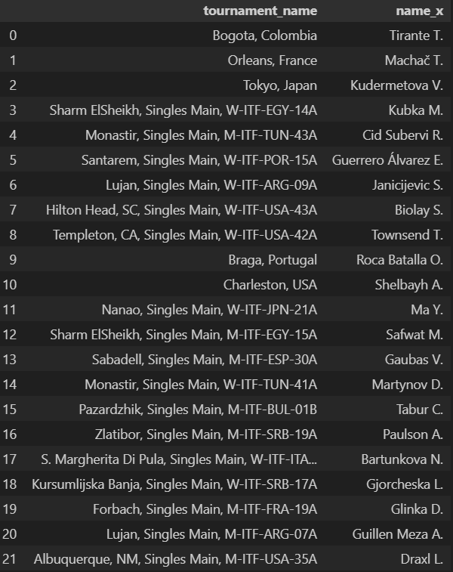
Winner of Each Tournament
The dataset includes results from 55 tournaments in total. However, complete information is only available for 22 of these events where the tournament winners have been identified. This leaves 33 tournaments where the champion remains unrecorded in our current data.

Slide 8
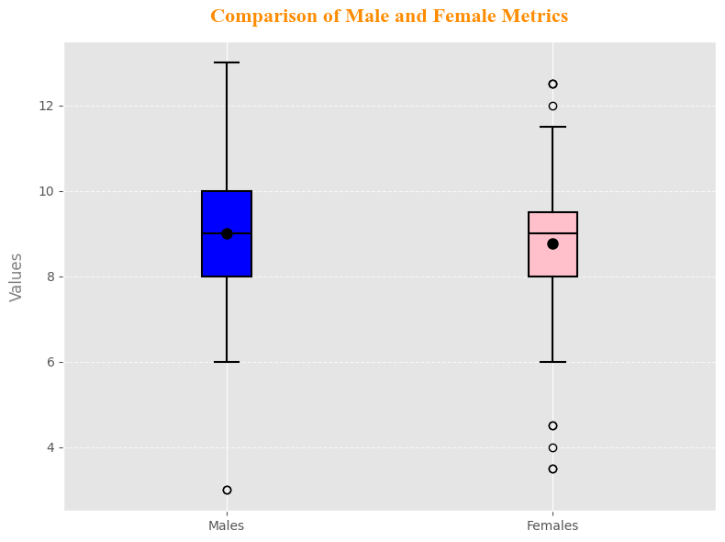
Match Statistics
Match Duration and Set Distribution
The longest recorded match lasted 12,835 seconds (approximately 3 hours, 33 minutes, and 55 seconds), played between Weis Alexander and Domingues Joao (Match ID: 11699235). On average, matches lasted 6,023 seconds.
Matches typically consist of 1 to 3 sets, with most matches played in 2 sets (average: 2.33).
Games per Set: Gender Differences
On average, men played more games per set than women, though the difference was minimal. The distribution across genders is best visualized in the accompanying chart.

Slide 9
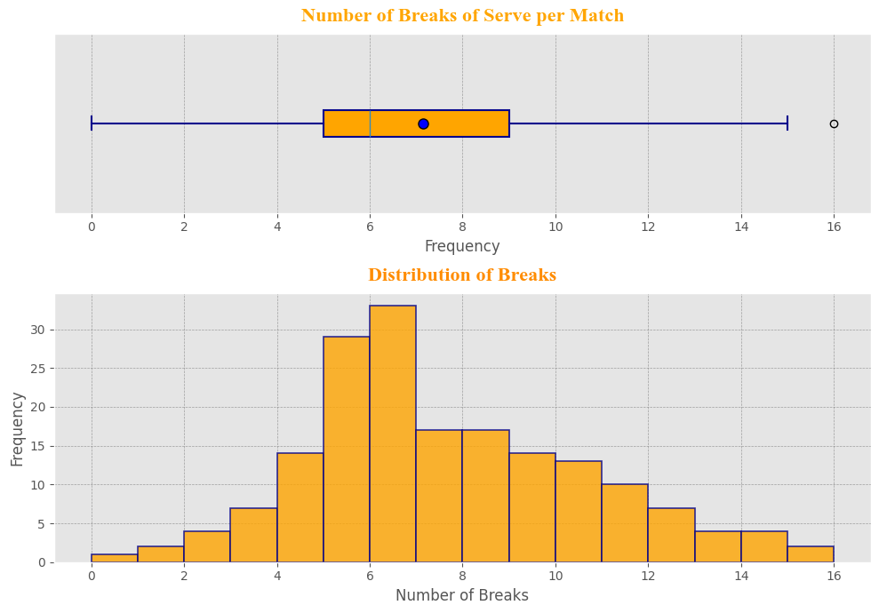
Breaks of Serve Analysis The average number of breaks of serve per match is 7, with a standard deviation of 3, indicating that 68% of matches had between 4 and 10 breaks. Most matches had 6 breaks of serve, as shown in the distribution chart below.

Slide 10
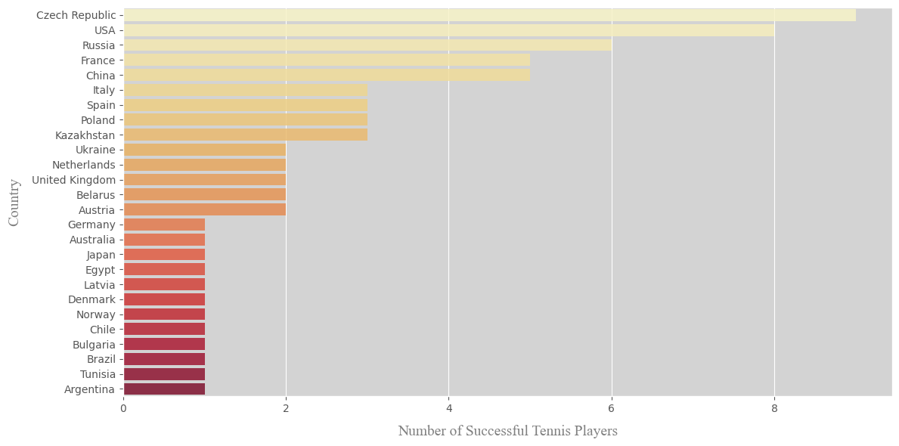
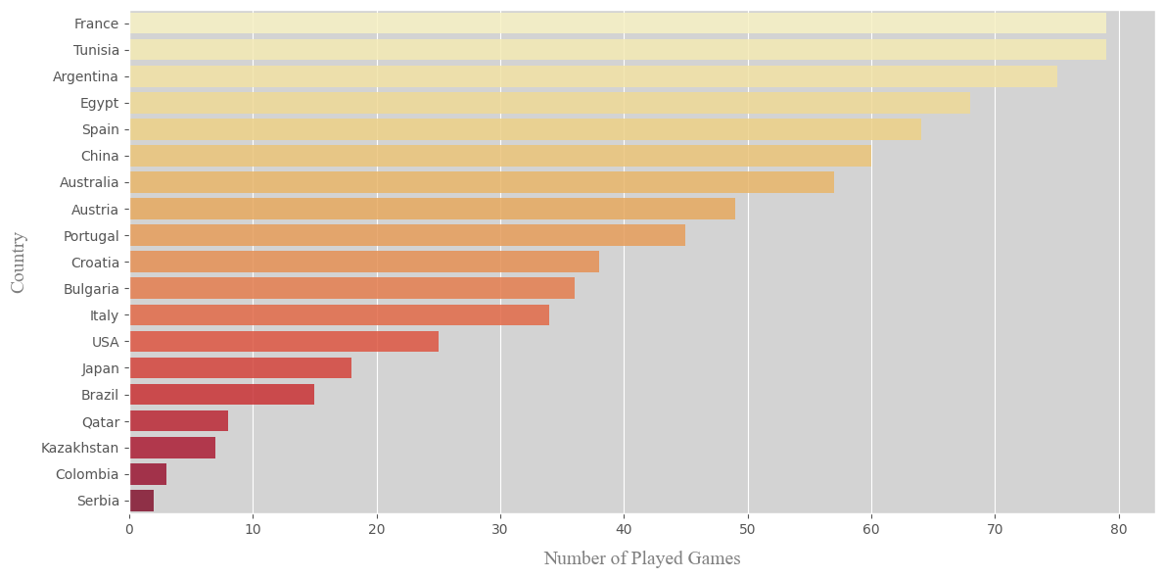
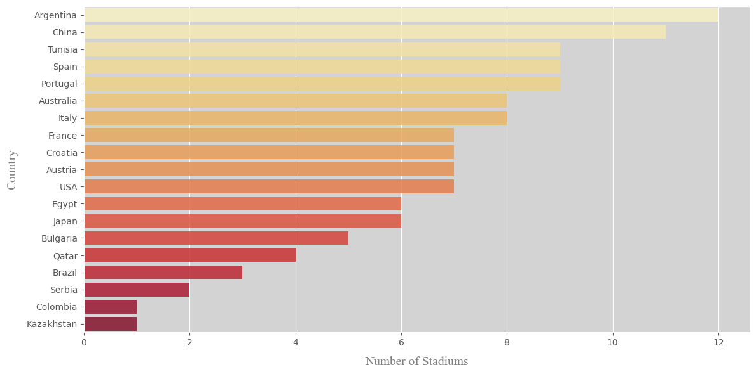
Country Performance
Player Representation Across Countries
Total countries represented: 71
Top countries with players ranked in the Top 100: 1. Czech Republic – 9 players 2. USA – 8 players 3. Russia – 6 players
Match Hosting Hotspots
Countries with the most matches played: 1. France – 79 matches 1. Tunisia – 79 matches (tied with France) 3. Argentina – 75 matches
Stadium Infrastructure Leaders
Countries with the most stadiums utilized: 1. Argentina – 12 stadiums 2. China – 11 stadiums 3. Tunisia – 9 stadiums

Slide 11
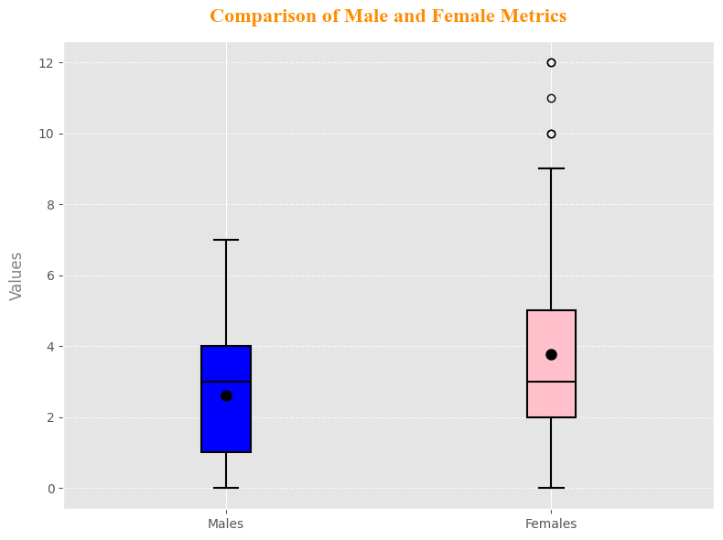
Game and Shot Statistics
Ace Performance Overview
Typical Range: 0 – 5 aces per match
Average: 4 aces per match
Outliers: Extreme cases observed (e.g., 34 aces in a single match)
Gender-Based Performance Comparison
Double Faults (Avg.):
Men: 2.6 per match
Women: 3.7 per match
Key Insight: Men demonstrate greater consistency in serving, with fewer double faults on average.
Visual Data: The box plot clearly illustrates the wider data scatter for women compared to men.

Slide 12
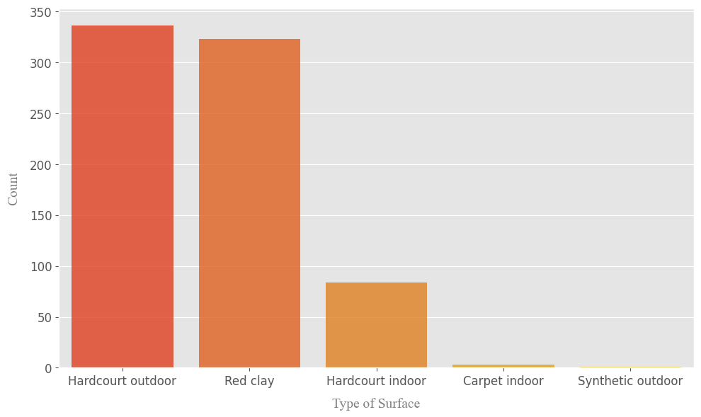
Surface and Court Conditions
Surface Type Distribution
The most commonly used court surfaces in professional tournaments are:
Hardcourt (Outdoor) - 336 tournaments The predominant surface type globally
Red Clay - 323 tournaments Nearly as popular as outdoor hardcourt
Hardcourt (Indoor) - 84 tournaments Significantly less common than outdoor variants
For detailed comparison of all surface types and their relative frequencies, please refer to the accompanying bar plot visualization.

Slide 13
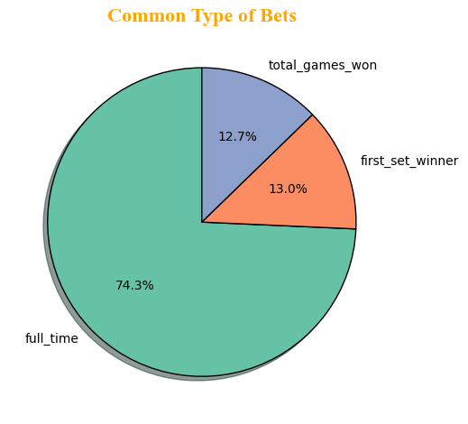
Betting Information
Betting Volume Overview
Total games with bets placed: 315
Average bets per game: 2.7
Most common number of bets per game: 2
Bet Type Distribution
The betting market shows the following distribution across wager types:
Full-Time Result - 630 bets (primary market)
First Set Winner - 110 bets
Total Games Won - 108 bets
Risk Assessment
All bet types carry equal risk probability: around 50%
This indicates a balanced market with no statistically significant advantage for any particular bet type
Key Observations
The market shows strong preference for full-match outcome betting
Set-specific and game-total wagers represent smaller but significant market segments
The consistent 50% risk across all bet types suggests efficient market pricing
For more detailed analysis of betting patterns, please refer to the accompanying market distribution charts

