Slide 1

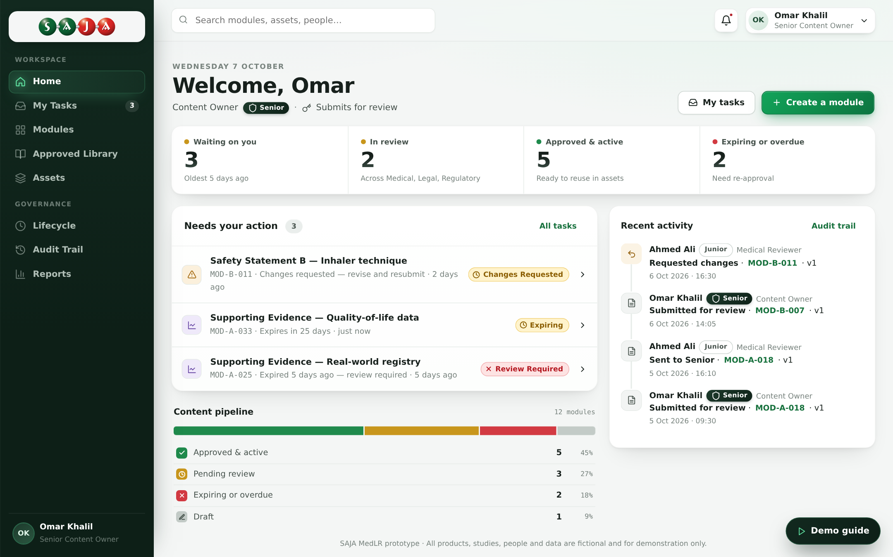

PROPOSAL · OCTOBER 2026
SAJA MedLR
A modular content and MLR review platform for SAJA Pharma
Create once. Approve once. Reuse safely.
Working prototype · ali-usama-gaber.github.io/MedLR
Prepared by
Notes:
Introduce Blue | InTelligancia and the purpose of the meeting: a proposal to build SAJA MedLR, with a clickable prototype ready to walk through.

Slide 2



Today every material is reviewed from scratch
The same claim is checked again in each email, detail aid and banner
Repeated reviews
Slow time to market
Hard to control change
Medical, Legal and Regulatory re-check the same approved claims in every new material.
Each asset waits for a full review cycle, even when most of its content is already approved.
When a claim or safety statement changes, nobody knows every material that still uses the old text.
Notes:
Frame the problem from SAJA's side: duplicated review effort, slow launches, and risk when approved content changes.

Slide 3




Approve content once, reuse it everywhere
Modules
Library
Assets
Small building blocks of content: one claim, one safety statement, one headline. Each is written once and approved once.
The Approved Library: the trusted collection of approved modules, searchable by product, market, audience and channel.
Finished materials built from library modules. Only new text goes back for review.
Notes:
The three parts of the product. Modules are the unit of approval; the library is where approved modules live; assets are assembled from them.

Slide 4




How content moves through the system
Five steps, from a first draft to a tracked, reusable piece of content
1
2
3
4
5
Create
Review
Approve
Build
Track
Content Owner writes a module
Medical, Legal and Regulatory check it
Senior reviewers sign off
Marketing assembles assets
Expiry, versions and audit trail
An approved module appears in the Approved Library straight away and can be reused in any eligible asset.
Notes:
Walk left to right. Stress that step 3 is where the module becomes reusable.

Slide 5



MLR review with Junior and Senior reviewers
The review route is configured by an administrator, not fixed in code
Medical
Junior
Reviews, passes on
Senior
Final approval
Configurable
Add, remove or reorder steps by drag and drop
Senior-only routes for low-risk updates
Email steps notify chosen people when a step is approved
Legal
Junior
Reviews, passes on
Senior
Final approval
Regulatory
Junior
Reviews, passes on
Senior
Final approval
Notes:
Six user types: Content Owner, Medical, Legal, Regulatory, Marketing and Administrator. The first five have Junior and Senior levels; seniority decides authority.

Slide 6
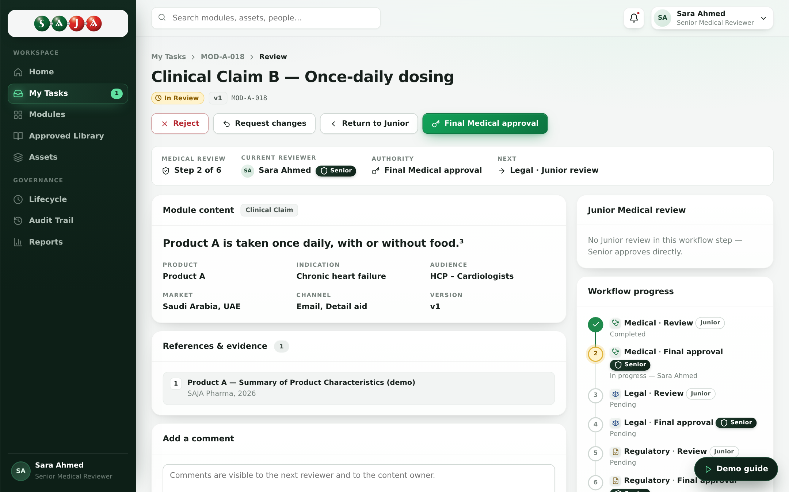
Every reviewer sees exactly what they can decide
Review workspace from the working prototype
Clear authority
Step, current reviewer and what they can approve.
One-click decisions
Send to Senior, request changes, return or reject.
Full history
Every comment kept with role and seniority.

Slide 7
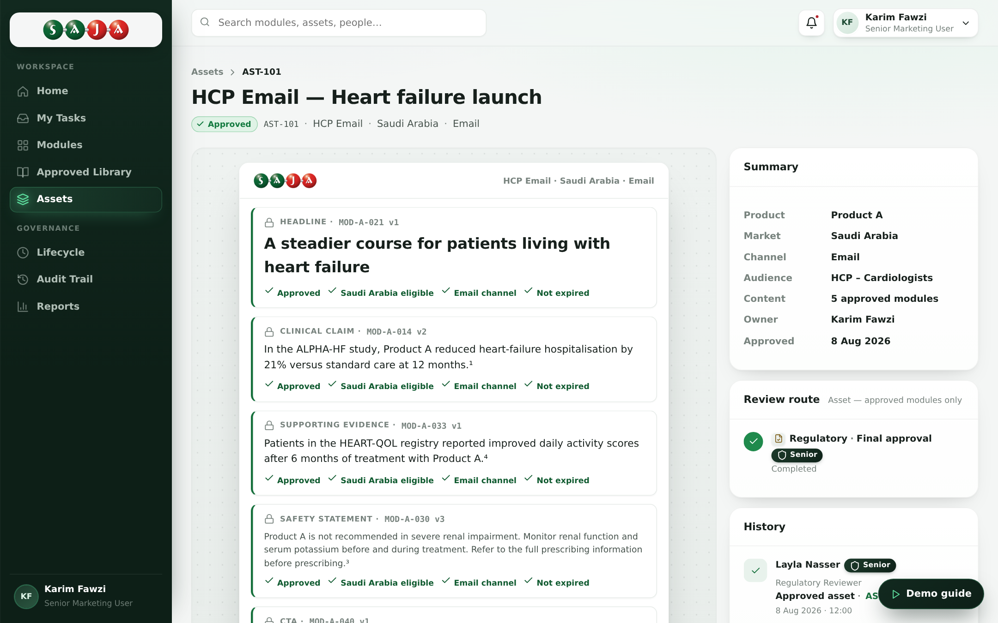
Assets built from approved modules
Approved content is locked; new text is flagged for review
Drag and drop
Pick modules from the library onto the asset.
Automatic checks
Approved, market, channel and expiry are validated.
New content detected
Only new text goes through full MLR review.

Slide 8

Change is controlled, end to end
A new version never breaks content that is already live
v1
v2
v3
Expiry alerts
Modules close to expiry are flagged before they lapse.
Superseded
Live
In review
Audit trail
When v3 is approved, v2 is superseded and every asset still using v2 is listed, with a one-click replace.
Every action with person, role, seniority and time.
Notifications
The right people are told when content changes.

Slide 9
What SAJA gains
Faster launches with less review effort and full control
1×
100%
3
review per module
traceable decisions
markets at launch
Approved once, reused in every eligible asset
Who approved what, when, and at what seniority
Saudi Arabia, UAE and Egypt, with room to grow

Slide 10
Proposed delivery approach
Indicative phases, to be confirmed together during discovery
1
2
3
4
5
Discovery
Design
Build
Testing
Launch
2 weeks
3 weeks
10 weeks
3 weeks
2 weeks
Workflows, roles, markets and integrations confirmed
Final UX built on the approved prototype
Platform, review engine, library and assets
User acceptance with SAJA reviewers
Go-live, training and handover
Discovery starts from the working prototype, so SAJA reviews real screens from week one.
Notes:
Durations are indicative (about 20 weeks in total) and will be confirmed in discovery.

Slide 11
Next steps
Review the prototype
1
Walk through the demo journey with SAJA Medical, Legal and Regulatory leads.
Confirm scope
×
2
Agree workflows, user types, markets and integrations.
Start discovery
3
Kick off the first phase and set the delivery plan.
Try the prototype: ali-usama-gaber.github.io/MedLR
All products, people and data in the prototype are fictional.

