Slide 1
Assignment # 3 Ali Iqbal 24529 Name: ERP-ID:

Slide 2
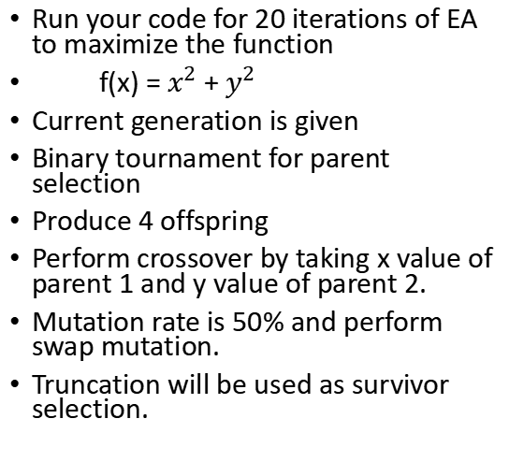
Assignment # 3
Run your code for 20 iterations of EA to maximize the function
f(x) = $x^{2}$ + $y^{2}$
Current generation is given
Binary tournament for parent selection
Produce 4 offspring
Perform crossover by taking x value of parent 1 and y value of parent 2.
Mutation rate is 50% and perform swap mutation.
Truncation will be used as survivor selection.
 | (x,y)
1 | (1,2)
2 | (-2,3)
3 | (4,-1)
4 | (5,2)
5 | (-3,3)

Slide 3
Results from Code
Name and ERP ID: | Ali Iqbal 24529
Iteration # | Best Fitness Value f(x)
1 | 29
2 | 50
3 | 50
4 | 50
5 | 50
6 | 50
7 | 50
8 | 50
9 | 50
10 | 50
Name and ERP ID: | Ali Iqbal 24529
Iteration # | Best Fitness Value f(x)
11 | 50
12 | 50
13 | 50
14 | 50
15 | 50
16 | 50
17 | 50
18 | 50
19 | 50
20 | 50

