Slide 1


Spotify Popularity
Prediction
Project Summary & Model Analysis
Analyzing 85,000 tracks (2015-2025) to identify the key drivers behind musical success using machine learning.

Slide 2

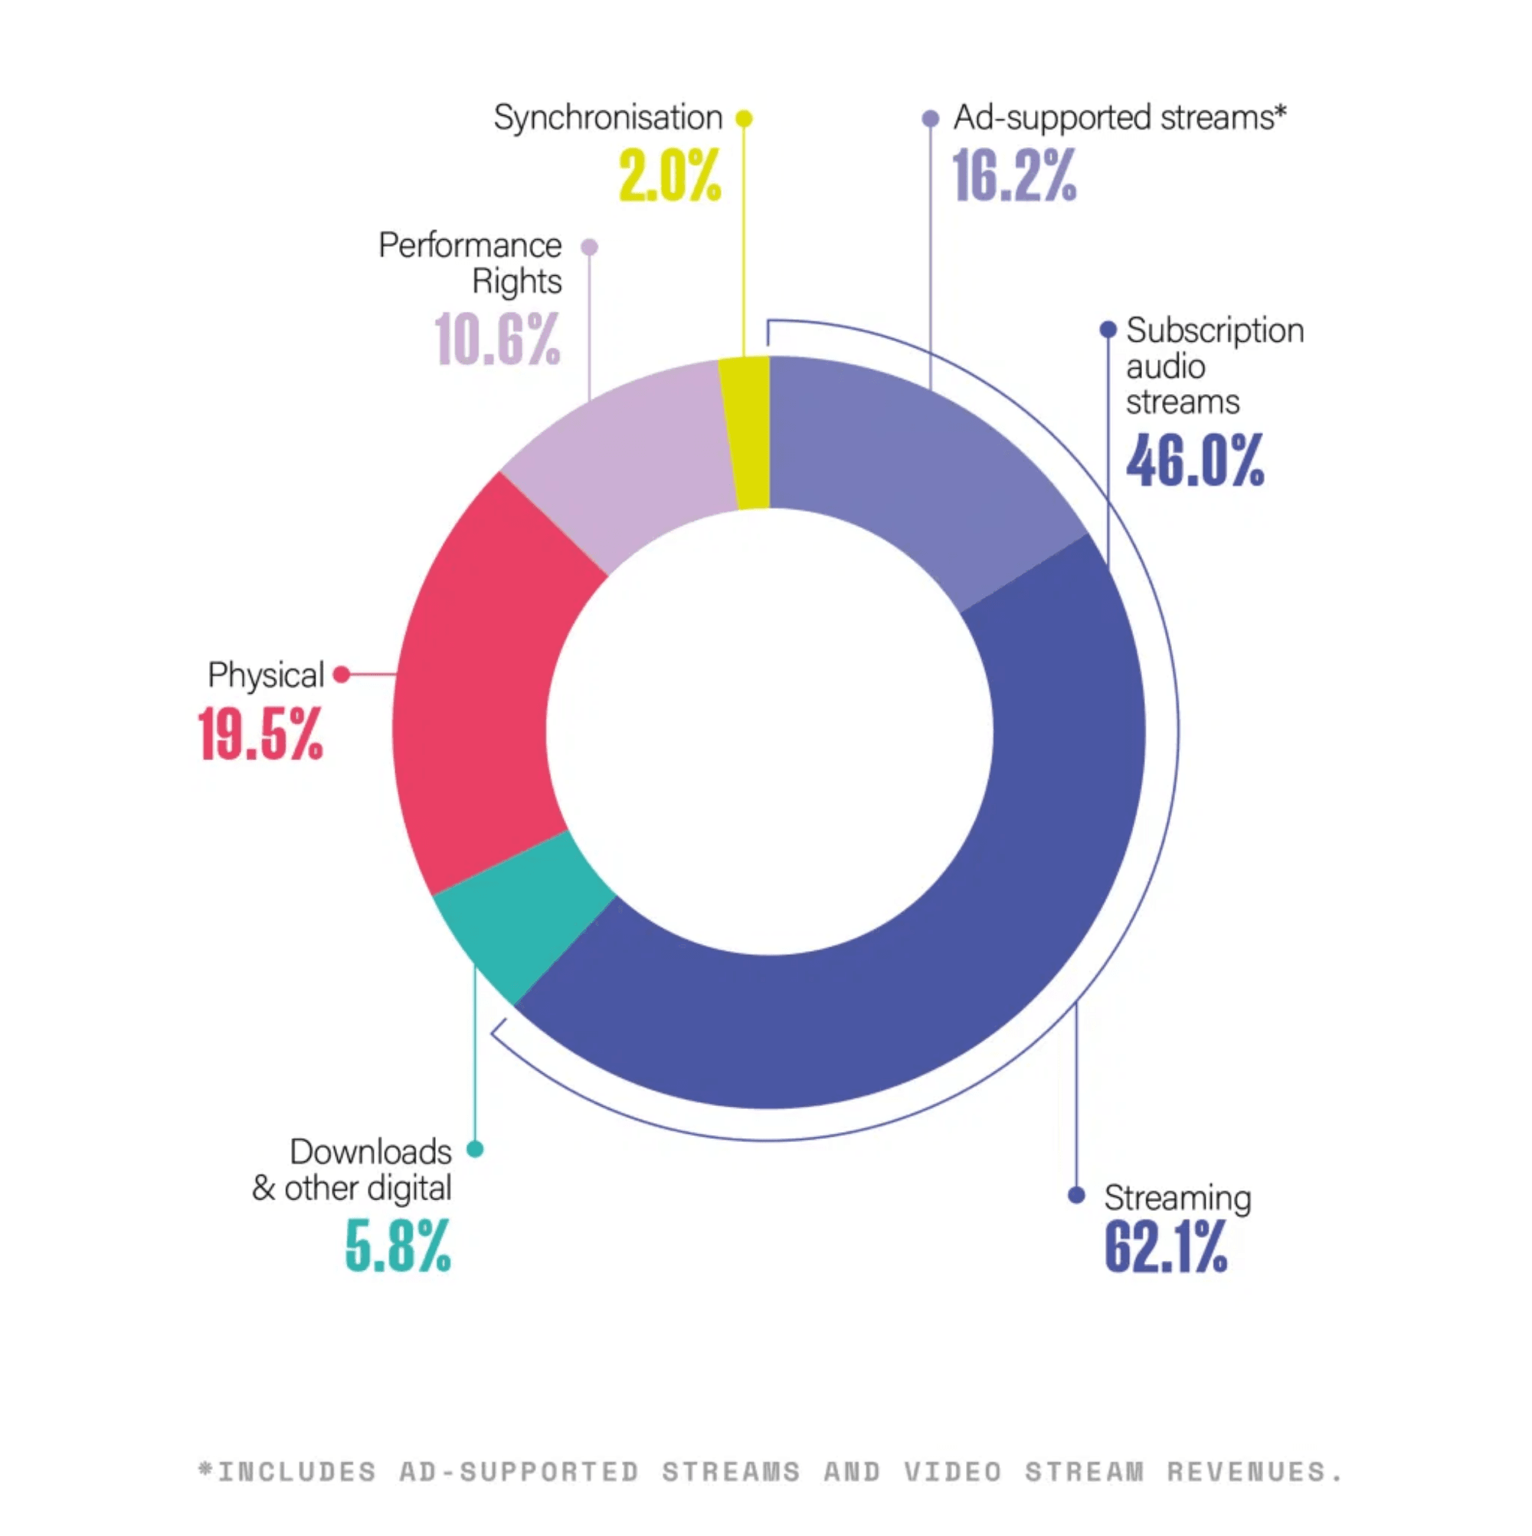
Dataset & Features
Source & Scope
The dataset was sourced from Kaggle, encompassing a wide range of attributes for tracks released between 2015 and 2025.
Key Attributes
Analysis includes core audio features (danceability, energy, loudness), metadata (genre, label), and engagement metrics (stream count).
85,000
Total Tracks Analyzed

Slide 3


Data Preprocessing
01
02
03
04
Cleaning
Outliers
Encoding
Scaling
Removal of missing values and duplicate entries to maintain dataset integrity.
Interquartile Range (IQR) method used to cap extreme values in numerical columns.
Label and One-Hot Encoding for categorical variables like genre and country.
StandardScaler applied to normalize features for model consistency.

Slide 4
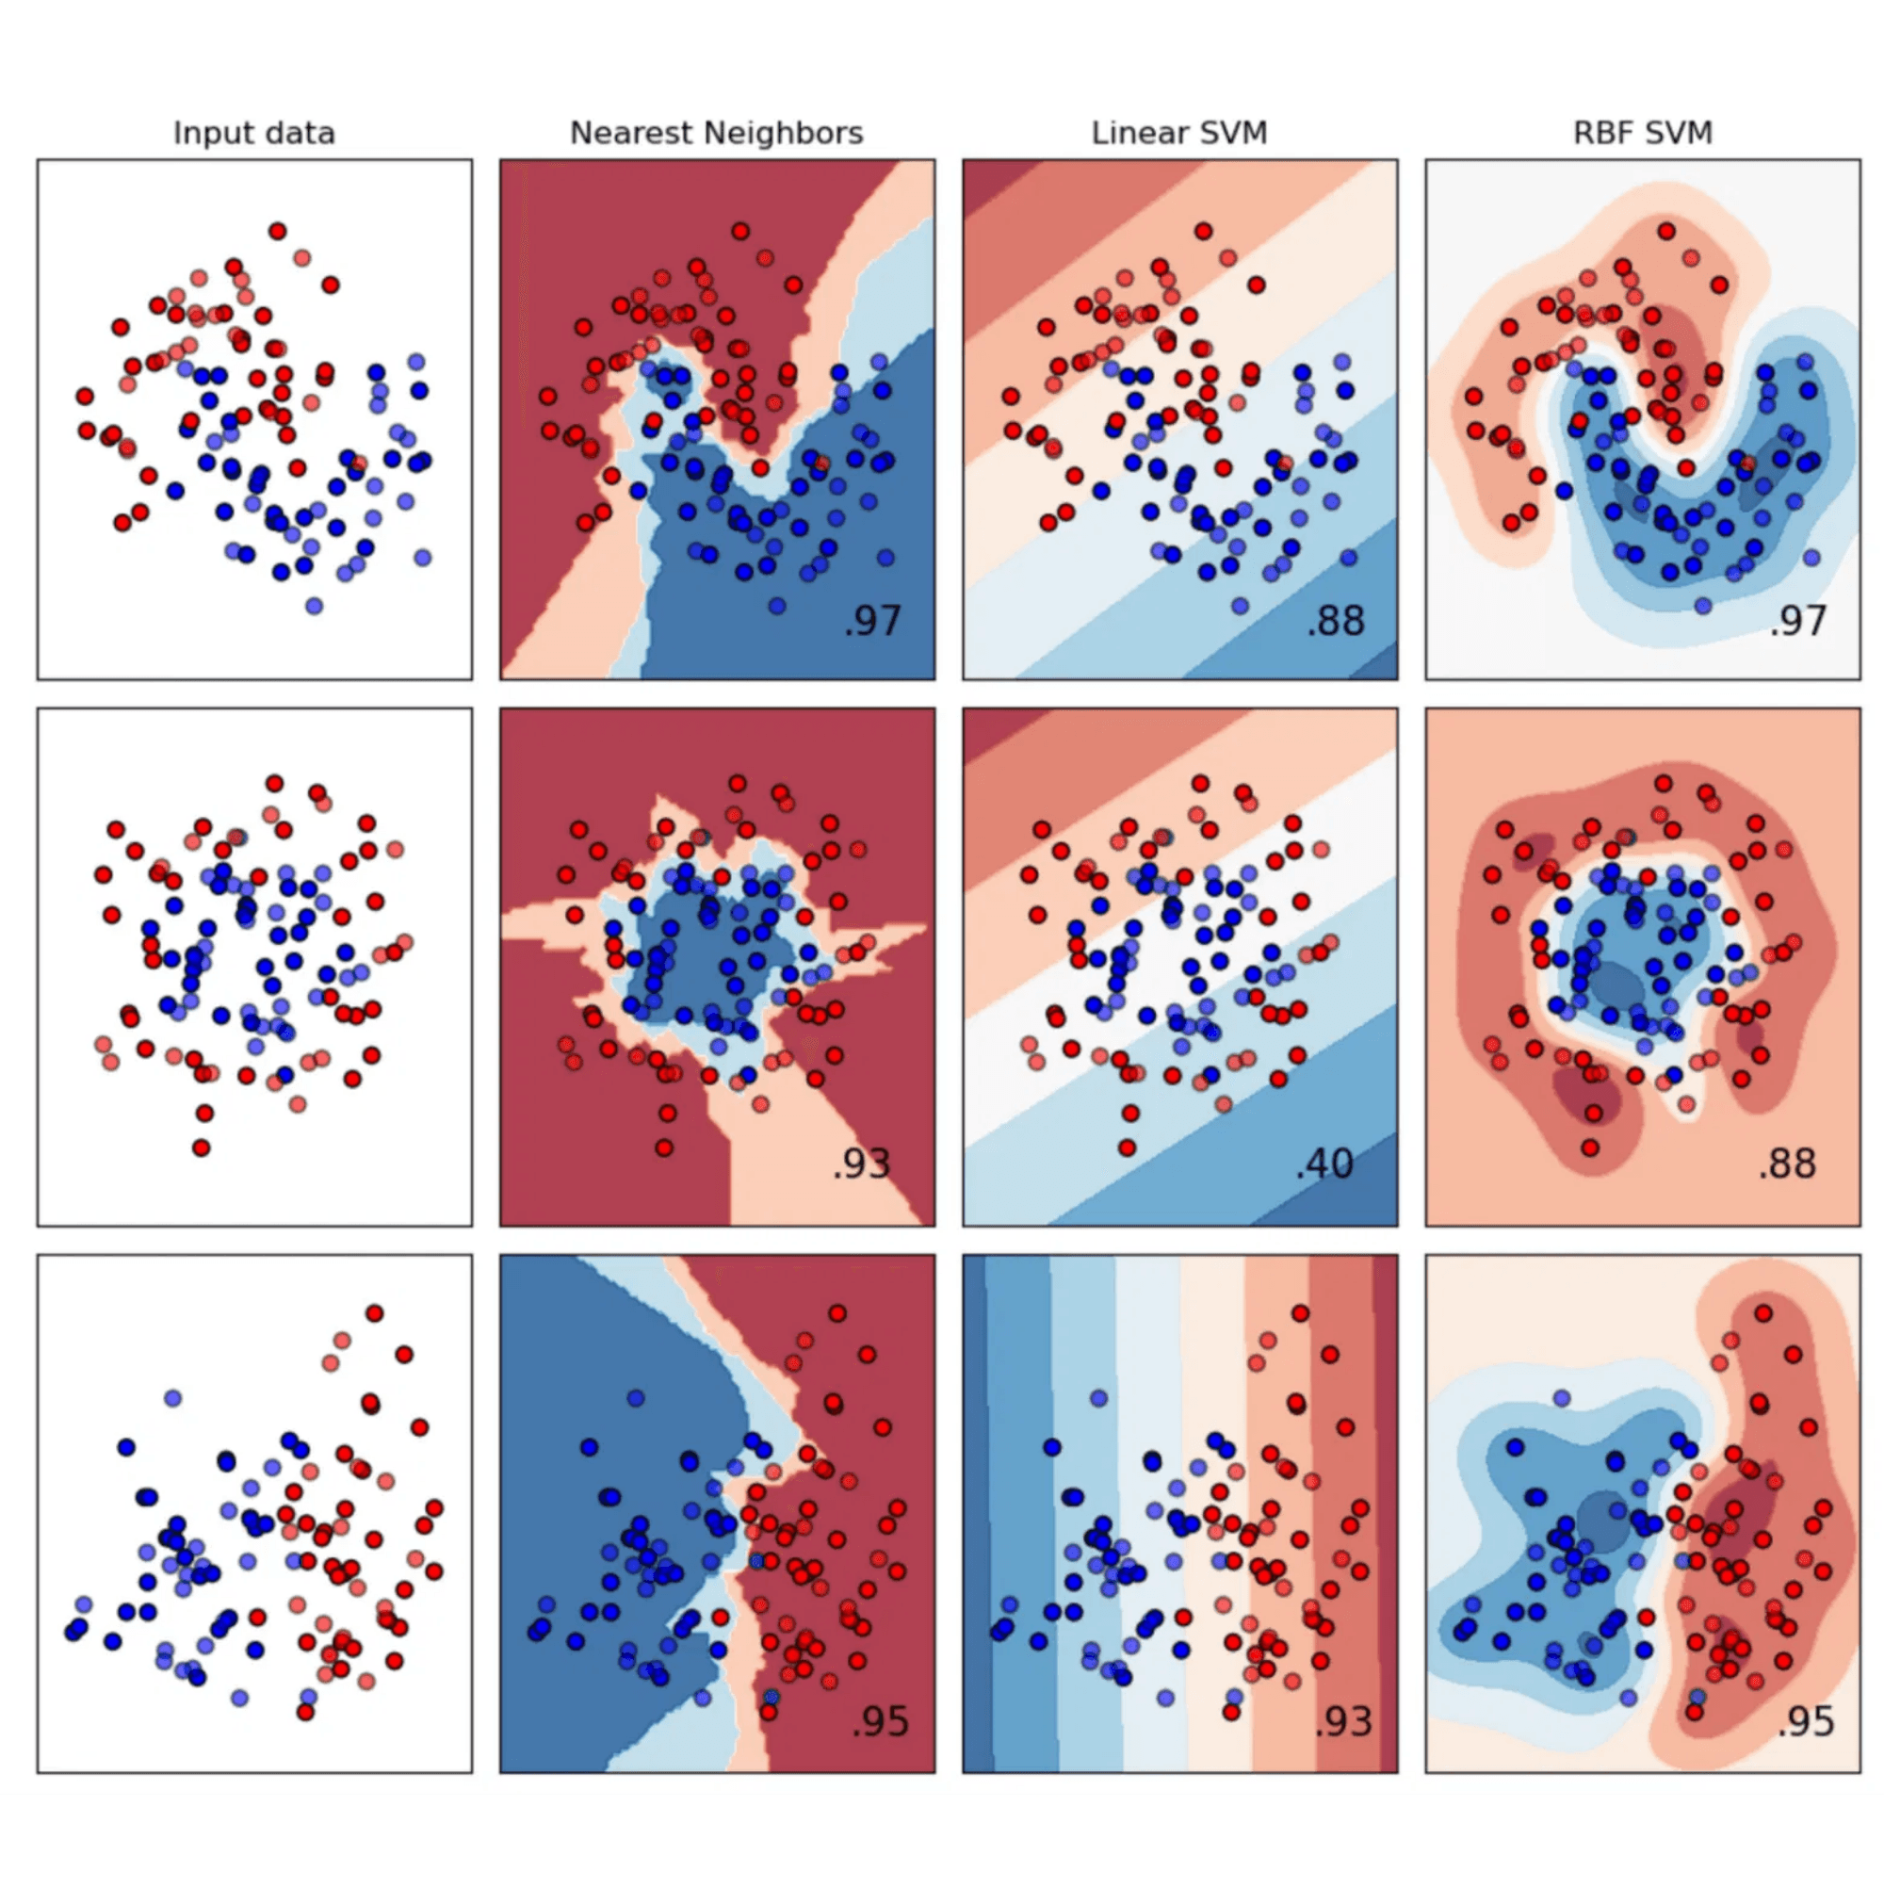
Model Selection & Justification
Linear Regression
Selected for its simplicity, computational efficiency, and high level of interpretability. It serves as a reliable baseline for predicting popularity scores based on linear feature relationships.
Random Forest Regressor
Chosen for its ability to capture complex, non-linear relationships within the data. It provides robust performance and is instrumental in assessing the relative importance of various features.

Slide 5
Results & Evaluation
Model performance was rigorously evaluated using three primary metrics. While both models demonstrated comparable predictive capabilities, Linear Regression consistently outperformed the Random Forest Regressor across all benchmarks.
Metric
Linear Regression
Random Forest Regressor
R² Score
0.4497
0.4434
Mean Absolute Error (MAE)
0.5826
0.5856
Root Mean Squared Error (RMSE)
0.7353
0.7396
Key Insight: Linear Regression provides superior accuracy and efficiency.

Slide 6
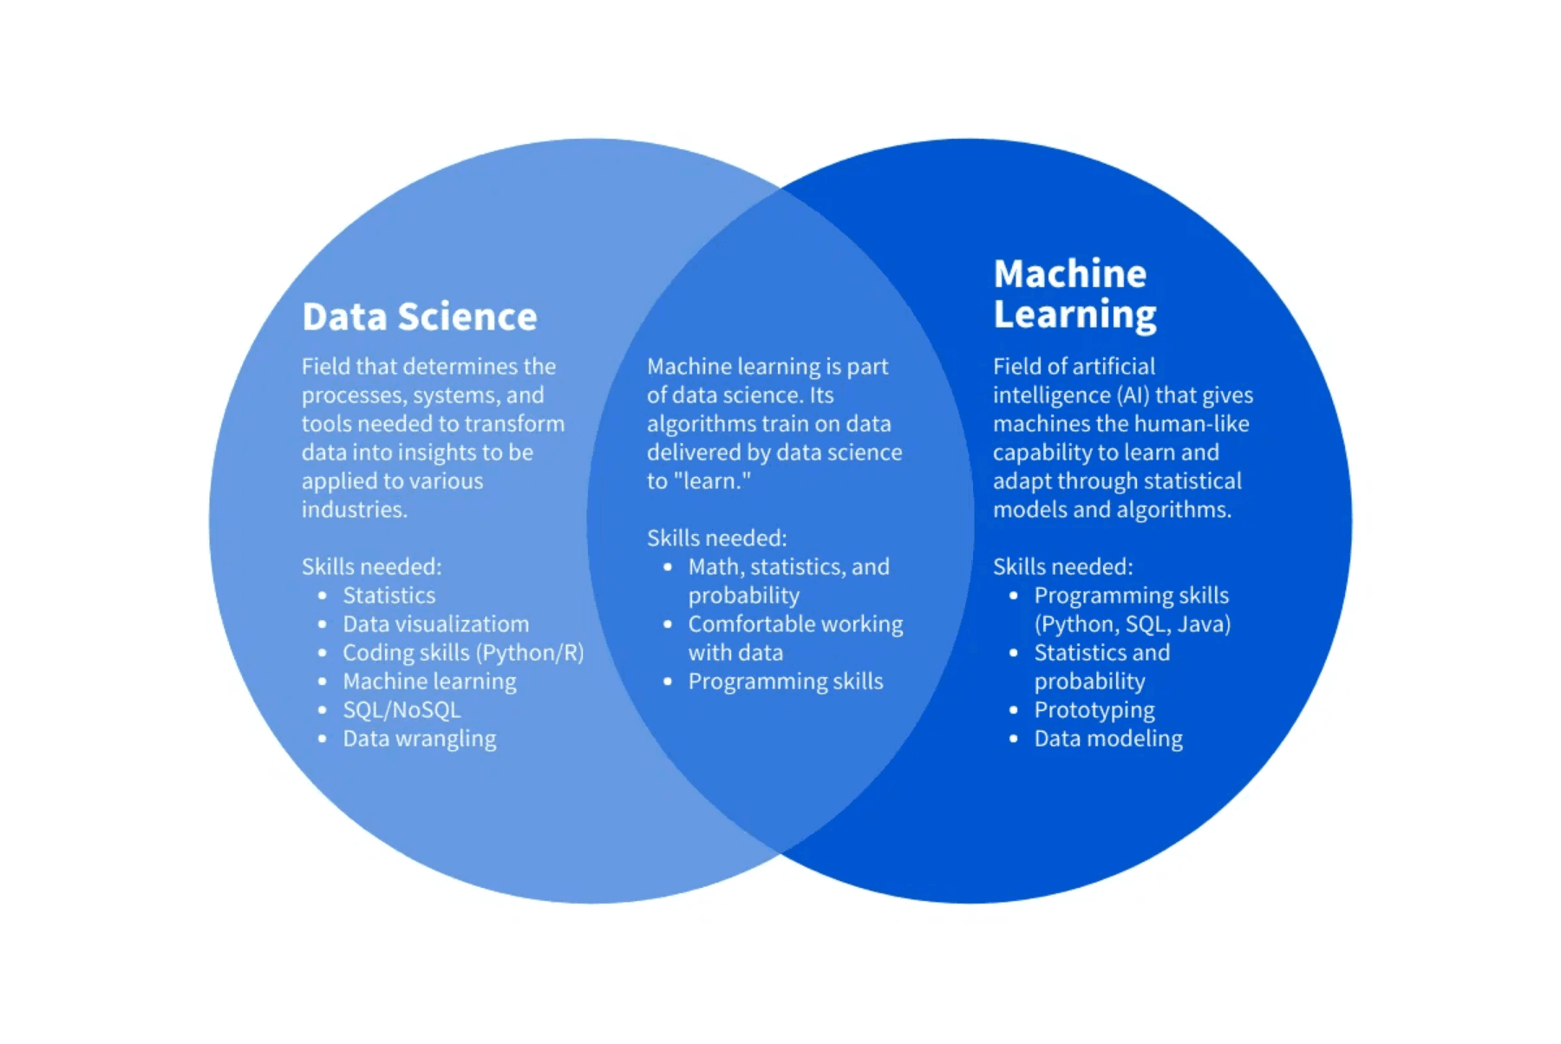
Key Findings: Feature Importance
PRIMARY
Dominance of Stream Count
The stream_count feature is the most significant predictor, indicating that popularity is heavily driven by existing user engagement and reach.
SECONDARY
Technical Attributes
Features like duration, tempo, and loudness contribute moderately, suggesting that production quality and track length play a role in listener retention.
LOW IMPACT
Musical Core Features
Surprisingly, danceability and energy showed the least importance, implying that popularity may be more influenced by external factors than by specific musical vibes.

Slide 7


Conclusions
Model Preference
Linear Regression is the preferred model due to its superior performance and lower computational requirements compared to Random Forest.
Predictive Power
The models explain approximately 45% of the variance in song popularity, indicating that core features capture significant trends but not the full picture.
Future Research
Success is likely driven by external factors such as artist reputation, marketing strategies, and social media trends. Integrating these sources is key to enhancing accuracy.

