Slide 1

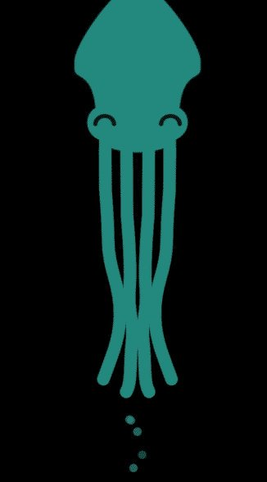
GitKraken
A cross-platform Git client

Slide 2
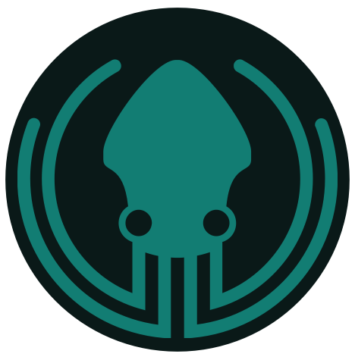
What is GitKraken?
Axosoft GitKraken is a cross-platform Git client with efficiency, elegance and reliability at the core. It was made for devs by devs. Lets unpack that a bit. Git client – It is a client for working with the version control system git
It doesn’t require any command line experience
It works with GitHub, Bitbucket, Azure DevOps etc

Slide 3
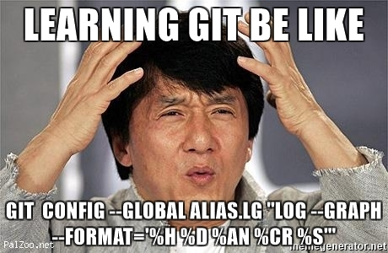
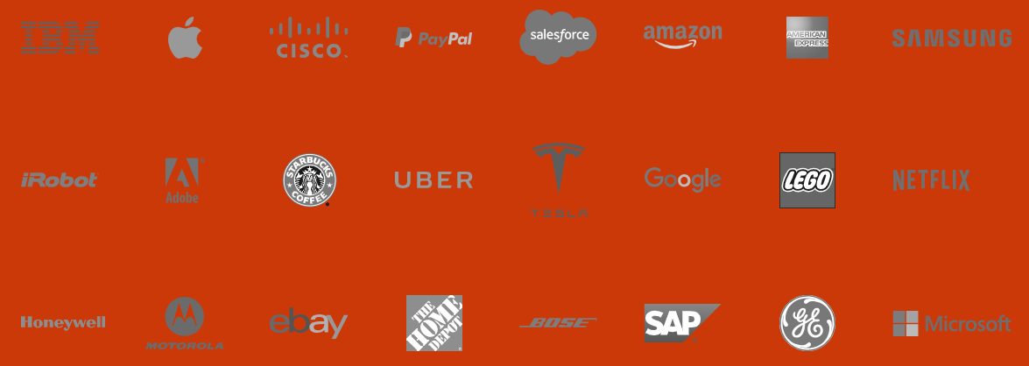
Why GitKraken?
User friendly
One Million GitKraken Users

Slide 4
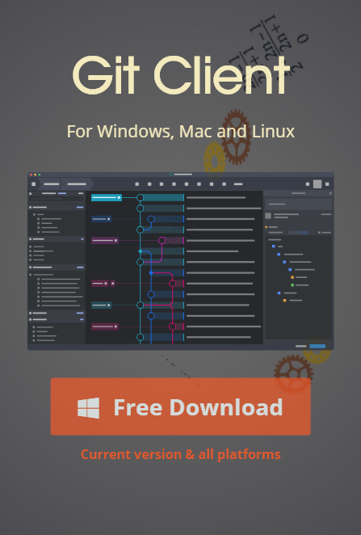
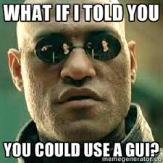
Downloading GitKraken
https://www.gitkraken.com/

Slide 5
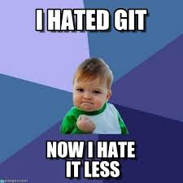
Using GitKraken
Live Demonstration!

Slide 6
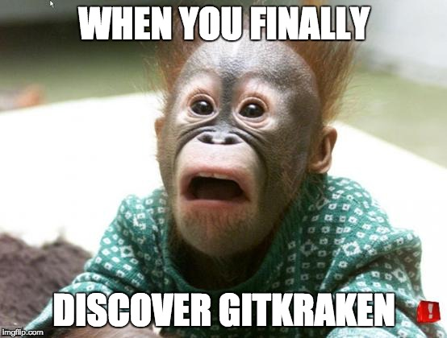
Questions?

