Slide 1
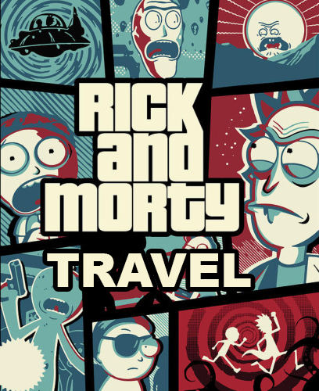
Rick & Morty Travel
BY: Muhammad ALI & mark zeagler

Slide 2
Who did what?
Muhammad Ali (Front-end): Created the UI and display functionality for the app on Angular, beautified using CSS, established the GitHub repo
Mark Zeagler (Back-end): Created the logic on Java EE, setup up the server, wrote tests

Slide 3
Technologies we used
Angular
Material Design
Java EE
CSS
HTML
Typescript
GitHub
Maven

Slide 4
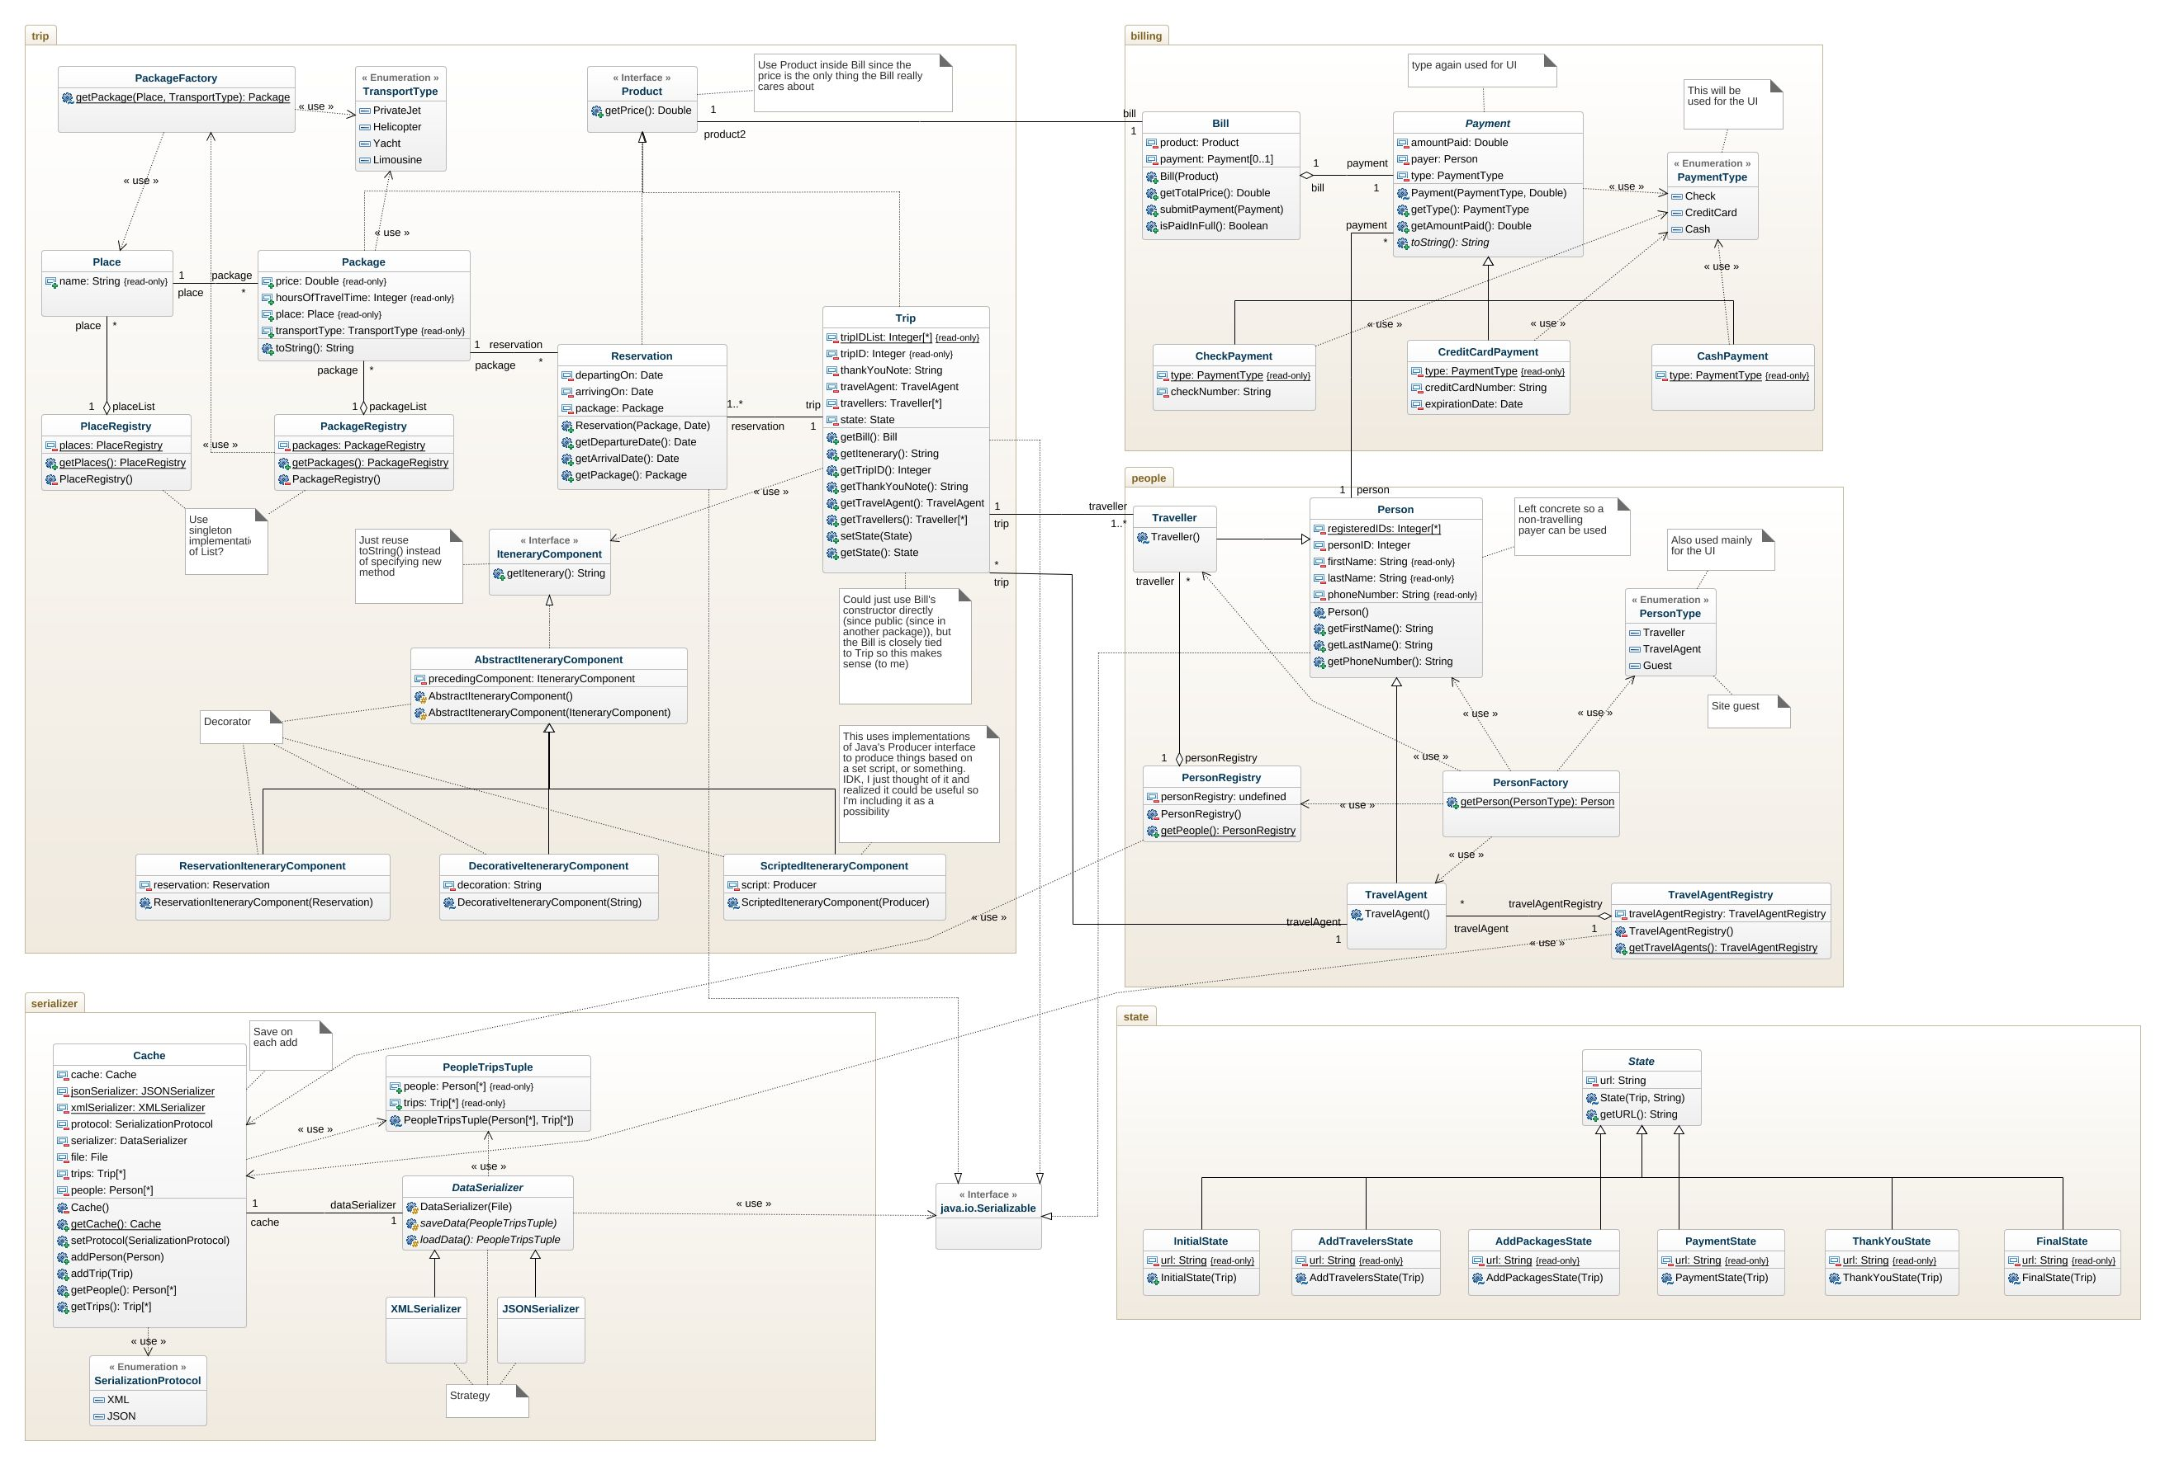
Class Diagram

Slide 5
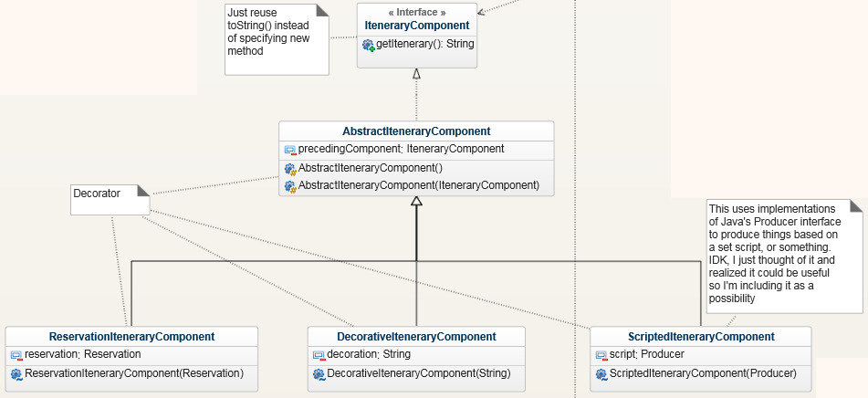
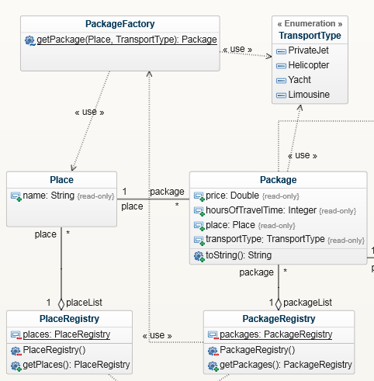
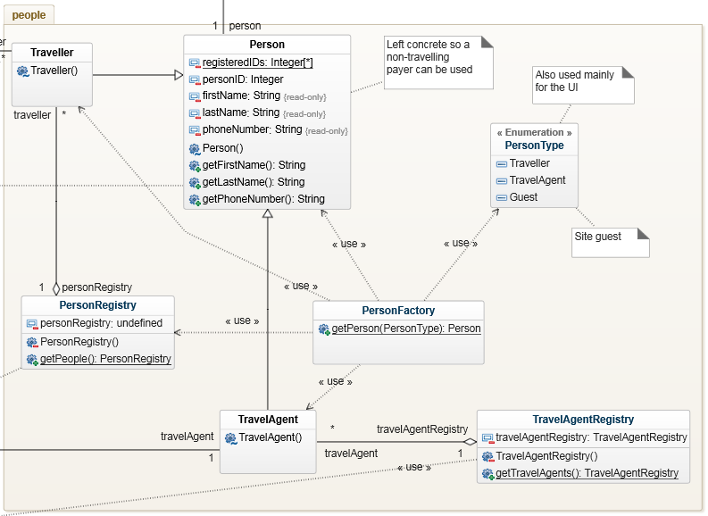
Patterns we used

Slide 6
What we learned?
Go old school ugly command line interface
Needed more time to integrate the front-end and back-end
Learned more about Angular and how it is being used today in the industry
The hassles of Cross-Origin Resource Sharing (CORS)

Slide 7
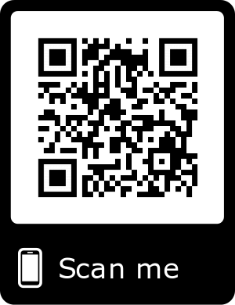
Access to our source code
https://github.com/Ali229/Premium-Travel

Slide 8
Access to our documentation
https://markzeagler.com/docs/premium-travel/

Slide 9
Any questions?
___ . -^ `--, /# =========`-_ /# (--====___====\ /# .- --. . --.| /## | * ) ( * ), |## \ /\ \ / | |### --- \ --- | |#### ___) #| |###### ##| \##### ---------- / \#### ( `\### | \### | \## | \###. .) `======/

