Slide 1



dashboard1
View in Power BI
Last data refresh:
3/7/2024 6:16:22 PM UTC
Downloaded at:
3/7/2024 6:58:14 PM UTC

Slide 2
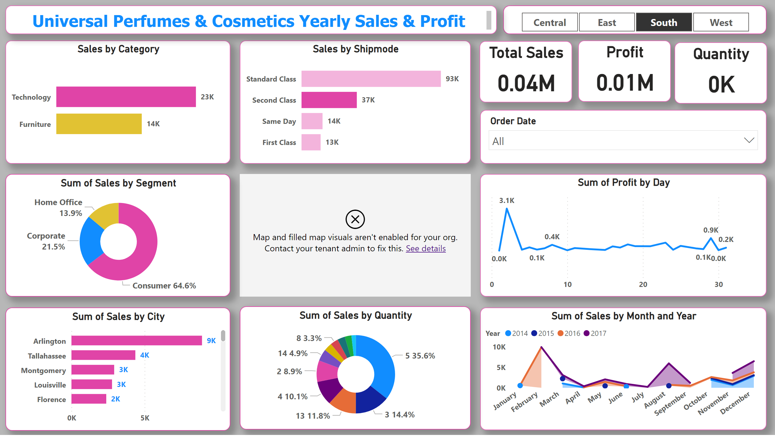
Page 1
Notes:
Sales by Category
No alt text provided
Sales by Shipmode
No alt text provided
stackedAreaChart
No alt text provided
map
No alt text provided
donutChart
No alt text provided
donutChart
No alt text provided
clusteredBarChart
No alt text provided
slicer
No alt text provided
textbox
No alt text provided
lineChart
No alt text provided
Total Sales
No alt text provided
Profit
No alt text provided
Quantity
No alt text provided
slicer
No alt text provided

