Slide 1
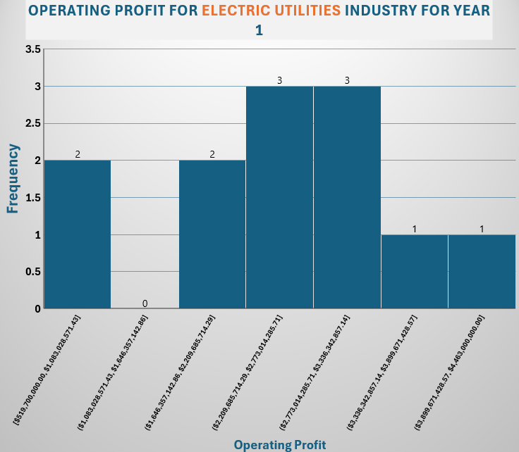
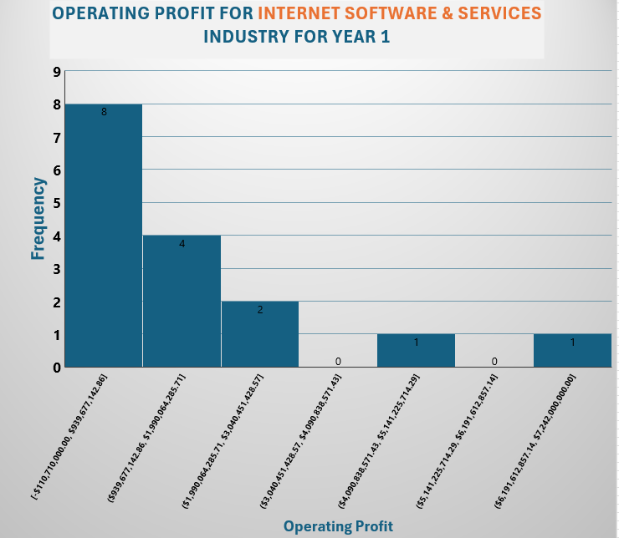
Which GICS sub-Industry had more Operating Profit in year 1 , Electric Utilities or Internet Software & Services ?
Here are the histograms for annual Operating Profit in year 1 for Electric Utilities and Internet software & services industries.
Both distributions are right-skewed, meaning the mean is higher than the median. The total operating profit for Electric Utilities was $28.96 billion, higher than Internet Software & Services at $24.8 billion, indicating Electric Utilities generated more overall profit in Year 1. The mean operating profit for Electric Utilities was $2.41 billion, compared to $1.55 billion for Internet Software & Services, showing that Electric Utilities had a significantly higher average profit by almost $1 billion, though outliers could influence the mean. The median for Electric Utilities was $2.27 billion, compared to $925 million for Internet Software & Services. The standard deviation for Electric Utilities was $1.03 billion, while for Internet Software & Services, it was $1.87 billion, indicating that Internet Software & Services shows more variability due to a few outliers with very high profits.
The Internet Software & Services industry shows a much wider range in operating profits, with a maximum of $7.24 billion and a minimum of $110.71 million, resulting in a range of $7.13 billion. In contrast, the Electric Utilities industry has a smaller range, with a maximum of $4.46 billion and a minimum of $519.7 million, yielding a range of $3.94 billion . the range emphasizes the larger variability and the presence of high outliers in the Internet Software & Services industry compared to the more stable performance in the Electric Utilities industry.
*Electric Utilities show higher and more stable profits, while Internet Software & Services has lower average profits but more variation due to some outliers earning significantly more*

