Slide 1
Front End Development presentation
Year 1 Block 3
By Ali Vohra
L39596761
Notes:
This is my assignment for front end development

Slide 2
Introduction
My website is a tech blogging website
I wanted to ask the client what devices

Slide 3
Requirements
I interviewed the client with these questions
Notes:
Interview is better because you aren’t restricted to a set of questions

Slide 4
Functions
Sign up page
You can view different consoles and see the differences

Slide 5
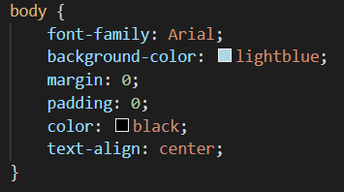
Accessibility features
Images have alt tags which means people who are using text to speech know what the image is
Colour of the text contrasts with the text so it stands out
The font is Arial which is professional so everyone can read it
Links are in a different colour so you know you can click on it

Slide 6
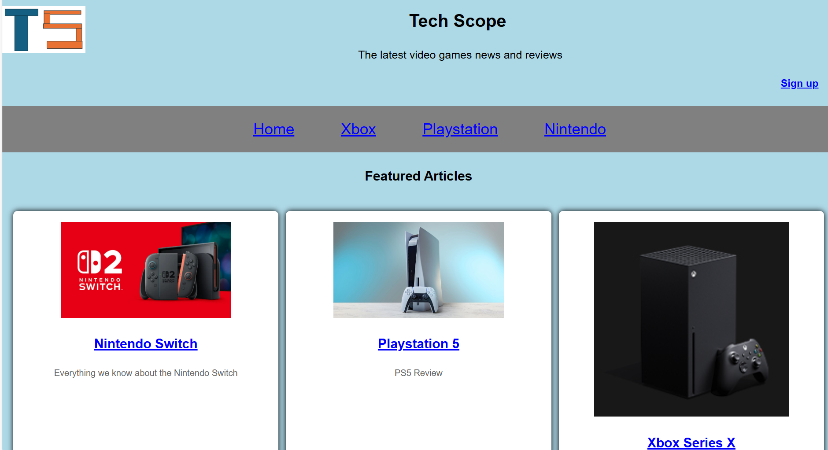
Home page
The main page of the website

Slide 7
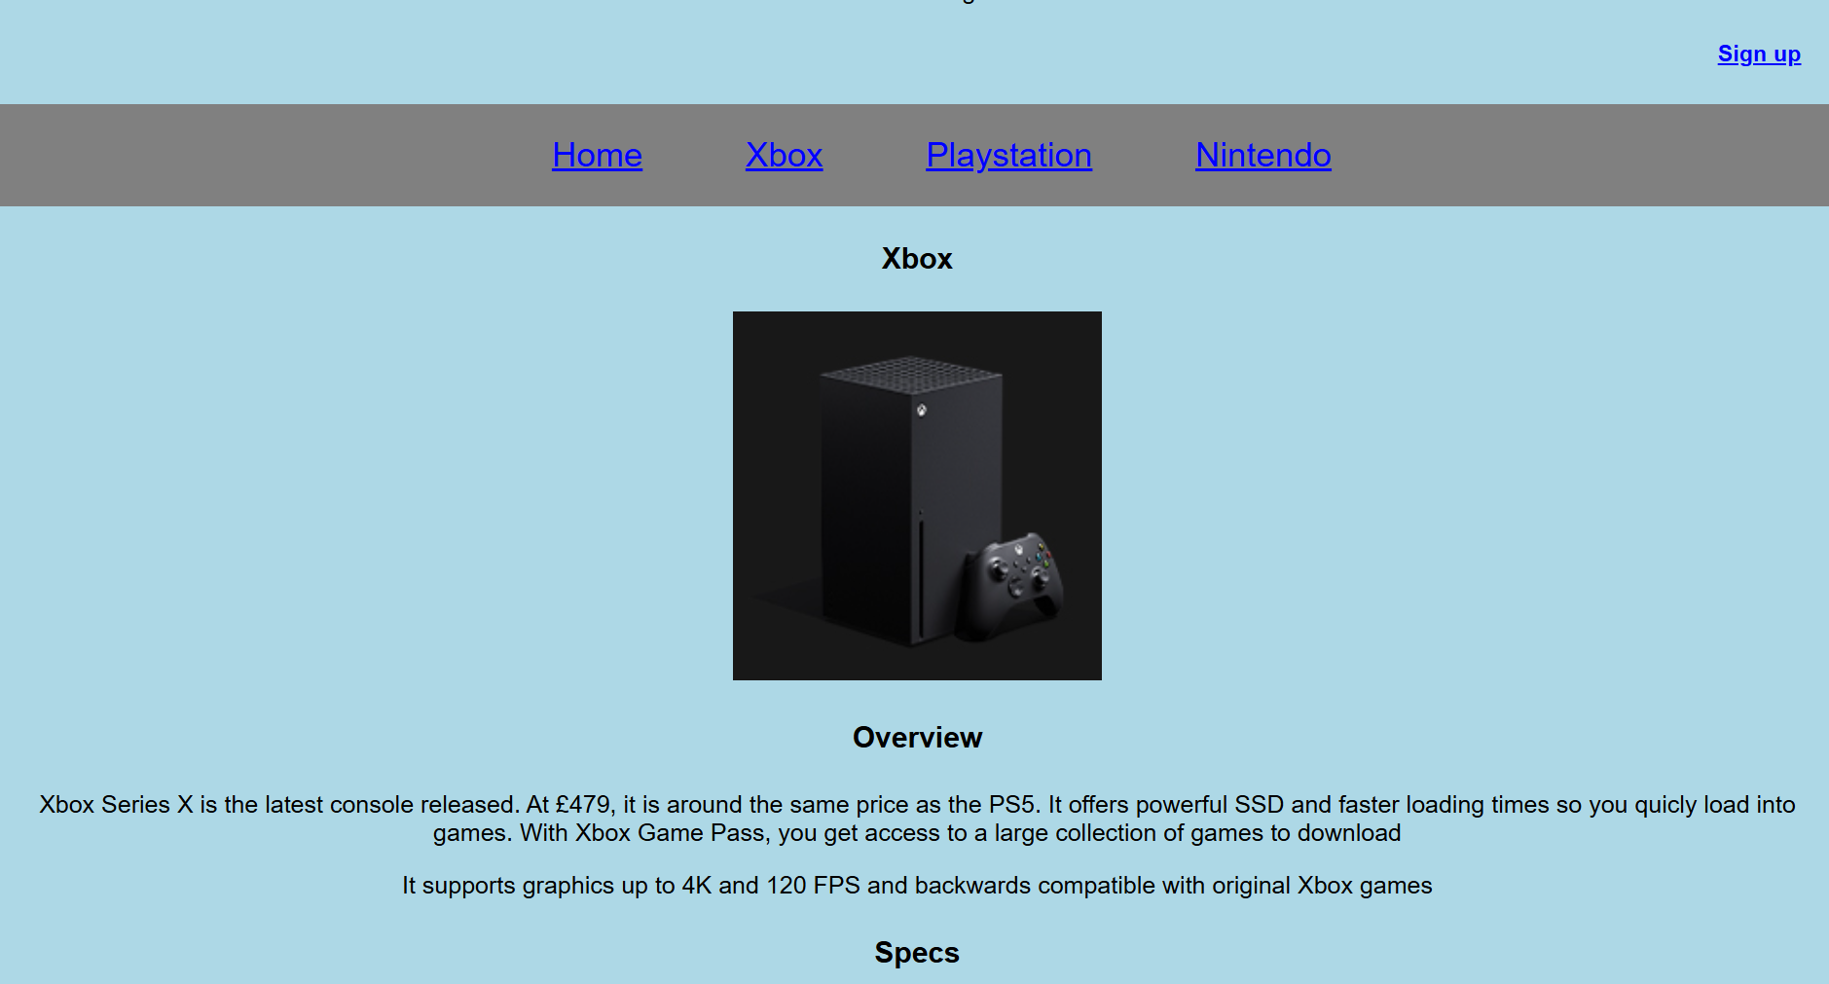
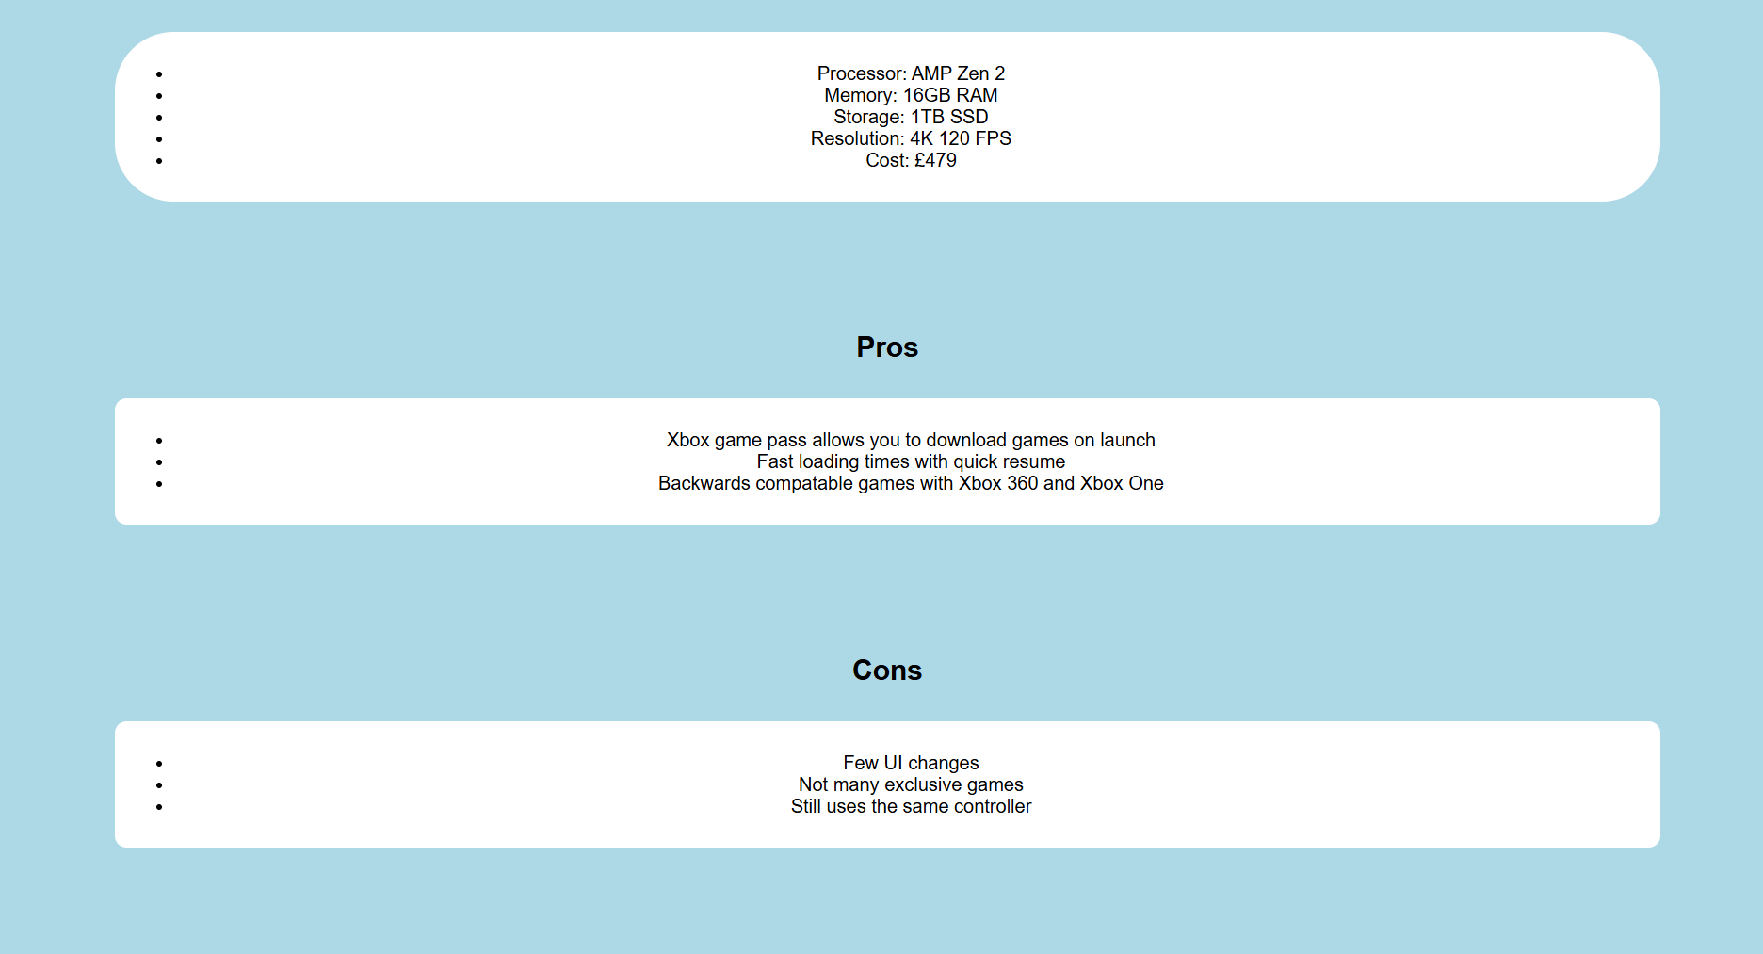
Xbox page
Xbox review

Slide 8
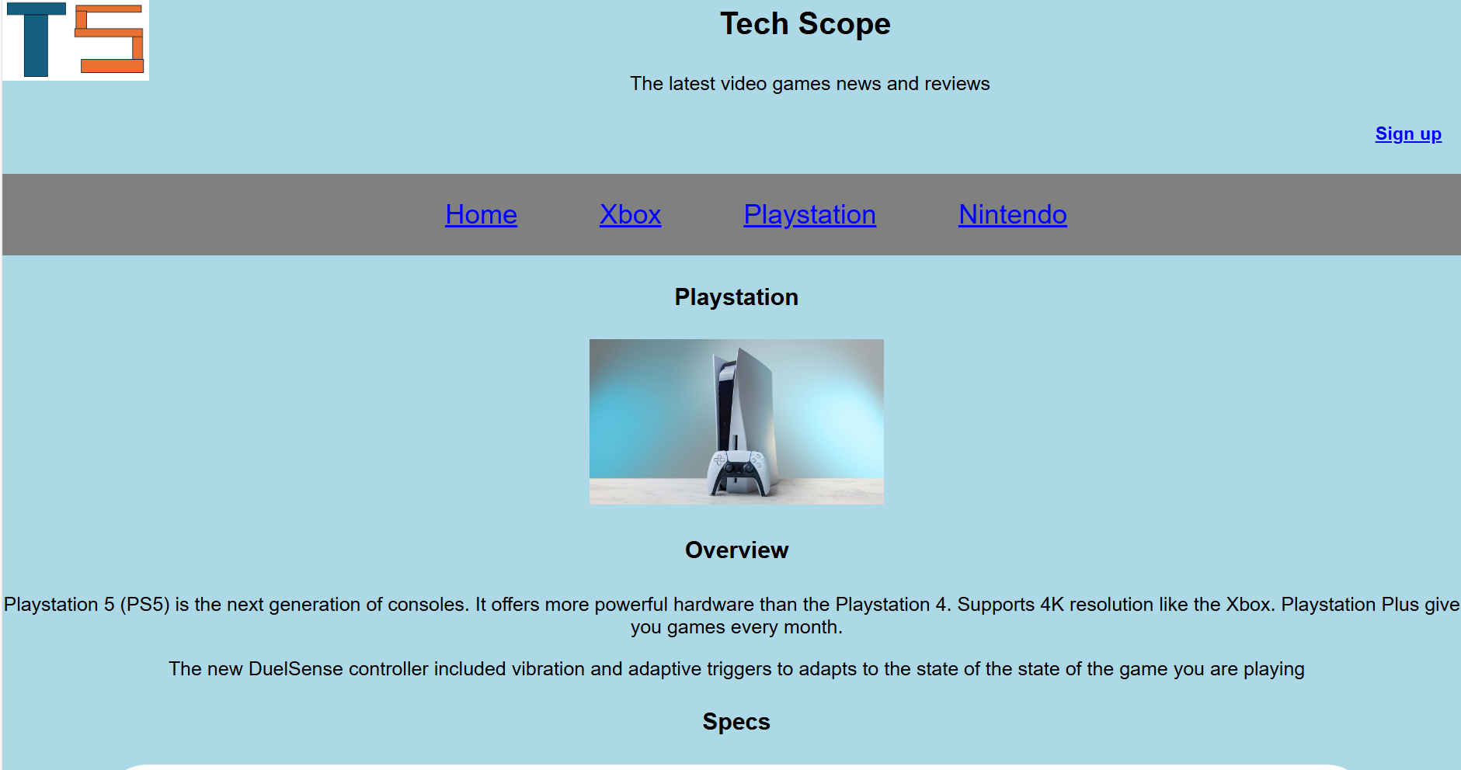
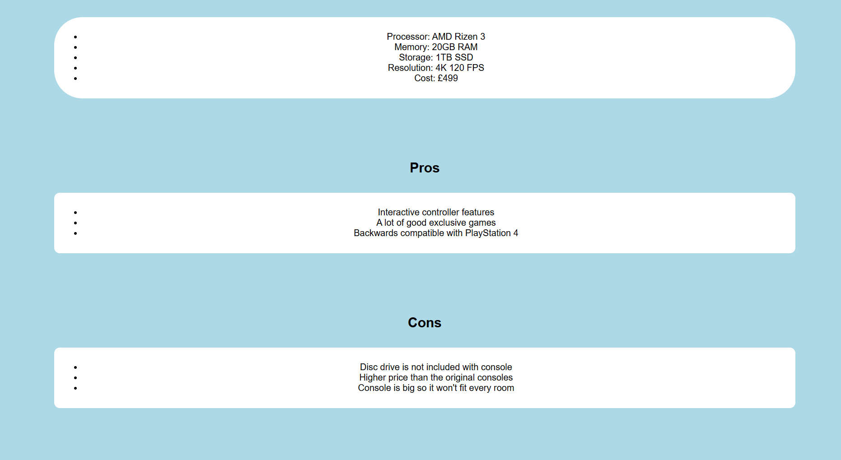
PlayStation page
PlayStation review

Slide 9
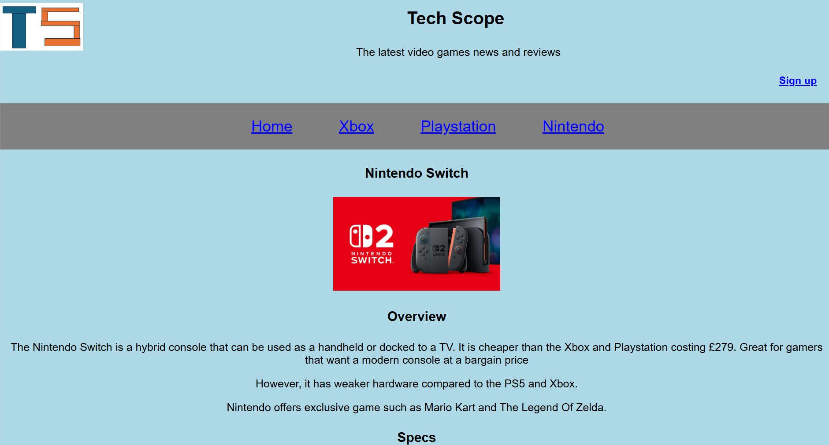
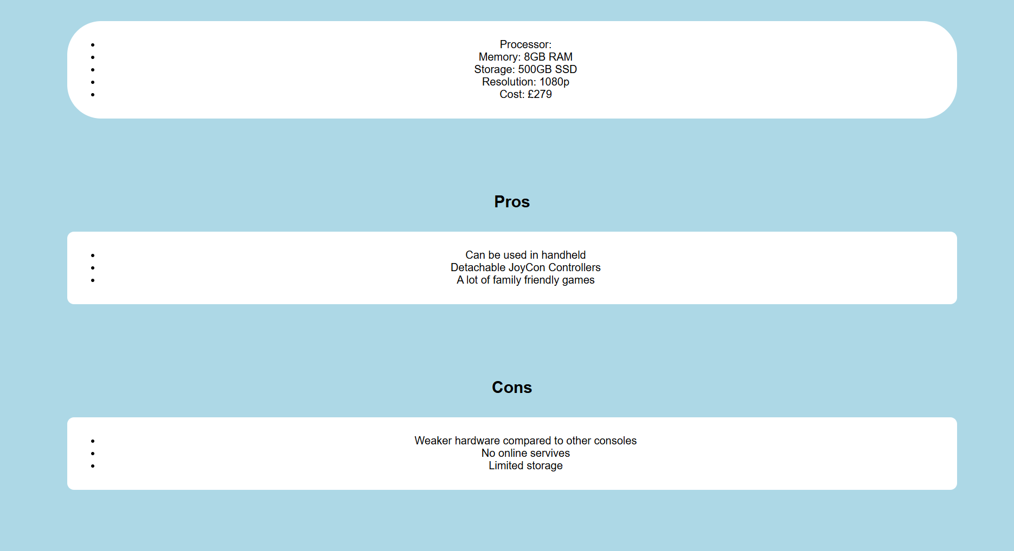
Nintendo page
Nintendo switch review

Slide 10
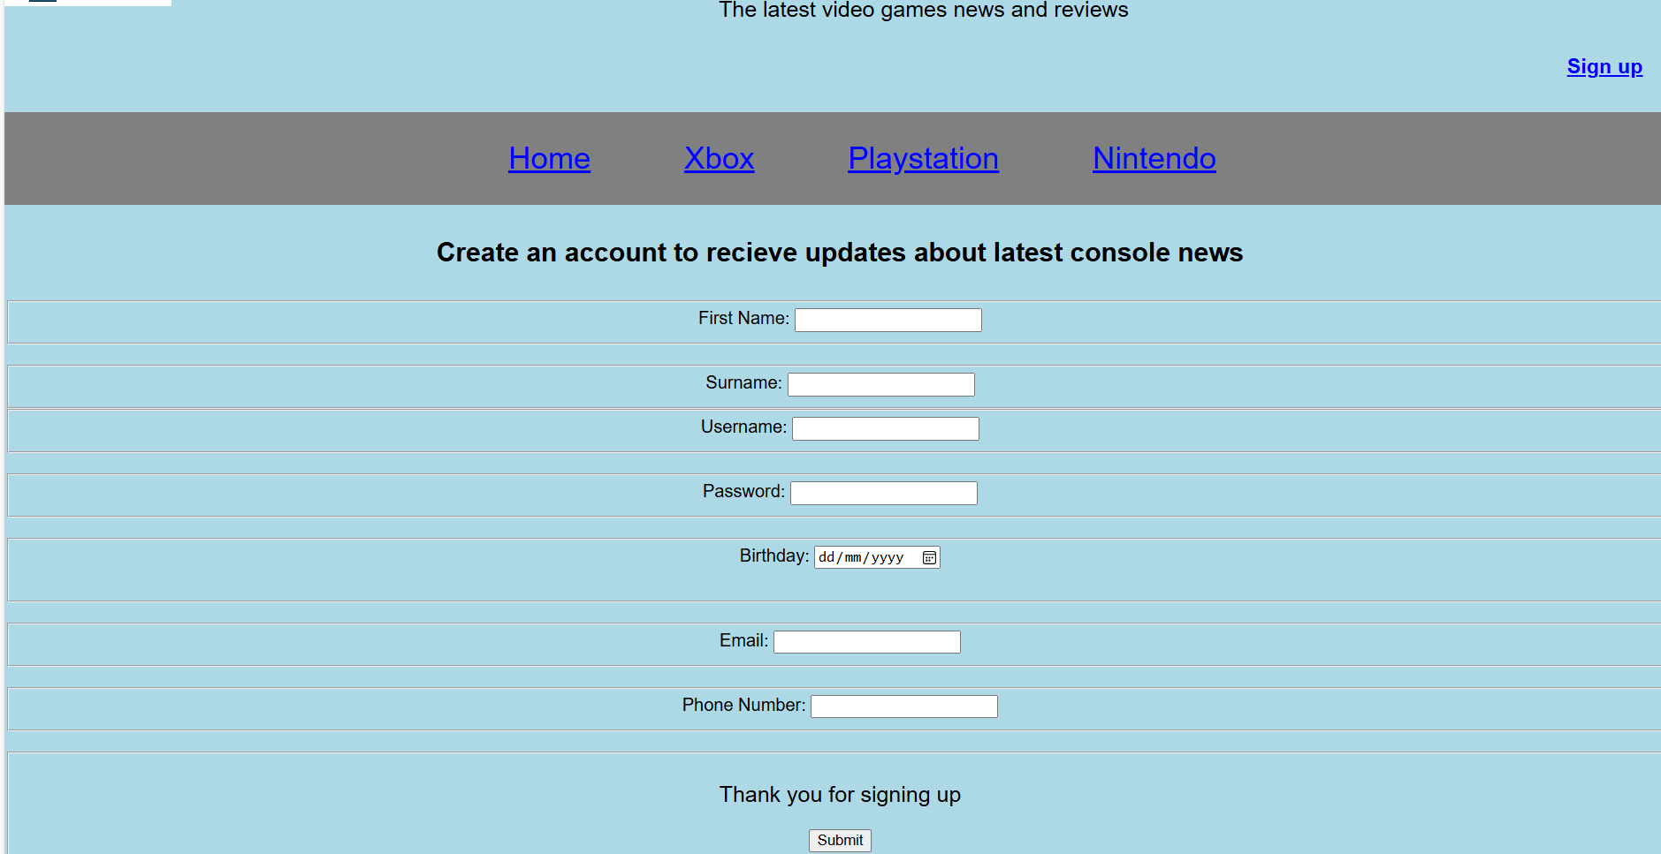
Sign up page
Where you sign up

Slide 11
Testing
Validating W3C

