Slide 1
Data Structures & Algorithms
Lecture # 01
Instructor: Javeria Naz

Slide 2
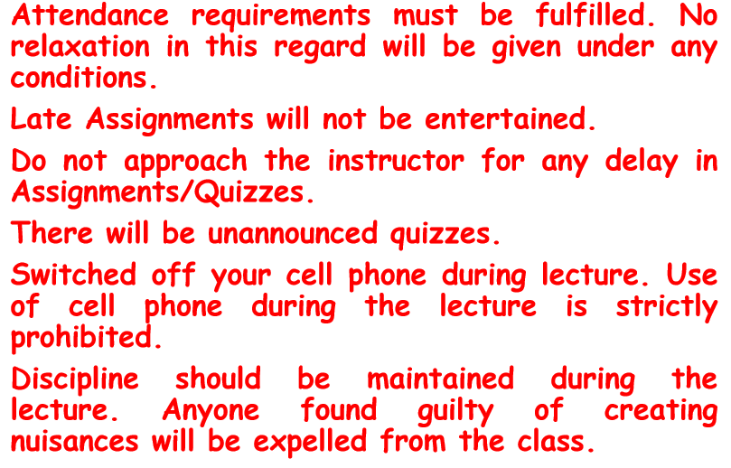
Rules and Regulations

Slide 3
Grading
Final Term Exam................................. 50%
Mid Term Exam................................... 25%
Assignments........................................10%
Quizzes/Attendance ............................10%
Presentation/Class Conduct.................5%

Slide 4
Course Outline
SORTING AND SEARCHING TECHNIQUES
Bubble
Selection
Insertion
Sequential
Heap sort
Merge sort
Quick sort
Sequential Searches
Binary Search Tree Sort

Slide 5
Cont.
Analysis of Algorithms: Algorithm, Pseudo code for expressing algorithms, time complexity, space complexity, O-notation, Omega notation and theta notation.
LINEAR LISTS
Stacks: LIFO structure, create, POP, PUSH, delete stack
Queues: FIFO structure Priority Queues, Circular Queues, operations on Queues
Linear List Concept
List v/s Array, Internal pointer & External pointer, head, tail of a list, Null list, length of a list
Linked Lists concept
Linked List Data Structure
Linked Lists algorithms: Create List, Insert Node (empty list, beginning, Middle, end), Delete node (First, general case), Search list
Types : Circularly-Linked List, Doubly Linked List, Multilinked Lists (Insertion, Deletion)

Slide 6
Cont.
INTRODUCTION TO TREES
Binary Trees Traversals (breadth-first, depth-first)
Expression Trees (Infix, Prefix, Postfix Traversals)
Search Trees
Binary Search Trees
GRAPHS Terminology
Operations (Add vertex, Delete Vertex, Add Edge, Delete Edge, Find Vertex)
Traverse Graph (Depth-First, Breadth-First)
NETWORKS
Minimum Spanning Tree
Shortest Path Algorithm
Dijkstra’s algorithm

Slide 7
Why Data Structures?
Prepares the students for (and is a prerequisite for) the more advanced material students will encounter in later courses.
Cover well-known data structures such as dynamic arrays, linked lists, stacks, queues, tree and graphs.
Pre-Requisites
Basic programming knowledge
Familiarity with C++
Implement data structures in C++

Slide 8
What is Programming?
Programming is the process of taking an algorithm and encoding it into a notation, a programming language, so that it can be executed by a computer.
Although many programming languages and many different types of computers exist, the important first step is the need to have the solution.
Without an algorithm there can be no program.

Slide 9
What is Data Structure?
Data structure is the data organization, management and storage format for easy access and modification of the data.
There are different requirements when we are working in projects. Although storage can be done in any format but access and modifications of the data have different needs every time and have a good efficiency in our program a good choice of data structure is required.

Slide 10
Cont.
To manage the complexity of problems and the problem-solving process, computer scientists use abstractions to allow them to focus on the “big picture” without getting lost in the details.
By creating models of the problem domain, we are able to utilize a better and more efficient problem-solving process.
These models allow us to describe the data that our algorithms will manipulate in a much more consistent way with respect to the problem itself.

Slide 11
What does organizing the data mean?
It means that the data should be arranged in a way that it is easily accessible. The data is inside the computer and we want to see it.
We may also perform some calculations on it. Suppose the data contains some numbers and the programmer wants to calculate the average, standard deviation etc.
May be we have a list of names and want to search a particular name in it. To solve such problems, data structures and algorithm are used.
Sometimes you may realize that the application is too slow and taking more time. There are chances that it may be due to the data structure used, not due to the CPU speed and memory. We will see such examples.
In the assignments, you will also check whether the data structure in the program is beneficial or not. You may have two data structures and try to decide which one is more suitable for the resolution of the problem.

Slide 12
Efficiency
A solution is said to be efficient if it solves the problem within its resource constraints.
Space
Time
The cost of a solution is the amount of resources that the solution consumes.

Slide 13
Selecting a Data Structure
Select a data structure as follows:
Analyze the problem to determine the resource constraints a solution must meet.
Determine the basic operations that must be supported. Quantify the resource constraints for each operation.
Select the data structure that best meets these requirements.

Slide 14
Data Structure Philosophy
Each data structure has costs and benefits.
Rarely is one data structure better than another in all situations.
A data structure requires:
space for each data item it stores,
time to perform each basic operation,
programming effort.

Slide 15
Basic Terminology; Elementary Data Organization
Data are simply values or set of values
A data item refers to a single unit of values.
Data items that are divided into sub items, are called group items.
Those are not called elementary items.
Example employee’s name ( first name, middle name and last name)
Social security number can’t be divided .

Slide 16
Entity: An entity is something that has certain attributes or properties which may be assigned values. The values themselves may be either numeric or non numeric. Entities with similar attributes (for example- all employees in an organization) form an entity set.
Attribute: Each attribute of an entity set has a range of values, the set of all possible values that could be assigned to the particular attribute.
Field, Records and Files: The way that organizes the data into the hierarchy of fields, records and files reflects the relationship between attributes, entities and entity sets. "A field is single elementary unit of information representing an attribute of an entity; a record is the collection of fields. Values of a given entity and a file are the collection of records"

Slide 17
Records:
Records may also be classified according to length .
Fixed-length Record: all the records contain the same data items with the same amount of space assigned to each data item.
Variable-length Record : Files records may contain different lengths, usually have a minimum and maximum length.

Slide 18
Types of Data Structure
Data Structures can be classified into two categories
Linear Data Structures
Non Linear Data Structures
Linear Data Structures:-
A Data Structures whose elements form a sequence and each element has a unique successor and unique predecessor is known as linear data structures for example: Array, Linked List, Stack, Queue
Non Linear Data Structures:-
A Data Structures whose elements do not form a sequence and each element has not a unique successor and unique predecessor is known as non linear data structures for example: Tree, Graph

Slide 19
Logical and Physical Data Structures
Logical Data Structures describe how the data “seem” to be arranged and the meaning of data in relation to one another.
It indicates the name of the major elements, their attributes, and logical relationship between them.
The manner in which data are physically organized or arranged on a storage medium is called Physical Data Structure.
For example a data file could be stored on a disk in several scattered pieces.

Slide 20
Cont.
When a data structure is first defined only the data elements that a user would see, such as name, address, phone number are included. This stage is called Logical Design.
Using the logical design as a basis, the analyst then designs the physical data structures, which include additional elements necessary for the implementation of system.

Slide 21
Static and Dynamic Data Structures
Static Data Structure (SDS)
The data structure in which the number of elements of data is fixed and cannot be changed at run time of program is called static data structure.
The size of data structure is known at the compilation time. Array is the best example of static data structure.
It is possible to change the value of data structure but it is not possible to change the size or space allocated to it.
Its use is ideal for storing fixed number of data elements.
It occupy the large size of memory till the termination of program restricting other programs to execute.

Slide 22
Cont.
Dynamic Data Structure (DDS)
In dynamic data structure number of elements of data is not fixed and can be changed at the runtime of the program.
The size of dynamic data structure is not known at compilation time in most programming language.
The memory size can grow and shrink as required by the program at run time.
Linked List is an example of dynamic data structure.
Data in this type of structure is usually stored in the non-contiguous memory locations.
It is more flexible and efficient method for insertion and deletion of data elements.

Slide 23
Operations on Data Structure
The following operations play a major role in data structures
Traversing: - Accessing each record exactly once. Also called visiting the data.
Searching: - Finding the location of the record with a given key value
Inserting: - Adding a new record
Updating:- Modifying a data item
Deleting: - Removing a existing record from the structure
The following two operations, which are used in some special situations, are
Sorting- arranging the values in some logical order (by alphabetically, ascending, or descending order)
Merging- combining the records in two different sorted files into a single sorted file

Slide 24
Abstract Data Types
Abstract Data type (ADT) is a type (or class) for objects whose behavior is defined by a set of value and a set of operations.
The definition of ADT only mentions what operations are to be performed but not how these operations will be implemented.
It does not specify how data will be organized in memory and what algorithms will be used for implementing the operations. It is called “abstract” because it gives an implementation-independent view.
The process of providing only the essentials and hiding the details is known as abstraction.

Slide 25
The Core Operations
Every Collection ADT should provide a way to:
add an item
remove an item
find, retrieve, or access an item
Many, many more possibilities
is the collection empty
make the collection empty
give me a sub set of the collection
and on and on and on…

Slide 26
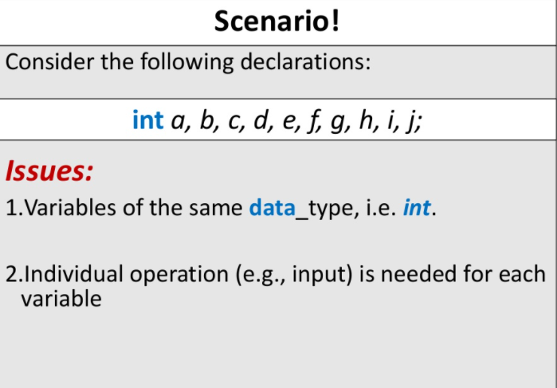

Slide 27
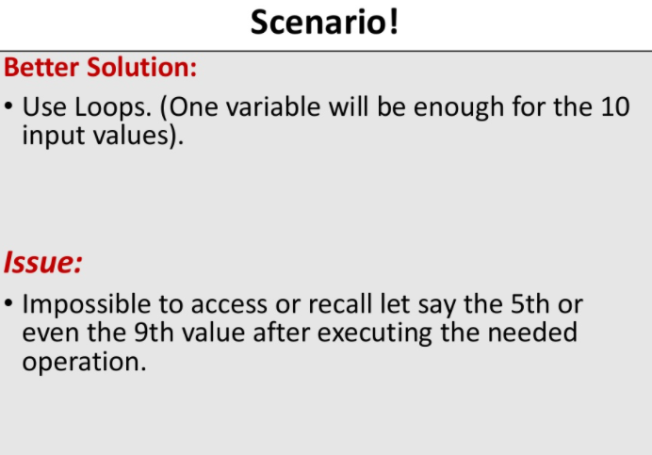

Slide 28
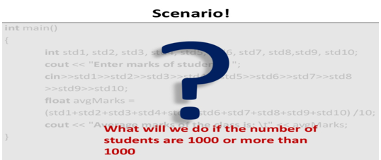

Slide 29
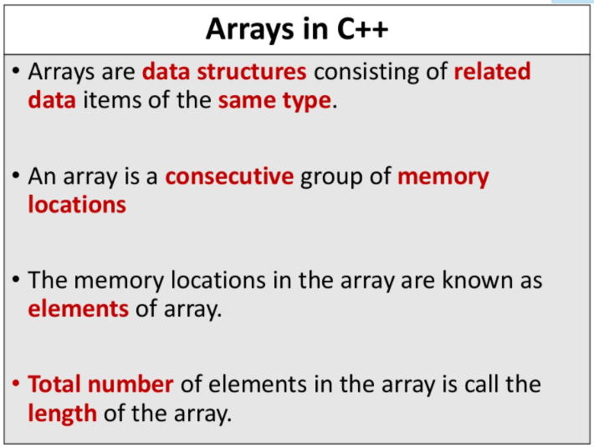

Slide 30
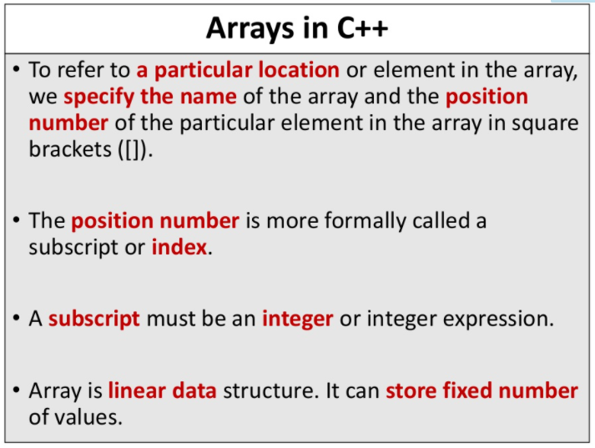

Slide 31
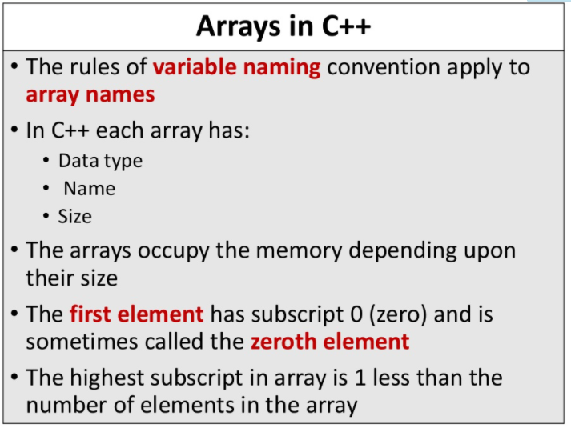

Slide 32
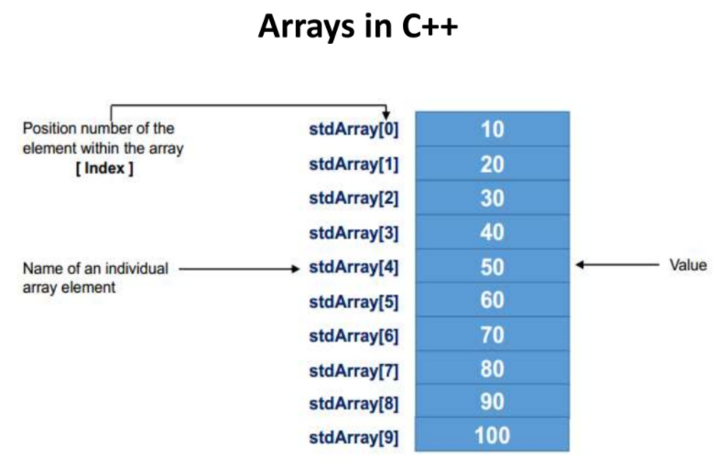

Slide 33
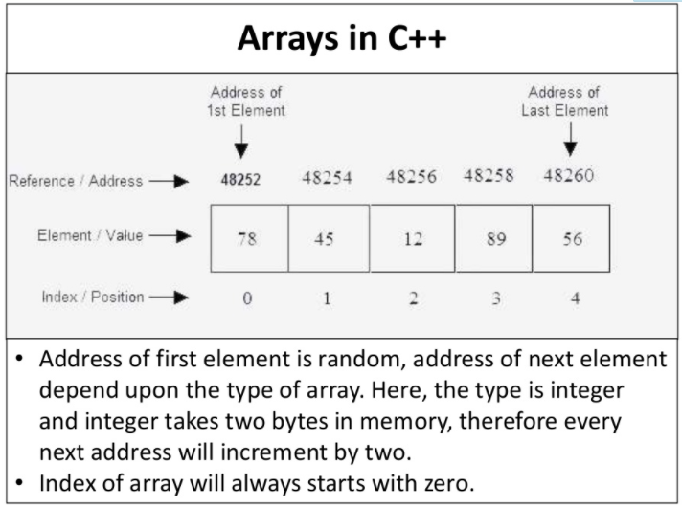

Slide 34
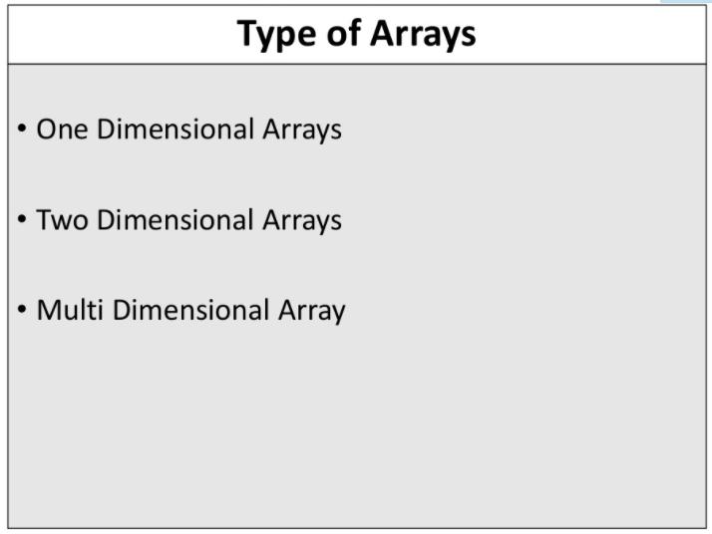

Slide 35
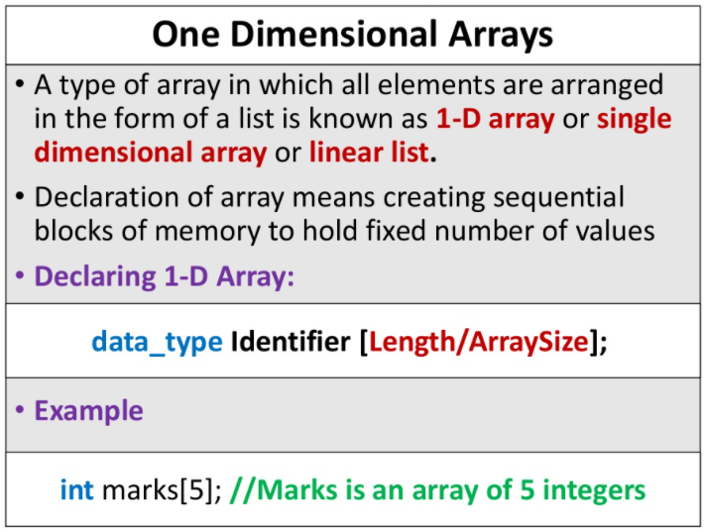

Slide 36
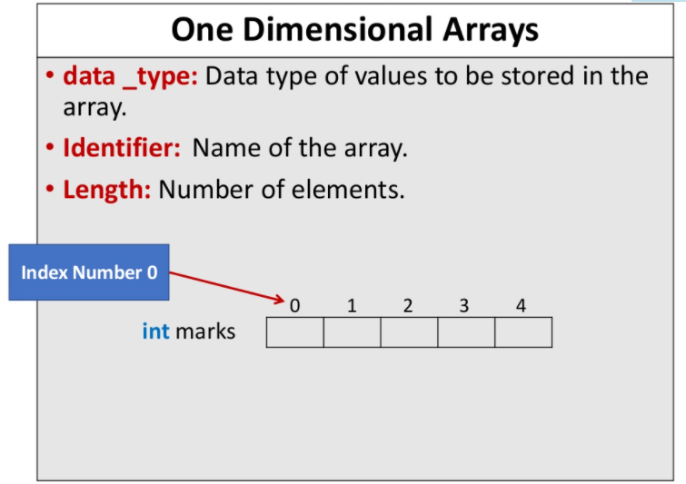

Slide 37
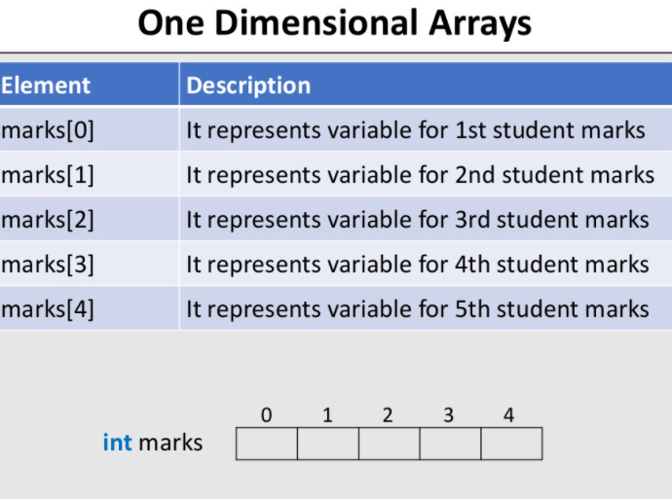

Slide 38
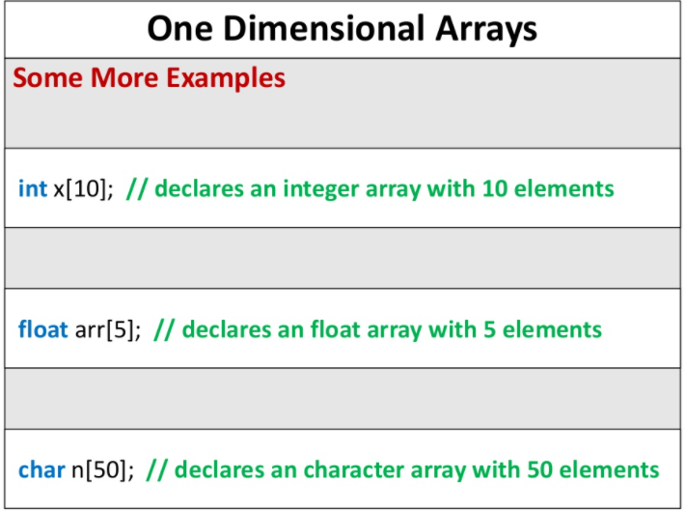

Slide 39
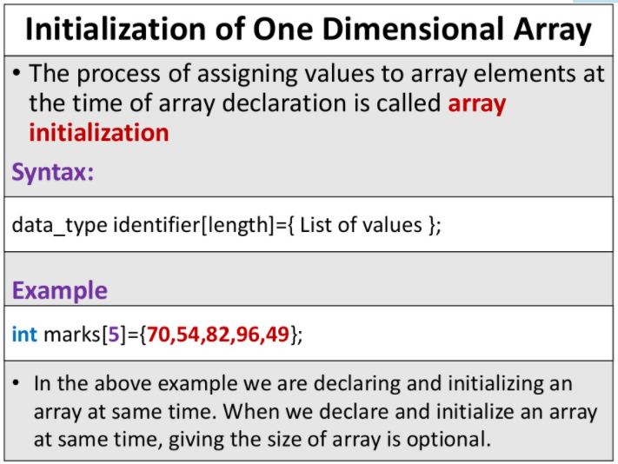

Slide 40
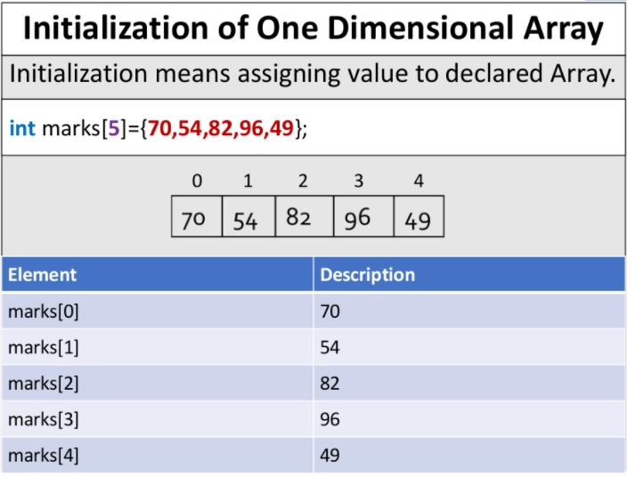

Slide 41
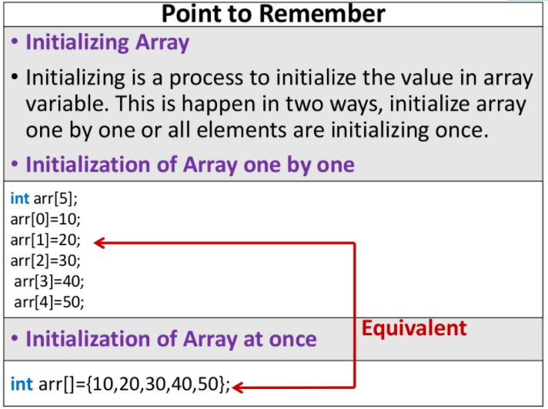

Slide 42
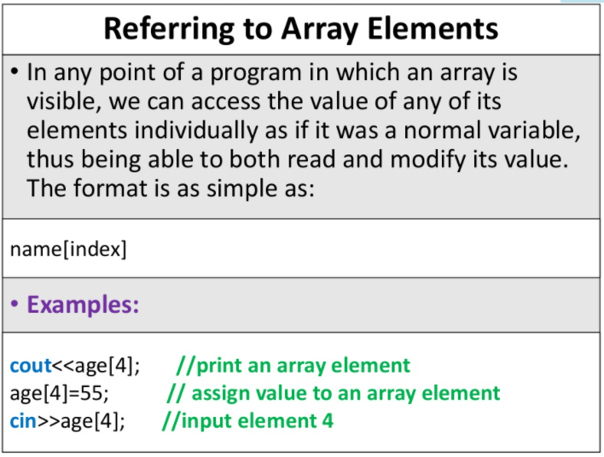

Slide 43
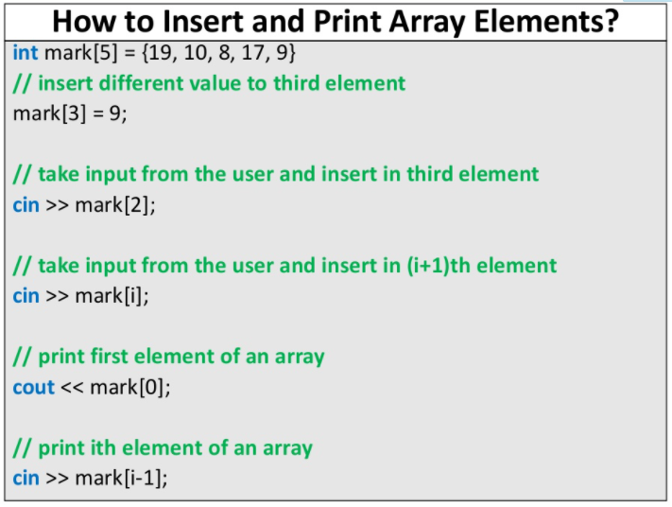

Slide 44
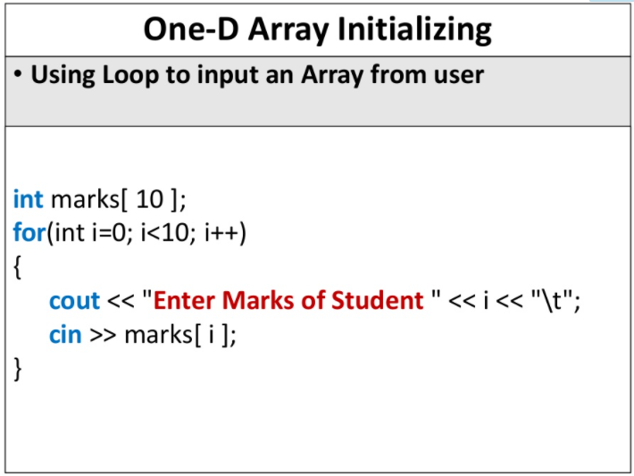

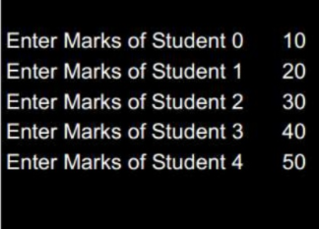

Slide 45
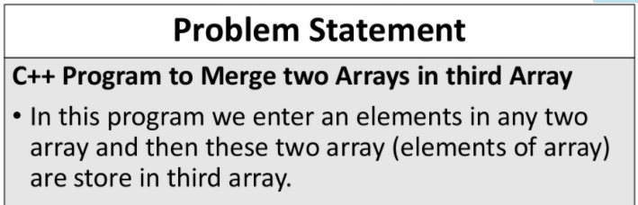
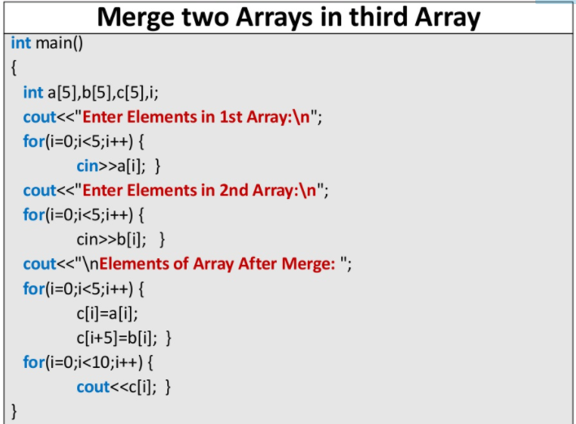

Slide 46
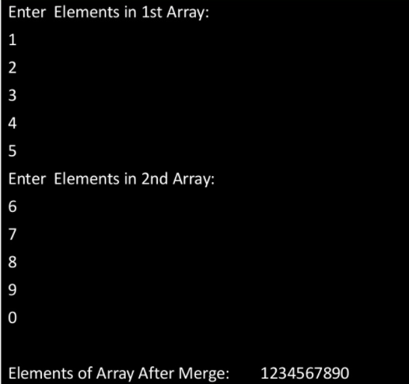

Slide 47
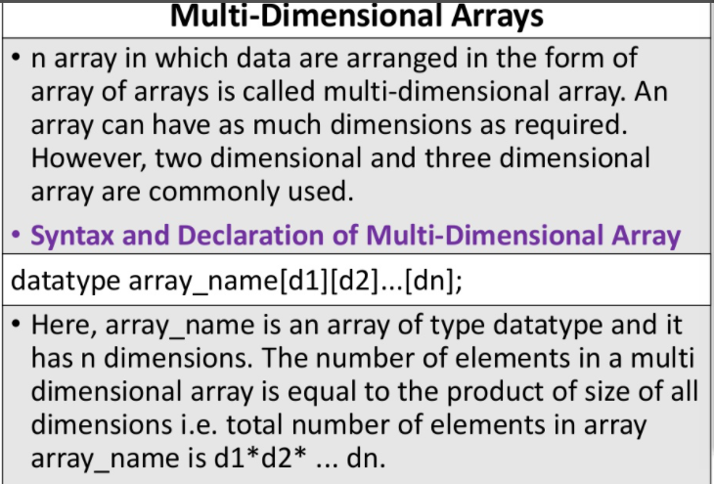

Slide 48
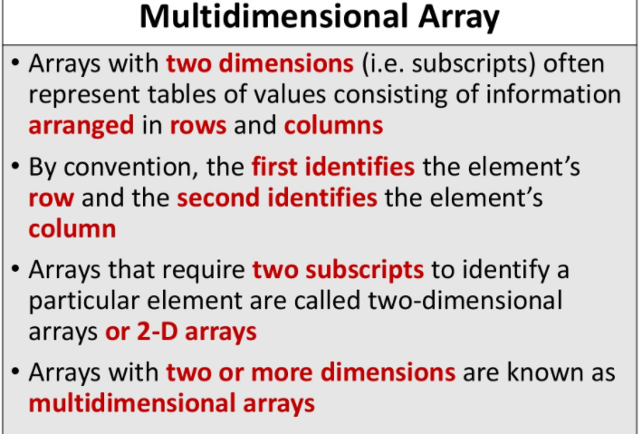

Slide 49
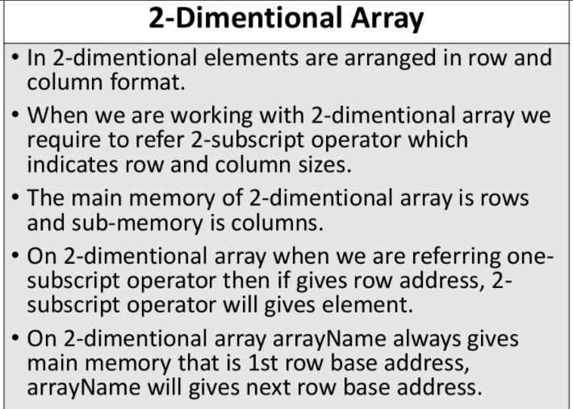

Slide 50
