Slide 1
Stack in C++
Instructor: Javeria Naz

Slide 2

What is stack?
A stack is a linear data structure that can be accessed only at one of its ends for storing and retrieving data.
Such a stack resembles a stack of trays in a cafeteria: new trays are put on the top of the stack and taken off the top.
The last tray put on the stack is the first tray removed from the stack.
For this reason, a stack is called an LIFO structure that is:
last in/first out.

Slide 3
Cont.
A tray can be taken only if there is at least one tray on the stack, and a tray can be added to the stack only if there is enough room; that is, if the stack is not too high.
Therefore, a stack is defined in terms of operations that change its status and operations that check this status.
The operations are as follows:
clear()—Clear the stack.
isEmpty()—Check to see if the stack is empty.
push(2)—Put the element 2 on the top of the stack.
pop()—Take the topmost element from the stack.
topEl()—Return the topmost element in the stack without removing it.

Slide 4
Implementation of stacks
Stacks can be implemented by using arrays or linked list.
An array provide a simple way of stack implementation.
It allows only fixed data items to be added in stack only. It is because the size of static array can not be changed during the execution of program.
The other way is to implement the stack using linked list. (as in linked list memory is allocated dynamically to store data items into stack.)
So any number of data items can be added providing more flexibility to the programmers.

Slide 5
Cont.
The following figure shiows the implementation of stack using array.
It has the capacity of 6 elements and three items are stored in it.
The top most accessible position of the stack is called the Top of the stack and the first item’s position is called Bottom of the stack.
25 | 59 | 43
Bottom
Top

Slide 6
Basic Features of Stack
Following are the basic features of stack:
Stack is an ordered list of items with similar data types.
Stack is a LIFO data structure (i.e. Items are accessed in last in first out order).
The PUSH operation is used to insert new element into the stack and POP operation is used to delete an element from the top of the stack. (please note that Insertion and deletion are allowed at only one end of the stack called top).
A stack is said to be in OVERFLOW state when it is completely full whereas it is said to be in UNDERFLOW state when it is completely empty.

Slide 7
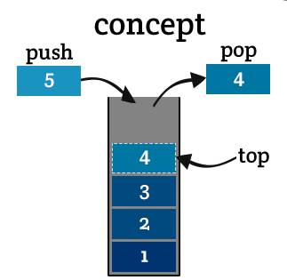
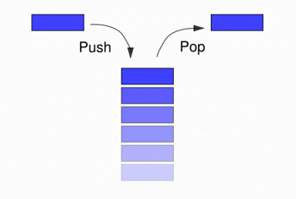
Stack Operation
Two fundamental operations can be performed on the stack. These operations are called PUSH and POP.

Slide 8
PUSH Operation
When a new data item is added or inserted into the stack at its top is called PUSH operation.
Before pushing a data item into the stack it is ensured that there is an available location in the stack to store that item .
If there is no room, no further value can be pushed on the stack.
This situation or condition is called “stack overflow”.
In this case “Stack overflow” message is sent to the user.

Slide 9
Cont.
The push operation involves the following steps:
Check if the stack is full.
If the stack is full produce an error message and exit the program.
If the stack is not full make an increment to the top position of the stack.
Add the new data element into the top position of the stack.
Exit the operation.

Slide 10
Example of PUSH operation
3
8
3
5
8
3
9
5
8
3
Top
Top
Top
Top
Empty Stack
Push 3
Push 8
Push 5
Push 9

Slide 11
POP Operation
When a data item is removed from the stack it is called POP operation.
Before removing a data item into the stack it is ensured that there is at least one item in the stack.
If there is no item, the stack is declared as empty.
This situation or condition is called “stack underflow”.

Slide 12
Cont.
The push operation involves the following steps:
Check if the stack is full.
If the stack is full produce an error message and exit the program.
If the stack is not full make an increment to the top position of the stack.
Add the new data element into the top position of the stack.
Exit the operation.

Slide 13
Example of POP operation
7
2
8
3
2
8
3
8
3
3
7
Top
2
Top
8
Top
3
Top
POP “7”
POP “2”
POP “8”
POP “3”

Slide 14
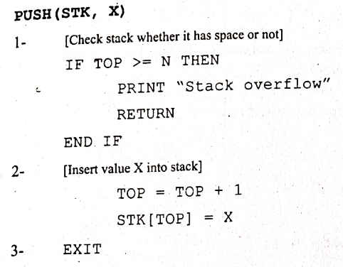
Algorithm-1
Write an algorithm to PUSH a data element X in the stack “STK” which can store N elements.

Slide 15
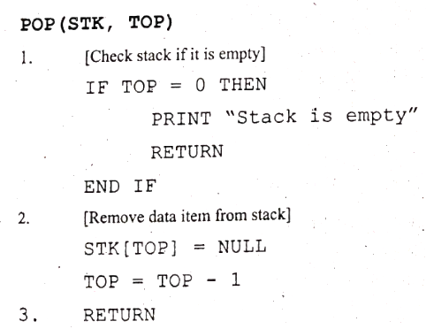
Algorithm-2
Write an algorithm to remove a data element from the stack “STK” which has N elements.

Slide 16
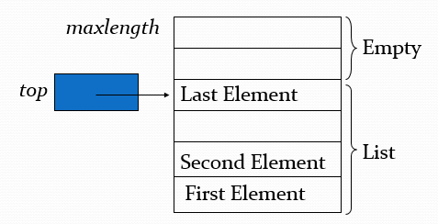
An Array Implementation of Stacks
First Implementation
Elements are stored in contiguous cells of an array.
New elements can be inserted to the top of the list.

Slide 17
Applications of stack
Reversal of string
Nested parenthesis
Conversion of infix to postfix expression
Evaluation of postfix expression

Slide 18
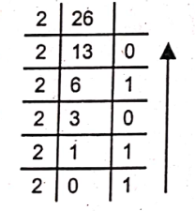
Decimal to Binary conversion using Stack
Decimals numbers can be converted into the equivalent binary numbers using stack.
Figure gives the visual process of conversion of decimal no 26 into binary.
The stack data structure can be used to convert decimal number to binary.
The push operation of stack is used to store the remainder of each step of the division operation.
After division process, the remainders of all the steps can be popped. In this way, the remainders will be removed in reverse order.

Slide 19
Cont.
For example, the decimal number 26 can be converted into binary number using stack:
Divide 26 by 2. The quotient of this step is 13, and remainder is 0. Push remainder i.e. 0 onto the stack.
Divide 13 by 2. The quotient of this step is 6, and remainder is 1. Push remainder i.e. 1 onto the stack.
Divide 6 by 2. The quotient of this step is 3, and remainder is 0. Push remainder i.e. 0 onto the stack.
Divide 3 by 2. The quotient of this step is 1, and remainder is 1. Push remainder i.e. 1 onto the stack.
Divide 3 by 2. The quotient of this step is 1, and remainder is 1. Push remainder i.e. 1 onto the stack.
POP all values from the stack and print in the same sequence i.e. 11010
1
1
0
1
0
1
0
1
0
0
1
0
1
0
0

Slide 20
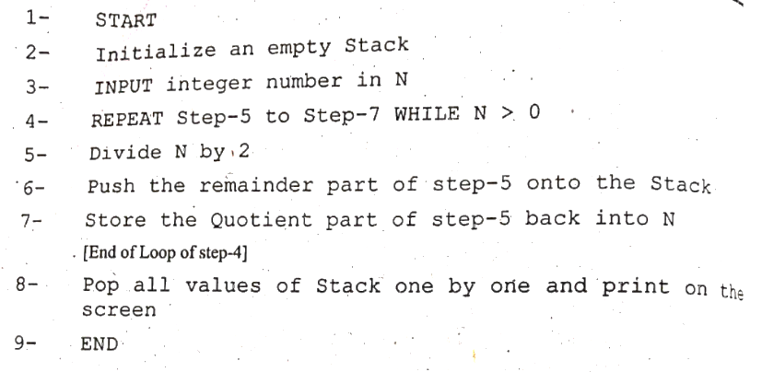
Algorithm (Binary to Decimal Conversion)

Slide 21
Reversal of string
Top/Index | Data
4 | A
3 | I
2 | R
1 | A
0 | M
Top/Index | Data
4 | M
3 | A
2 | R
1 | I
0 | A

Slide 22
Algebraic Expression
An algebraic expression is a legal combination of operands and the operators.
Operand is the quantity on which a mathematical operation is performed.
Operator is a symbol which signifies a mathematical or logical operation.

Slide 23
Infix, Postfix and Prefix Expressions
INFIX: expressions in which operands surround the operator.
POSTFIX: operator comes after the operands, also Known as Reverse Polish Notation (RPN).
PREFIX: operator comes before the operands, also Known as Polish notation.
Example
Infix: A+B-C Postfix: AB+C- Prefix: -+ABC

