Slide 1
Stack - 2
Instructor: Javeria Naz

Slide 2
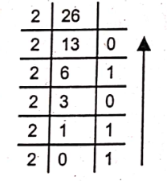
Decimal to Binary conversion using Stack
Decimals numbers can be converted into the equivalent binary numbers using stack.
Figure gives the visual process of conversion of decimal no 26 into binary.
The stack data structure can be used to convert decimal number to binary.
The push operation of stack is used to store the remainder of each step of the division operation.
After division process, the remainders of all the steps can be popped. In this way, the remainders will be removed in reverse order.

Slide 3
Cont.
For example, the decimal number 26 can be converted into binary number using stack:
Divide 26 by 2. The quotient of this step is 13, and remainder is 0. Push remainder i.e. 0 onto the stack.
Divide 13 by 2. The quotient of this step is 6, and remainder is 1. Push remainder i.e. 1 onto the stack.
Divide 6 by 2. The quotient of this step is 3, and remainder is 0. Push remainder i.e. 0 onto the stack.
Divide 3 by 2. The quotient of this step is 1, and remainder is 1. Push remainder i.e. 1 onto the stack.
Divide 3 by 2. The quotient of this step is 1, and remainder is 1. Push remainder i.e. 1 onto the stack.
POP all values from the stack and print in the same sequence i.e. 11010
1
1
0
1
0
1
0
1
0
0
1
0
1
0
0

Slide 4
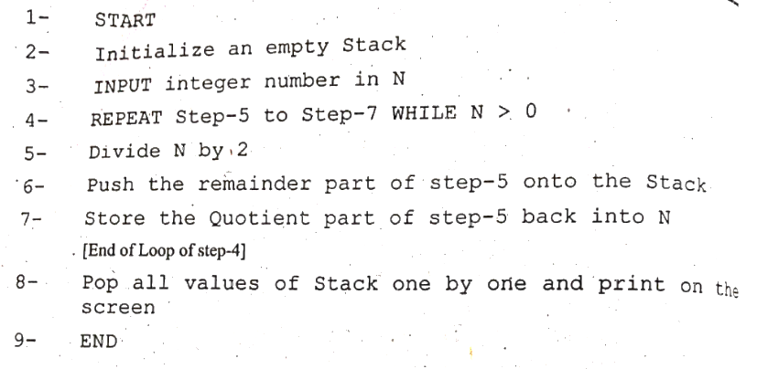
Algorithm (Decimal to Binary Conversion)

Slide 5
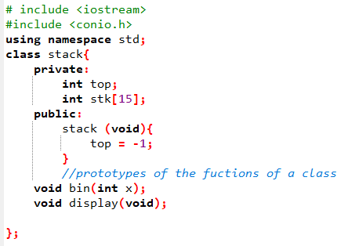
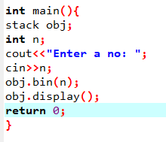
Code (Decimal to Binary Conversion)

Slide 6
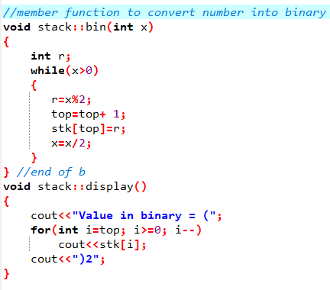
Cont.

Slide 7
Recursion
Recursion is a powerful programming technique in which either a single function calls itself again and again (direct recursion) or two functions call each other again and again (indirect recursion) till the final calculation of the result is obtained.
The involved function in the recursion is called recursive function. The number of times a function is called recursively is called depth of recursion.
Recursion is a fundamental concept in computer science. The feature of calling a function from itself was not supported in older programming languages like FORTRAN, COBOL, and BASIC. However, all the latest modern programming languages(such as C++and Java)support recursion.

Slide 8
Conditions for Recursive Function
There are two important conditions that must be satisfied by any recursive function. These conditions are necessary to prevent the recursive function from running infinitely. The conditions are as follows:
A recursive function must have a non-recursive part, called the base criteria. It is the criteria or condition used to terminate the execution of the recursive function.
Each time the recursive function is called directly or indirectly, the condition must get closer to the base criteria.
A recursive function that fulfills these two conditions is called a well-defined recursive function.

Slide 9
Implementation of Recursive Function through Stacks
A recursive function can be executed several times depending on the situation. It receives values from the calling function and transmits results back to it.
For its proper functioning, it must save the parameters and variables upon execution and restore these parameters and variables at completion. While returning values, the function must keep track of the return address in the calling function.
This return address is used to transfer the control back to its proper place in the calling function. It saves the return address of each calling function in the same order in which it is called and returns the control to proper place in the calling function each time the control is returned.

Slide 10
Cont.
The recursive function terminates execution when the base criteria is reached. Then it returns parameters and variables to the calling function. It returns these values such that the values from the last execution are returned first.
This last-in and first-out（LIFO) characteristics of a recursive function shows that stack is the most suitable data structure for its implementation.
At each function call, the stack is pushed to save the necessary values. Upon exit from the function, the stack is popped to retrieve the values.

Slide 11
Parts of Recursive Function
General algorithm for a recursive function contains the following three parts:
Prologue: It is the opening part of the recursive function. Its purpose is to save the formal parameters, local variables and return address.
Body: It contains definition of the function, including the test criteria, in which the function calls itself. Each time the function calls itself, the prologue of the function saves all necessary information required for its functioning.
Epilogue: It is the last part of the recursive function. It restores the most recently saved parameters, local variables and return addresses.

Slide 12
Factorial Concept
n | n!
1 | 1 | 1 | 1
2 | 2 × 1 | = 2 × 1! | = 2
3 | 3 × 2 × 1 | = 3 × 2! | = 6
4 | 4 × 3 × 2 × 1 | = 4 × 3! | = 24
5 | 5 × 4 × 3 × 2 × 1 | = 5 × 4! | = 120

Slide 13
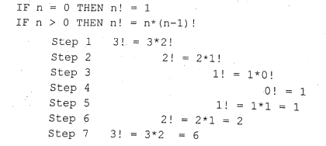
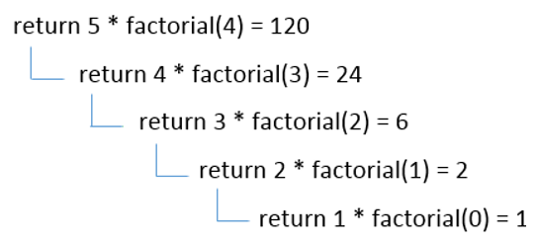
Example

Slide 14
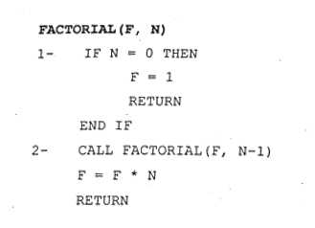
Algorithm

Slide 15
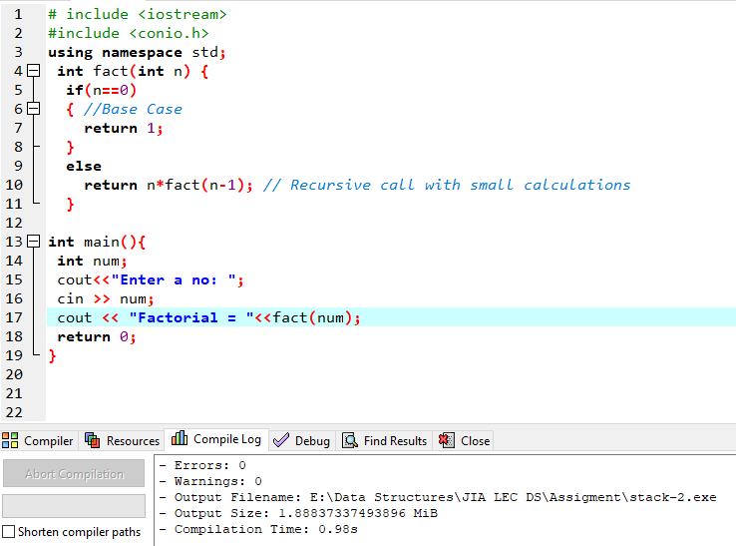
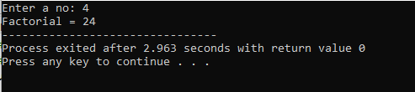
Code

Slide 16
Difference between Recursion and Iteration
Property | Recursion | Iteration
Definition | Function calls itself. | A set of instructions repeatedly executed.
Application | For functions. | For loops.
Termination | Through base case, where there will be no function call. | When the termination condition for the iterator ceases to be satisfied.
Usage | Used when code size needs to be small, and time complexity is not an issue. | Used when time complexity needs to be balanced against an expanded code size.
Code Size | Smaller code size | Larger Code Size.
Time Complexity | Very high(generally exponential) time complexity. | Relatively lower time complexity(generally polynomial-logarithmic).

