Slide 1
The Waterfall Model
By: Farah Jabeen

Slide 2
INDEX
Introduction of Waterfall Model.
Phases of Waterfall Model.
Brief description Of Phases.
Advantages.
Disadvantages.
Example

Slide 3
Introduction
1. The waterfall model is a popular version of the systems development life cycle model for software engineering.
2. The waterfall model describes a development method that is linear and sequential.

Slide 4
Phases Of waterfall Model
1. Needs Analysis.
2. Needs Specification.
3. Algorithm design.
4. Software implementation.
5. Testing and Integration.
6. Delivery and operation.
7. Maintenance.

Slide 5
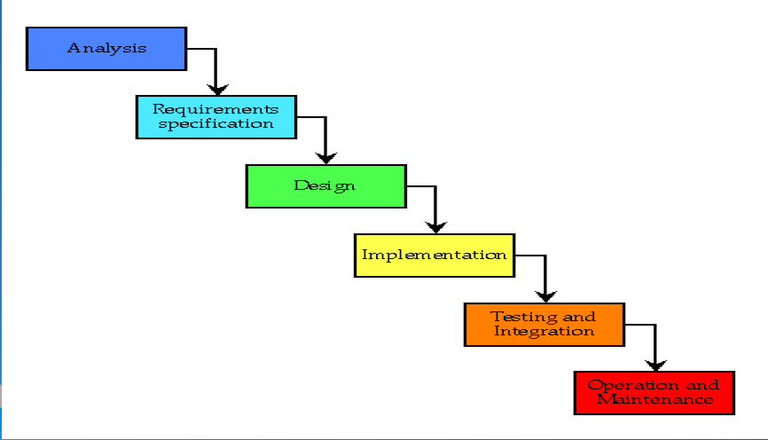
The Waterfall Model

Slide 6
Brief Description Of Phases
1) Needs Analysis:-
> This is the first phase of waterfall model.
>Which includes a meeting with customer to understand his requirements.
> Requirements gathering and analysis phase the basic requirements of the system must be understood by software engineer, who is also called ANALYSTS.

Slide 7
Brief Description Of Phases
2) Needs Specification:-
> The needs specification documents, what the user expects from the software system in a formal statement showing input, process and output.

Slide 8
Brief Description Of Phases
3) Algorithm Design:-
> An Algorithm design involves a give and take between what is needed and how it will be supplied.
> The design needs to be documented for further use.
>The requirements are translated in some easy to represent from using which coding can be done effectively and efficiently.

Slide 9
Brief Description Of Phases
4) Software Implementation:-
> The software Implementation is the coding of the algorithm.
> This is generally the easiest part of the system is well-designed and a suitable programing language is used.
>Coding is a step in which the design is translated into machine readable form.

Slide 10
Brief Description Of Phases
5) Testing:-
> in the stage both individual component and integrated whole are methodically verified to ensure that they are error-free and full meet the requirements outlined in the first step.
> in this phase testing whole software into two parts
1) Hardware & 2) Software

Slide 11
Brief Description Of Phases
6) Delivery And Operation:-
> Delivery and operation are turning over the finished system to the customer.
> Once delivered , the system has to be maintained, as we shall see the next.

Slide 12
Brief Description Of Phases
7) Maintenance:-
> This is the final phase of the waterfall model, in which the completed software product is handed over the client., after alpha beta testing.
> If the customer suggest to change or enhancements the software process has to be follow all over again right from the first phase i.e needs analysis.

Slide 13
Advantages:-
>The waterfall model is easy to implementation.
> For implementation of small systems waterfall model is useful.
> The project requires the fulfilment of one phase, before proceeding to the next.
> It is easier to develop various softwares through this method in short span of time.

Slide 14
Disadvantages:-
> The customer can see working model of the project only at the end.
> If we want to go back turn then it is not possible in this model.
> It is difficult to follow the sequential flow in software development process.

Slide 15
Example
The waterfall model was used primarily to develop enterprise applications like Human Resource Management Systems (HRMS), Supply Chain Management Systems, Customer Relationship Management (CRM) systems, Inventory Management Systems, Point of Sales (POS) systems for retail.

