Slide 1
Software Requirement Engineering
By: Farah Jabeen

Slide 2
SDLC
Software Development life cycle (SDLC) is a spiritual model used in project management that defines the stages include in an information system development project, from an initial feasibility study to the maintenance of the completed application.
The SDLC process includes planning, designing, developing, testing and deploying

Slide 3
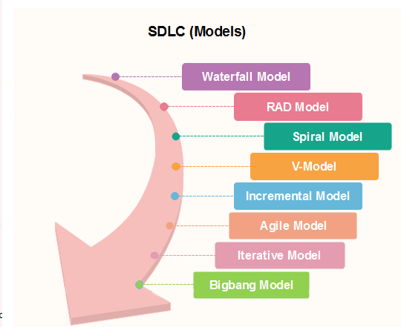
SDLC Models

Slide 4
Spiral Model
The spiral model has four phases. A software project repeatedly passes through these phases in iterations called Spirals.
Identification:
This phase starts with gathering the business requirements in the baseline spiral. In the subsequent spirals as the product matures, identification of system requirements, subsystem requirements and unit requirements are all done in this phase. This also includes understanding the system requirements by continuous communication between the customer and the system analyst. At the end of the spiral the product is deployed in the identified market.

Slide 5
Spiral Model
Design:
Design phase starts with the conceptual design in the baseline spiral and involves architectural design, logical design of modules, physical product design and final design in the subsequent spirals.
Construct or Build:
Construct phase refers to production of the actual software product at every spiral. In the baseline spiral when the product is just thought of and the design is being developed a POC Proof of Concept is developed in this phase to get customer feedback. Then in the subsequent spirals with higher clarity on requirements and design details a working model of the software called build is produced with a version number. These builds are sent to customer for feedback.

Slide 6
Spiral Model
Evaluation and Risk Analysis:
Risk Analysis includes identifying, estimating, and monitoring technical feasibility and management risks, such as schedule slippage and cost overrun. After testing the build, at the end of first iteration, the customer evaluates the software and provides feedback.

Slide 7
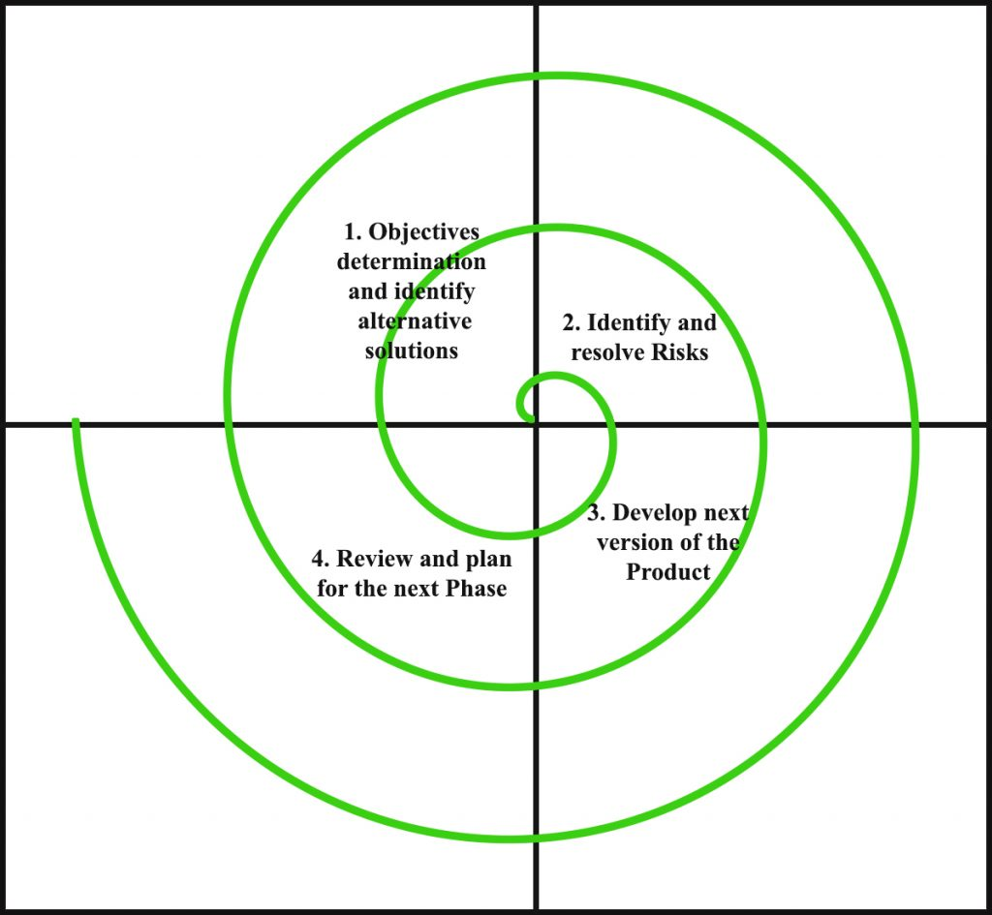
Spiral Model

Slide 8
Spiral Model Application
Following are the typical uses of Spiral model:
When costs there is a budget constraint and risk evaluation is important.
For medium to high-risk projects.
Long-term project commitment because of potential changes to economic priorities as the requirements change with time.
Customer is not sure of their requirements which is usually the case. Requirements are complex and need evaluation to get clarity.
New product line which should be released in phases to get enough customer feedback.
Significant changes are expected in the product during the development cycle.

Slide 9
Pros and Cons
Pros | Cons
Customer can see and review the test and different stages | Cannot be used for small projects as it can be expensive
Projects can be separated into various parts to ease the management difficulty | A vast amount of documentation owing to several intermediate stages
Documentation control is strong in this type of methodology | The end date of the project cannot be calculated at the early stages of the project
Project estimate will tend to be more realistic as it progresses. | Complex process

Slide 10
Incremental Model
Incremental Model is a process of software development where requirements are broken down into multiple standalone modules of software development cycle. Incremental development is done in steps from analysis design, implementation, testing/verification, maintenance.
Each iteration passes through the requirements, design, coding and testing phases.

Slide 11
Incremental Model
Incremental Phases | Activities performed in incremental phases
Requirement Analysis | Requirement and specification of the software are collected
Design | Some high-end function are designed during this stage
Code | Coding of software is done during this stage
Test | Once the system is deployed, it goes through the testing phase

Slide 12
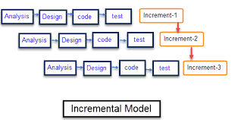
Incremental Model

Slide 13
Incremental Model
The various phases of incremental model are as follows:
Requirement analysis:
In the first phase of the incremental model, the product analysis expertise identifies the requirements. And the system functional requirements are understood by the requirement analysis team. To develop the software under the incremental model, this phase performs a crucial role.
Design and Development:
In this phase of the Incremental model of SDLC, the design of the system functionality and the development method are finished with success. When software develops new practicality, the incremental model uses style and development phase

Slide 14
Incremental Model
Testing:
In the incremental model, the testing phase checks the performance of each existing function as well as additional functionality. In the testing phase, the various methods are used to test the behavior of each task.
Implementation:
Implementation phase enables the coding phase of the development system. It involves the final coding that design in the designing and development phase and tests the functionality in the testing phase. After completion of this phase, the number of the product working is enhanced and upgraded up to the final system product

Slide 15
Incremental Model
When we use the Incremental Model?
A project has a lengthy development schedule .
When Software team are not very well skilled or trained.
When the customer demands a quick release of the product. o You can develop prioritized requirements first.
Requirements of the system are clearly understood .
When high-risk features and goals are involved .
Such methodology is more in use for web application and product based companies.

Slide 16
Advantage of Incremental Model
Errors are easy to be recognized.
The software will be generated quickly during the software life cycle.
It is flexible and less expensive to change requirements and scope.
Errors are easy to be identified.
This model is less costly compared to others.

Slide 17
Disadvantage of Incremental Model
Need for good planning designing .
Total Cost is high.
Well defined module interfaces are needed.
Problems might cause due to system architecture as such not all requirements collected up front for the entire software lifecycle .
Each iteration phase is rigid and does not overlap each other.
Rectifying a problem in one unit requires correction in all the units and consumes a lot of time.

