Slide 1
Software Engineering : Management & Leadership
Instructor: Ali Nawaz

Slide 2
Course Outline
Introduction to Management and Leadership
Management, Leadership, Management v/s Leadership
Software Development Management
Project Management, Software PM, Management Constraint Triangle
Software Engineering Management
Initiation and Scope Definition; Determination and Negotiation of Requirements, Feasibility Analysis, Process for the Review and Revision of Requirements. Software Project Planning; Process Planning , Determine Deliverables, Resource Allocation,

Slide 3
Course Outline
Software Engineering Management
Effort, Schedule, and Cost Estimation, Risk Management, Quality Management, Plan Management. Software Project Enactment; Implementation of Plans, Software Acquisition and Supplier Contract Management, Implementation of Measurement Process, Monitor Process, Control Process, Reporting. Review and Evaluation; Determining Satisfaction of Requirements, Reviewing and Evaluating Performance. Closure; Determining Closure, Closure Activities. Software Engineering Measurement; Establish and Sustain Measurement Commitment, Plan the Measurement Process, Perform the Measurement Process, Evaluate Measurement. Software Engineering Management Tools.

Slide 4
Reference Materials
Software Engineering, A Practitioner’s Approach, Pressman R. S.& Maxim B. R., 8th Edition, McGraw-Hill, 2015 (or Latest Edition)
SWEBOK, Latest Edition.
Google AdWords for Beginners: A Do-It-Yourself Guide to PPC Advertising, by Corey Rabazinski, 2015 (or Latest Edition)

Slide 5
Marks Distribution
Marks
Assignments (04) : 10
Quiz (04) : 10
Presentation : 05
Mid Term : 25
5. Final Term : 50
Total : 100
Passing Marks : 50

Slide 6
Software Engineering Management

Slide 7
Introduction
Software engineering management can be defined as the application of management activities: planning, coordinating, measuring, monitoring, controlling, and reporting, to ensure that software products and software engineering services are delivered efficiently, effectively, and to the benefit of stakeholders.
It should be possible to manage a software engineering project in the same way other complex endeavors are managed. However, there are aspects

Slide 8
Introduction
specific to software projects and software life cycle processes that complicate effective management, including these:
Clients often don’t know what is needed or what is feasible.
Clients often lack appreciation for the complexities inherent in software engineering, particularly regarding the impact of changing requirements.
It is likely that increased understanding and changing conditions will generate new or changed software requirements.

Slide 9
Introduction
As a result of changing requirements, software is often built using an iterative process rather than as a sequence of closed tasks.
Software engineering necessarily incorporates creativity and discipline. Maintaining an appropriate balance between the two is sometimes difficult.
The degree of novelty and complexity is often high.
There is often a rapid rate of change in the underlying technology.

Slide 10
Introduction
Software engineering management activities occur at three levels:
Organizational and infrastructure management
Project management
Management of the measurement program.
First level is discussed in detail in “introduction to management” in 2nd semester. In this course we will focus on the other two levels i.e; Project management and management of measurement program.

Slide 11
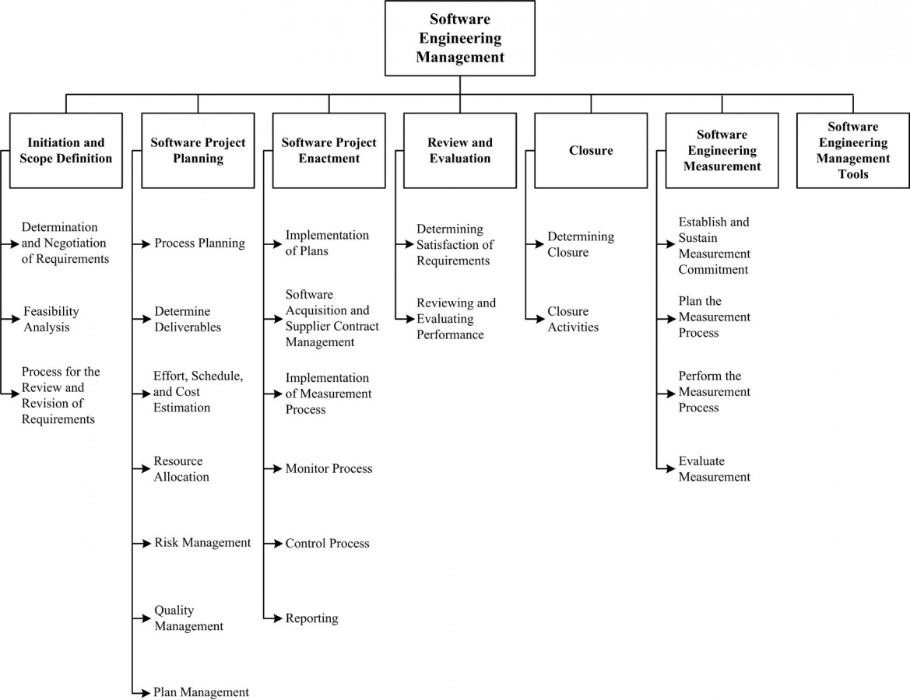
Breakdown of Software Engineering Management
Notes:
Software project enactment=software project execution

Slide 12
Breakdown of Software Engineering Management
Initiation and Scope Definition:
Which deal with the decision to embark on a software engineering project;
Software Project Planning:
Which addresses the activities undertaken to prepare for a successful software engineering project from the management perspective;

Slide 13
Breakdown of Software Engineering Management
Software Project Enactment:
which deals with generally accepted software engineering management activities that occur during the execution of a software engineering project
Review and Evaluation:
Which deal with ensuring that technical, schedule, cost, and quality engineering activities are satisfactory.

Slide 14
Breakdown of Software Engineering Management
Closure:
Which addresses the activities accomplished to complete a project.
Software Engineering Measurement:
Which deals with the effective development and implementation of measurement programs in software engineering organizations.
Software Engineering Management Tools:
Which describes the selection and use of tools for managing a software engineering project.

Slide 15
1. Initiation and Scope Definition

Slide 16
Introduction
The focus of these activities is on effective determination of software requirements using various elicitation methods and the assessment of project feasibility from a variety of standpoints. Once project feasibility has been established, the remaining tasks within this section are the specification of requirements and selection of the processes for revision and review of requirements.

Slide 17
1.1 Determination and Negotiation of Requirements
Determining and negotiating requirements set the visible boundaries for the set of tasks being undertaken. Activities include requirements elicitation, analysis, specification, and validation. Methods and techniques should be selected and applied, taking into account the various stakeholder perspectives. This leads to the determination of project scope in order to meet objectives and satisfy constraints.

Slide 18
1.2 Feasibility Analysis
A feasibility study is conducted to find out whether the proposed system is possible, affordable and acceptable for organization. The financial, political, social and time constraints must be considered during this study.
It is important to be reasonably sure of the success of proposed system before initiating work on it. A feasibility study is a study to find out whether the proposed system is:
Notes:
Affordable in terms of buyers

Slide 19
1.2 Feasibility Analysis
· Possible to build it with the given technology and resources
Affordable given the time and cost constraints of the organization
· Acceptable for use by the eventual users of the system
Notes:
Acceptable = client perspective

Slide 20
1.2 Feasibility Analysis
A feasibility study is initiated by an organization when a change is required in the current system. A feasibility study is needed to ascertain the advantages and disadvantages of the new system. Following are the important purposes of feasibility study:
Need Analysis
Determine the need for change within an organization. A Need Analysis is conducted with the following objectives in mind.

Slide 21
1.2 Feasibility Analysis
Seeking background information on the organization:
The person conducting the feasibility study should gather information on the industry to which the organization belongs. He should also try and find out similar cases of automation. He should know the weakness of other such systems so that the same may not be repeated.
Understanding current issues to be tackled:
It involves a preliminary study to find out problem areas and determine the scope of the system.

Slide 22
1.2 Feasibility Analysis
Understanding the user profile:
Feasibility study determine new system’s impacts on different users of both high and lower levels in organization chart. Normally, the users at the lower level are more aware of true problems as they re involved in day to day running of a system. It is important to understand their aspirations and the things that please or displease them.

Slide 23
1.2 Feasibility Analysis
Cost Benefit Analysis
Study the effect of change on the economics of organization
Evaluating Alternatives
Evaluate various alternatives to resolve the problems of an organization and recommend the best one.
A feasibility Study is conducted to understand the issues that face a project before the project is initiated. Ideally, it should be initiated at the beginning of a project. It will be the least inexpensive and most useful to do so.

Slide 24
1.2 Feasibility Analysis
Feasibility and risk analysis are related in many ways. If project risk is great, the feasibility of producing quality software is reduced. Different aspects related to feasibility study are as follows:
Economic Feasibility
Economic Feasibility determines the costs of developing and implementing a new system as well as the benefits of the new system. The study of costs and benefits is also known as Cost Benefit analysis.
A system is said to be economically feasible if benefits are more than costs. It includes tangible and intangible benefits.
Notes:
Types of feasibility

Slide 25
1.2 Feasibility Analysis
Tangible benefit is the benefit that can be measured in money value. It results increased revenue and decreased cost. Intangible benefit is difficult to quantify but its effect is realized as follows:
Better market position in comparison to the competition
Improved service to customers due to correct information on time
Improved service to customers results in better good will resulting in more business

Slide 26
1.2 Feasibility Analysis
Technical Feasibility
Technical feasibility helps in understanding the level and kind of technology needed for a system. It includes performance issues and constraints that may affect the ability to achieve an acceptable system.
Legal Feasibility
Legal feasibility determines the issues like copyright violations for the proposed systems for the open market. It includes frame sing of the contract for large systems and violation of terms etc.

Slide 27
1.2 Feasibility Analysis
Legal Feasibility
There are two aspects to remember about legal feasibility:
It is not required for all systems. When required, it is usually to frame a contract of service between two parties i.e. the consultants hired to develop the system and the organization for which the system is to be developed.
It requires legal experts. An analyst cannot conduct this study.

Slide 28
1.3 Process for the Review and Revision of Requirements
Given the inevitability of change, stakeholders should agree on the means by which requirements and scope are to be reviewed and revised (for example, change management procedures). This clearly implies that scope and requirements will not be “set in stone” but can and should be revisited at predetermined points as the project unfolds. If changes are accepted, then some form of traceability analysis and risk analysis should be used to ascertain the impact of those changes.
A managed-change approach can also form the basis for evaluation of success during closure of an incremental cycle or an entire project, based on changes that have occurred along the way.

Slide 29
2. Software Project Planning

Slide 30
Introduction
The first step in software project planning should be selection of an appropriate software development life cycle model and perhaps tailoring it based on project scope, software requirements, and a risk assessment. Other factors to be considered include the nature of the application domain, functional and technical complexity, and software quality requirements.
In all SDLCs, risk assessment should be an element of initial project planning, and the “risk profile” of the project should be discussed and accepted by all relevant stakeholders.

Slide 31
Introduction
Software quality management should be determined as part of the planning process and result in procedures and responsibilities for software quality assurance, verification and validation, reviews, and audits.

Slide 32
2.1 Process Planning
Software development life cycle (SDLC) models span a continuum from predictive to adaptive.
Adaptive SDLC: Adaptive SDLC is implemented mainly when the software at hand involves unknown or unspecified outcomes. The adaptive methodology involves breaking the software project into various components over an undetermined timeline to allow for flexibility in directing the path and the course of the project. Agile software development methodology is one example of adaptive SDLC.

Slide 33
2.1 Process Planning
Predictive SDLC: On the other hand, predictive SDLC is implemented in software projects whose outcomes are well specified and known. Predictive SDLC lays down a linear, specific software development plan that is structured around some pre-defined results and within a specific timeline. Waterfall methodology falls in the predictive SDLC approach to software development.
Well-known SDLCs include the waterfall, incremental, and spiral models plus various forms of agile software development.

Slide 34
2.1 Process Planning
Relevant methods and tools should be selected as part of planning. Automated tools that will be used throughout the project should also be planned for and acquired. Tools may include tools for project scheduling, software requirements, software design, software construction, software maintenance, software configuration management, software engineering process, software quality, and others.

Slide 35
2.2 Determine Deliverables
The work product(s) of each project activity (for example, software architecture design documents, inspection reports, tested software) should be identified and characterized. Opportunities to reuse software components from previous projects or to utilize off-the-shelf software products should be evaluated. Procurement of software and use of third parties to develop deliverables should be planned and suppliers selected.

Slide 36
2.3 Effort, Schedule, and Cost Estimation
Estimation is the process of finding an estimate, or approximation, which is a value that can be used for some purpose even if input data may be incomplete, uncertain, or unstable. Estimation determines how much money, effort, resources, and time it will take to build a specific system or product. Estimation is based on:
Past Data/Past Experience
Available Documents/Knowledge

Slide 37
2.3 Effort, Schedule, and Cost Estimation
Assumptions
Identified Risks
The four basic steps in Software Project Estimation are:
Estimate the size of the development product.
Estimate the effort in person-months or person-hours.
Estimate the schedule in calendar months.
Estimate the project cost in agreed currency.

Slide 38
2.3 Effort, Schedule, and Cost Estimation
Estimation need not be a one-time task in a project. It can take place during:
Acquiring a Project.
Planning the Project.
Execution of the Project as the need arises.
Project scope must be understood before the estimation process begins. It will be helpful to have historical Project Data.

Slide 39
2.3 Effort, Schedule, and Cost Estimation
Approach: The Project Estimation Approach that is widely used is Decomposition Technique. Decomposition techniques take a divide and conquer approach. Size, Effort and Cost estimation are performed in a stepwise manner by breaking down a Project into major Functions or related Software Engineering Activities.
Step#1: Understand the scope of the software to be built.

Slide 40
2.3 Effort, Schedule, and Cost Estimation
Step#2: Generate an estimate of the software size.
Start with the statement of scope.
Decompose the software into functions that can each be estimated individually.
Calculate the size of each function.
Derive effort and cost estimates by applying the size values to your baseline productivity metrics.
Combine function estimates to produce an overall estimate for the entire project.

Slide 41
2.3 Effort, Schedule, and Cost Estimation
Step#3: Generate an estimate of the effort and cost. You can arrive at the effort and cost estimates by breaking down a project into related software engineering activities.
Identify the sequence of activities that need to be performed for the project to be completed.
Divide activities into tasks that can be measured.
Estimate the effort (in person hours/days) required to complete each task.

Slide 42
2.3 Effort, Schedule, and Cost Estimation
Step#3:
Combine effort estimates of tasks of activity to produce an estimate for the activity.
Compute the total effort and cost for each activity.
Combine effort and cost estimates for each activity to produce an overall effort and cost estimate for the entire project.

Slide 43
2.3 Effort, Schedule, and Cost Estimation
Step#4: Reconcile estimates: Compare the resulting values from Step 3 to those obtained from Step 2. If both sets of estimates agree, then your numbers are highly reliable. Otherwise, if widely divergent estimates occur conduct further investigation concerning whether:
The scope of the project is not adequately understood or has been misinterpreted.
The function and/or activity breakdown is not accurate.
Historical data used for the estimation techniques is inappropriate for the application, or obsolete, or has been misapplied.

Slide 44
2.3 Effort, Schedule, and Cost Estimation
Step#5: Determine the cause of divergence and then reconcile the estimates.
Often, project managers resort to estimating schedules skipping to estimate size. This may be because of the timelines set by the top management or the marketing team. However, whatever the reason, if this is done, then at a later stage it would be difficult to estimate the schedules to accommodate the scope changes.

Slide 45
2.4 Resource Allocation
Equipment, facilities, and people should be allocated to the identified tasks, including the allocation of responsibilities for completion of various elements of a project and the overall project. A matrix that shows who is responsible for, accountable for, consulted about, and informed about each of the tasks can be used. Resource allocation is based on, and constrained by, the availability of resources and their optimal use, as well as by issues relating to personnel (for example, productivity of individuals and teams, team dynamics, and team structures)..

Slide 46
2.5 Risk Management
Risk is inevitable in a business organization when undertaking projects. However, the project manager needs to ensure that risks are kept to a minimal. Risks can be mainly divided between two types, negative impact risk and positive impact risk.
Not all the time would project managers be facing negative impact risks as there are positive impact risks too. Once the risk has been identified, project managers need to come up with a mitigation plan or any other solution to counter attack the risk.

Slide 47
2.5 Risk Management
Managers can plan their strategy based on four steps of risk management which prevails in an organization. Following are the steps to manage risks effectively in an organization:
Risk Identification
Risk Quantification
Risk Response
Risk Monitoring and Control

Slide 48
2.5 Risk Management
Risk Identification
Risks could be resolved through structured or unstructured brainstorming or strategies. It's important to understand that risks pertaining to the project can only be handled by the project manager and other stakeholders of the project. Risks, such as operational or business risks will be handled by the relevant teams. The risks that often impact a project are supplier risk, resource risk and budget risk.

Slide 49
2.5 Risk Management
Risk Identification
Supplier risk would refer to risks that can occur in case the supplier is not meeting the timeline to supply the resources required. Resource risk occurs when the human resource used in the project is not enough or not skilled enough. Budget risk would refer to risks that can occur if the costs are more than what was budgeted.

Slide 50
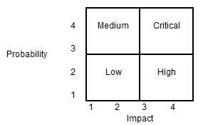
2.5 Risk Management
Risk Quantification
Risks can be evaluated based on quantity. Project managers need to analyze the likely chances of a risk occurring with the help of a matrix.

Slide 51
2.5 Risk Management
Risk Quantification
Using the matrix, the project manager can categorize the risk into four categories as Low, Medium, High and Critical. The probability of occurrence and the impact on the project are the two parameters used for placing the risk in the matrix categories. As an example, if a risk occurrence is low (probability = 2) and it has the highest impact (impact = 4), the risk can be categorized as 'High'.

Slide 52
2.5 Risk Management
Risk Response
When it comes to risk management, it depends on the project manager to choose strategies that will reduce the risk to minimal. Project managers can choose between the four risk response strategies, which are outlined below.
Risks can be avoided
Although often not possible, this is the easiest way of removing risk from a project. It involves the removal of the tasks that contain the risk from the project. Sometimes you can remove a small part of a

Slide 53
2.5 Risk Management
Risk Response
Risks can be avoided
project which carries a large risk factor. In this case, proactive risk management planning is a very worthwhile endeavor. Changing the project plan to remove a risk will involve changes to the project scope, resources, and/or time, but it can be the right response.

Slide 54
2.5 Risk Management
Risk Response
Acknowledge the risk
Acknowledgement involves planning the risk into the project. Remember, all projects carry risk in some form. It is not imperative that all risk be eliminated. But they should be itemized and analyzed to the necessary extent that they are part of the project plan, and all the appropriate parties have signed on to accept the risk. Management should be notified that there could be implications to cost/time/etc. if the risk occurs.

Slide 55
2.5 Risk Management
Risk Response
Pass on the risk
Risk can be transferred onto another party. Naturally, this will usually require some form of trade-off (or cost). Shifting the consequence of a risk to a third party is not always easy but is often overlooked. For example Purchase insurance or Outsource difficult work to a more experienced company or Remove warranties and/or guarantees.

Slide 56
2.5 Risk Management
Risk Response
Mitigation
Since risk is a function of probability and severity, both of these factors can be scrutinized to reduce the risk of project failure.
Probability of occurrence: Take measures to reduce the likelihood of a risk occurring. This is usually a more preferable option than reducing the severity because it’s better not to experience the risk occurrence in the first place.
Severity. Reduce the impact of the risk on the critical success factors of the project.

Slide 57
2.5 Risk Management
Risk Monitoring and Control
Risks can be monitored on a continuous basis to check if any change is made. New risks can be identified through the constant monitoring and assessing mechanisms.

Slide 58
2.5 Risk Management
Risk Register: Often project managers will compile a document, which outlines the risks involved and the strategies in place. This document is vital as it provides a huge deal of information.
Risk register will often consists of diagrams to aid the reader as to the types of risks that are dealt by the organization and the course of action taken. The risk register should be freely accessible for all the members of the project team.

Slide 59
2.5 Risk Management
Risk Register: Often project managers will compile a document, which outlines the risks involved and the strategies in place. This document is vital as it provides a huge deal of information.
Risk register will often consists of diagrams to aid the reader as to the types of risks that are dealt by the organization and the course of action taken. The risk register should be freely accessible for all the members of the project team.

Slide 60
2.6 Quality Management
Software Quality Management is a process that ensures the required level of software quality is achieved when it reaches the users, so that they are satisfied by its performance.
Quality software refers to a software which is reasonably bug or defect free, is delivered in time and within the specified budget, meets the requirements and/or expectations, and is maintainable. In the software engineering context, software quality reflects both functional quality as well as structural quality.

Slide 61
2.6 Quality Management
Software Functional Quality: It reflects how well it satisfies a given design, based on the functional requirements or specifications.
Software Structural Quality: It deals with the handling of non-functional requirements that support the delivery of the functional requirements, such as robustness or maintainability, and the degree to which the software was produced correctly.

Slide 62
2.6 Quality Management
Activities of Software Quality Management
Software Quality Assurance
Software Quality Assurance (SQA) is a set of activities to ensure the quality in software engineering processes that ultimately result in quality software products. The activities establish and evaluate the processes that produce products. It involves process-focused action.

Slide 63
2.6 Quality Management
Software Quality Control
Software Quality Control (SQC) is a set of activities to ensure the quality in software products. These activities focus on determining the defects in the actual products produced. It involves product- focused action.
Software Quality Planning
Select applicable procedures and standards for a particular project and modify as required to develop a quality plan.

Slide 64
2.6 Quality Management
Software Quality Challenges
In the software industry, the developers will never declare that the software is free of defects, unlike other industrial product manufacturers usually do. This difference is due to the following reasons.
Product Complexity
Product Visibility
Product Development and Production Process

Slide 65
2.7 Plan management
For software projects, where change is an expectation, plans should be managed. Managing the project plan should thus be planned. Plans and processes selected for software development should be systematically monitored, reviewed, reported, and, when appropriate, revised. Plans associated with supporting processes (for example, documentation, software configuration management, and problem resolution) also should be managed.

Slide 66
2.7 Plan management
Reporting, monitoring, and controlling a project should fit within the selected SDLC and the realities of the project; plans should account for the various artifacts that will be used to manage the project.

Slide 67
Motivation gets you going,
But
Discipline keeps you growing
………..

