Slide 1
Software Design and Architecture
Instructor: Ms. Sonia Rafaqat

Slide 2
Software Design Processes

Slide 3
Software Design Process
A process is a collection of related tasks that transforms a set of inputs into a set of outputs. A design process is the core of any design endeavor, so it is essential that designers adopt an efficient and effective process. Processes are also specified by software engineering designers as part of their work. Process description notation in UML is called an activity diagram.

Slide 4
Software Design Activities
We have discussed how software design consists of two rather different design activities: software product design and software engineering design. We can thus say that the software design process consists of two actions: software product design and software engineering design.

Slide 5
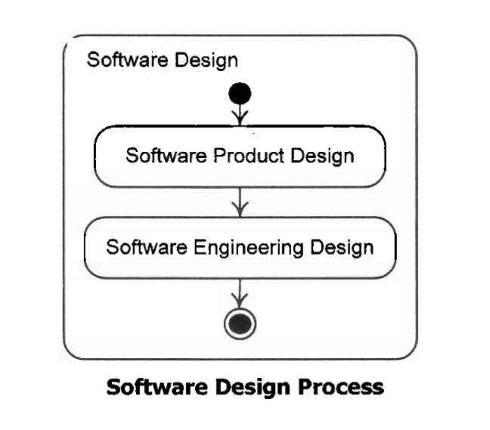
Software Design Process

Slide 6
Analysis and Resolution
The first step of problem solving must always be to understand the problem. If design is problem solving, then this activity must be the first step in design. Analysis is the activity of breaking down a design problem for the purpose of understanding it. Once understood, a problem can be solved. unfortunately the activity of solving a design problem does not have a good, widely accepted name. Traditionally this activity has been called design, but this is very confusing.

Slide 7
Analysis and Resolution
In the traditional way of speaking, design consists of the following steps:
Analysis Understanding the problem
Design Solving the problem.
Here in our discussion we will refer to the activity of solving a design problem as resolution (to avoid confusion).

Slide 8
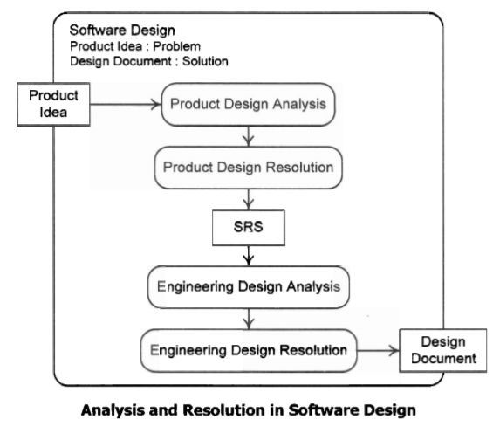

Slide 9
A Generic Design Process
The input to general design process is a design problem; the output is a well-documented design solution. The steps of this process are:
Analyze the Problem: Obtain information about the problem and then break it down to understand it. This task may begin with an existing problem statement, or one may have to be written. This step should produce a clear design problem statement to guide the remainder of the process.

Slide 10
A Generic Design Process
Generate/Improve Candidate Solutions: Generate candidate solutions, or improve inadequate candidate solutions generated and evaluated before.
Evaluate Candidate Solutions: Evaluate the newly generated or improved candidate solutions, especially against the problem statement.

Slide 11
A Generic Design Process
Select Solutions: Rank the solutions, and if one or more of them are adequate, select the best one as the final solution; otherwise, select several of the best solutions for further improvement.
Iterate: If a misunderstanding is discovered during solution generation, improvement, or evaluation, return to step 1 to correct the misunderstanding. If none of the solutions is adequate, return to step 2 to improve the best solutions or generate new solutions.

Slide 12
A Generic Design Process
Finalize the Design: Make sure that the design process and the final solution are well documented and deliver the finished design.

Slide 13
A Generic Software Product Design Process
We have discussed in detail the generic design process in previous slides. Now lets have a detailed insight of software product design, software product design begins with a product design problem and ends with delivery of an SRS. The first step is to understand the product design problem, including its scope, its clients and other interested parties, and the Process enterprise goals the new product must achieve. This starting point is provided by a document we call a project mission statement.

Slide 14
A Generic Software Product Design Process
Analysis of more and more detailed needs is interspersed with product design resolution. Abstract product requirements are iteratively refined by eliciting detailed client needs and desires about abstractly specified parts of the product, and then making more detailed specifications of product features and functions to meet them. This process eventually results in requirements that are sufficiently detailed to realize in software. The activity diagram in the next describes a generic software product design process.

Slide 15
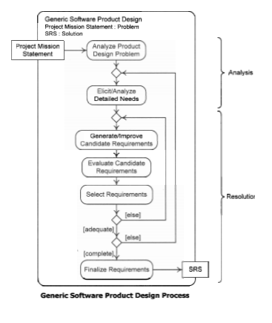
A Generic Software Product Design Process

Slide 16
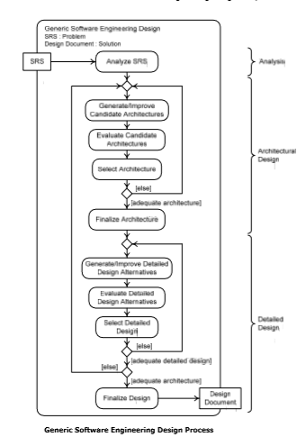
A Generic Software Engineering Design Process

Slide 17
Food for Thought
Good manners
will open doors
that the best
Education
cannot.

