Slide 1
Lecture 01: Importance of Communication Skills Note: Sharing or editing the video using any software or website is strongly prohibited.

Slide 2
Quotes on Communication
Communication is any behavior that results in an exchange of meaning
American Management Association
Communication is the process involving the transmission and reception of symbols eliciting meaning in the minds of the participants by making common their life experiences.
Baird Jr.E.John
Effective communication is purposive symbolic interchange resulting in workable understanding and agreement between the sender and the receiver
George T Vardaman

Slide 3
What is communication?
The word ‘Communication’ is used in common talk
Usually to mean speaking or writing or sending a message to another person.
In management:
It ensures your message reaches the target audience.
The receiver understands and responds
Ensures that the sender also receives, understands, interprets and responds to messages sent by the receiver.
Communication is an important aspect of behavior
Human communication is affected by all factors that influence human behavior.

Slide 4
Role of Communication – Importance
A primary skill in management competency
A skill central to everything we do – home, school, office…..
A mortar that holds organisation together
Most important foundation skill for anyone in the world – ability to communicate – globally
Communication in offices – ideas, persuasion
Public relations
Advertisement
Aviation
Space-science
Communication to inform
Communication to persuade

Slide 5
Importance of communication
Communication is central to human activity.
It is an integral part of our daily life.
In daily life, we have to:
Adaption:
Adapt our communication to a variety of human settings and or persons
Based on the role we are assuming in the interaction.
Make Decisions:
Make daily decisions
About the appropriateness of the sent
messages we

Slide 6
Contd…
Communication:
Be aware that the manner and methods we choose to communicate our messages.
Have an impact on the effectiveness of those messages.
Evaluation:
Interpret and evaluate messages received everyday.
And decide what action to take on the basis of the message.
Interaction:
Interact with people in groups
At home and outside home and at work.

Slide 7
Contd…
Education:
Development of a person
Family Life:
Communication the best nurturing ground.
Social Life:
Social adjustment, psychological development
Professional Life:
Basic competence

Slide 8
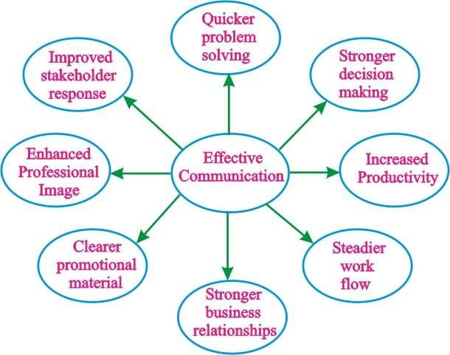
Benefits of Effective Communication

Slide 9
Communication Skills Important to You
Communication important to business
Business wants and needs people with good communication skills
Communication ranks at or near the top of the business skills needed for success.
Employers must have a good communication skill to advance professionals.
To stand out from the competition, one must demonstrate the unwritten requirements that are now most in demand
Leadership and communication skills.
There is a high correlation between communication skills, growth and income.

Slide 10
Goals of Communication in Organizations
To inform
To provide information for use in decision making
But not necessarily advocating any cause of action
To request
To ask for a specific action by the receiver
To persuade
To strengthen or change a receiver’s something
And act on the belief, if needed
belief
about
To build relationships
To create goodwill with the receiver.

Slide 11
Business Depends upon Communication
Every business is an economic and social system
To produce and sell goods and services any business must coordinate with
Employees
Suppliers
Customers
Legal advisors
Community
Government agencies
This feet is achieved largely through communication
Information is managed and exchanged through many oral written and electronic forms
Communication enables human beings to work together

Slide 12
Thank you
Please post your questions in comments

