Slide 1
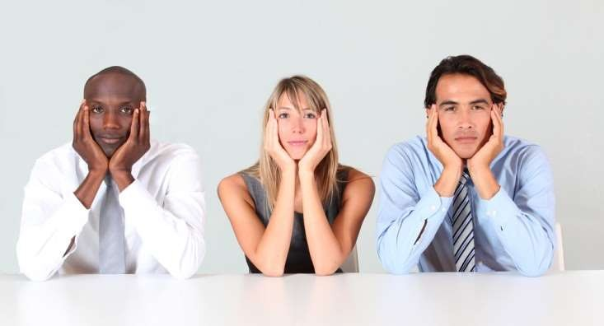

Lecture 03: BARRIERS to COMMUNICATION
Note: Sharing or editing the video using any software or website is strongly prohibited.

Slide 2
“Whatever words we utter should be chosen with care for people will hear them and be influenced by them for good or ill.” Buddha

Slide 3
WHAT IS COMMUNICATION AND BARRIER ?
Communication is the activity of conveying meaningful information. It requires a sender, a message, and an intended recipient.
Barrier An obstacle in a place that prevents us from completing certain tasks.
Communication barriers can be defined as the aspects or conditions that interfere with effective exchange of ideas or thoughts.

Slide 4
TYPES OF BARRIER
Physical Barrier
Cultural Barrier
Language Barrier
Emotional Barrier
Gender Barrier
Organizational Barrier
Psychological Barrier

Slide 5
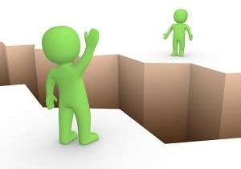
PHYSICAL BARRIER
Physical barriers relate to disturbance in the immediate situation, which can interfere in the course of an effective communication.
Some of them are easy to Alter whereas, some may prove to be tough obstacles in the process of effective communication.

Slide 6
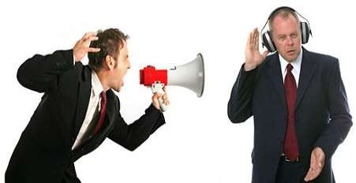
FACTORS CAUSING PHYSICAL BARRIER
Defects in media
Distraction in environment
Distance
Ignorance of medium
Physical disability

Slide 7
HOW TO OVERCOME?
To be updated with latest technologies.
Choosing a suitable environment.
Removing obstacle.
Making signs easier to read, example, you could supplement written signs with pictures and visual signs.
Self Motivation.

Slide 8
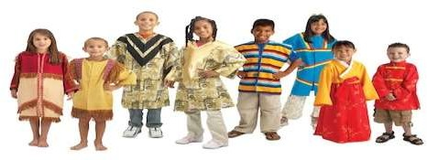
CULTURAL BARRIER
Cultures provide people ways of thinking-- ways of seeing, hearing, and interpreting the world.
Similar words can mean different things to people from different cultures, even when they talk the "same" language.

Slide 9
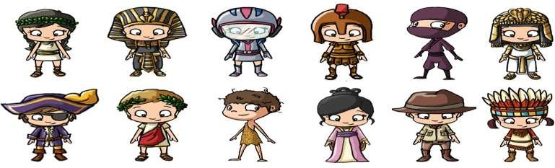
FACTORS CAUSING CULTURAL BARRIER
Diversified cultural background.
Language and Accent.
Behavior and Nature.
Religion.

Slide 10
HOW TO OVERCOME ?
Cross culture environment.
Have a thorough knowledge of your counterpart’s culture background.
Conduct effective communication workshop.
Work in groups and run frequent meeting

Slide 11

LANGUAGE BARRIERS
Inability to converse in a language that is known by both the sender and receiver is the greatest barrier to effective communication.
When a person uses inappropriate words while conversing or writing, it could lead to misunderstanding between the sender and a receiver.

Slide 12

FACTORS CAUSING LANGUAGE BARRIERS
Multi language
Region
Inadequate vocabulary
Interpreting difference

Slide 13
HOW TO OVERCOME ?
Speak slowly and clearly.
Ask for clarification.
Frequently check for understanding.
Be specific.
Choose your medium of communication effectively.
Be patient.

Slide 14
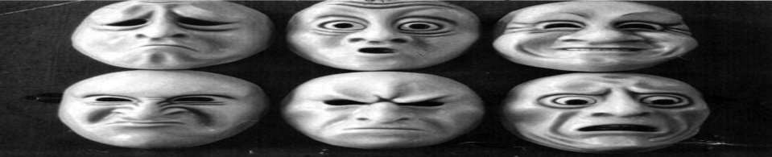
EMOTIONAL BARRIER
The emotional state may
influence your understood and
capacity to make yourself
hamper your understanding of others.
Many times, emotional barriers on your part or the part of the person you are speaking which may inhibit your ability to communicate on an effective level.

Slide 15


FACTORS CAUSING EMOTIONAL BARRIER
Fear/ insecurity
Mistrust
Stress

Slide 16
How to overcome
Motivation and commitment to change.
Peer or mentor support .
Practice

Slide 17
GENDER BARRIERS
Relationships, respect, workplace authority and education are common ways men and women are pitted against each other.
Overcoming barriers in gender communication isn’t simple but can be made clear with a little patience and understanding.
This barrier arises because men and women have different ways of thinking and communication.

Slide 18
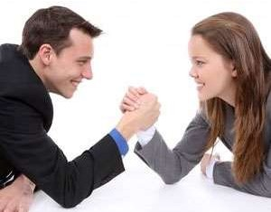
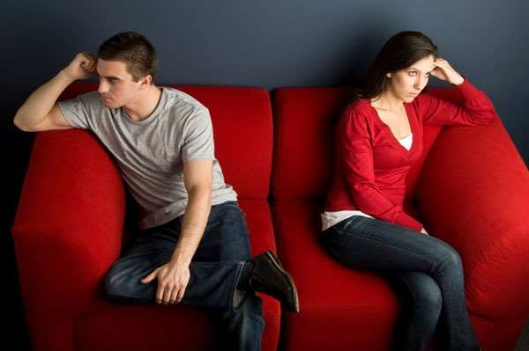
FACTORS CAUSING GENDER BARRIERS
Fear and shy
Environment
Misunderstanding

Slide 19

How to overcome
The process of bridging the gap in gender communication requires the great deal of patience and understanding that only time and attention will teach.

Slide 20
ORGANIZATIONAL BARRIERS
Organizational structure greatly affects the
the
capability of the employees as far as
communication is concerned .
All the internal factors which stymie or block the process of communication are known as organisational barriers. Some such factors have already been discussed like restrictive environments, deceptive tactics, communication network.

Slide 21

FACTORS CAUSING ORGANIZATIONAL BARRIERS
Status relationship
One way flow
Organization structure
Rules and regulations
Too many levels in organization structure

Slide 22
HOW TO OVERCOME?
Poor structure to the communication.
A weak delivery.
The use of the wrong medium to deliver the communication.
A mixed message.
The message is delivered to the wrong audience.
A distracting environment.

Slide 23
PSYCHOLOGICAL BARRIERS
Misperception & misunderstanding
Distrust & unhappy emotions
Emotional disturbances
Psychological illness
Worry & emotional disturbances
Fear, anxiety & confused thinking
The most common problem is that the people have difference opinion .

Slide 24
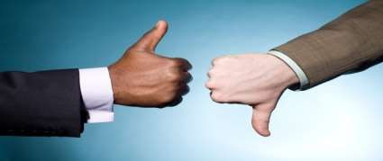
FACTORS CAUSING PSYCHOLOGICAL BARRIERS
Difference in Understanding
Difference in Perception of Reality
Differences in Values, Attitudes and Opinions

Slide 25
HOW TO OVERCOME?
Pay attention during the sharing of information
Ensure each other’s comfort.
Ensure the intactness of sensory perception.
The limitation of hearing abilities must keep in mind.
Active listening.
Information overload must be avoided.

Slide 26


Slide 27


