Slide 1
Lecture 05: Kinds (Types) of Communication employed by Business Organizations
(Note: Sharing or editing the video using any software or website is strongly prohibited.)

Slide 2
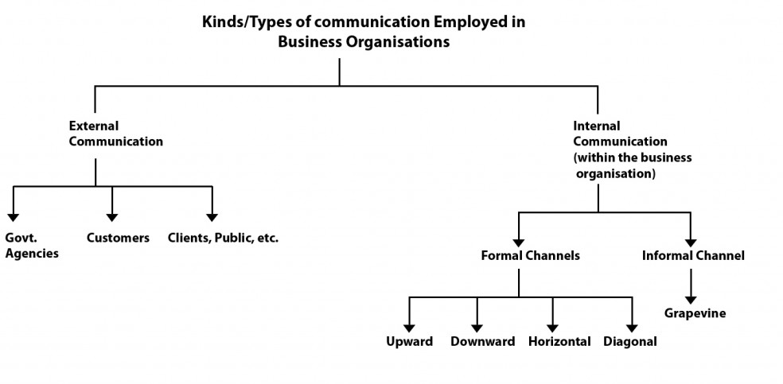
Categories of communication
In a business context, all communication can be divided into two categories namely, External Communication and Internal Communication

Slide 3
External Communication
An organization, when it communicates with Governmental agencies, other organizations, customers, clients and Public it is called external communication.
The media employed may be written media like letters, reports, proposals or visual media like posters, advertisements video tapes or electronic media like faxes, telegrams, e-mails, telexes.
The communication might also be through teleconferences, face-to-face meetings, panel discussions or presentations, exhibitions and such events.

Slide 4
Advantages of External Communication
External communication helps an organization to keep its outsourcing agencies like distributors, wholesalers, retailers and clientele well informed about the company’s products, services, progress and goals.
The information gets continuously updated and accurate. All organizations have to maintain cordial relationships with government agencies, licensing authorities, suppliers of raw materials, ancillary industries and financial institutions.
Continual and updated information without any communication gap is essential for business houses.

Slide 5
Internal Communication
Every organization has the necessity to maintain appropriate communication with its branches, staff and employees.
This is generally called internal communication.
Internal communication is an essential feature of an organization’s administrative structure.
In modern times, the Human Resource Department plays an important role in maintaining internal communication.

Slide 6
Advantages of Internal Communication
2
In the new millennium, particularly in the context of globalization, business has become highly competitive. Business houses have the need to maintain good channels of internal communication.
The central organization or corporate office should keep its branches well informed of new policies and policy changes.
The growth in business, the future projections for business, increased specializations make a great demand on the central office to maintain an uninterrupted flow of internal communication.
Employees need to be motivated and exposed to the business objectives and ethical ideas of a company so that they get an involvement in the work they do.

Slide 7
Advantages of Internal Communication
Employees on production line should be aware of the targets so that they overcome obstacles.
Even the shifting of the canteen and a re-adjustment of the lunch- breaks and tea-breaks have to be informed well in advance to the employees. In turn, employees should be able to tell people at higher levels their grievances, expectations and difficulties.
Effective internal communication forges a strong bond between the employees and management, promotes co- operation among different sections in an establishment.
It removes misunderstanding and aids the growth of the organization at a desirable and optimum level. Internal communication in short, ensures involvement of all the people without alienating any section.

Slide 8
Directions of Communication
In olden days communication was unidirectional. The boss gave the order and the employees executed it. In fact, uni-directional communication has its origin in the feudal system. The lord directed the vassal (a slave or bondman) to carry out a job.
Business and industry continued the age old tradition of the feudal system even after the industrial revolution. But soon areas of conflict got promoted by sectarian interests (of homogenous groups) within an organization.
The barrier between the management and employees became an iron curtain. It has been discovered that a multidirectional communication system demolishes the barriers and removes friction.
Business depends on such anew communication paradigm (pattern or model) to ensure the success of business and the realization of even difficult objectives.

Slide 9
Downward Communication
Downward communication means the flow of communication from the top echelon (level or rank) of an organization to the lower levels of employees.
Downward communication not only recognizes and accepts a hierarchical structure but also is based on the assumption that people at the higher level have the ability and authority to direct the employees on all do’s and dont’s.
Downward communication has its own shortcomings, if it is not complemented by other directional communications. The shortcomings will be pronounced if an organization adopts only unidirectional communication namely downward communication.
Downward communication, if practiced without complementing it with upward communication, will fail because it accepts the premise ” The boss is always right”. Moreover, it may get delayed or distorted as it goes down through the various levels of the hierarchical set up as all decisions are taken without any proper feedback. But it helps in creating an awareness among employees of the objectives, targets and goals. It also helps in establishing a certain authority in the organization and discipline. In the armed forces and police department, mostly, only downward communication exists.

Slide 10
Upward Communication
Communication maintained from lower level of employees to higher-ups is called upward communication.
Upward communication gives scope for the employees to offer their suggestions, opinions, make complaints and seek redressal of their grievances. Upward communication helps an organization to receive and reset its objectives at realistic levels.
Upward communication may cause ego problems to persons in higher hierarchical positions. It may also lead to meaningless criticisms of the policies by disgruntled employees. But on the whole, modern management recognizes the need for healthy upward communication to make the organization responsive to suggestions and ideas.
Some organizations invite the opinions of personnel at the lower level. Jhs personnel department, the HRD section and the Swedish type of ‘Ombudsman Office’ (Official appointed by a government to investigate and report on complaints made by citizens on Public authorities) take steps to see that a healthy and acceptable upward communication system is adopted by organizations.

Slide 11
Horizontal / Lateral Communication
The interaction among peer groups is called horizontal communication.
Inter departmental communication is also horizontal communication.
Sales department, production department, quality control department and the stores department have to constantly interact and coordinate among themselves.
Horizontal communication leads to a better understanding among individuals and departments, cooperation and coordination.

Slide 12
Diagonal or multi-directional Communication
Diagonal communication means the use of upward, downward and horizontal communication. It is a healthy practice not to depend on any one mode.
Diagonal communication leads to better feedback at all levels. It promotes understanding, motivates employees and gives a sense of belonging and involvement to all people at all levels.
But such communication should not be allowed to degenerate to a meaningless criss-cross communication which will lead to chaos and confusion. All modes have to be maintained at the appropriate and optimum level.

Slide 13
Formal and Informal Channels of Communication
Every business organization adopts some formal channels of communication which may be upward, downward, or horizontal or all the three.
They are usually in the form of notices, announcements, reports, official or demi-official letters, advertisements, etc.
Formal channels are officially recognised and organised.
They make the working of the organization transparent. They motivate the employees.
They provide the necessary feedback. But formal channels operate with some limitations.
A continuous maintenance of a formal channel is time and resource consuming.
At ordinary times, they exist for their own sake without any objective, as a formality and routine. Sometimes, free flow of information gets affected by personal factors.

Slide 14
Grapevine
Large organizations, where there are a large number of people working closely, generate certain informal or unofficial channels of communication.
These channels exist with or without official patronage. Even if they are officially and secretly patronized, they are not authentic.
This type of communication is generally called “Grapevine” communication.
Grapevine communication is an informal, unofficial, horizontal channel of communication because generally peer groups participate in it.

Slide 15
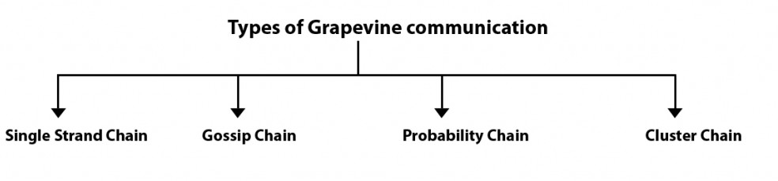
Types of Grapevine Communication
Types

Slide 16
Types
Grapevine communication is of four different types.
It can seep from individual to individual in a strictly linear fashion. Information takes time to spread in this fashion. It is called Single Strand Chain.
In some situations, an individual goes around communicating the message / information he thinks he has obtained. This is called Gossip Chain. The listeners are a chosen few only.
In some other situation, an individual passes an information without any restriction to all those with whom he comes into contact. This is called Probability Chain and the information / message passed on may be interesting but not important.
In yet another situation, one person communicates to a few chosen associates who in turn communicate the same to yet another group. This is called Cluster Chain

Slide 17
Advantages of Grapevine Communication
Grapevine communication brings about a strong bond among peer groups.
It develops because of the involvement of the persons connected with an organization.
It gives mental satisfaction to the participants and gradually reduces emotional outbursts and reactions.
It keeps the employees anticipating and acts as a buffer against Shockwaves.
It is fast and can supplement formal channels. It provides informal feedback on the changes contemplated by the Management.

Slide 18
Disadvantages of Grapevine Communication
Grapevine, is definitely dangerous to the health of an organization if allowed to grow without monitoring. Grapevine channel distorts or exaggerates the content of a message.
It has the potential to spread unnecessary gossip. It may result in character assassination and personal vilification of individuals. It may provoke sudden unwanted and unexpected reactions from emotionally unstable people.
Grapevine channels can be moderated but not eliminated. A transparent administration policy, employee-friendly attitude, fruitful peer group meetings, inter-action sessions, parties and outings where all those connected with the organisation participate are some of the strategies to monitor grapevine and use it to the advantage of the organization.
Business houses and industries adopt one or several of these strategies to keep grapevine under reasonable control so that it does not degenerate into a rumour mill and promote unwanted gossip sessions among the employees.

Slide 19
THANK YOU

