Slide 1
Introduction To Digital Marketing
Lecture-1(Introduction)

Slide 2
Marketing:
Marketing is the activity, set of institutions, and processes for creating, communicating, delivering, and exchanging offerings that have value for customers, clients, partners, and society at large.
Process of Marketing:
Creating
Communicating
Delivery
Exchanging
Offering

Slide 3
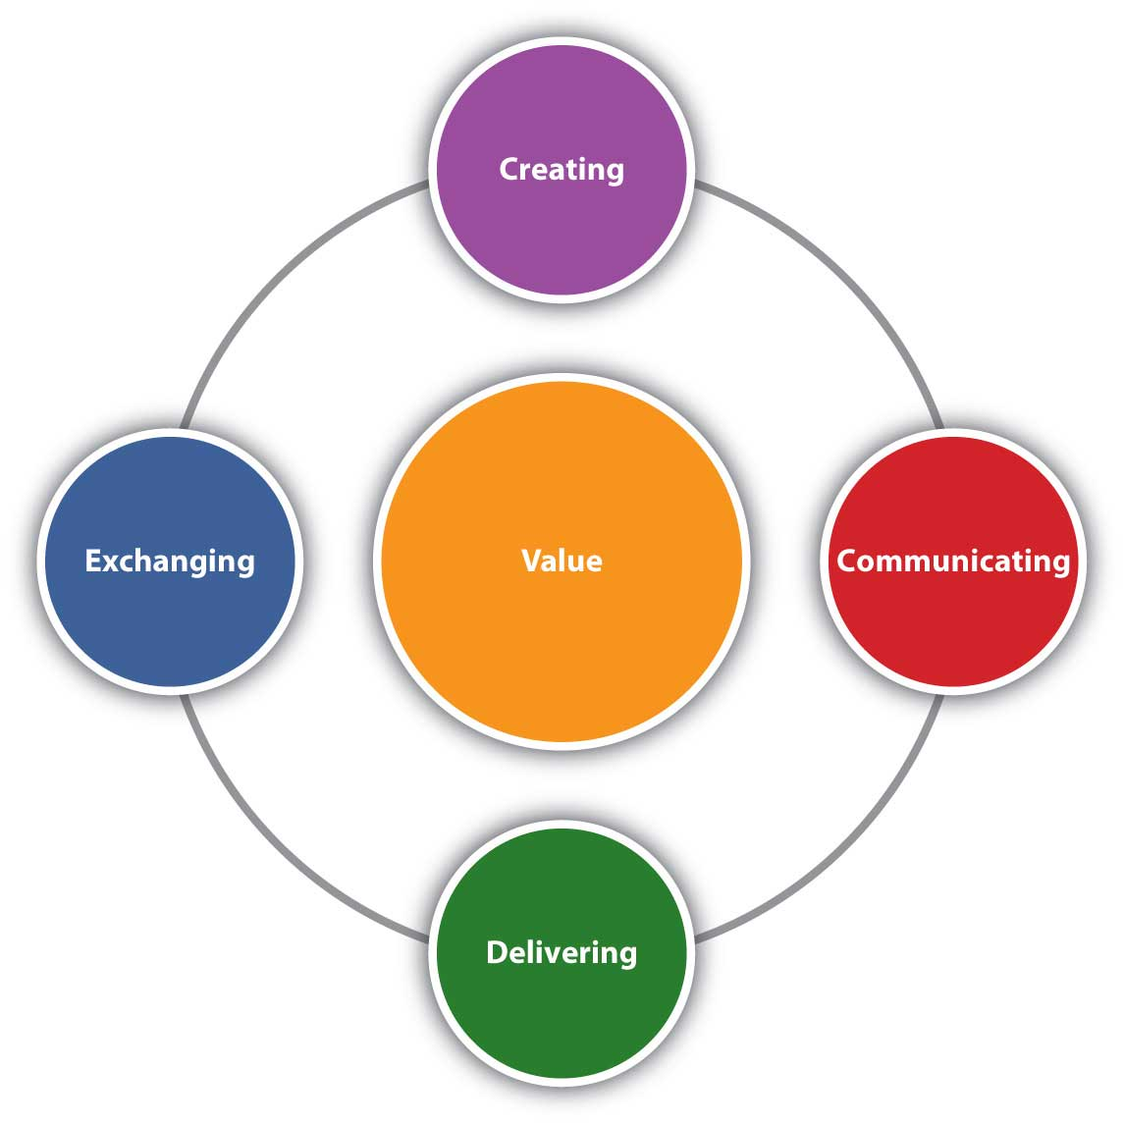
Value
Value is at the center of everything marketing does (Figure 1.1). What does value mean?
When we use the term value, we mean the benefits buyers receive that meet their needs.

Slide 4
Value
value = benefits received – [price + hassle]
Hassle is the time and effort the consumer puts into the shopping process

Slide 5
Evolution of Marketing:
Barter System
Production Era
Sales Era
Marketing Era(Advertisement & Brand development)
Marketing Company Era(Production + Sales+Brand development)
Relationship Era(long-term relationship with customer)
Social Media Marketing
Digital Marketing

Slide 6
Digital Media:
Refers to audio, video, photo or textual content that has been encoded using a computer and can be transmitted digitally to people.
Features:
Mass Reach
Message is transmitted to thousand people on one click
Interactivity
Customer/audience can give feedback for your published content on spot.
Social Networking
Making communities

Slide 7
Digital Media:
Types:
Social Media Platform
Facebook, Twitter, YouTube, Instagram
Website
Blogs
Emails & SMS

Slide 8
Digital Marketing:
Digital Marketing
Exploring new avenues
Making company-wide efforts(Goal oriented marketing)
Creating and advertising brand
Creating customer relationship
Involving communities(with the help of customers)
Optimizing production
All marketing activities done
on modern digital channels.
Notes:
Exploring new avenues
Optimizing production
Creating and advertising brand
Making company-wide efforts(Goal oriented marketing)
Creating customer relationship
Involving communities(with the help of customers)

Slide 9
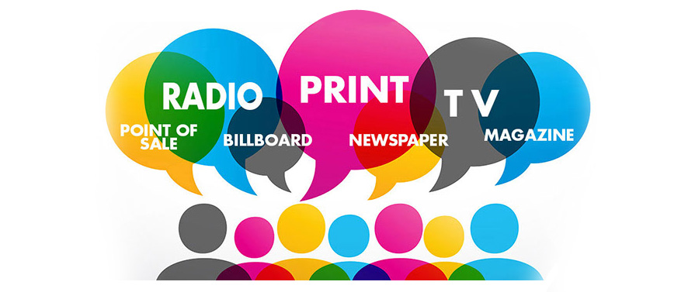
Traditional Marketing:
Conventional mode of marketing that helps to reach out to a semi-targeted audience with various offline advertising and promotional methods.

Slide 10
Traditional Marketing:
Many of the common and most tried offline marketing tactics come under the following five major categories:
Print (magazines, newspapers, etc.)
Broadcast (TV, radio, etc.)
Direct Mail (catalogues, postcards, etc.)
Telephone (telemarketing, sms marketing, etc.)
Outdoor (billboards, fliers, etc.)
Notes:
Direct mail is marketing material or product mailed directly to the homes of consumers or offices of business buyers. Examples include postcards with an offer, catalogs that display goods etc.

Slide 11
Traditional vs Digital Marketing:
Traditional Marketing | Digital Marketing
Limited audience | Reach out to maximum people
Global Marketing | Targeted or client specific marketing
Non-versatile(can not be altered once published) | Versatile(changes can be made after publication)
Delayed communication | Immediate communication
No direct interaction with the published content | Audience can directly interact with the published content

Slide 12
Digital Marketing:
Activities:
Paid advertisements
Social Media Marketing
Email & SMS
Search Engine Optimization
Mobile Marketing
Marketing Research

Slide 13
Digital Marketing:
Advantages:
Global reach
Personalized Marketing
Customer Engagement
Content Variety
Sales Conversion(Conversion of prospect to lead and lead to customer)
Cost Reduction
Notes:
Prospect is possible future customer
Lead is one who agreed to be a potential buyer (+ive prospect)
Customer is who have purchased the product

Slide 14
Digital Marketing Jobs:
Blog Creation
Content Creation
Community Management
Advertising(mass audience reach)
SEO
Online Selling
Lead Generation
Online campaigning
Part of social media and content creation
What to post?
When to post?
Where to post?
Email marketing & Mobile apps (in-app advertisement)

Slide 15
Digital Marketing Tools:
Facebook insight
Reach: How many people reached your post
Virality: Is your post got popular or not?
Likeness
Comments
Customer Demographics(age, gender etc.)
Linked in
Companies goes for employees
Employees goes for job
Instagram
Picture sharing plateform
Twitter
Text oriented plateform

Slide 16
Digital Marketing Tools:
5. YouTube Studio
6. Google Adwods
Software through which you can advertise on another website
7. Google Adsense
Software through which google advertise on your website
8. Bloggers.com
Website through which you can create blogs
9. Taboola.com
Native advertisement(When an advertisement doesn’t feel like an advertisement)
10. mailchimp.com
Email advertisement
Email automation

