Slide 1
Introduction To Digital Marketing
Affiliate Marketing

Slide 2
Affiliate Marketing:
Affiliate marketing is the process of earning a commission by promoting other people’s[or company’s products]. You find a product you like, promote it to others and earn a piece of profit for each sale that you make.
Affiliate Marketing is the practice whereby a digital publisher or website promotes an online retailer and earns a commission based on the sales or leads that the advertising generates for that online retailer

Slide 3
Cost Per Action(CPA):
We term this payment metric CPA – Cost Per Action.
Typically an ‘Action’ is a sale of an online good or service, but it can also be a lead or registration, a call, a download or any other trackable action that is desired of the end customer.
In recent years this has grown to even include offline sales — provided they can be tracked back by a coupon or barcode

Slide 4
Cost Per Action(CPA):
There are two ways the CPA are set:
Flat rate:
For every action a fixed fee is paid. This is typically used for registration type actions with no cost, such as a credit card sign-up or for a fixed price product like a mobile phone contract.
Revenue Share:
The price of the item purchased is tracked and a percentage of that price is then paid to the affiliate.
This is generally favoured by advertisers selling a range of tangible goods at varying prices, such as fashion retailers

Slide 5
Common Misconception:
Affiliate Marketing isn’t just banner advertising, in fact, most campaigns will get less than 10% of their sales as a result of banner advertising.
Consumers have learned to ignore these banners, so successful affiliates employ smarter, more engaging tactics to generate sales for the advertisers they work with, with most sales coming from ‘text links’ often hidden behind ‘Buy Now’ or ‘Shop Here’ type buttons.
A ‘text Link’ in the affiliate world is just a trackable URL that redirects to the relevant page of the advertiser’s website.

Slide 6
How does it work technically:
Most advertisers will employ an Affiliate Network to administer the tracking of their Affiliate Campaign.
The network will provide a set of tracking links to the affiliates that sit behind the banners and text links on the affiliates’ websites.
When the customer clicks on that link a cookie is dropped onto their computer and that click is registered by the Affiliate Network.

Slide 7
How does it work technically:
When that customer then completes a purchase and reaches the advertiser’s confirmation page, the Affiliate Network’s tracking tag is fired.
That tag checks for the relevant cookie and if the customer has come from one of the Affiliate Network’s publishers, the sale is recorded by the Affiliate Network in their platform.
Via that platform both the advertiser and affiliate should be able to see that the sale has tracked and a commission can be awarded.

Slide 8
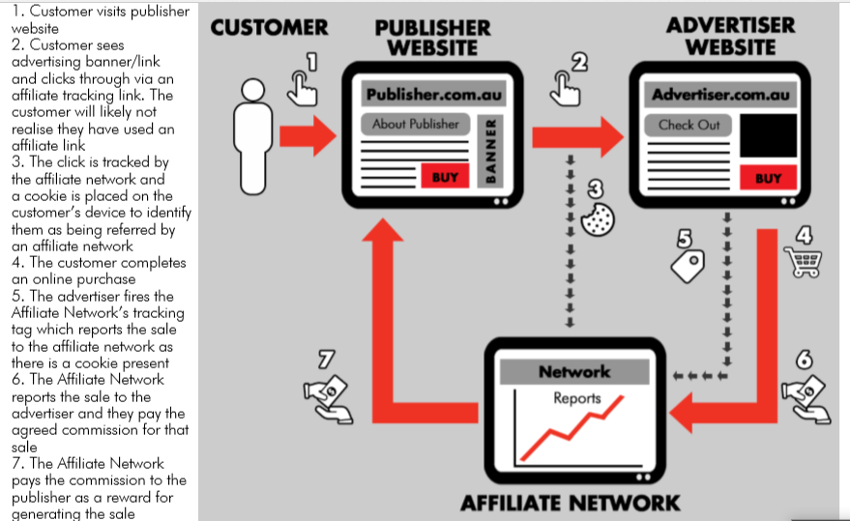
How does it work technically:
Notes:
Customer visits publisher website
Customer seed advertising banner/link and clicks through via an affiliate tracking link.
The customer will likely not realise that they have used an affiliate link.
The click is tracked by the affiliate network and a cookie is placed on the customer’s device to identify them as being referred by an affiliate network.
The customer completes an online purchase
The advertiser fires the affiliate network’s tracking tag which reports the sale to the affiliate network as there is a cookie pesent.
The affiliate network reports the sale to the advertiser and they pay the agreed commission for tat sale.
The affiliate network pays the commission to the publisher as a reward for generating the sale.

Slide 9
How does it work technically:
Customer visits publisher website.
Customer seed advertising banner/link and clicks through via an affiliate tracking link.
The customer will likely not realise that they have used an affiliate link.
The click is tracked by the affiliate network and a cookie is placed on the customer’s device to identify them as being referred by an affiliate network.

Slide 10
How does it work technically:
The customer completes an online purchase.
The advertiser fires the affiliate network’s tracking tag which reports the sale to the affiliate network as there is a cookie pesent.
The affiliate network reports the sale to the advertiser and they pay the agreed commission for tat sale.
The affiliate network pays the commission to the publisher as a reward for generating the sale.

Slide 11
Affiliate Types:
When we talk about Affiliate Marketing, it is important to note that there are different types of affiliates.
The method chosen by the affiliate to promote the advertisers’ products is the key differentiation.
Each affiliate type fulfills a different role in terms of value, volume and reach.
By understanding affiliates on an individual basis, advertisers will have the knowledge of who is best positioned to deliver in certain industries or to promote particular products

Slide 12
Reward Sites:
With online shoppers becoming increasingly intelligent, reward sites have seen a surge in popularity.
This type of affiliate drives sales by rewarding its members through a share of the commission it earns from an advertiser.
If provided with a competitive offer, reward sites can generate significant volume.

Slide 13
Reward Sites:
They provide brands with an effective way to increase its exposure, especially if products are not strongly positioned on aggregator sites.
If used strategically, reward websites can drive incremental growth (e.g. reward to increase average order value, higher commission for purchase of new customers).
It is important to have a sophisticated validation process in place, in order to avoid paying commissions on cancelled bookings or return purchases.
Notes:
Aggregator website is a site that collects data from other sources across the internet and puts the information in one place where users can access it

Slide 14
Content Sites & Blogs:
These types of websites are often focused on a niche interest and feature unique content.
A few examples are product review sites, blogs and online forums.
Often, Content Affiliates form part of an Affiliate Program’s long-tail strategy and are rarely large volume drivers.
Regardless of their contribution to overall sales, they are valued partners.
The reason for this is that unique content suggests editorial credibility and often has a positive impact on an advertiser’s search engine optimization (SEO) efforts.
Notes:
Nich: special, speciality

Slide 15
Content Sites & Blogs:
Content sites can also help reach a new audience.
This audience might not necessarily be looking for your brand in particular but could come across it through a feature in a newsletter as the affiliate reaches an audience that is actively looking for the topic around your brand.
A great way to engage and optimise activity with content sites is by providing fresh content or an exclusive offer.
Recently we have also seen an increase in integrated content pieces as well as affiliates who are using video to monetise a product

Slide 16
Email:
An Email Affiliate sends targeted emails to its own (or third-party) data base to drive conversions on behalf of a brand.
In order to drive volume, a strong and time-sensitive offer is required and should be refreshed regularly.
It is important to always consider the size and source of the data to ensure it is compliant with local and brand regulations and to avoid over promotion or database exhaustion.

Slide 17
Comparison Website:
These sites offer consumers the opportunity to compare products of different advertisers (like credit cards or phone plans).
Through a compelling offer, comparison websites can generate large sales volumes.
They vary a lot on how they structure their rankings, which is not always based on best product but often earnings per click (EPC).
Notes:
Earnings per click (EPC) is an affiliate marketing term that refers to the average amount of money you earn each time someone clicks one of your affiliate links. EPC affiliate marketing is, typically, run through pay-per-click (PPC) ads

Slide 18
PPC Affiliate:
A PPC (pay-per-click) Affiliate is a search specialist who drives traffic to an advertiser’s site by bidding on relevant keywords via a custom-built landing page.
They generally work on a CPA basis but sometimes require hybrid commercial agreements. PPC Affiliates are not for every client but can be great strategic partners if:
Competitors are cannibalising advertisers’ ads
Notes:
PPC stands for pay-per-click, a model of internet marketing in which advertisers pay a fee each time one of their ads is clicked. Search engine advertising is one of the most popular forms of PPC.
Keyword advertising is a method of advertising on search engines using keyword research. By determining the keyword searches that are most relevant to your business's offerings, you can then bid to place your ads in the search results for relevant keywords.
Cost per action (CPA) is an online advertising marketing strategy that allows an advertiser to pay for a specified action from a prospective customer
In marketing strategy, cannibalization refers to a reduction in sales volume, sales revenue, or market share of one product as a result of the introduction of a new product by the same producer

Slide 19
PPC Affiliate:
Limited budgets don’t allow for an ‘always on’ approach, leading to lost exposure
Aggregator ads are appearing on advertisers’ search terms and directing brand traffic to competitor products
The key to a successful trial with a PPC Affiliate is to set up strict guidelines which help ensure affiliates are compliant

Slide 20
Voucher & Deal Sites:
These type of sites generate sales by offering their users a discount code that can be redeemed online against their purchase.
They also often promote generic deals in a designated section.
An exclusive code will usually increase exposure on the site, where a quick expiry date will create a sense of urgency for consumers and can be used as a strategic tool to drive quick sales.

Slide 21
Social Affiliate:
This type of affiliate works via highly targeted posts on social networks or sponsored tweets, which can help to drive awareness and assist in generating need.

