Slide 1
Introduction To Digital Marketing
Network Marketing

Slide 2
What Is Network Marketing?
Network marketing, also known as multi-level marketing, is a business model which involves a pyramid structured network of people who sell a company’s products.
The participants in this network are usually remunerated on a commission basis. That is, people in this network get commission every time they perform the specified task, like –
Make a sale of a product.
Their recruits make a sale of the product.

Slide 3
What Is Network Marketing?
In simple words, this model involves a pyramid structure of non-salaried participants who get paid whenever they or a person below them in the pyramid makes a sale.
Network marketing is a business model that depends on person-to-person sales by independent representatives, often working from home.
A network marketing business may require you to build a network of business partners or salespeople to assist with lead generation and closing sales.

Slide 4
Characteristics Of Network Marketing Direct Sales:
Network marketing organizations market and sell their product directly and don’t make use of any well-defined channel of distribution.
The responsibility to sell the products is transferred to the non-employed individuals (the participants) who get the commission every time they make a sale.
Independent Business Owners (IBO)
The participants are called IBO as they work as if they are promoting their own business.

Slide 5
Selling Philosophy:
This model involves participants to use the selling philosophy of marketing.
The main focus is on recruiting and selling as much as you can to earn more commission. No relationships are built.
People may even trick you to buy the products or to join them.

Slide 6
System Of Hierarchy:
Suppose a person ‘A’ has a person ‘B’ under him.
Now A will get the commission whenever he makes a sale and also a part of B’s commission when B makes a sale.
Now, to earn more money, B will also try to recruit a person C under him and so on. This makes the system a big hierarchy.

Slide 7
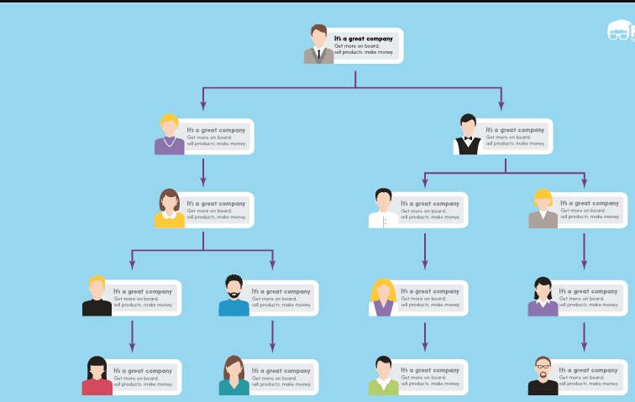
System Of Hierarchy:

Slide 8
Less Or No Advertising:
Dependency on direct sales helps the organization to rely less on advertising as personalized contact have more convincing power than advertisements.
No Fixed Salaries
This is a commission-based network where participants (not employees) are paid commissions to perform the specific task.
Accountability
Everyone is accountable only to himself. The more he sells, the more he earns.

Slide 9
Benefits To The Participants:
Participants are also the consumers of the network.
Hence, they also get discounts and other attractive offers to when they join the network.

Slide 10
The Advantages and Disadvantages of Network Marketing:
There is some stigma attached to the networking marketing business, especially those with multiple tiers, which can be characterized as pyramid schemes—that is, the salespeople in the top tier can make impressive amounts of money on commissions from the tiers below them.
The people on the lower tiers will earn much less. The company makes money by selling expensive starter kits to new recruits.
The appeal of network marketing is that an individual with a lot of energy and good sales skills can create a profitable business with a modest investment.

Slide 11
FCC rule:
A good rule of thumb, according to the Federal Trade Commission(FCC), is that single-tier network marketing operations tend to be more reputable than multi-tier schemes, in which people make money based on the number of distributors they recruit.

Slide 12
Benefits Of Direct Selling:
Research shows some of the most popular reasons why people choose direct selling are:
Direct selling is a good way to meet and socialize with people.
Direct selling offers flexible work schedules.
Direct selling is a good way to earn extra income.
Direct selling is a good way to own business.
There are no required levels of education, experience, financial resources or physical condition – Any one can do it

Slide 13
Benefits Of Direct Selling:
People of all ages and from all backgrounds have succeeded in direct selling.
You are your own boss, which means you can work part-time or full-time; you choose when and how much you want to work; set your own goals and determine yourself how to reach them.
Earn in proportion to your own efforts. The level of success you can achieve is limited only by your willingness to work hard.
Own a business with very little or no capital investment.
Receive training and support from an established company.

