Slide 1
Expression Conversion using STACK
Instructor: Javeria Naz

Slide 2
EXPRESSION CONVERSION
We can convert one type of expression to an equivalent other type of expression like infix to postfix, infix to prefix, postfix to prefix and vice versa.
Stack is used to convert an expression from one type to other.

Slide 3
Infix, Postfix and Prefix Expressions
INFIX: expressions in which operands surround the operator.
POSTFIX: operator comes after the operands, also Known as Reverse Polish Notation (RPN).
PREFIX: operator comes before the operands, also Known as Polish notation.
Example
Infix: A+B-C Postfix: AB+C- Prefix: -+ABC

Slide 4
Precedence
The order in which operations of an expression are evaluated is called order of precedence.
When an expression contains two or more different operators, the precedence of the operators controls the order in which the individual operators are evaluated.
An expression is always evaluated from left to right in the following order:
If the expression has parenthesis, the operations within parenthesis are evaluated first,
Exponential (TM) is given the highest priority.
Multiplication (*) and division (/) have the next priority. They have equal priority and are evaluated from left to right.
Addition (+) and subtraction (-) have the lowest priority. They also have equal priority and are evaluated from left to right.
For example, the expression “x+y*z” is evaluated as “x+(y*z)" because the "*" operator has higher precedence than the binary "+" operator.

Slide 5
Associativity
When an expression contains two or more operators having same precedence associativity determines how operators of the same precedence are grouped absence of parentheses and the order in which they execute.
For example expression "a+b-c", both + and - have the same precedence, then which part of the expression will be evaluated first, is determined by associativity of these operator. Here, both + and - are left associative, so the expression will be evaluated "(a + b)-c".

Slide 6
Cont.
Operator | Precedence | Associativity
Exponentiation (^) | Highest | Right Associative
Multiplication (*) & Division (/) | Second Highest | Left Associative
Addition (+) & Subtraction (-) | Lowest | Left Associative

Slide 7
Infix to Postfix Expression Conversion
During conversion process from infix to postfix, operands are directly added to the output and operators are stored onto the stack.
They are popped from stack and added to the output according to their precedence. In an infix expression, the arithmetic operators appear between two operands.
Parentheses can be used in the infix expression to specify the order of the operations.
For example: a + (b * c).

Slide 8
Cont.
But in the postfix expression, parentheses are not used.
During conversion process, parentheses are treated as operators.
The left parenthesis indicates the beginning of a sub-expression and when encountered, it is pushed onto the stack.
The right parenthesis is never pushed to the stack. When it is encountered, operators an popped from the stack until the left parenthesis is encountered, but do not add it to the output.
At this point, the sub-expression originally enclosed by the parentheses has been converted to postfix expression.
So the parentheses are discarded and these are not added to the output i.e. postfix expressions. When end of the expression is reached, all the operators from stack are popped and added to the output.

Slide 9
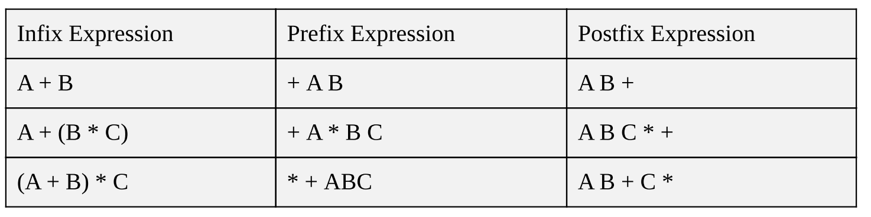
Cont.

Slide 10
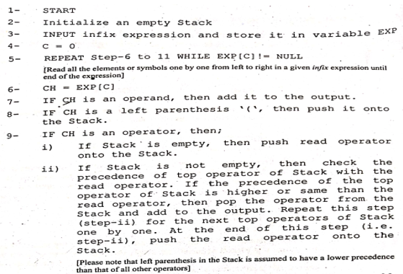
Algorithm

Slide 11
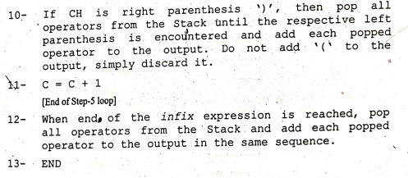
Cont.

Slide 12
Example
Covert (X – Y)*Z into postfix expression using STACK.
Steps | Reading Symbol | Stack | Output
1 | ( | (
2 | X | ( | X
3 | - | ( , - | X
4 | Y | ( , - | X Y
5 | ) | Empty | X Y -
6 | * | * | X Y -
7 | Z | * | X Y - Z
8 | End | Empty | X Y - Z *

Slide 13
Example
Covert X + ( Y / Z ) into postfix expression using STACK.
Steps | Reading Symbol | Stack | Output
1 | X | Empty | X
2 | + | + | X
3 | ( | +,( | X
4 | Y | +,( | X Y
5 | / | +,(,/ | X Y
6 | Z | +,(,/ | X Y Z
7 | ) | + | X Y Z /
8 | End | Empty | X Y Z / +

Slide 14
Example
Covert X ^ Y / ( 4 * Z ) + 9 into postfix expression using STACK.
Steps | Reading Symbol | Stack | Output
1 | X | Empty | X
2 | ^ | ^ | X
3 | Y | ^ | X Y
4 | / | / | X Y ^
5 | ( | / , ( | X Y ^
6 | 4 | / , ( | X Y ^ 4
7 | * | / , ( , * | X Y ^ 4
8 | Z | / , ( , * | X Y ^ 4 Z
9 | ) | / | X Y ^ 4 Z *
10 | + | + | X Y ^ 4 Z * /
11 | 9 | + | X Y ^ 4 Z * / 9
12 | End | Empty | X Y ^ 4 Z * / 9 +

Slide 15
Example
Covert X + ( Y / Z ) into postfix expression using STACK.
Steps | Reading Symbol | Stack | Output
1 | X | Empty | X
2 | + | + | X
3 | ( | +,( | X
4 | Y | +,( | X Y
5 | / | +,(,/ | X Y
6 | Z | +,(,/ | X Y Z
7 | ) | + | X Y Z /
8 | End | Empty | X Y Z / +

Slide 16
Infix to Prefix Expression Conversion
As mentioned earlier, in prefix expression operators are written before operands.
For example, the infix expression "A+B" is equivalent to prefix expression "+AB".
The infix expression is converted to prefix expression in the similar way infix to postfix conversion.
However, the infix expression is reversed, before converting to prefix expression.
Similarly, right parenthesis is pushed onto Stack, when left parenthesis '(' is encountered, then all operators from the stack popped and added to the output.
For example, infix expression A+B*C into reverse order is C*B+A.

Slide 17
Examples
Infix Notation | Prefix Notation | Comment
A+B | +AB | Add A and B
A/B | /AB | Divide A by B
(A+B)*C | *+ABC | Add A and B multiply the result by C
A+(B*C) | +A*BC | Multiply B and C, and add A
A*B+C/D | +*AB/CD | Multiply A and B, Divide C by D and add the results.
A*(B+C)/D | /*A+BCD | Add B and C, multiply by A, divide by D
A*(B+C/D) | *A+B/CD | Divide C by D, add B, Multiply by A.

Slide 18
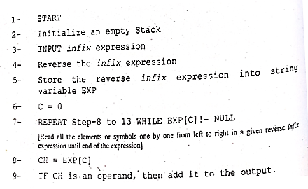
Algorithm Infix to Prefix

Slide 19
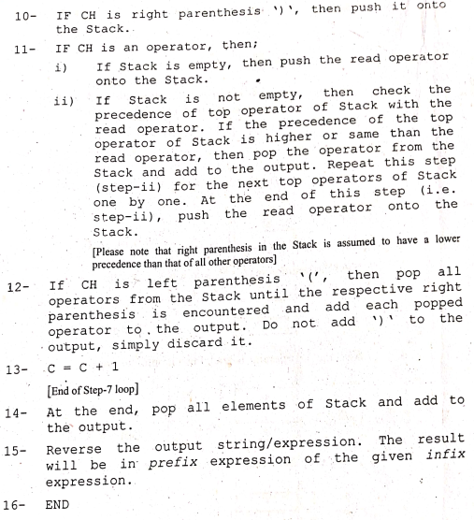
Cont.

Slide 20
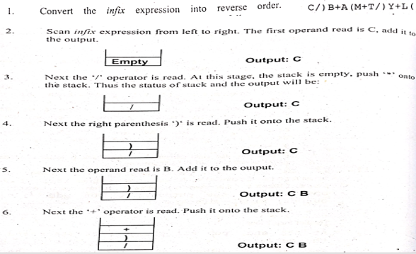
Example: Covert (L + Y) / T + M (A + B) / C into prefix expression using STACK.

Slide 21
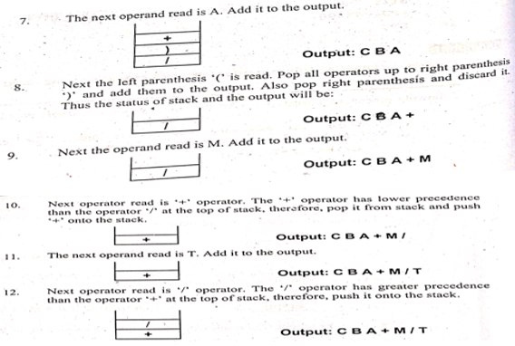
Example : Covert (L + Y) / T + M (A + B) / C into prefix expression using STACK.

Slide 22
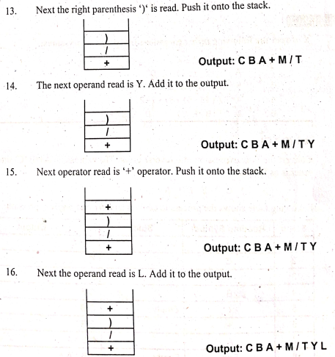
Example : Covert (L + Y) / T + M (A + B) / C into prefix expression using STACK.

Slide 23
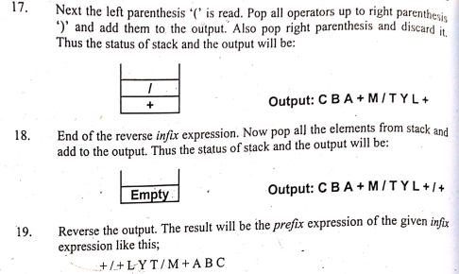
Example : Covert (L + Y) / T + M (A + B) / C into prefix expression using STACK.

Slide 24
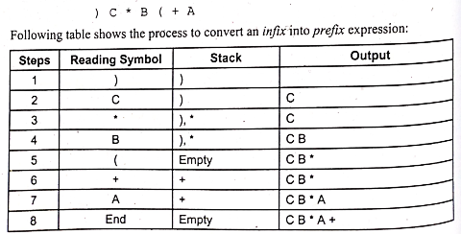
Example : Covert A + (B * C) into prefix expression using STACK.

Slide 25
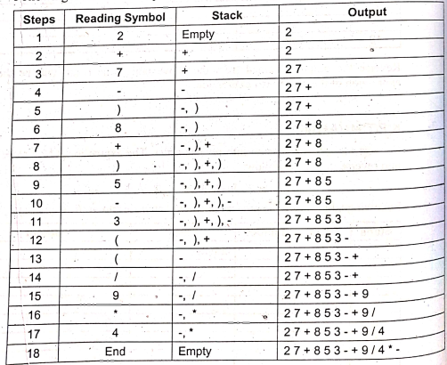
Example : Covert 4 * 9 / (( 3 – 5 ) + 8 ) – 7 + 2 into prefix expression using STACK.
2 +7 - ) 8 + ) 5 – 3 ( ( / 9 * 4

Slide 26
Expression Evaluation
Postfix expression evaluation
The expressions written in postfix form are evaluated faster than infix notation.
Parentheses are not used in postfix expression.
Generally postfix expressions are free from operator precedence that's why they are preferred in computer systems.
A computer system uses postfix form to represent expression.
A postfix expression can easily be evaluated using the stack data structure.

Slide 27
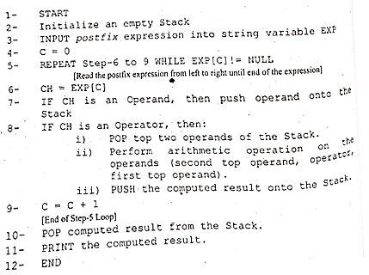
Algorithm: Postfix expression evaluation

Slide 28
Example: “AB/C-DE*+” when A=6,B=2, C=1,D=3,E=4
The total number of items I the expression “A/C-DE*+” are 9. So there will e 9 iterations of the loop.
In the 1st iteration the value of A is pushed onto the stack. The status of stack will be:
In the 2nd iteration the value of B is pushed onto the stack. The status of stack will be:
In 3rd iteration the operator ‘/’ is encountered, so the two values 2 and 6 are popped form the stack, and division operation is performed. The calculated result will be stored back onto the stack. The status of stack will be:
6
2
6
3

Slide 29
Cont.
1
3
In the 4th iteration the value of C is pushed onto the stack. The status of stack will be:
In 5th iteration the operator ‘-’ is encountered, so the two values from top are popped form the stack, and arithmetic operation is performed 3-1=2 . The calculated result will be stored back onto the stack. The status of stack will be:
In the 6th iteration value of D is Pushed onto the stack. The status of stack will be:
In the 7th iteration value of E is Pushed onto the stack. The status of stack will be:
2
3
2
4
3
2

Slide 30
Cont.
In 8th iteration the operator ‘*’ is encountered, so the two values from top are popped form the stack, and arithmetic operation is performed 4*3=12 . The calculated result will be stored back onto the stack. The status of stack will be:
In 9th iteration the operator ‘+’ is encountered, so the two values from top are popped form the stack, and arithmetic operation is performed 12+2=14 . The calculated result will be stored back onto the stack. It is the final value of expression.
12
2
14

Slide 31
Example
Input | Stack | Operation | Comment
6 | 6 |  | Push onto the stack
5 | 6,5 |  | Push onto the stack
2 | 6,5,2 |  | Push onto the stack
3 | 6,5,2,3 |  | Push onto the stack
+ | 6,5,5 | 2+3=5 | Pop 2 and 3 from the stack, perform addition “2+3” and add result 5 onto the stack.
8 | 6,5,5,8 |  | Push onto the stack
* | 6,5,40 | 5*8=40 | Pop 8 and 5 from the stack, perform multiplication “5*8” and add result onto the stack.
+ | 6,45 | 5+40=45 | Pop 40 and 5 from the stack, perform addition “5+40” and add result 45 onto the stack.
3 | 6,45,3 |  | Push onto the stack
+ | 6,48 | 45+3=48 | Pop 3 and 45 from the stack, perform addition “45+3” and add result onto the stack.
* | 288 | 6*48=288 | Pop 48 and 6 from the stack, perform multiplication “6*48” and add result onto the stack.

Slide 32
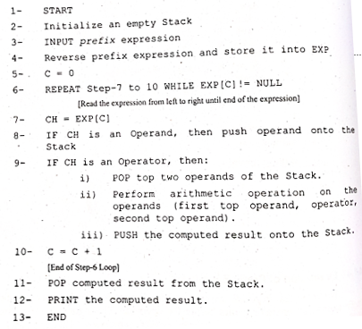
Prefix expression evaluation

Slide 33

Example
Input | Stack | Operation | Comment
4 | 4 |  | Push onto the stack
20 | 4,20 |  | Push onto the stack
/ | 5 | 20 / 4 = 5 | Pop 20 and 4 from the stack, perform divide “20/4” and add result 5 onto the stack.
4 | 5,4 |  | Push onto the stack
+ | 9 | 4 + 5 = 9 | Pop 4 and 5 from the stack, perform addition “5+4” and add result 9 onto the stack.
3 | 9,3 |  | Push onto the stack
+ | 12 | 3 + 9 = 12 | Pop 3 and 9 from the stack, perform addition “3+9” and add result 12 onto the stack.

Slide 34


