Slide 1
Hashing
Instructor: Javeria Naz

Slide 2
What is Hashing?
Hashing is a common technique for storing and searching data in such a way that the data can be inserted and retrieved very quickly.
Hashing uses a data structure called a hash table.
It means that hashing is achieved using hash table.
Hashing technique is used for performing insertion, deletion, and searching operations in a constant average time.
The constant average time means, the amount of time to perform the operation does not depend on data size.

Slide 3
Hash Table
A hash table is a data structure which stores data items in an associative manner (each data item is stored as "index or key, value” pair).
A hash table is also known as hash map. In a hash table, data is stored in an array format, where each data value has its own unique index value.
Each position of the hash table, often called a slot or bucket, where data item is stored (i.e. hash table is an array of slots on buckets).
Access of data becomes very fast if we know the index or key of the desired data.
In C++, usually we implement a hash table as an array of linked lists.
A hash table has two parts: an array as a storage medium (the act where data is stored) and a mapping function, known as hash function which for mapping between data items and slots.

Slide 4
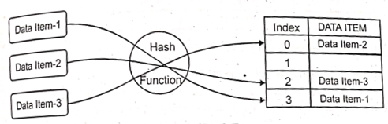
Hash Function
A hash function decides where to store and takes a data item (key value) as its parameter and generate an index location for that particular item to store it into the table.
Similarly, hash function regenerates (re-computes) the index (hash value) for that particular data item to retrieve it from the table.

Slide 5
Construction of a hash function
There are many possible ways to construct a hash function.
Different hash Functions use different techniques to generate the indices or hash values.
Generally, a hash function uses modulus arithmetic operator (%) to generate or regenerate the index.
In particular, the value of a data item is divided (using modulo % operator) by me table length to generate an index number or hash value in the table.
This index number refers to a location, or bucket in the hash table, where to store or retrieve the data item.

Slide 6
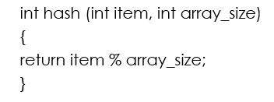
Example-1:
Example-1:(Hash Table with Integers as Data Items)
Assume that we have a set of integer data items 54, 26, 93, 17, 77, and 31.
The hash function takes a data item and divides it by the table or array size, returning the value.
Suppose the size of array is 11. So the formula value by the simple hash function is as under:
Index = (Data Item) % 11
Therefore, the hash function to compute data item is as under: (compute or generate the index or hash value)

Slide 7
Data Item | Data Item % 11 | Hash Value
54 | 54 % 11 | 10
26 | 26 % 11 | 4
93 | 93 % 11 | 5
17 | 17 % 11 | 6
77 | 77 % 11 | 0
31 | 31 % 11 | 9

Slide 8
Insertion of data in Hash Table
Once the hash values have been generated (or computed), we can insert item into the hash table at the designated position as shown in figure below.
0 | 1 | 2 | 3 | 4 | 5 | 6 | 7 | 8 | 9 | 10
77 | (None) | (None) | (None) | 26 | 93 | 17 | (None) | (None) | 31 | 54

Slide 9
Searching Data Items from Hash Table
when we want to search for a data item, we simply use the hash function to re-compute the index or hash value for the data item to be searched.
On the basis of hash value, we directly go to the slot where this data item is stored. Suppose, in above example, we want to search 26 from the hash table. We will re-compute its index or hash value and that will be 4 (26%11). Thus, we shall go to slot number 4 and directly access data item stored in this slot.
We can observe that this searching operation is very fast because a constant amount of time is used to retrieve a data item from any location of a hash table.

Slide 10
Collision Resolution
When two items hash to the same slot, we must have a systematic method for placing the second item in hash table.
This process is called collision resolution.
If the hash function is perfect, collisions will never occur but it is not always possible to design a perfect hash function which would generate unique index.
There are many collision resolution strategies to handle collisions. Some common strategies are as follows:
i) Open hashing or separate chaining
ii) Closed hashing or open addressing

Slide 11
i) Open Hashing (Separate Chaining)
The open hashing is also known as separate chaining.
In this technique, data items are not directly stored in the slots of the hash table.
Data items are stored in linked lists. The linked lists are attached to the slots of the hash table.
The starting address of the linked list is stored in the related slot of the hash table. It means that Slots of hash table will be the pointers to linked lists created for the data items.
Each slot of hash table points to one of these linked lists:
When an element hashes to a linked list, It is added to the linked list at that index in the array.
If more than one element hashes to the same value, then these data items are stored in the same linked list.
In this technique, when a data needs to be searched, it might become necessary to traverse all the nodes in a specific linked list attached with a hash table to retrieve the data.

Slide 12
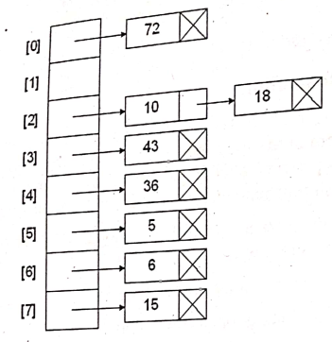
Example
Solution of collision using open Hashing:
Here size of array is 8.
Data values are: 10, 15, 18, 72, 5, 6, 43, 36.
Here. Each element is a pointer to a linked list of numeric data.
The Hash Function calculate the index for each data item.
For example, to insert 36 in hash table we compute the hash index as: (36%8)=4, so 36 will be stored in index 4.

Slide 13
closed hashing or open addressing
The closed hashing is also known as open addressing.
In this technique, data items are stored in the hash table itself without the use of linked lists.
In this method, a hash collision is resolved by linear probing, or searching through alternate locations in the array (the probe sequence) until either the target record is found, or an unused array slot is found (It means that the data item is placed into the closed empty slot the hash table).
EXAMPLE: As practiced in class

