Slide 1
People Excellence Performance

Slide 2
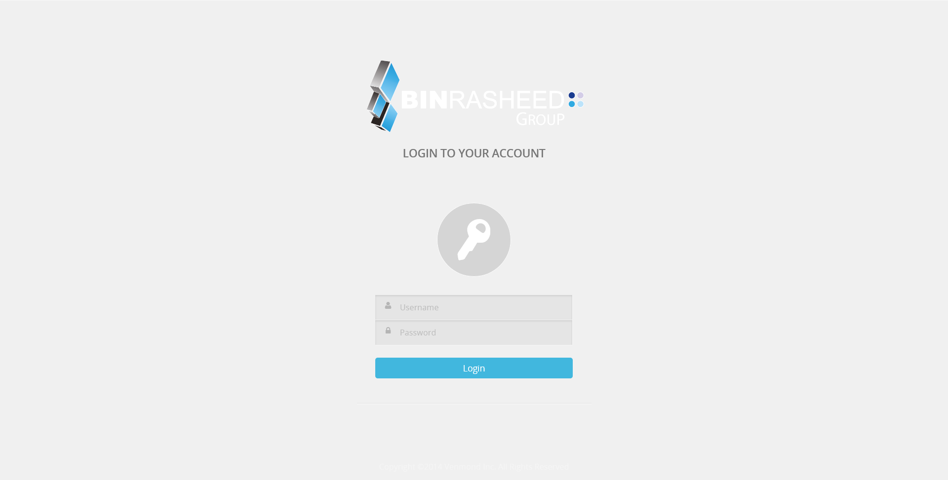
1- Login Screen

Slide 3
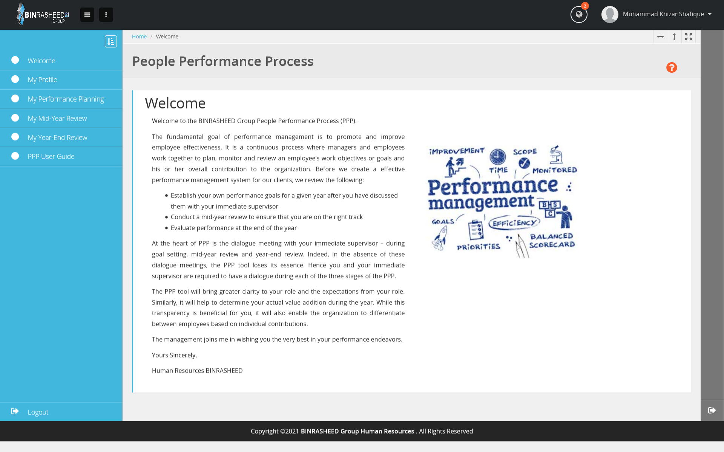
2- Welcome Screen

Slide 4
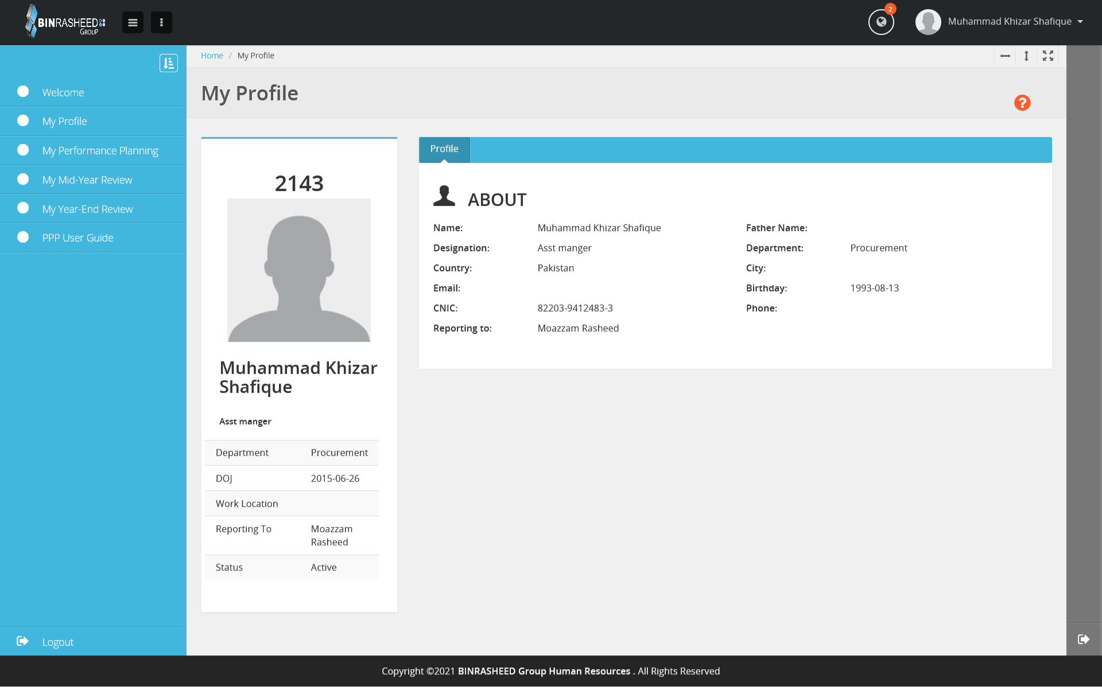
3- Employee Profile

Slide 5
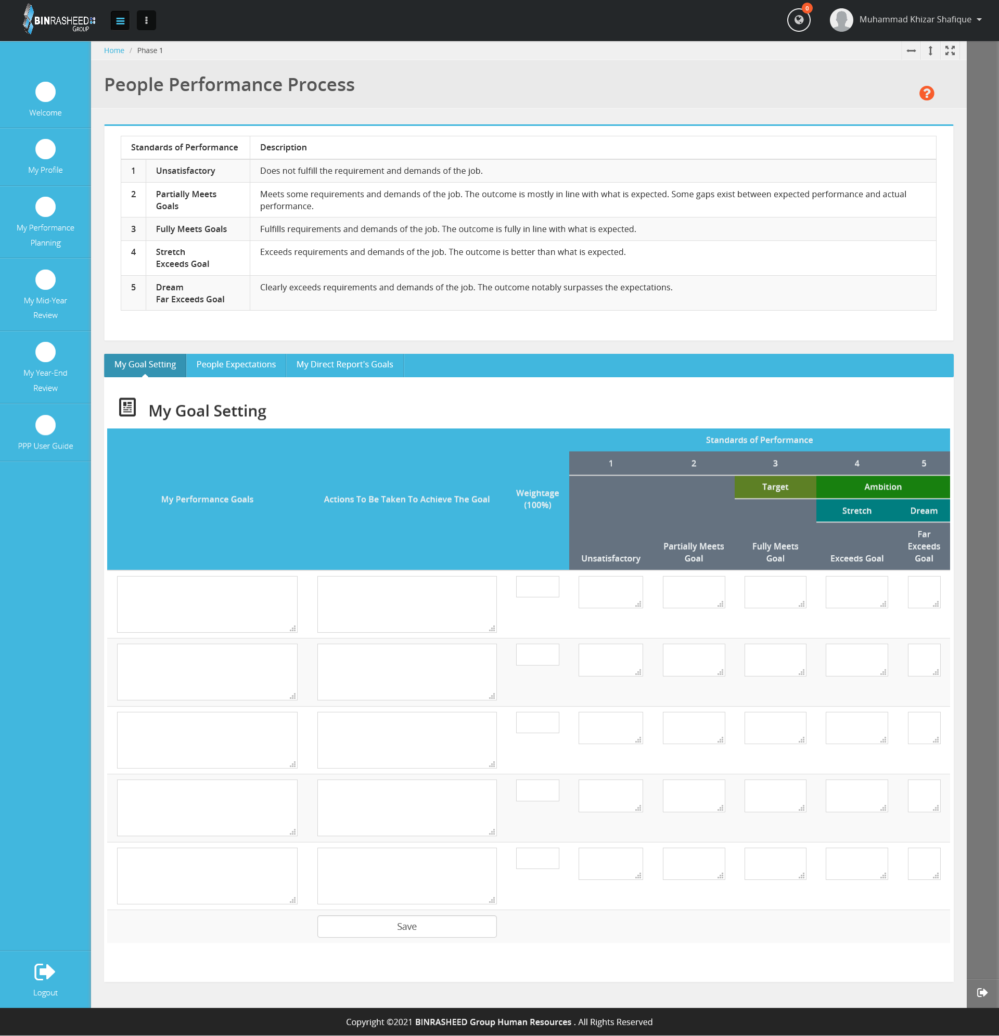
4- My Performance Planning
Tab 1- My Goal Setting In this tab every employee set their yearly goal and send it to their HOD. Tab 2- People Expectations Its just information Tab 3- My Direct Report's Goals In this tab HOD see their employee who directly reporting to him.

Slide 6
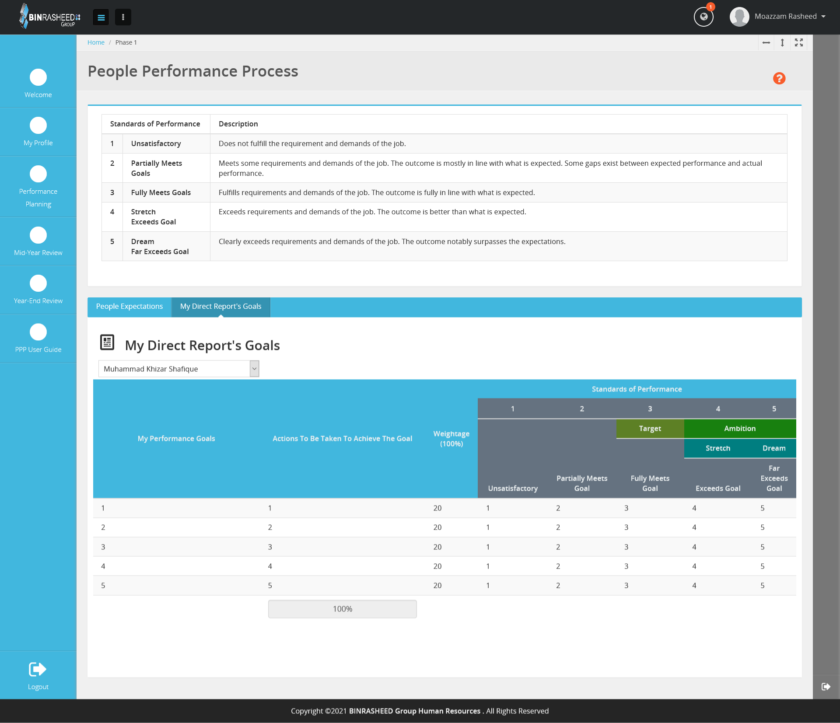
5- Performance Planning – HOD Display
When any employee set their goals and send it to his/her HOD then HOD will see all employees GOALS from this screen using selection of any of the employee.

Slide 7
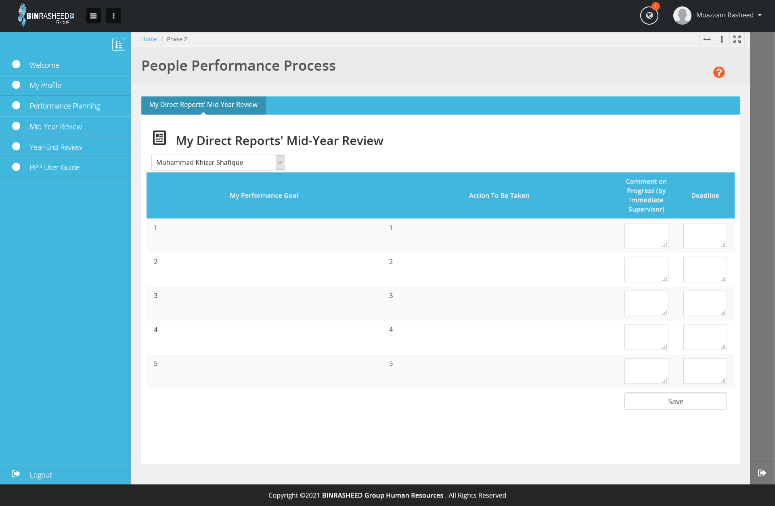
6- Mid Year Review – Employee / HOD Display
When HOD wants to see any employee Performance in middle of the year he/she used this screen and also give their comments on his/her progress. Also Every employee also used this screen to see their HOD comments on his/her progress.

Slide 8
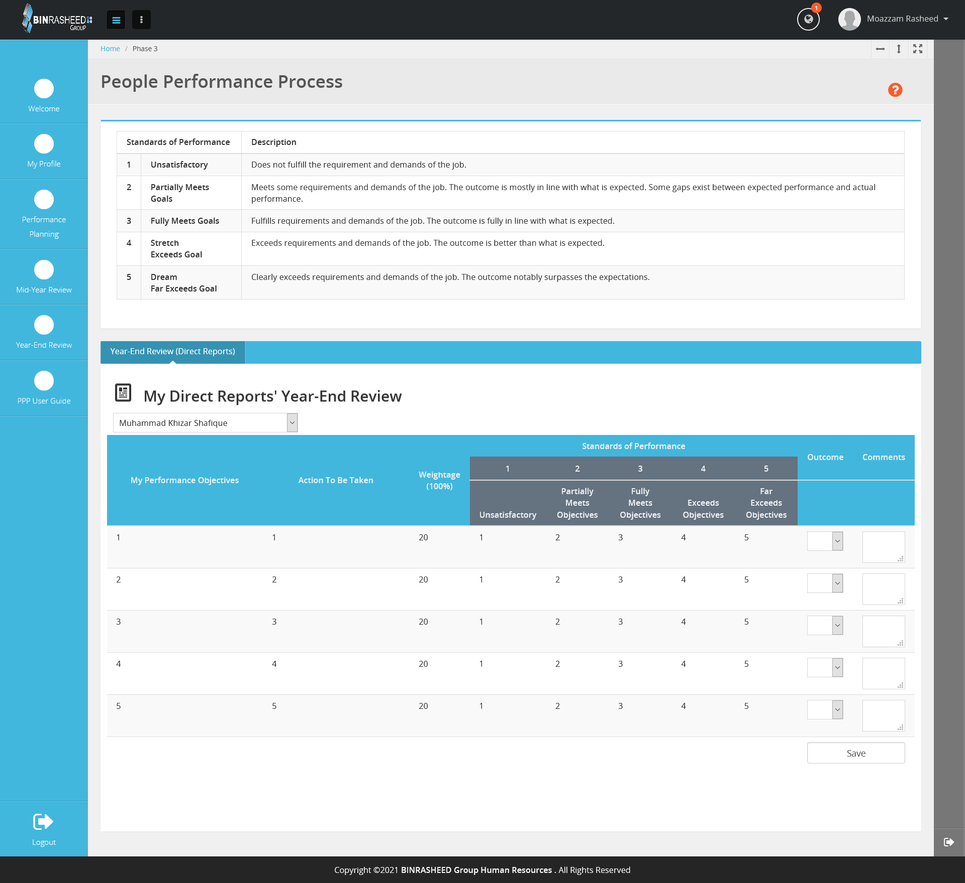
At Year End when HR Department initiate that all HOD submit final evaluation of all employees then this screen will used. In this screen all HOD gives marks according to the progress of every employee and also give marks of Section 2 (BEHAVIORAL COMPETENCIES) 1-Punctuality 2-Adaptability 3-Team work 4-Response Time 5-Self initiation After submit Year End review HR department received his/her final marks.
7- Year End Review – Employee / HOD Display

Slide 9
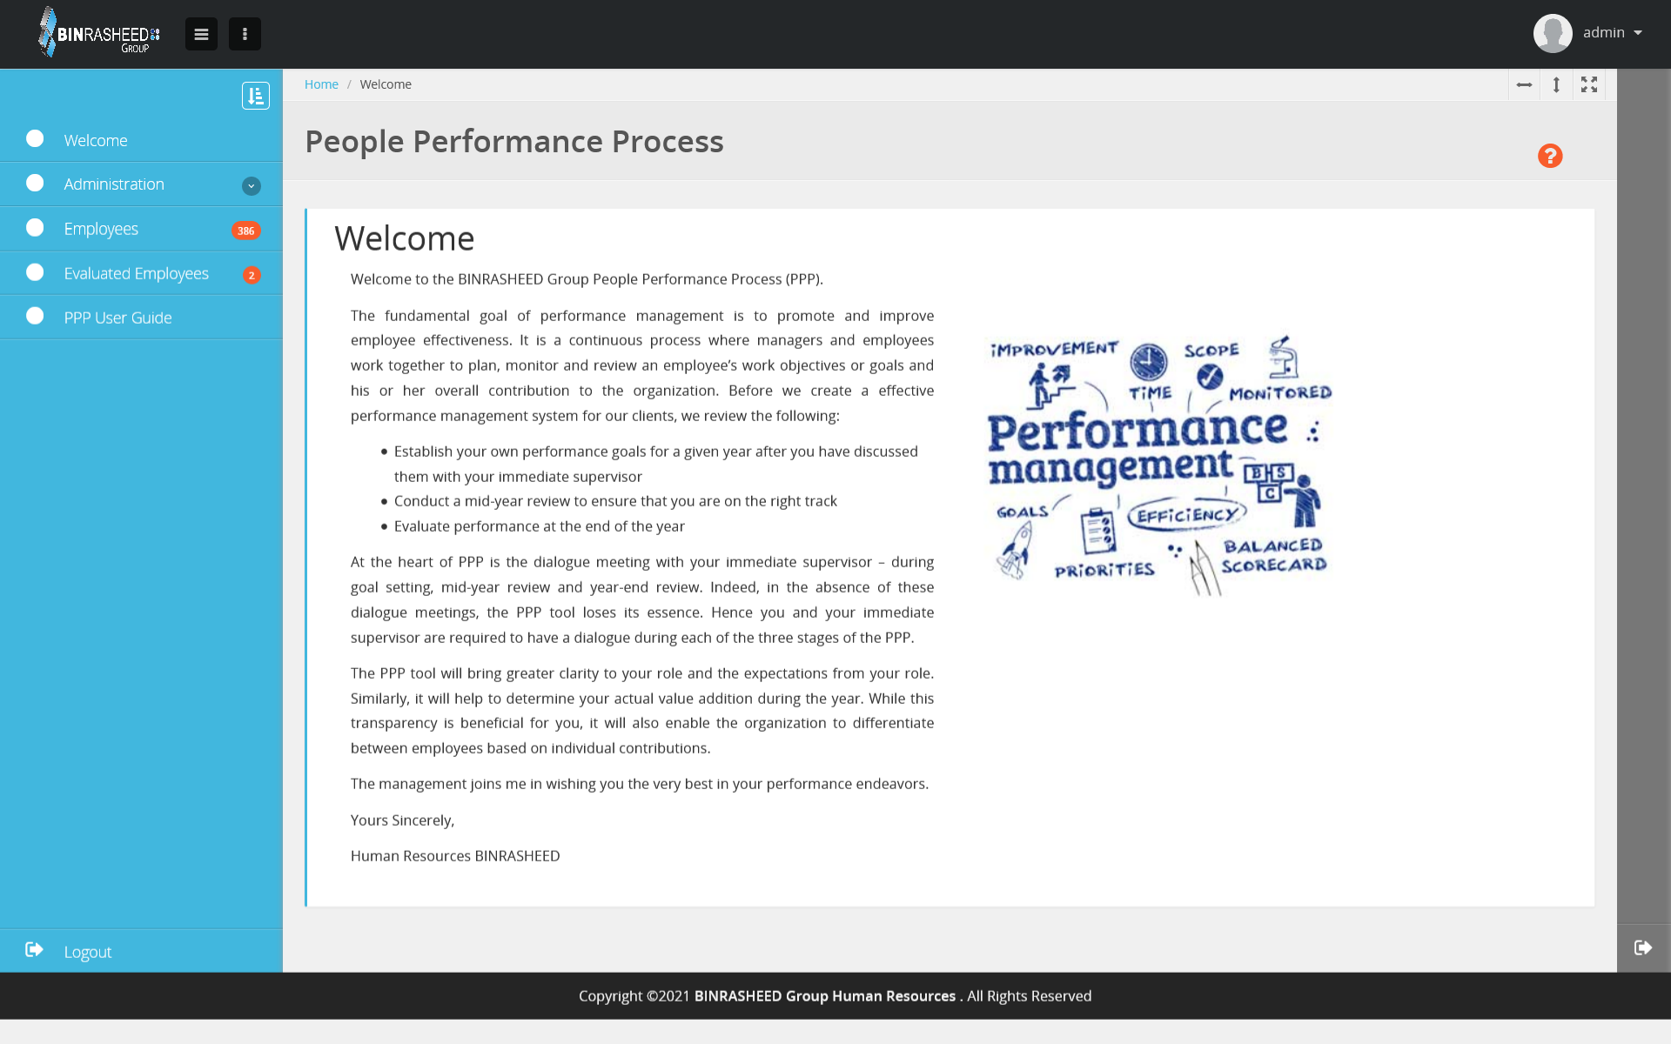
8- Admin Display
In admin display HR department see all employees list and those employees who have been evaluated by their HOD.

Slide 10
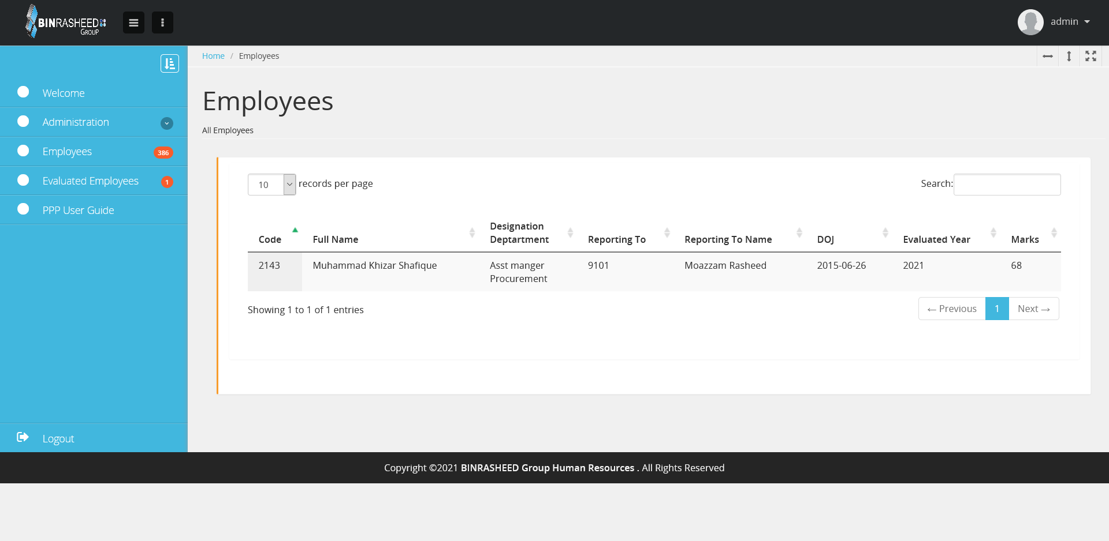
8- Admin Display
List of evaluated employees and later HR department will be able to download in excel for their own working.

