Slide 1
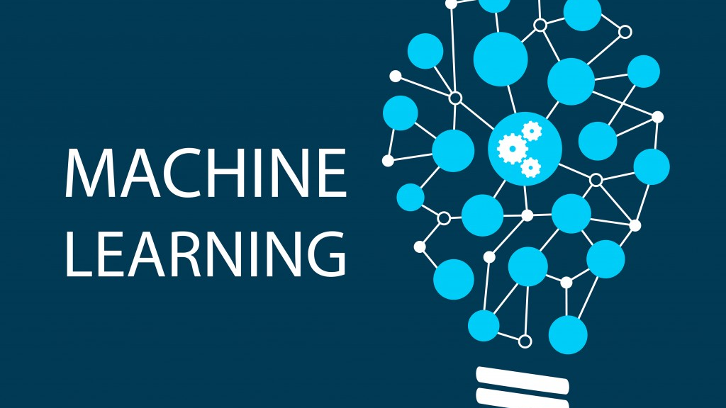
Hussein Alrubaye

Slide 2
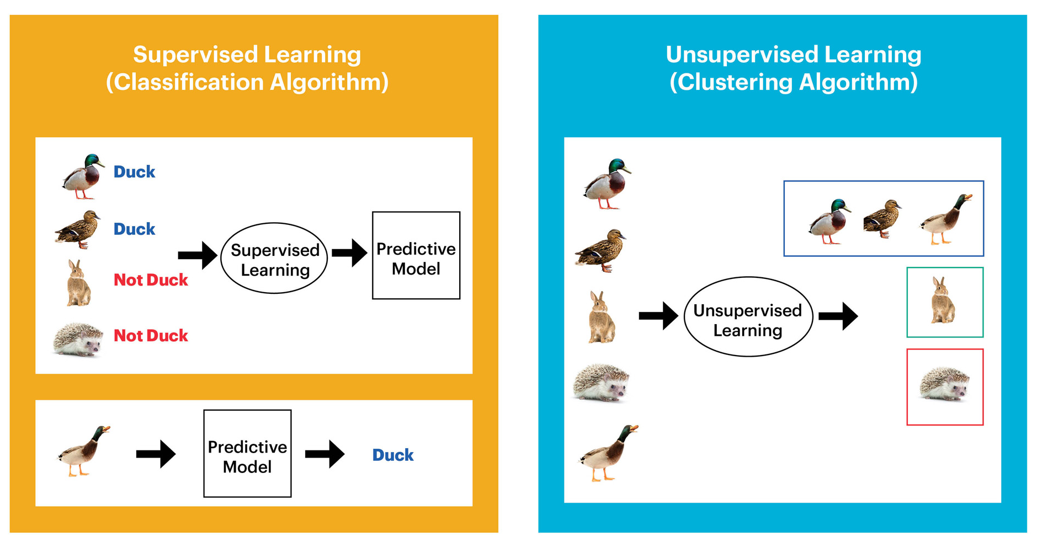
Type Of machine learning Algorithms

Slide 3

Type Of machine learning Algorithms
Supervisor Leaning: Have data to learn from
You already learn from your previous work about the physical characters of fruits
So arranging the same type of fruits at one place is easy now
Unsupervised Leaning : don't have data to learn from
Suppose you have a basket and it is filled with some different types of fruits and your task is to arrange them as groups.
This time, you don’t know anything about the fruits, honestly saying this is the first time you have seen them. You have no clue about those.

Slide 4
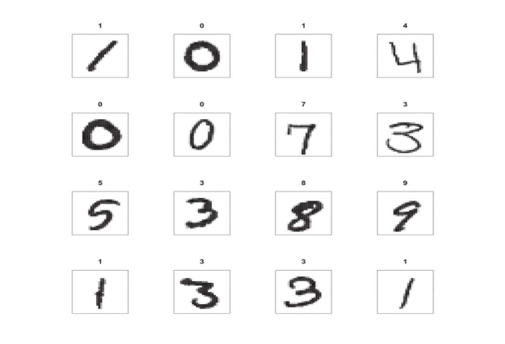
Problems

Slide 5
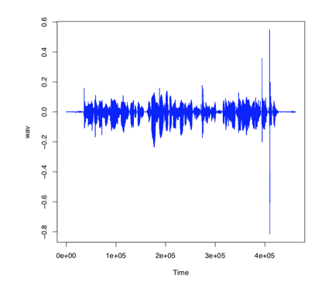
Problems

Slide 6
Problems
Who own article
What he may buy next
Face recognition

Slide 7
k-Nearest Neighbors
Choose
Choose a distance for measuring how far a given point is from another (Euclidean distance , Manhattan distance , etc )
Set
Set the size of the neighborhood k
Compute
Compute the distance from each existing point to the new point
Identify
Identify the class labels of the k points closest/nearest to the new point
Assign
Assign the most frequent label to the new point

Slide 8
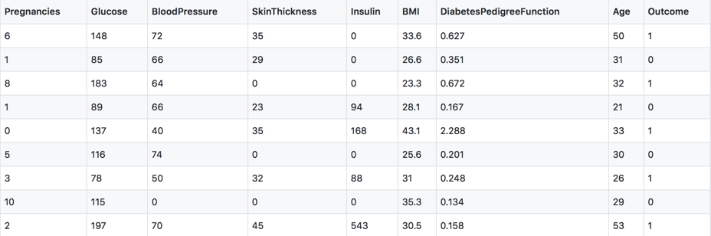

Diabetes dataset
Find W from this data
Y=W*x
X -->

Slide 9

Diabetes dataset
Distance Manhattan= $\sqrt{{(Xi−xj)}^{2}}$

Slide 10
Diabetes dataset
First row distance= $\sqrt{{{(X1−x1)}^{2}+{(X2−x2)}^{2}+{(X3−x3)}^{2}……{(X10−x10)}^{2}}^{}}$

Slide 11
k-Nearest Neighbors Regression
Choose
1
Choose a distance for measuring how far a given point is from another
Set
2
Set the size of the neighborhood k
Compute
3
Compute the distance from each existing point to the new point
Identify
4
Identify the response values of the k points closest/nearest to the new point
Compute
5
Compute the average of the response values of those k neighbors as the best estimate of the response value of the new point

