Slide 1
Machine Learning Project
Churn Modeling
Business Objective:-
Customer churn is a concerning problem for large companies (especially in the Telecom field) due to its direct effect on revenues. Companies often seek to know which customers are likely to churn in the recent future so that timely action can be taken to prevent it

Slide 2
Problem Statement
Building Logistic Regression Machine Learning model that predicts which of their customers are likely to churn (stop using their service in future).

Slide 3
Data Health
The dataset provided for this activity consists of 11 features where 10 are independent features and 1 is a target variable.
There are 3333 data instances distributed across 11 variables.
Variable datatypes
- 5 variables are of float64 datatype
- 6 variables are of int64 datatype
DataFrame does not have any duplicate instances

Slide 4
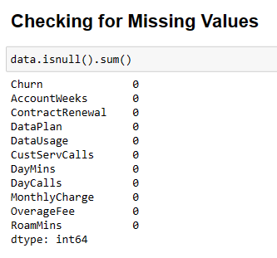
Missing Values
The DataFrame is devoid of any missing values

Slide 5
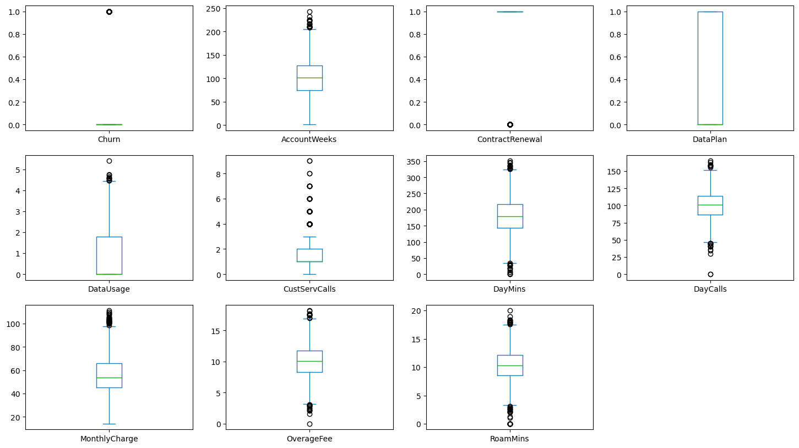
Outliers
The DataFrame has outliers.

Slide 6
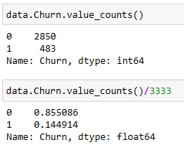
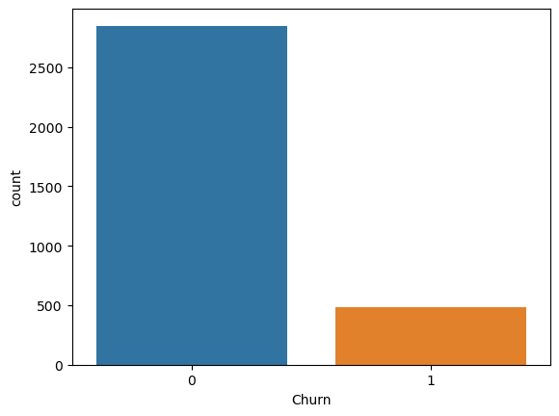
EDA Univariate Churn
Churn is the target variable
Data is heavily imbalanced
2580 data instances belongs to negative class{0} and 483 data instances belongs to positive class{1}.

Slide 7
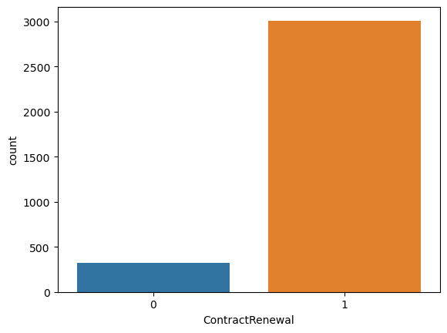

EDA Univariate ContractRenewal
3010 customers has recent renewal of contract
323 customers do not opt for contract renewal

Slide 8
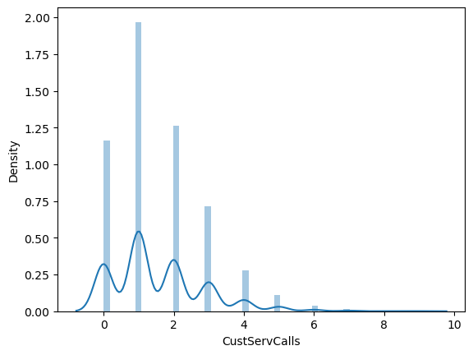
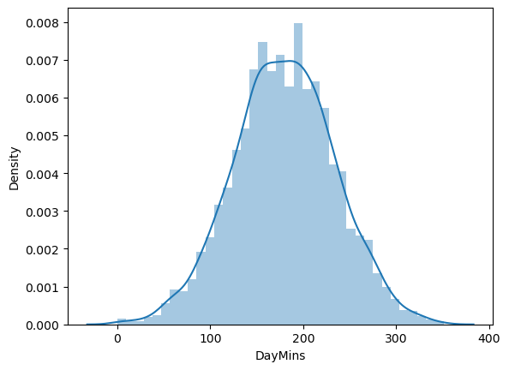
EDA Univariate CustServCalls Daymins

Slide 9
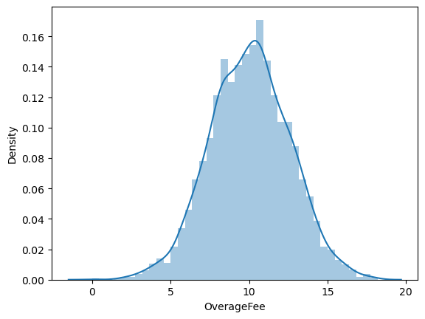
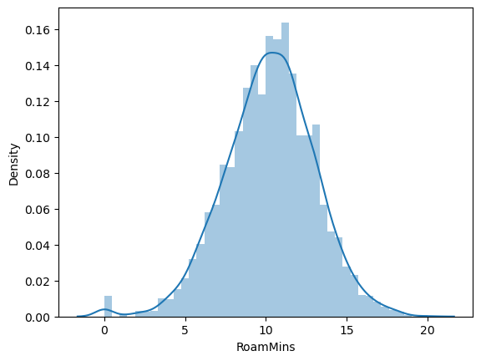
EDA Univariate OverageFee RoamMins

Slide 10
EDA
List of Important Variables
DataUsages
CustServCalls
DayMins
OverageFee
RoamMins
ContractRenewal

Slide 11
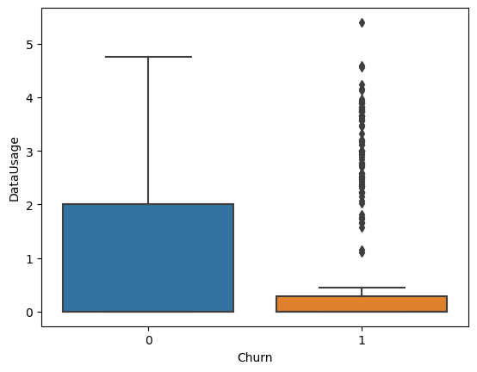
EDA Bivariate Churn Vs DataUsage
There is a significant difference between the groups

Slide 12

EDA Bivariate Churn Vs ContractRenawl
- Chi-Squared Statistic: 222.56575664993764
- P-value: 2.4931077033159204e-50
- There is significant association

Slide 13
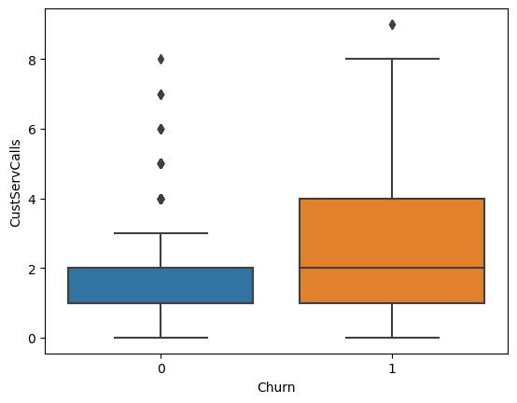
EDA Bivariate Churn Vs CustServCall
There is a significant difference between the groups

Slide 14
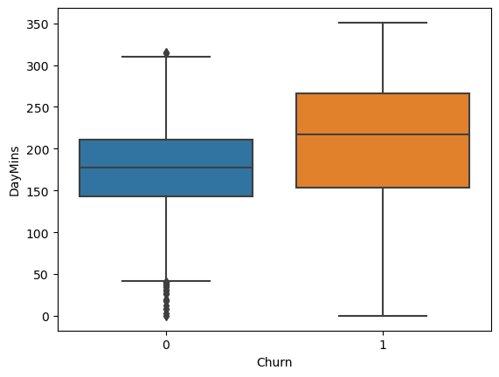
EDA Bivariate Churn Vs DayMins
There is a significant difference between the groups

Slide 15
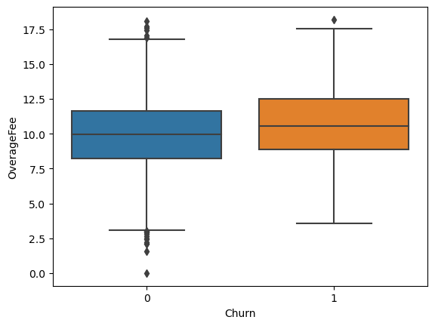
EDA Bivariate Churn Vs OverageFee
There is a significant difference between the groups

Slide 16
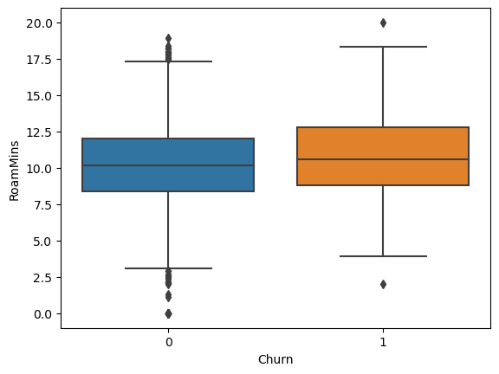
EDA Bivariate Churn Vs RoamMins
There is a significant difference between the groups

Slide 17

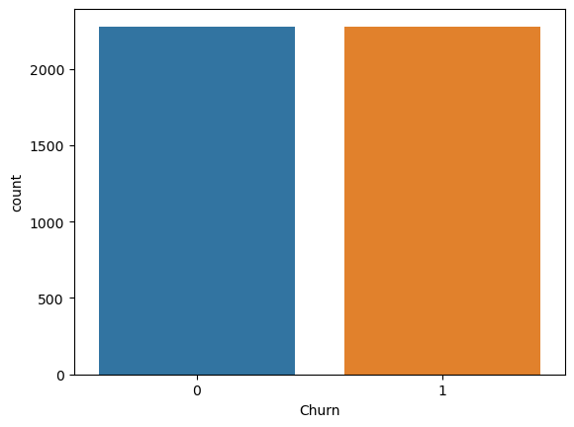
Feature Engineering
LabelEncoding has been done to bring all the variables similar Scale.
SMOTE technique has been used to get rid of the imbalanced data in Target Variable
SMOTE Resampling

Slide 18

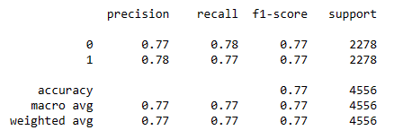
ML Model {Training} Model - 1

Slide 19

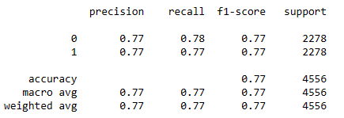
ML Model {Training} Model - 2

Slide 20

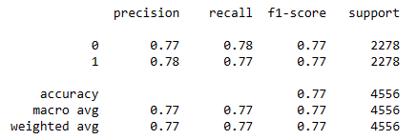
ML Model {Training} Model - 3

Slide 21

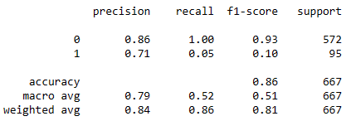
ML Model {Validation} Final Model

Slide 22
Final Model - Logistic Regression
The Logistic Regression algorithm works on probability threshold
Default Value is 0.5
So far all the metrics that we have analyzed works on threshold.
To judge the performance of our model in better way, we should go for ROC_AUC score.

Slide 23
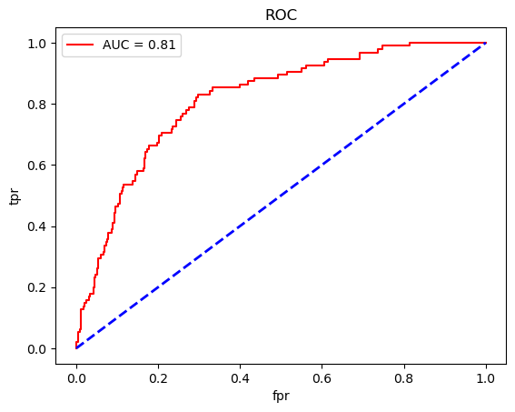
ROC_AUC Score & ROC Curve
ROC_AUC Score is 0.814

Slide 24
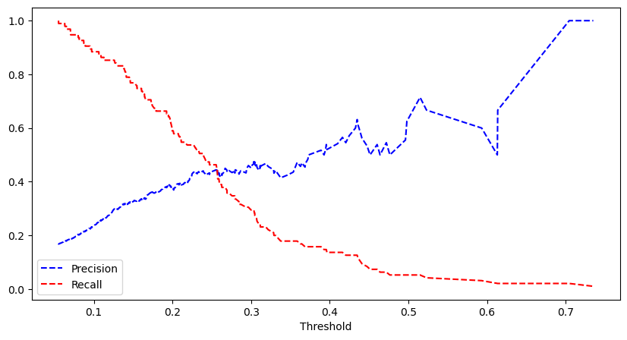
Optimizing the Model using Precision and Recall Score
Can obtain optimum model with threshold of 0.25

Slide 25

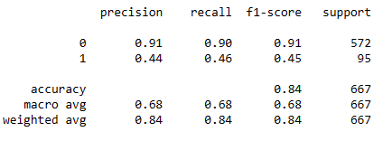
Optimized Model

