Slide 1


Creating LinkedIn Summary – Using Prompt Engineering Skills
Hello, everyone! I am excited to share with you my newly developed skills in the field of Prompt Engineering.
In this presentation, I will discuss how I utilized these skills to create my LinkedIn summary using OpenAI Playground.

Slide 2
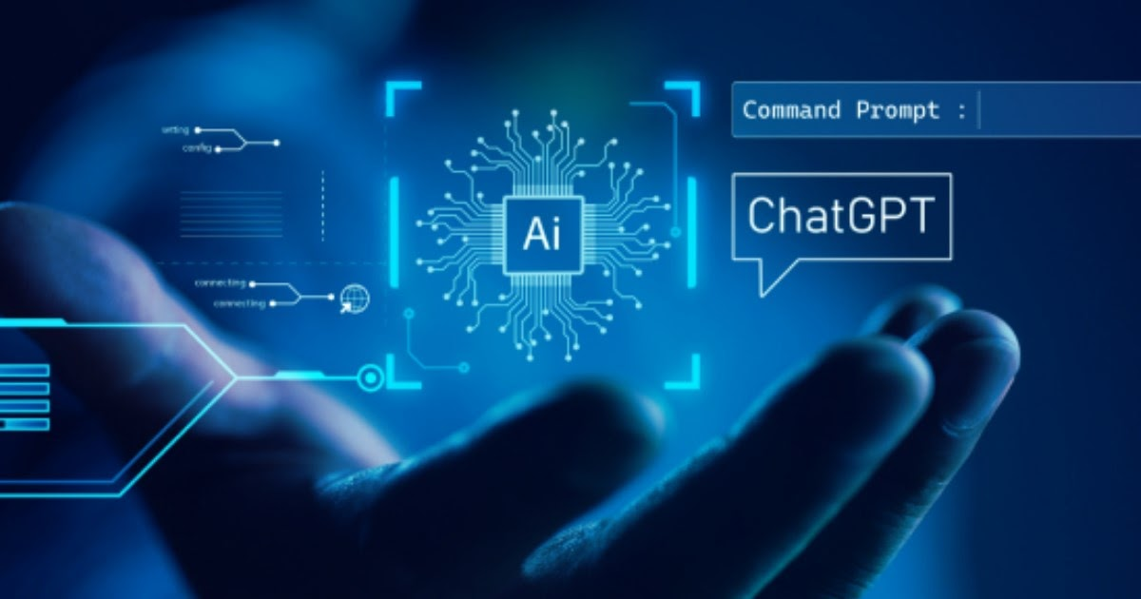
Art and Science of Prompt Engineering
It is the process of crafting effective prompts that yield desired responses from AI models like ChatGPT.
By understanding how language models work, we can optimize their output by providing well-crafted instructions or questions.
This Photo by Unknown author is licensed under CC BY-SA-NC.

Slide 3
LinkedIn Summary: Without Prompt Engineering
LinkedIn Summary:
With over 5 years of experience in the automobile industry, I am transitioning my career to the AI sector. Armed with a Masters in Vehicle Engineering from the University of Pavia and a B.Tech from VTU Karnataka, I bring a solid engineering foundation to my professional journey.
Recently completing certifications in Data Science and ML, I am now poised to contribute my skills to the Machine Learning and Data Analytics domain. My background in the automobile industry, coupled with a newfound proficiency in AI technologies, positions me as a versatile professional ready to navigate the challenges of evolving tech landscapes.
Key Highlights:
- 5+ years of hands-on experience in the Automobile Industry.
- M.Sc. in Vehicle Engineering from the University of Pavia.
- B.Tech from VTU Karnataka.
- Certified in Data Science and Machine Learning.
As I seek new opportunities, I am eager to bring my problem-solving skills and commitment to continuous learning to a team focused on the innovative advancements in AI. Let's connect to explore potential collaborations and share insights in this exciting field.

Slide 4
LinkedIn Summary: My Approach
I have utilized OpenAI Playground to complete this Project, as it provides an excellent platform for experimenting with prompt engineering techniques.
I have designing a Discrete Prompt for obtaining Expected Response.
To create an engaging LinkedIn summary, it was crucial to craft prompts that would elicit relevant information about myself, so by formulating specific questions or instructions in a structured manner (Utilizing Variables, Contexts, Delimiters, Indentations), I could guide ChatGPT towards generating appropriate content.
Defined following Variables inside the Discrete Prompt to give clear instruction to generate response as pe my expectation.
Role: 'This Variable Assigns specific role to Machine to perform Specific Task'
Context: 'This Variable gives information to the AI about the exact expectations from AI'
Requirements / Clarification: 'In this variable I have explicitly provided my requirements in Response'
Details: 'Here details being provided which I wanted to be incorporated in my response'
Prompt: 'Given clear Instruction how Machine will utilize the provided information and how it should return the output.'
At the end, have performed Response Analysis and Hyperparameters tunning to get the expected response.

Slide 5
LinkedIn Summary: Discrete Prompt
Role: You are a professional LinkedIn Summary Creator, having all the required knowledge and skills to perform this task.
Context: I require a LinkedIn summary made for my specific industry. This summary should grasp the attention of anyone who visits my LinkedIn profile. Focus on attracting the attention of hiring manager and anyone who is hiring in the AI Industry (Machine Learning, Deep Learning and Data Analytics).
Prompt: Write a LinkedIn summary for me that showcases all of my best skills, attributes and characteristics highlighted in the relevant variables below. Pay close attention and adhere strictly to the clarifications below:
Clarifications:
1. Write the summary in first person.
2. Utilize professional diction.
3. Ensure a formal register and friendly tone.
4. Do not make any information up pertaining to me.
5. Avoid emotive language.
6. Use Emojis and Hashtags
Details:
1. Previous Industry: Automobile Industry with 5+ years of experience in Pirelli SpA as Vehicle Dynamics Engineer
2. Switching Industry: AI (Machine Learning, Deep Learning, Data Analytics)
3. Education: M.Sc in Vehicle Engineering from Universita di Pavia (Italy), B.Tech in Mechanical Engineering from VTU (Karnataka)
4. Technical skills: Python, SQL, Tableau, Excel, EDA, Data Analysis
5. Having International Working Experience and Cross-Cultural adaptation
6. Certification: Data Science and Machine learning from MIT-USA on Edx, SQL from Skill Nation, Certification in Computational Statistics and Applied Probability

Slide 6
LinkedIn Summary: My Approach
Tuning Related Hyperparameters for Optimized Results
Adjusting hyperparameter values to achieve more accurate and desirable outputs from ChatGPT during summarization generation process.
Through trial-and-error iterations on parameters like temperature , Top P, Best of , max tokens I achieved optimal results for my LinkedIn summary project.
Hyperparameters | Values
Mode | Complete
Model | Text-davinci-003
Temperature | 0.8
Top P | 0.9
Maximum Length | 500 tokens
Frequency Penalty | 0.2
Presence Penalty | 0.4
Best of | 2

Slide 7
LinkedIn Summary: Engineered Summary Using Discrete Prompt
🚗 🚗 🚗 --------------🔀 ---------------- 📊 🧠 🤖 📈 🧠📊
🚀 Transitioning from the Automobile Industry to the AI Universe (ML, DL & Data Analytics) 🌟
Hello!
I'm an experienced Vehicle Dynamics Engineer with a passion for data-driven innovation. After more than 5 years of excelling in the automotive industry, I'm now steering my career towards Machine Learning, Deep Learning and Data Analytics.
🛠️ My journey in the automotive world has been thrilling, involving the fine-tuning the dynamics of the vehicles for optimal performance and safety. Yet, I've always been captivated by the power of data to unlock insights, make informed decisions, and drive progress.
💡🎓 Equipped with a M.Sc. degree in Vehicle Engineering from Universita Di Pavia - Milan (Italy)
💡👩‍🎓 B.Tech in Mechanical Engineering from VTU – Karnataka.
📚 Complemented my expertise by pursuing a MicroMaster program focused on Data Science & Machine Learning at MIT-USA on Edx platform.
💪 During this immersive learning experience ,I successfully completed several projects
related to Linear/Non-Linear Regression as well as Classification problems.
Additionally, I've worked extensively with Decision Tree and Random Forest algorithms utilizing Bagging and Boosting techniques. Moreover, I've also ventured into Deep Learning projects focused on NLP using Hugging face's BERT Transformer model, and Image Classification leveraging CNNs.
I possess 💪 excellent Prompt Engineering skills along with Large Language Models like ChatGPT, and fine-tuned hyperparameters for obtaining optimal responses.
My mission? To seamlessly merge my engineering prowess with data science expertise to tackle complex challenges and unlock new opportunities.
💼 As a Vehicle Dynamics Engineer at Pirelli S.p.A., I gained invaluable international working experience while collaborating with diverse teams across cultures 🌍 . This cross-cultural integration has equipped me with exceptional communication skills that enable seamless collaboration within multicultural environments.
✅ Now actively seeking opportunities where I can leverage my technical acumen 💻 , passion for data-driven insights 🔍 ,my newly developed expertise in ML,DL ,Data Analytics and international exposure to contribute effectively in the AI industry.
🤝 If you're looking for a dedicated professional who can bring fresh perspectives and innovative solutions, let's connect! 🤝
#AI #MachineLearning #DataAnalytics #Python #SQL #Tableau #PowerBI #DataScience #DeepLearning #NLP #Transformers #PromptEngineering

Slide 8

Conclusion:
My journey in learning Prompt Engineering and utilizing it to create a project for my LinkedIn summary has been both challenging and rewarding.
By understanding the art and science behind prompt crafting, as well as fine-tuning hyperparameters, I was able to generate high-quality content.
I am excited to apply these skills in future projects.

