Slide 1
Arabic TTS synthesizer By: Samir Mohamed, Ali abdelrhman, Amira abdel nabi, Mai Ahmed
Supervisor: Dr.hanaa

Slide 2
Momken Team

Slide 3
Introduction

Slide 4
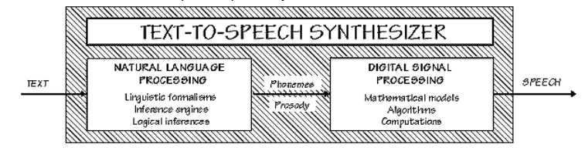
Text-To-Speech (TTS)
Text to speech is a software program that reads the text automatically and without human intervention.
The TTS consist of two modules:
Natural Language Processor (NLP).
Digital Signal Processor (DSP).

Slide 5
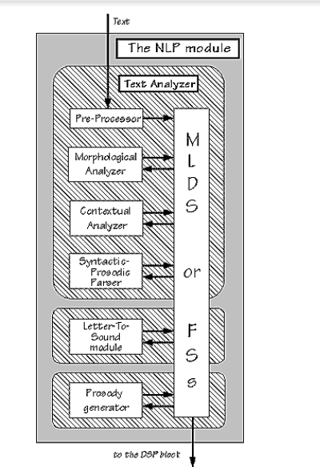
NLP
Text Normalization
Pre-Processor - Sentence Tokenization
Morphological Analyzer
Contextual Analyzer
Syntactic-Prosodic Parser
Phonetic Transcription
Phonetic Analysis
Letter To Sound Module

Slide 6
Arabic Language
Arabic is a complex language and it is not like other languages.
has special characters called “diacritics”
سَلِمْتُ عَلَى الْمُدَرِّسَةِ
ذَهَبْتُ الى الْمَدْرَسَة

Slide 7
Motivation
It is good for the blind, slow readers, and less straining for the eyes.
Arabic TTS Synthesizer System brings benefits especially in the educational field.
It helps the research, data collecting and text analyzing.
It is very useful for the students and language researchers. It provides them with an effective way of knowing how to pronounce the words
It is more relaxing to listen instead of reading large portions of text.

Slide 8
The needs of Arabic TTS
our main target peoples in our project are peoples whose disabled or blind or impaired users
used by beginners – those who have no background or do not speak Arabic.
teachers may use this system to teach their students on the correct pronunciation
finally This system also benefits students especially in learning and improving their skills and vocabularies of Arabic language.
Besides, many different types of people whose jobs require them to search for knowledge in documents would be useful in the field of linguistics and engineering can use this project.
Students who study the words occurrences in text.

Slide 9
The Benefits of Arabic TTS
The following are benefits of the Arabic TTS Synthesizer System:
Easy to use – intuitive: Arabic TTS Synthesizer System interface will be designed to be intuitive and easy to use.
Efficient: Arabic TTS Synthesizer System reduces costs and increases efficiency.
Arabic TTS Synthesizer System will help users to learn Arabic language
Provides accessibility: Over the Web and over the phone.
Offers adaptability and flexibility: Any time, anywhere can use it.

Slide 10
Techniques
1- Supervised Machine Learning
The majority of practical machine learning uses supervised learning. And we use it too in our project through naïve Bayes algorithm .
Y = f(X)
It is called supervised learning because the process of an algorithm learning from the training dataset can be thought of as a teacher supervising the learning process. We know the correct answers, Learning stops when the algorithm achieves an acceptable level of performance.
Supervised learning problems can be further grouped into regression and classification problems.
Classification: A classification problem is when the output variable is a category, such as “red” or “blue”.
Regression: A regression problem is when the output variable is a real value, such as “dollars” or “weight”.
Some popular examples of supervised machine learning algorithms are:
Linear regression for regression problems.
Support vector machines for classification problems.

Slide 11
Naïve Bayes

Slide 12
Techniques(cont.)
2- Unsupervised Machine Learning
Unsupervised learning is where you only have input data (X) and no corresponding output variables. The goal for unsupervised learning is to model the underlying structure or distribution in the data in order to learn more about the data.
These are called unsupervised learning because unlike supervised learning above there is no correct answers and there is no teacher
Unsupervised learning problems can be further grouped into clustering and association problems.
Clustering: A clustering problem is where you want to discover the inherent groupings in the data, such as grouping customers by purchasing behavior.
Association: An association rule learning problem is where you want to discover rules that describe large portions of your data, such as people that buy X also tend to buy Y.

Slide 13
Applications of Arabic TTS
Applications for the Blind
Educational Applications
Applications for Telecommunications
Applications for Multimedia
Fundamental and Applied Research
Government Services

Slide 14
THE CHALLENGES BEHIND THE Arabic TEXT-TO-SPEECH
The task of developing TTS Synthesizer System is very challenging and not easy, as it require
The Diacritization Problem
Dialects
Arabic is spoken in more than 23 countries by 300 million people. There are many varieties of the Arabic language, many dialects that reflect social variety of its speakers.
Differences in gender
There are in Arabic inflectional components that reflect the gender of the speaker and of the listener.
For example the word “تكلم” In cases where the listener is male.
In cases where the listener is female we say ”تكلمى “.

Slide 15
objectives
Solve diacritization problem.
design, implement and evaluate an Arabic TTS Synthesizer System.
Accuracy must be greater than 80%.
Open Source code.

Slide 16
Stakeholders
Blinds .
Researchers.
Students.
non speak Arabic or beginners.
Readers.
Companies.
Arabic TTS developer.

Slide 17
Modwanna Functional/NonFunctional Requirement
Functional
Selection of data from database should be less than 10 seconds.
Execution of the whole program should be less than 12 hours.
Database should be Mysql.
This program should be in java.
Program will run properly if word is in the database or not.
The System should
read file and splits the file into words.
remove diacritization and samples from words.
connect to MySQL Database.
select all elements from the table of the character we use.
identify the word is “new” if the word does not be in the selected data from database.
identify the word is “updated” if the word is in the selected data and update its counter.
identify the word is “old” if it’s not modified.
insert the data back to the database based on tags.
add a word in primary table if it’s new and it’s (مُشَكَّلَةْ) version in secondary.
Non Functional

Slide 18
Modwanna Non Functional Requirement
Selection of data from database should be less than 10 seconds.
Execution of the whole program should be less than 12 hours.
Database should be Mysql.
This program should be in java.
Program will run properly if word is in the database or not.

Slide 19
Tekrar Functional Requirement
Functional
The data should be Average 600,000 words.
Selection of data from database should be less than 10 seconds.
Execution of the whole program should be less than 24 hours.
Database should be MySQL.
This program should be in java.
Program will run properly if word is in the database or not.
The System should
read file and splits the file into words.
remove diacritization and samples from words.
connect to MySQL Database.
select all elements from the table of the character we use.
identify the word is “new” if the word does not be in the selected data from database.
identify the word is “updated” if the word is in the selected data and update its counter.
identify the word is “old” if it’s not modified.
insert the data back to the database based on tags.
add a word in primary table if it’s new and it’s (Diacritization) version in secondary.
Non Functional

Slide 20
Tekrar Non Functional Requirement
The data should be Average 600,000 words.
Selection of data from database should be less than 10 seconds.
Execution of the whole program should be less than 24 hours.
Database should be MySQL.
This program should be in java.
Program will run properly if word is in the database or not.

Slide 21
Naïve Bayes Code Functional Requirement
The system should
implement Naive Bayes Algorithm .
connect to 2 databases (gpModawana & gpFrequency)
get the id for specific word in primary table.
get all words associated to a certain id from secondary table.
get the number of times 2 words repeated.
remove samples from words.
remove diacritic from words.

Slide 22
Naïve Bayes Code Functional/NonFunctional Requirement
Functional
Non Functional
The system should
implement Naive Bayes Algorithm .
connect to 2 databases (gpModawana & gpFrequency)
get the id for specific word in primary table.
get all words associated to a certain id from secondary table.
oget the numbers of times that the two words are repeated together.
remove samples from words.
remove diacritic from words.
o The code working normally even if word doesn’t exist
o Code should be python.
o Using MySQL database.

Slide 23
Conclusion
Text-To-Speech Synthesizer has been developed gradually over the last few decades and it has been integrated into several new applications.
For most applications, the intelligibility and comprehensibility of TTS Synthesizer have reached the acceptable level.
Current TTS Synthesizer Systems are so complicated
that one researcher cannot handle the whole system.
With good modularity it is likely to divide the system into a number of individual modules whose developing process can be done alone

Slide 24
Conclusion(cont.)
The challenges with the Arabic language when building TTS Systems are addressed. Examples of these problems and challenges are
the diacritization problem, the existing of many dialects in the Arabic language
the differences in gender.
The lack of resources for Arabic
The high derivational and inflectional morphology of Arabic language (Ex. نفخر بمصرنا).
This mapping of the problems would be helpful for others who wish to build a TTS Synthesizer System in Arabic and other languages who have not been extensively studied and processed.

Slide 25
Refrences
http://www.rdi-eg.com/Downloads/Scientific%20Papers/PaperOnArabTalk.pdf
http://link.springer.com/article/10.1007/s10772-015-9304-6
Yasser H., Shady Q., Salah H., & Mohsen R. (2000). ARABTALK® An Implementation for Arabic Text To Speech System. www.nemlar.org/ARAB-TALK-RDI.doc.
MBROLA. The MBROLA project towards a freely available multilingual speech synthesizer. http://tcts.fpms.ac.be/synthesis/mbrola.html.
Wael H. & Mohsen R. (2000). Concatenative Arabic speech synthesis using large database, In Proceedings of ICSLP2000, vol. 2, pp. 182-185, Beijing, China.
http://repository.um.edu.my/142/1/Arabic%20TTS%20Synthesizer.pdf

Slide 26
The Flow of the project and Current State

Slide 27
Questions ?

Slide 28
Thank You

