Slide 1
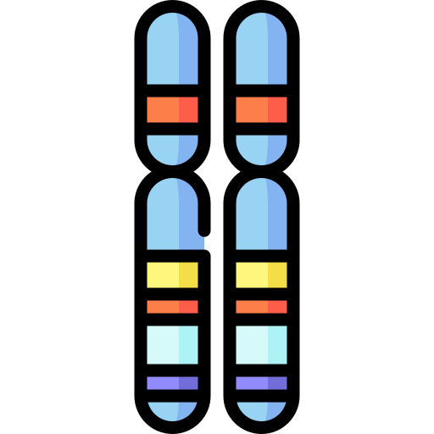

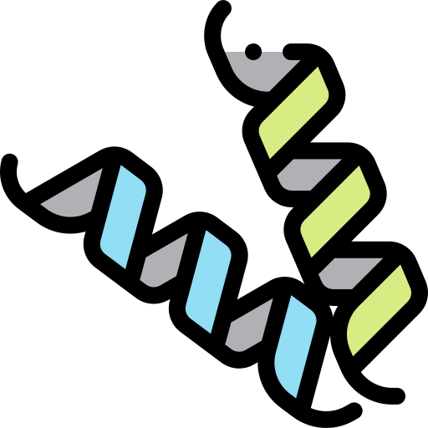
Proteomics

Slide 2

> Team members:
- Amgad montaser
- Ali Abdelkader
- Naira anwer
- Nada allam
- Aya abdelghafar
- Myhan hassan
- Nansy edward

Slide 3

Overview:
Bottom-Up Proteomics
Top-Down Proteomics
Mass spectrometry (MS)
Nanopore machine
PRIDE database
PPX library

Slide 4
1) Bottom-Up Proteomics:
In bottom-up proteomics, purified proteins or complex mixtures of protein are digested into peptides via proteolytic cleavage
The term bottom-up implies that information about the constituent proteins is reconstructed from individually identified fragment peptides.

Slide 5
2) Top-Down Proteomics:
- Top-down proteomics, intact protein ions or large protein fragments are subjected to
gas-phase fragmentation
- It involves identifying proteins in complex mixtures without prior
digestion into their corresponding peptide species

Slide 6
3) Mass Spectrometry (MS):
Mass spectrometry is the current standard method for protein sequencing
It needs a folded protein to be fragmented into short polypeptides (<50 amino acids) before detection
But MS does not provide enough sensitivity to accurately read long polypeptide sequences.

Slide 7

4) Nanopore machine:
Protein nanopores could offer an alternative approach for protein sequencing
A nanopore method will unfold and thread a heterogeneously charged protein through a nanopore capable of identifying all 20 amino acids from ionic current patterns
approaches have been developed with the sensitivity to identify small peptide fragments that differ by single amino acids
> further information: https://www.nature.com/articles/s41557-021-00844-6

Slide 8
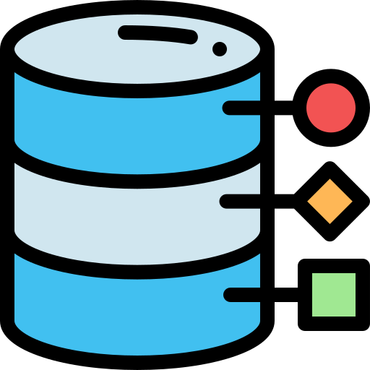
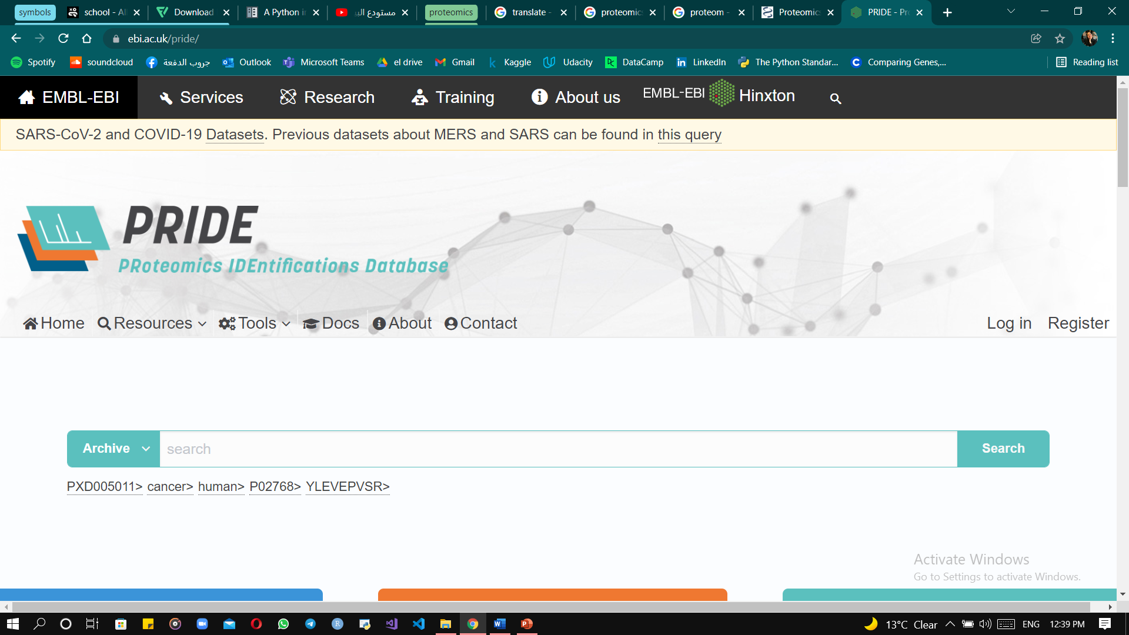
5) PRIDE database:
PRIDE is proteomics identifications database, here you can find spectra data

Slide 9

6) PPX:
PPX is a python interface to proteomics data repositories
Allows users to easily find and download files associated with projects in PRIDE
Link to library documentation: https://ppx.readthedocs.io/en/latest/

Slide 10
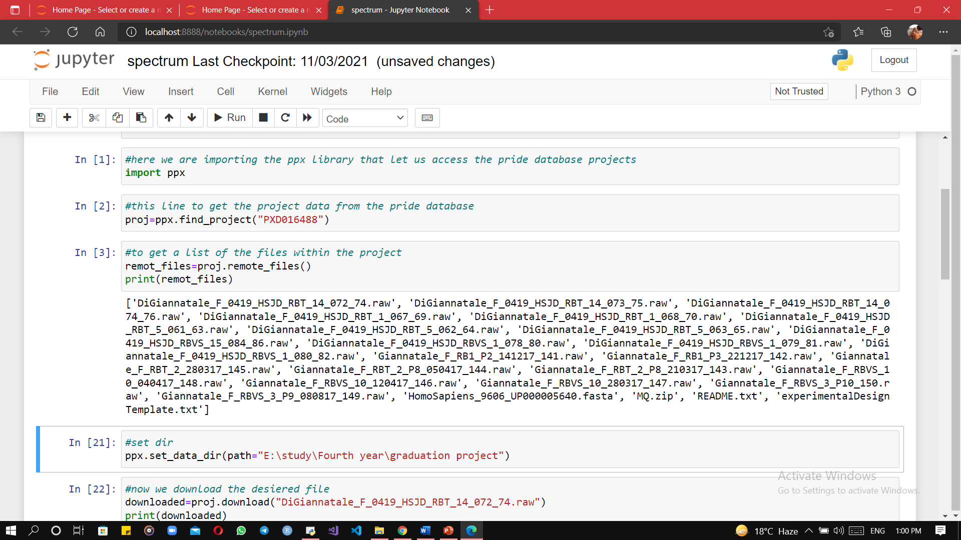

Slide 11
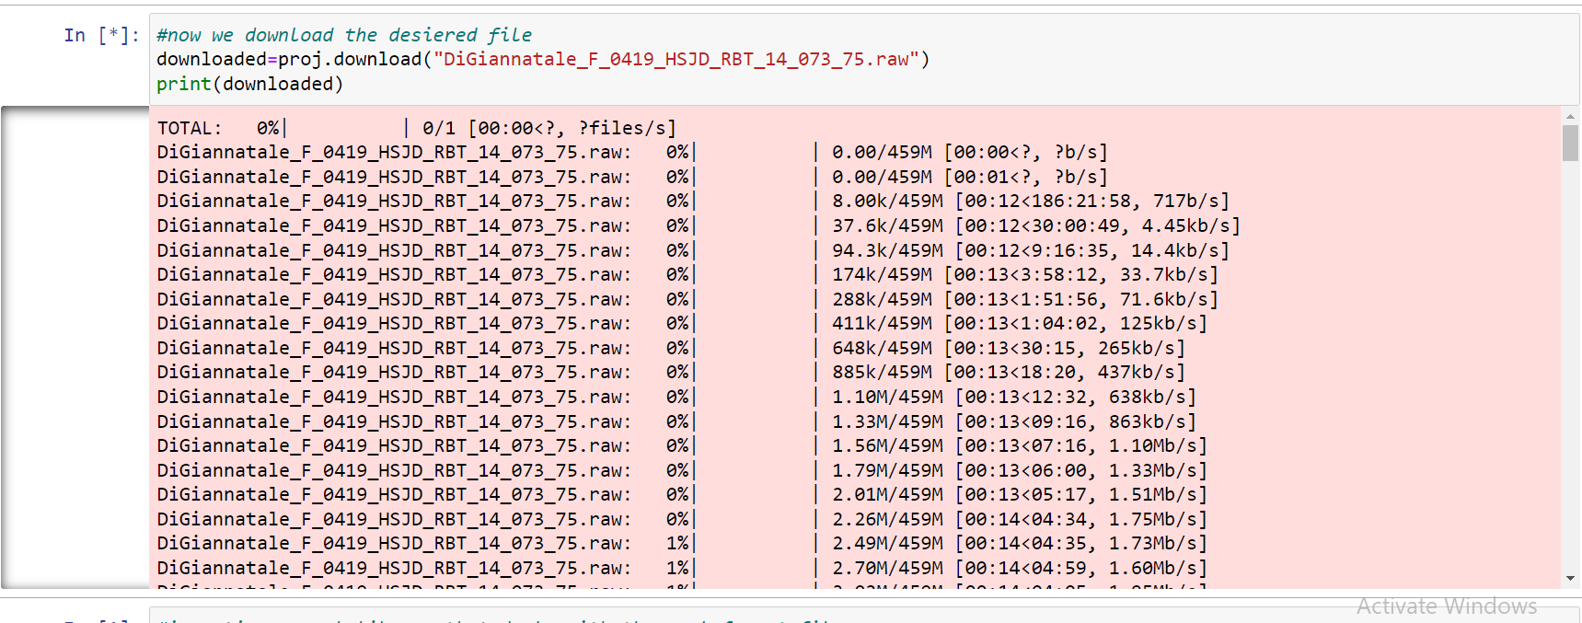
- The method download takes file name, then it starts downloading it

Slide 12

> References:
https://www.ncbi.nlm.nih.gov/pmc/articles/PMC8473418/
https://www.nature.com/articles/s41557-021-00844-6
https://www.creative-proteomics.com/blog/index.php/bottom-up-proteomics-and-top-down-proteomics/

Slide 13


