Slide 1
Beauty classification
By: Ali Osama Abdien

Slide 2
TABLE OF CONTENTS
01
02
03
04
05
06
Abstract
Introduction
problem
Proposed work
Results
conclusion

Slide 3
01
Abstract

Slide 4
Convolutional Neural Networks
(CNNs) are a powerful type of deep learning neural network used for computer vision tasks such as image classification and object detection. They automatically learn and extract meaningful features from raw image data, and have achieved state-of-the-art performance in various applications.

Slide 5
02
Introduction

Slide 6
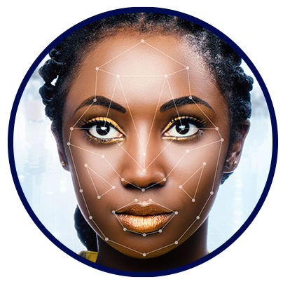
Beauty Classification
This dataset aims to classify female facial images as either "Beautiful" or "Average" using a CNN. It consists of a training set, a test set, a validation set, and a consolidated set. The images are 224 X 224 X 3 color jpg images that have been cropped to only show the face. The dataset has a natural bias in the selection, but the CNN used in the dataset demonstrates high accuracy. The creator also posted a Predictor kernel that uses the trained model to make predictions.

Slide 7
03
problem

Slide 8
THE MAIN ISSUE
Another challenge in beauty classification using CNN is the subjective nature of beauty itself. What one person considers beautiful may not be the same as what another person considers beautiful. This makes it difficult to create a universal standard for beauty classification.To address this issue, researchers are exploring ways to incorporate cultural and individual differences into the classification process. This could involve training the CNN on a diverse set of images and incorporating feedback from users to improve the accuracy of the classifications.

Slide 9
04
Proposed work

Slide 10
the decomposition of solving the problem
STEP 1
STEP 2
STEP 3
import necessary libraries
define the path and Reading images and preprocessing
View a set of data
STEP 6
STEP 5
STEP 4
Testing the model
Training the model
Building the model

Slide 11
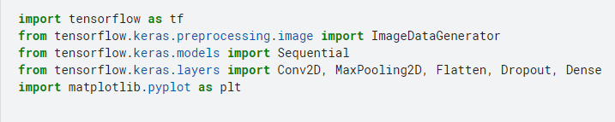
STEP 1 : import necessary libraries

Slide 12

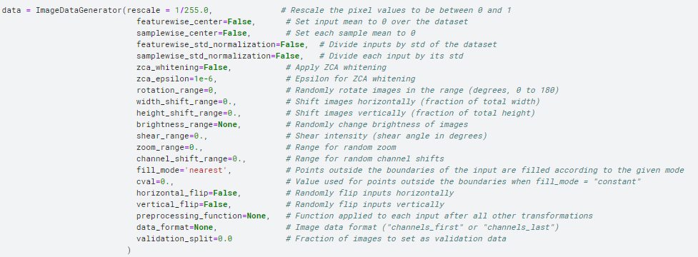
STEP 2 : define the path and Reading images and preprocessing

Slide 13
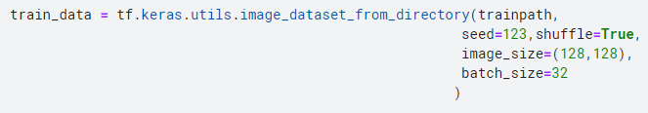
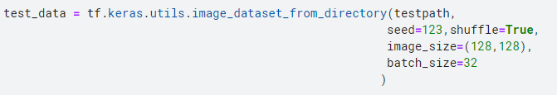
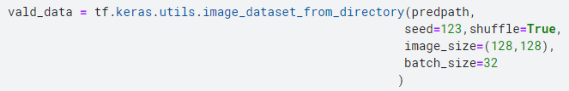
STEP 2 : define the path and Reading images and preprocessing

Slide 14
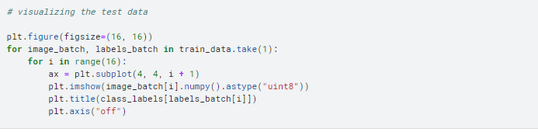
STEP 3 : View a set of data

Slide 15
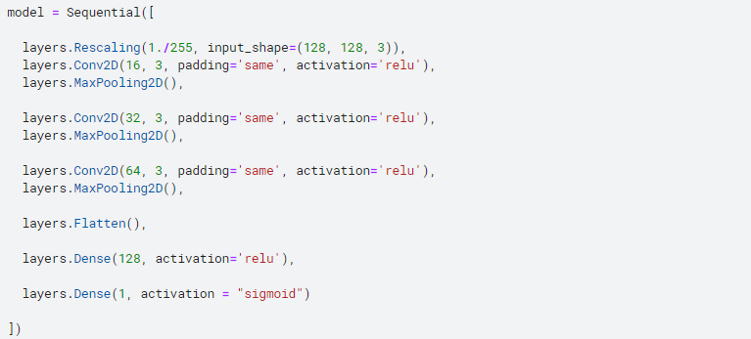
STEP 4 : Building the model

Slide 16
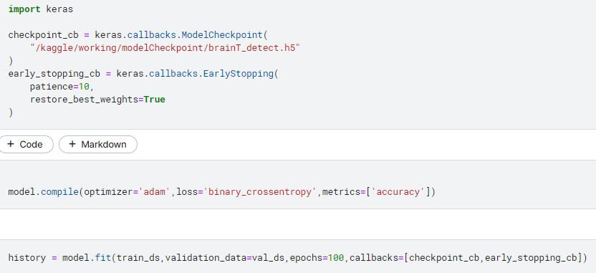
STEP 5 : Training the model

Slide 17
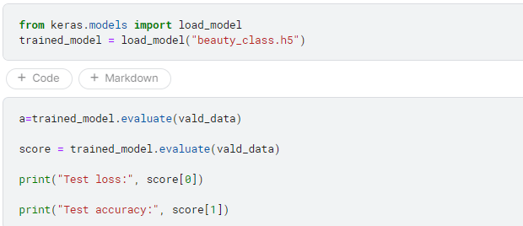
STEP 6 : Testing the model

Slide 18
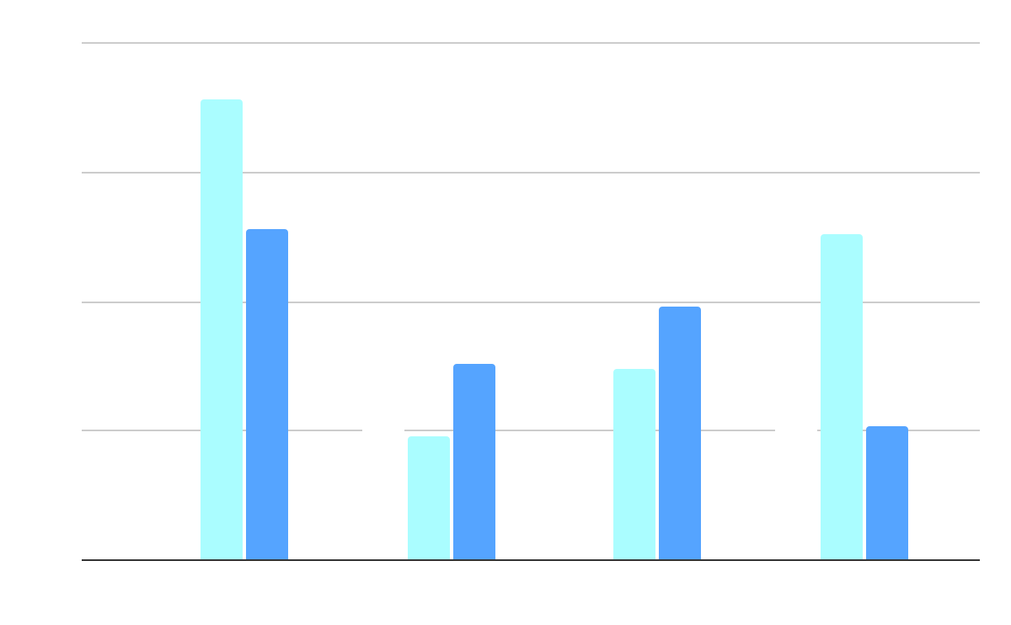
05
The Final Results

Slide 19
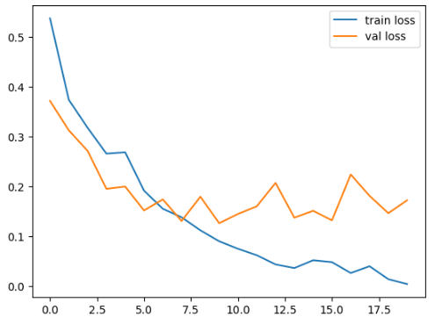
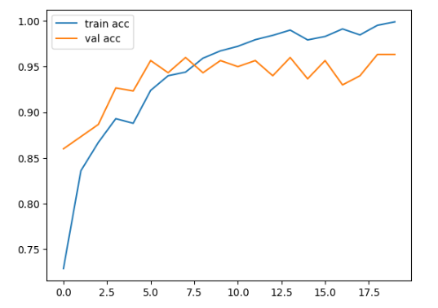
Results and comparison

Slide 20
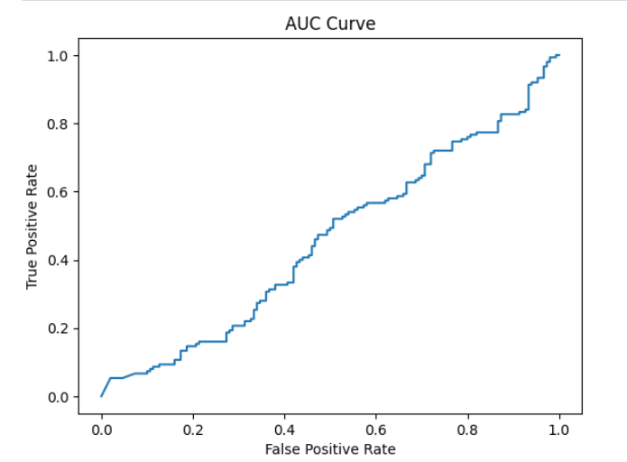
Results and comparison

Slide 21



6 . Conclusion

Slide 22

—In this project, a CNN model was built to classify female facial images into two categories: "Beautiful" or "Average". Despite potential issues with the dataset, such as bias and lack of demographic information, the model achieved good results and could be used in areas such as face recognition and binary image classification.

