Slide 1
Portfolio Optimization
Asset Universe Selection Based on Investor Profiles
Supervised by DR Mervat abuelkheir
Notes:
Good morning. My name is Ali, and this presentation covers my bachelor thesis on Asset Universe Selection based on Investor Profile in Portfolio Optimization.
The core idea is simple. Portfolio construction starts with two connected questions: which assets should be considered in the first place, and then how much should be allocated to each asset?
My thesis studies that earlier selection stage. It ranks assets according to their predicted risk behavior, then uses that ranking to build candidate universes that match the investor profile.
Transition
I'll start with a quick roadmap.

Slide 2
Roadmap
Problem Definition
Literature Gap
Proposed Solution
Methodology & Experiments
Results
Conclusion
Future Work
Notes:
Script
I will begin with the problem definition, then the literature gap, then the proposed solution, followed by methodology, experiments, results, conclusion, and future work.
Transition: So firstly, what is the actual portfolio problem I am trying to solve?

Slide 3
Problem Definition

Slide 4
The Fixed-Universe Assumption
Optimization often starts after assets are already chosen
A weak candidate universe limits even a strong optimizer
This thesis studies selection before allocation
Notes:
Script
Many portfolio optimization methods assume a fixed asset universe. After that assumption is made, the main task becomes how to allocate weights inside that predefined universe.
But there is an earlier decision that also matters: which assets should enter the allocation stage. If that first decision is weak, even a strong optimizer is limited by the menu of assets it receives.

Slide 5
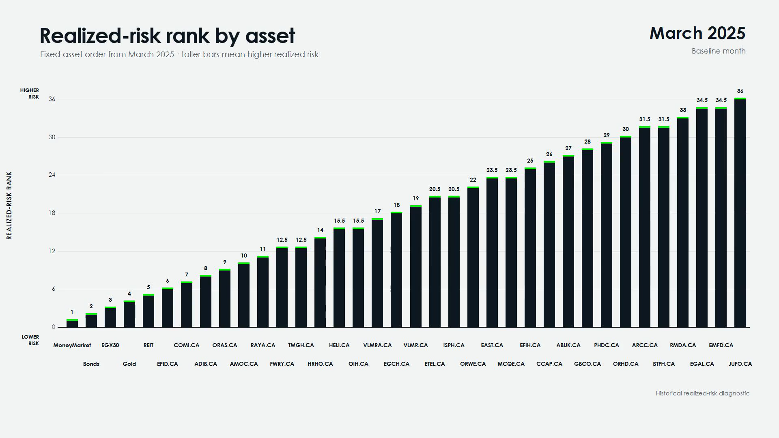
Notes:
In the Egyptian investment market, inflation, currency movements, and changing economic conditions can alter the volatility and behavior of different assets. For example, an asset suitable for a conservative investor in one period may not remain suitable under different conditions.
This video shows it directly. The x axis represent the assets, and its height is its risk rank in that month. As the months advance, watch the ranking reshuffle.
Transition: As seen in the video, asset's risk rank is not persistent which is exactly why the investable universe has to be selected based on market conditions.

Slide 6
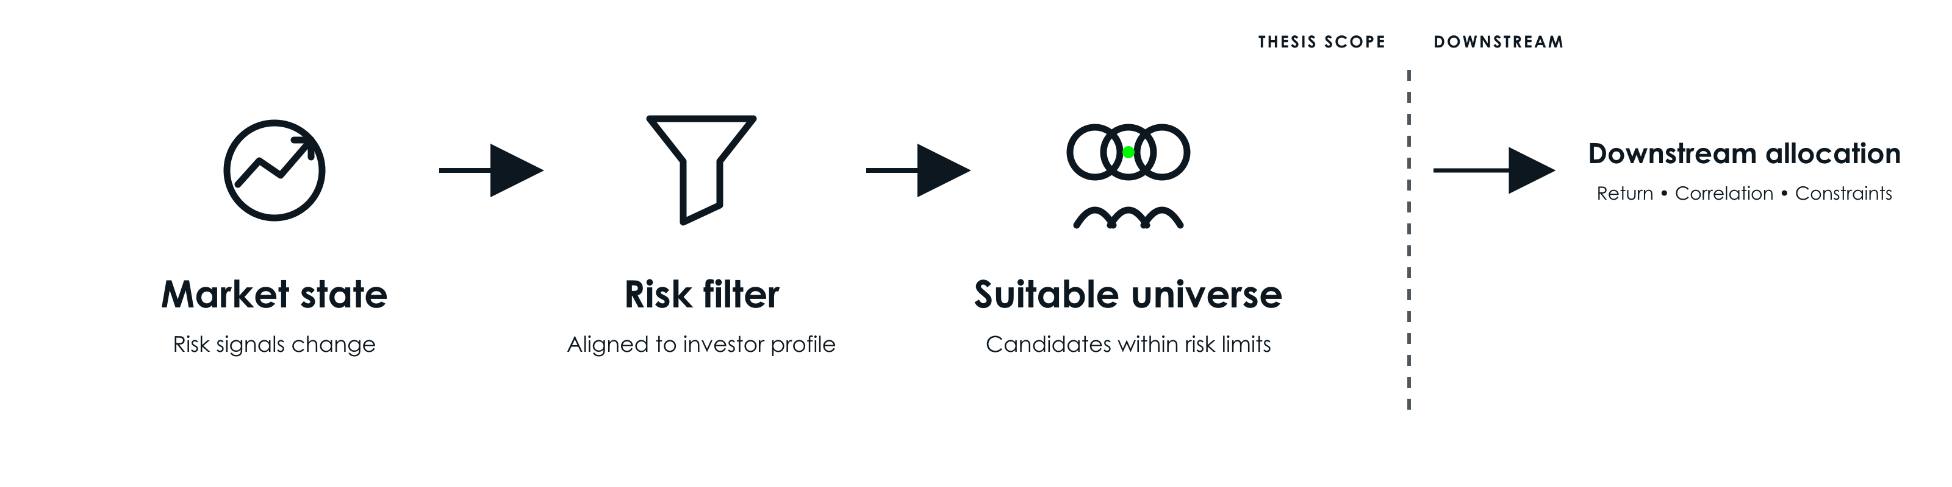
Why Universe Selection Matters?
Notes:
Therefore, this thesis takes a risk-first view on suitability to ensure that only assets consistent with the investor’s risk tolerance are considered. The resulting filtered universe provides the foundation for the next portfolio construction decisions involving other suitability metrics like returns and diversification.

Slide 7
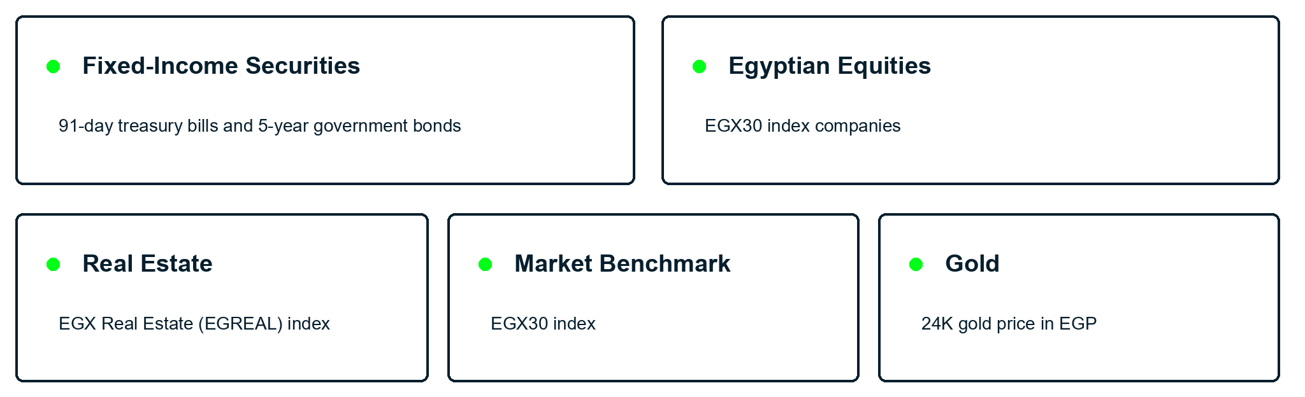
Scope and Asset Universe
Notes:
The thesis works with a mixed Egyptian asset universe rather than focusing only on equities. The universe includes fixed-income securities represented by 91-day treasury bills and 5-year government bonds. Egyptian equities are represented by individual EGX30 companies, while the EGX30 index is included separately as the overall market benchmark. The universe also includes real-estate exposure through a EGX Real Estate index and gold exposure through the price of 24-karat gold in Egypt. Transition
With the raw asset universe now defined, the thesis asks three direct research questions.

Slide 8
Research Questions
RQ1: Can Reinforcement Learning support dynamic risk-based universe selection?
RQ2: Do selected universes align with investor profiles?
RQ3: How do selected universes compare with the full active universe?
Notes:
Script
The first question asks whether Reinforcement learning can support dynamic asset-universe selection before allocation using predicted risk behavior.
The second asks whether the selected universes actually align with conservative, balanced, and aggressive investor profiles.
The third asks how the candidate Universes compare with the full active universe when both are evaluated under the same allocation rule.

Slide 9
Literature Review
Notes:
Transition: Before presenting my method, Lets dig into the Literature review.

Slide 10
Classical Allocation Context
Classical methods focus on return-risk weight allocation
Markowitz (1952) and MVO assumes the investable universe is already defined
This thesis focuses on the step before weighting
Notes:
Script
Classical portfolio construction usually treats the problem as a return-risk weighting problem. Markowitz and later allocation methods mainly study how to divide weights once the asset universe is already known.
That literature is still important here because it gives the benchmark logic behind equal-weight allocation comparisons.

Slide 11
AI/ML Preselection Context
Existing work filters assets before optimization
Common signals include expected price, expected return, or profitability
Risk metrics usually appear later in weight optimization and evaluation
Notes:
In the literature, AI and machine learning have already been used as a filtering step before portfolio optimization. The model helps decide which stocks should enter the portfolio construction stage.
However, these papers select assets using expected price, expected return, profitability, etc. After that, the selected universe move into the allocation optimizer where risk measures such as Sharpe ratio, volatility or drawdown usually appear. That is why the literature gap remains open for risk-oriented universe selection.

Slide 12
DEA Preselection Paper
Atta Mills and Anyomi (2022) use DEA to screen assets before allocation
Standard deviation appears as one of the key input
The method mainly filters by efficiency using a statistical DEA approach rather than AI-based ranking
Notes:
One useful exception is the paper by Atta Mills and Anyomi, which uses Data Envelopment Analysis, or DEA, to rank candidate stocks using multiple efficiency metrics.
Among these metrics, standard deviation is the only risk-related input.
The paper therefore supports screening assets before portfolio allocation, but its main objective remains efficiency. It also uses a statistical approach rather than an AI model that learns predicted risk behavior.

Slide 13
RL And Investor Personalization
Reinforcement Learning in finance work often targets trading or weight allocation
Personalization often maps profiles to advice, products, or final portfolios
This thesis ranks asset risk first, then builds profile-specific universes
Notes:
RL in finance is often used for trading decisions or direct allocation weights. Personalization research often maps investor profiles to advice, products, funds, or full portfolio choices.
My thesis connects these two directions differently. It predicts asset risk behavior first using Reinforcement Learning, then uses that prediction to build personalized asset universes.
Transition: Now I can show the whole contribution before going into technical details.

Slide 14
Proposed Solution

Slide 15
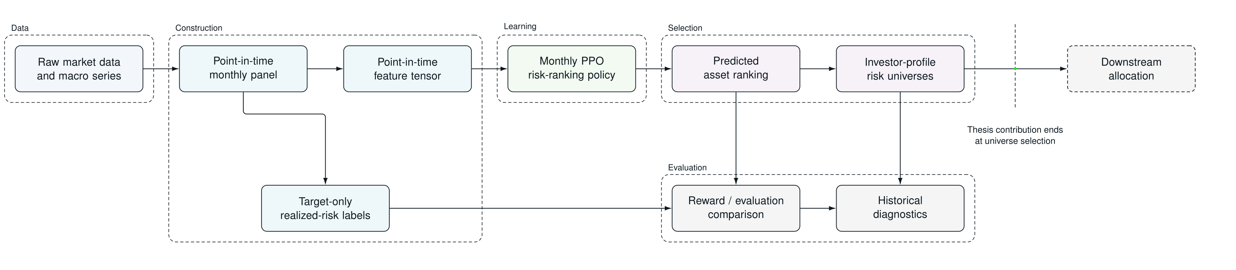
Contribution In One View
Notes:
The full pipeline has four linked parts:
Data and Construction Layer: Collects, cleans, and transforms the raw financial data into the model input.
Learning Layer: The model estimates each asset’s future risk behavior and ranks the assets accordingly. This ranking becomes the foundation used in the Selection layer
Asset Universe Selection Layer: Uses the investor’s profile to select the appropriate group of assets from the ranking.
Evaluation Layer: Tests the resulting portfolios using historical data..
Transition:

Slide 16
Methodology
Notes:
Now we are ready to go deeper into the technical details

Slide 17
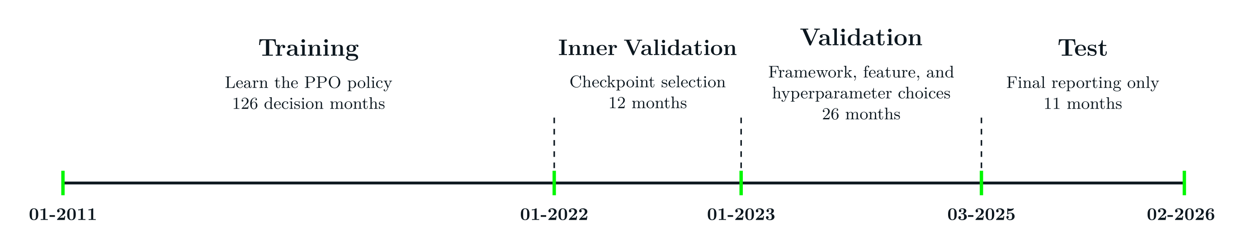
Chronological Split Design
Notes:
I will first define how the data was divided. The split is strictly chronological.
The training period is where the model learns. The inner-validation period is used to select the strongest checkpoint from a training run. The main validation period is then used to compare framework choices, features, bucket mappings, and hyperparameters. Finally, the test period is reserved for final reporting.
I will now explain how se data were transformed

Slide 18
Raw Data Engineering
Inputs include date, OHLC fields, and volume
T-bill and bond yield quotes are converted into price proxies
USD/EGP and CPI add macro market context
Notes:
I collected the raw financial input for each asset individually including date, price, OHLC fields, and volume.
An important detail is that treasury bill and bonds are quoted as yields. So before calculating returns, those yields are converted into price proxies.
I also include macroeconomic context through USD/EGP conversion rate and Consumer Price Index, or CPI, because market conditions influence how risky the active universe is in each month.
Transition: From those inputs, I build a monthly panel for the model.

Slide 19
Point-In-Time Monthly Panel
Features use only information available up to that month
Assets are not backfilled before they existed
Asset identity stays metadata and is excluded from model inputs
Notes:
Script
One row in the panel means one active asset in a specific month, so the model only sees active assets for a specific month.
Features for a specific row only use information available up to that point in time, and assets are never backfilled before they truly existed.
The panel keeps asset identity as metadata which is hidden from the model’s input. That helps the policy learn behavior patterns across the universe instead of memorizing specific asset behavior.
Transition:
Once the panel exists, the next question is what information each row actually contains.

Slide 20
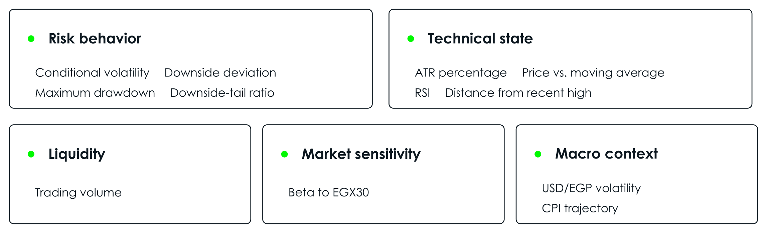
Feature Families
Notes:
Script
Rather than presenting the model inputs as one long list, I group them by the type of behavior they describe.
Risk behavior captures recent instability and the severity of harmful losses. Liquidity describes how actively the asset trades. Technical state summarizes recent price behavior, including range, momentum, and position relative to previous highs. Market sensitivity describes how strongly the asset is correlated with the broader equity market. Finally, macro context captures shared currency and inflation conditions affecting every active asset.
Transition: The next step is defining the realized risk used in the ordering that the model should learn.

Slide 21
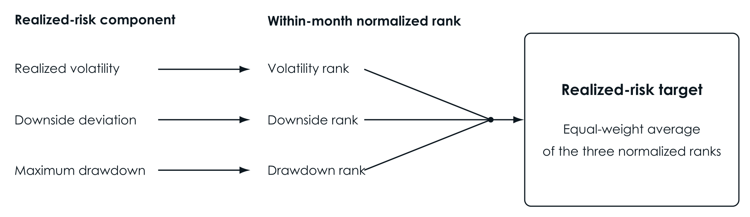
Realized Risk Target
Notes:
The realized-risk target combines realized volatility, downside deviation, and maximum drawdown. Each component is rank-normalized within the same month. This means an asset is compared only with the other assets that were active at that time, rather than being judged using an absolute scale.
The three ranks are averaged equally to form the realized risk target. I also tested alternative formulas, but they produced weak sensitivity to the weights. Therefore, Equal weights was promoted as the most transparent and balanced definition.
Transition: I will quickly explain reinforcement learning.

Slide 22
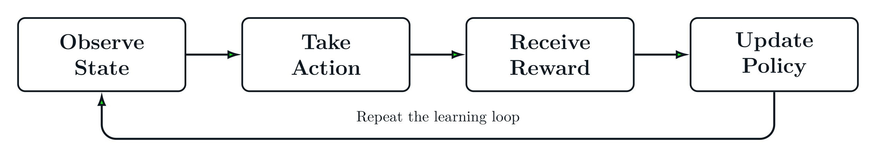
What Is Reinforcement Learning
Notes:
Reinforcement learning is a learning setup where a model improves through interaction and feedback. The model observes a state, takes an action, receives a reward, and then updates its policy.
The policy is basically the model's decision rule. The reward function tells the model what behavior should improve. If an action leads to a better reward, the model adjusts its internal policy so similar actions become more likely in the future.
Transition: With that idea clear, I can explain how this problem fits reinforcement learning.

Slide 23
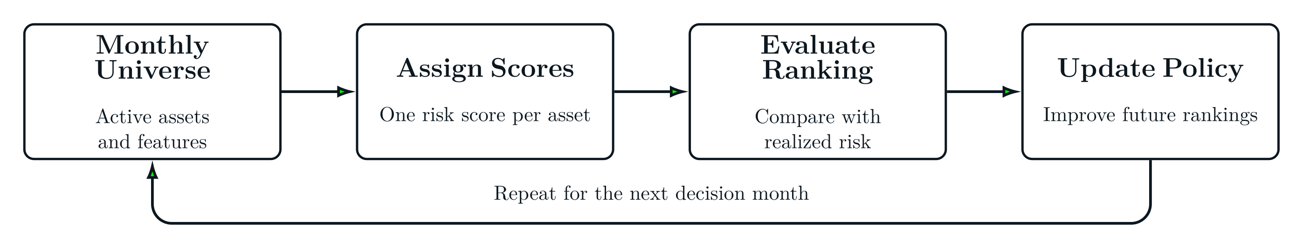
Reinforcement Learning
Notes:
The figure shows how these ideas form one monthly decision environment. The state is the active asset universe and its features. The action is assigning one risk score to every active asset.
The predicted ranking is then compared with the realized-risk ranking to calculate the reward. That feedback is used to update the scoring policy, so it can produce better rankings in future decision months.
Transition: Among reinforcement learning methods, I used PPO because it gives a more controlled training update.

Slide 24
Why PPO
Clipping limits unstable policy jumps
Actor-critic structure stabilizes learning
Suitable for month-level reward feedback
Notes:
Financial months can differ significantly, and an unusually difficult month could cause the model to change its behavior too aggressively. PPO reduces this risk through clipping, which limits how far the updated policy can move from the previous policy during one training update.
PPO also uses an actor-critic architecture. The actor makes decisions, while the critic evaluates them and provides a learning signal that helps train the model more reliably.
Transition: Before explaining the actor-critic architecture in more details, I first need to define what one PPO decision looks like.

Slide 25
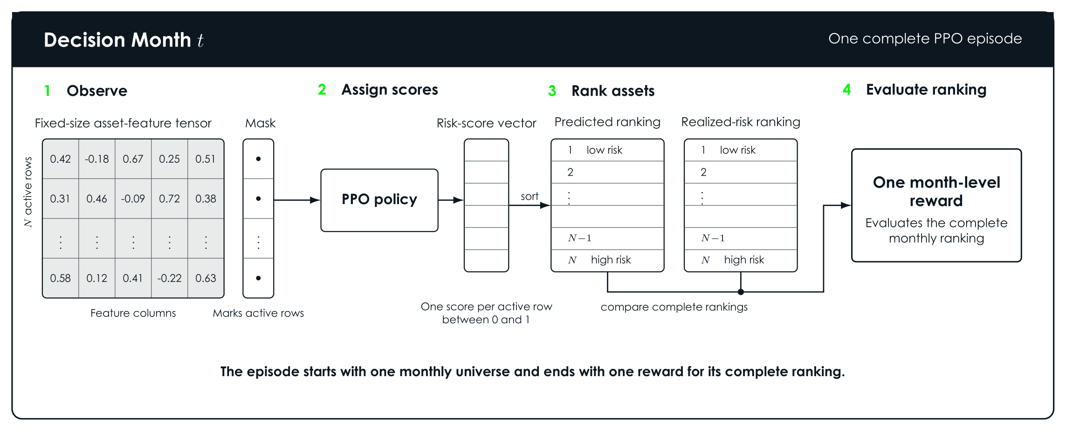
PPO Episode Format
Notes:
Script
One PPO episode equals one monthly decision. The observation is a tensor of all asset features, together with a mask that marks which rows are real assets. This setup supports a different number of available assets depending on the decision month.
The action is one continuous risk score for each real asset row, between zero and one. After the model scores the month, the assets are sorted and compared with the realized-risk ordering for that same month.
So the reward is based on how well the full monthly ranking matches reality.

Slide 26
Variable Universe & Masking
Padding gives a consistent tensor shape
The mask separates real asset rows from padding rows
Padded rows do not affect actions, learning, or reward calculations
Notes:
Script
The practical challenge is that every month has a different number of active assets. A neural network still needs a consistent tensor shape, so the input is padded to a fixed size.
The mask tells the model which rows are real and which rows are just padding. That way, padded rows do not pollute learning, or reward calculations.
Transition: Now I will explain the actor-critic architecture.

Slide 27
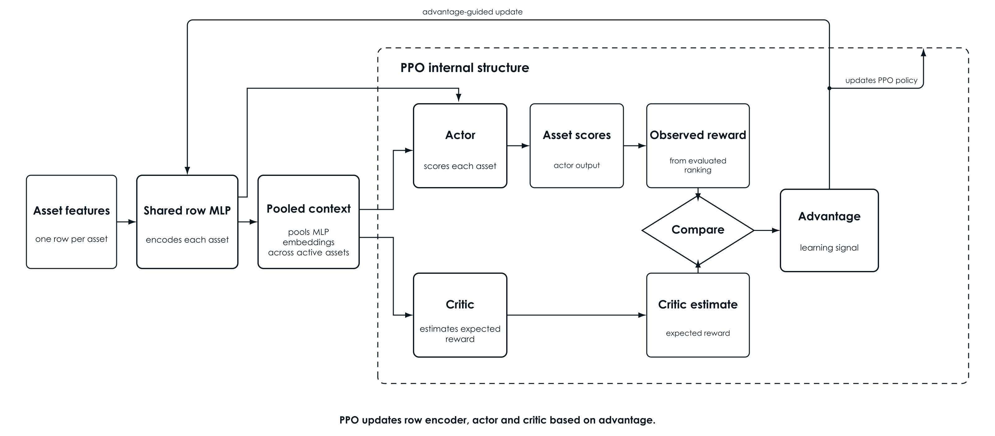
Actor-Critic Architecture
Notes:
This architecture contains three MLP neural networks.
First, the shared row encoder MLP reads every asset’s feature row and converts it into a learned representation. These representations are also pooled to summarize the active universe for that month.
Internally inside the PPO, the actor is the second neural network. It receives each asset’s representation together with the pooled monthly context and outputs one risk score per asset.
The critic is the third neural network. It receives the pooled context and estimates the reward expected for that monthly decision.
After the complete ranking is evaluated, PPO receives the observed monthly reward. The advantage is the observed reward minus the critic’s estimate. A positive advantage means the outcome was better than expected, while a negative advantage means it was worse. PPO uses this signal to update its policy accordingly.
TRANSITION: Now we can observe how monthly reward is calculated.

Slide 28
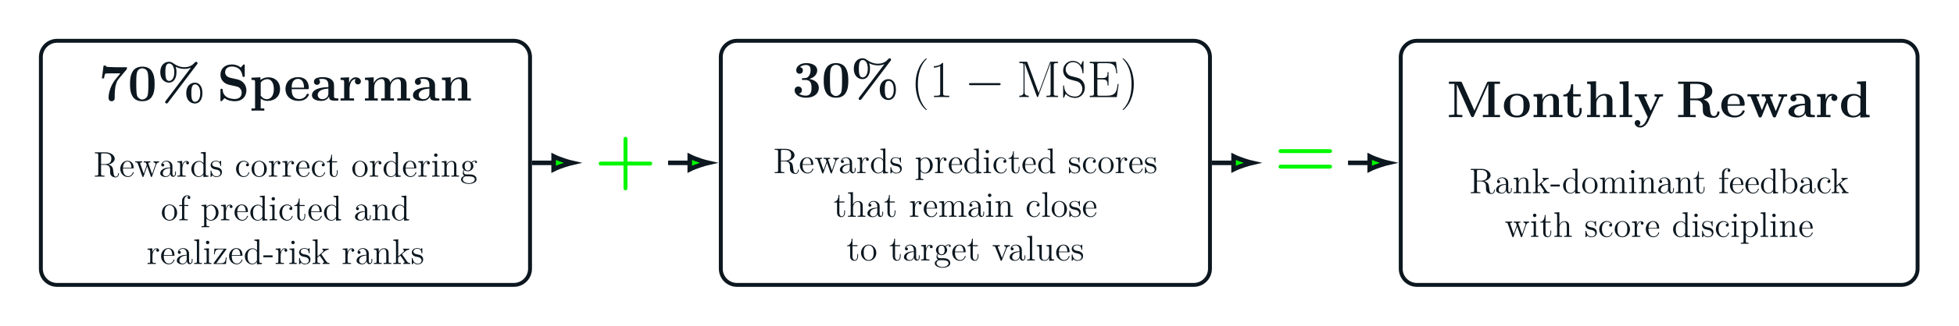
Reward Definition
Notes:
The reward is computed after the entire monthly universe is scored. Seventy percent of it measures how close the predicted ranking was to the realized-risk ranking, and thirty percent measures how close the predicted score values were to the target values to discourage the model from placing all assets too close together.
The first part uses Spearman rank correlation. The second part uses MSE.
Transition: Once the model produces a ranked list, I can map that list into profile-specific asset universes.

Slide 29
Profile-Specific Asset Universes
Conservative: lowest 30% predicted-risk assets
Balanced: 20% to 80% predicted-risk band
Aggressive: highest 30% predicted-risk assets
Notes:
After ranking, the predicted positions are converted into rank percentiles. These percentiles are then used to form three profile-specific asset universes.
The conservative asset universe uses the lowest 30 percent of predicted-risk assets. The balanced asset universe uses the middle 20 to 80 percent band. The aggressive asset universe uses the highest 30 percent of predicted-risk assets.
The overlap is intentional because some assets can reasonably fit two neighboring investor profiles.

Slide 30
Experiments
Notes:
With the full method defined, the next step is to show the experiments.

Slide 31
Framework Selection
Compared one-month versus three-month feature windows
Evaluated the inclusion of pooled active-universe context
Evaluated the addition of Daily price variants
Notes:
Several formulations were compared to understand which input structure fits the problem, while keeping the base feature set fixed.
I tested whether the model should look at only the most recent month or a three-month feature window. I also tested whether adding context from the whole active universe improved the model's performance.
I also explored variants that included daily price information more directly, but that appeared to add noise and did not improve the model’s performance.
The three-month view with active-universe context had the best performance, so it was promoted as the final framework for the next stage

Slide 32
Features and Reward Function
Ran drop-one ablations on the base set to identify which feature families contributed signal
Stress-tested the chosen set across seed configuration, redesigned feature families, and incremental additions before locking the final inputs
Compared alternative reward designs and selected a rank-dominant reward with secondary score discipline
Notes:
Script
Feature selection followed a sequential process. I first used drop-one-feature ablations on the fixed feature set. After that, I tested redesigned feature-family alternatives and new feature additions.
Reward formula experiments came afterwards where I compared different balances between ranking quality and score accuracy. I also tested the addition of tail-risk emphasis to focus on getting the riskiest assets first.
Transition: I then tuned the PPO configuration.

Slide 33
Hyper-parameters and Selection
Used Optuna validation trials to tune PPO hyperparameters and select the configuration that generalized best
Confirmed the selected configuration across three random seeds before locking the final model
Compared alternative profile-universe mappings
Notes:
Hyperparameter tuning came afterwards where I used Optuna which is a hyperparameter tuning tool. I then confirmed the selected configuration across three random seeds before locking the PPO model.
After the model was finalized, I compared different ways of mapping the predicted ranking to investor profiles. These included several mapping structures with different levels of overlap and selectivity. Selection criteria was producing the clearest separation between conservative and aggressive while maintaining the expected monotonic ordering.
Transition: Once the model was locked, I evaluated it in two connected stages.

Slide 34
Evaluation Logic
Stage 1
Stage 2
compare predicted ranks with realized risk ranks
compare profile universes with the full active universe
Notes:
Script
The first stage evaluates ranking quality directly by comparing predicted risk ranks with realized-risk ranks.
The second stage evaluates what those rankings mean for investor groups by forming conservative, balanced, and aggressive universes and comparing them with the full active universe under the same equal-weight rule.
Equal weights rule keeps the focus on universe selection.
Transition: Now I can show the core results.

Slide 35
Results

Slide 36
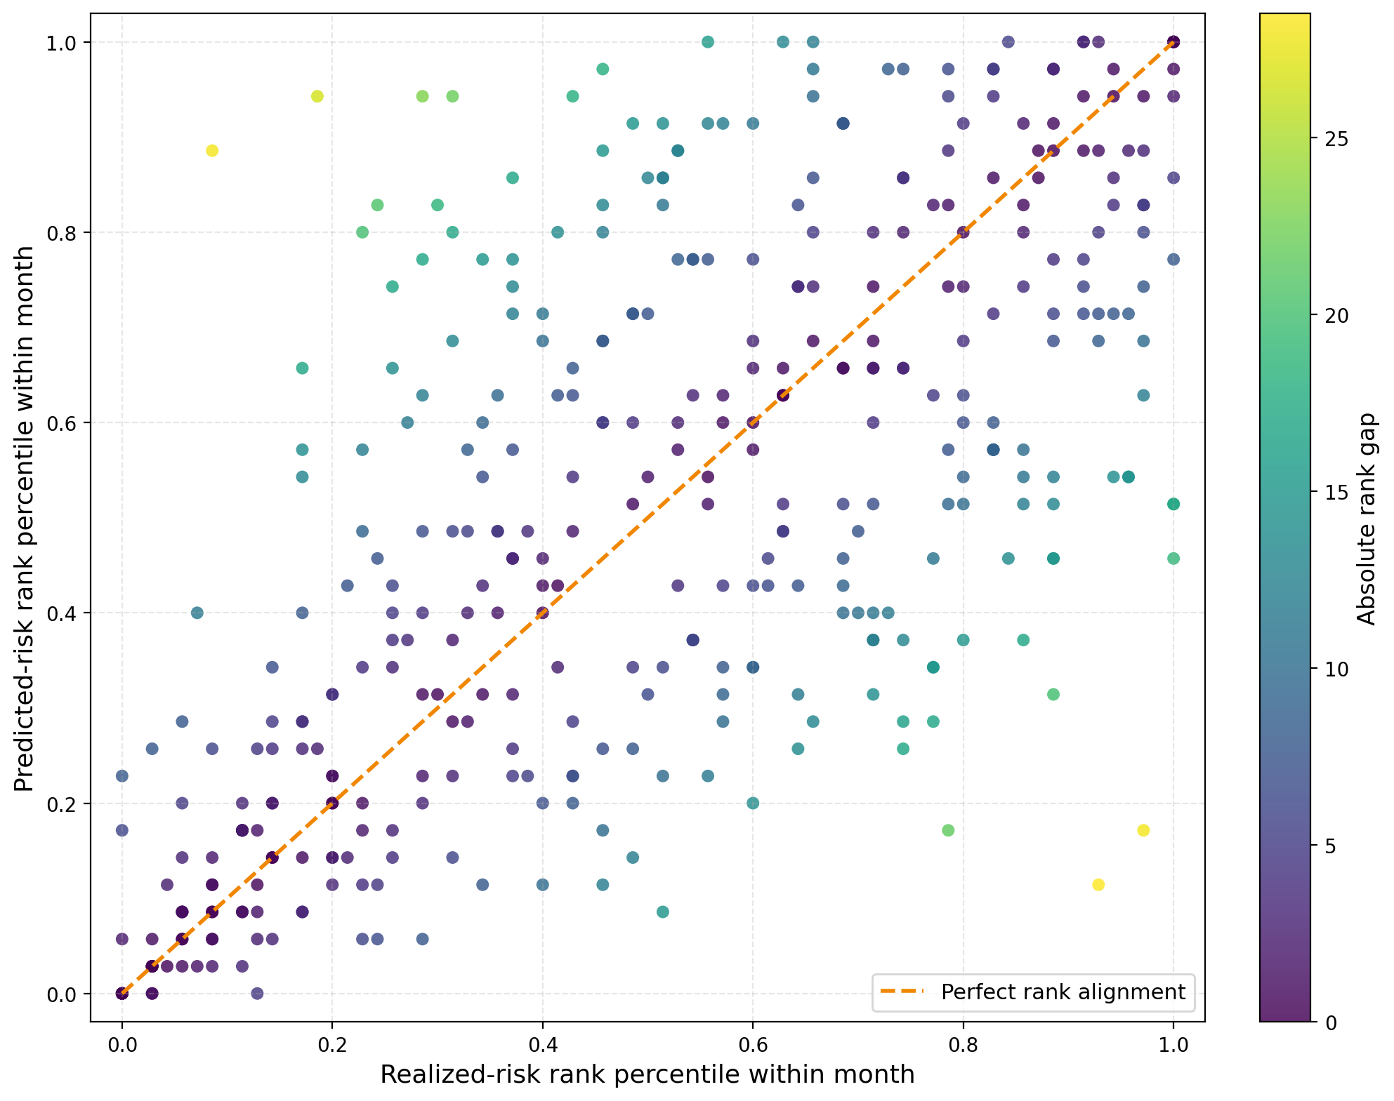
Ranking Quality
Mean reward: 0.75
Mean Spearman correlation: 0.67
Predicted rankings meaningfully align with realized-risk rankings
Notes:
The model achieved a mean reward of 0.75. Its Spearman correlation of approximately 0.67 also shows high agreement between the predicted and realized-risk rankings.
Looking at the graph, the horizontal axis shows each asset’s realized-risk rank, while the vertical axis shows the rank predicted by the model. Points closer to the orange diagonal represent stronger agreement between the two rankings. Although the predictions are not perfect, the overall upward pattern reflects the positive Spearman correlation.
The next slide examines whether the predicted ranks separate assets into clearly different realized-risk buckets.

Slide 37
Risk Separation
Conservative, Full Universe, Balanced, and Aggressive universes mean realized risk across testing period
Monotonic ordering held in 11 of 11 test months.
Notes:
The asset universes realized risk is in the expected order. The full universe mean realized risk was 50% because the risk was normalized. The monotonic ordering held in all test months. That is the cleanest evidence that the model can produce distinct risk-oriented universes.
From a financial point of view, the main message is that the conservative asset universe behaved materially safer, while the aggressive asset universe carried clearly higher risk.
Transition: After risk separation, we can look carefully at the returns

Slide 38
Return Separation
Return diagnostics used to compare returns against the Full Universe benchmark under the equal-weight allocation rule.
Notes:
Using the same equal-weight allocation rule, cumulative return in the test window showed monotonic ordering.
The aggressive universe also carried higher volatility, so, the higher return came with visibly higher risk exposure.

Slide 39
Baseline Comparison
The baseline used is full active universe without filtering
Conservative Universe
Aggressive Universe
Reduced mean realized risk by 52.2%
Increased mean realized risk by 37.6%
Lower realized risk in all test months
Higher historical cumulative return by 73.9%
Notes:
Script
The baseline here is the full active universe under the same equal-weight rule. Under that comparison, conservative-universe filtering materially reduced realized risk versus the full universe, while aggressive-universe filtering produced higher realized risk and stronger return participation.
The risk based filtering stage by itself already changes the opportunity set in a meaningful way.

Slide 40
Conclusion

Slide 41
Research Question Answers
RQ1
RQ2
RQ3
QUESTION
QUESTION Do selected universes align with investor profiles?
QUESTION How do selected universes compare with the full active universe?
Yes
Yes
ANSWER
Can RL support dynamic risk-based universe selection?
PPO model produced meaningful profile asset universes across the changing active universe according to the predicted risk behaviour
Conservative filtering aligned with risk reduction, while aggressive filtering captured stronger return participation with higher realized risk.
Filtering changed the opportunity set under the same equal-weight rule. Conservative reduced realized risk. Aggressive increased realized risk and return participation.
Universe selection
Investor suitability
Baseline comparison
Notes:
RQ1 asks whether Reinforcement learning can support dynamic asset-universe selection using asset’s predicted risk. The answer is yes: the PPO model produced meaningful profile asset universes across the changing active universe.
RQ2 asks whether the selected universes align with conservative, balanced, and aggressive investor profiles. For this question, also yes: the predicted-rank universes produced distinct realized-risk groups in the expected order.
RQ3 asks how the proposed risk-tolerance-based universes compare with the full active universe under the same equal-weight historical simulation rule. The answer is that the filtered universes behaved differently from the full active universe in realized risk and returns.
Transition The last content section is future work.

Slide 42
Limitations & Future Work

Slide 43
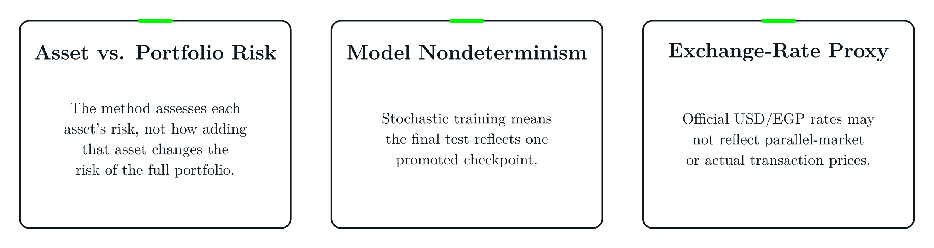
Key Limitations
Notes:
Among the limitations, an important extension is to connect the asset-level risk to portfolio-level risk. This thesis evaluates whether the model can identify assets appropriate for different risk profiles. In practice, these predictions would be combined with asset correlations to assess how including each asset changes the risk of the complete portfolio.
Second, PPO can produce different learned policies across training runs. We therefore confirmed the configuration across three seeds and reported the promoted checkpoint.
Third, the model uses official USD-to-EGP exchange rates. These rates may not fully represent parallel-market or actual transaction prices during periods of currency pressure.

Slide 44
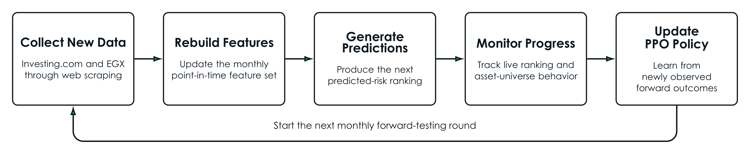
Live Data and Forward Testing
Notes:
There are possible next steps beyond the thesis scope. One future direction is connecting the pipeline to live market-data APIs, rebuilding the monthly features over time, and monitoring how the selected asset universes behave in real conditions.
Transition: There is also a natural extension on the objective side.

Slide 45
Return-Aware Suitability
Return awareness can refine suitability, but it should never override investor risk limits.
Risk suitability defines the boundaries
Return awareness adds context
Choices must remain consistent with the investor’s risk tolerance without increased risk exposure.
Return information may support a more complete suitability assessment while maintaining better returns for investors.
Exact integration requires further research.
Notes:
Another possible extension is return-aware suitability where a future version may add return-aware utility logic after the risk-ranked universes are formed.
That would let the system stay investor-aware while exploring richer tradeoffs inside each selected universe.
Transition: I'll conclude with the key references behind the ideas we've discussed.

Slide 46
Key References
Academic References
Historical Data Sources
Markowitz (1952) — Portfolio Selection
Investing.com — historical market-series CSV data
Wang et al. (2020) — Deep-Learning Portfolio Preselection
Egyptian Exchange (EGX) — Macro-economics data
Ma et al. (2021) — Return Prediction and Portfolio Optimization
Chaweewanchon & Chaysiri (2022) — Predictive Stock Selection
Atta Mills & Anyomi (2022) — DEA-Based Portfolio Preselection
Notes:
These are the five core references directly supporting the problem framing and the preselection literature for this thesis.

Slide 47
Q&A
Notes:
WHY RL: I chose RL because supervised methods require predefined target labels, such as the correct risk score for each asset. Those labels are not naturally available. RL instead learns the desired ranking directly through a reward function
Financial value in individual asset risk? The financial value is reducing the investor’s exposure to unsuitable assets before the remaining optimization stages.
Persistence? I did not implement a persistence baseline, so I cannot quantify the model’s incremental value over carrying forward the previous month’s ranking, but my analysis showed that the mean rank change for an asset is 7.7 ranks
Why equal weights: I tested alternative formulas, but they produced weak sensitivity to the weights so Equal weighting was retained as a transparent methodological choice because the thesis had no defensible basis for privileging one risk concept over another.

Slide 48
Thank You

Slide 49
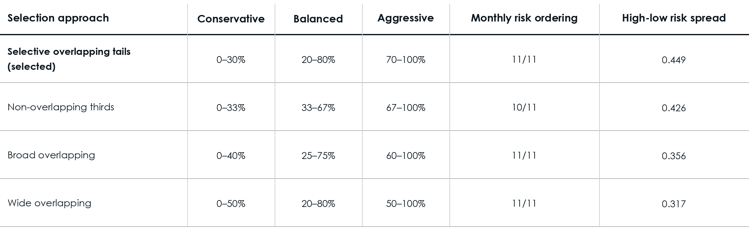
Asset Universe Selection Formulas

