Slide 1
AI Portfolio Optimization
Asset Universe Selection Based on Investor Profiles

Slide 2
Roadmap
Problem Definition
Literature Gap
Proposed Solution
Methodology & Experiments
Results
Conclusion
Future Work
Notes:
Talk track
I will begin with the problem definition, then the literature gap, then the proposed solution, followed by methodology, experiments, results, conclusion, and future work.
Transition
So firstly, what is the actual portfolio problem I am trying to solve?

Slide 3
Problem Definition

Slide 4
The Fixed-Universe Assumption
Optimization often starts after assets are already chosen
A weak candidate universe limits even a strong optimizer
This thesis studies selection before allocation
Notes:
Talk track
Many portfolio optimization methods make a fixed-universe assumption. This means the investable assets are treated as already known and fixed before optimization begins.
After that assumption is made, the main task becomes how to allocate weights inside that predefined universe.
But there is an earlier decision that also matters: which assets should even enter the allocation stage. If that first decision is weak, even a strong optimizer is limited by the menu of assets it receives.
My thesis focuses on this earlier step. It studies asset-universe selection before allocation.

Slide 5
Why Universe Selection Matters?
Conservative, balanced, and aggressive investors need different starting universes
Inflation, currency movement, volatility, and drawdowns shift risk behavior
Suitability is treated as risk behavior first
Notes:
Talk track
In the Egyptian investment market, many investors are highly sensitive to instability because of inflation, currency fluctuations, and broader economic uncertainty. That often pushes investors toward assets they see as more stable, such as gold, bank certificates, or foreign currency exposure.
This thesis takes a risk-first view of suitability. The goal is to align the starting asset universe with the investor profile, then study how that universe performs based on historical diagnostics.
So conservative, balanced, and aggressive investors should not always begin from the same candidate universe. Market conditions change, and the risk behavior of assets changes with them.

Slide 6
Scope and Asset Universe
Egyptian mixed-asset setting
Defensive, equity, real-asset, and macro-sensitive exposure
Macro inputs describe the market context, not selected portfolio assets
Notes:
Talk track
The thesis works in an Egyptian mixed-asset setting. The scored asset universe includes 91-day treasury bills, 5-year government bonds, EGX30 ETF, EGX30 constituent stocks, Real Estate Investment Trust exposure, and gold.
USD/EGP conversion rate and CPI are used as macro-context inputs. They are not treated as selected portfolio assets in the main universe, but they help describe the market environment around each monthly decision.
This setup is more realistic than an equities-only view because it gives the model defensive assets, growth assets, real-asset exposure, and macro context in the same system.
Transition
With that scope in place, the thesis asks three direct research questions.

Slide 7
Research Questions
RQ1: Can AI/ML support dynamic risk-based universe selection?
RQ2: Do selected universes align with investor profiles?
RQ3: How do selected universes compare with the full active universe?
Notes:
Talk track
The first question asks whether AI and machine learning can support dynamic asset-universe selection before allocation using predictions of each asset's realized-risk behavior.
The second asks whether the selected universes actually align with conservative, balanced, and aggressive investor profiles.
The third asks how the proposed risk-tolerance-based universes compare with the full active universe when both are evaluated under the same equal-weight historical simulation rule.
Together, these questions keep the project focused on asset suitability for the investor.
Transition
Before presenting my method, I need to place it inside the literature.

Slide 8
Literature Review

Slide 9
Classical Allocation Context
Classical methods focus on return-risk weight allocation
MVO assumes the investable universe is already defined
This thesis focuses on the step before weighting
Notes:
Talk track
Classical portfolio construction usually treats the problem as a return-risk weighting problem. Markowitz and later allocation methods mainly study how to divide weights once the investable universe is already known.
That literature is still important here because it gives the benchmark logic behind equal-weight and MVO allocation comparisons. But it usually assumes the asset set has already been defined.

Slide 10
AI/ML Preselection Context
Existing work filters assets before optimization
Common signals include expected price, expected return, or profitability
Risk metrics usually appear later in weight optimization and evaluation
Notes:
Talk track
In the literature, AI and machine learning have already been used as a filtering step before portfolio optimization. The model helps decide which stocks should enter the portfolio construction stage.
However, these papers select assets using expected price, expected return, profitability, or related performance signals. After that, the selected candidates move into an optimizer.
Risk measures such as Sharpe ratio, volatility, drawdown, or robustness usually appear later during weight allocation, optimization, or evaluation. That is why the literature gap remains open for risk-tolerance-oriented universe selection.

Slide 11
DEA Preselection Paper
Atta Mills and Anyomi (2022) use DEA to screen assets before allocation
Standard deviation appears as one of the key input
The method mainly filters by efficiency using a statistical DEA approach rather than AI-based ranking
Notes:
Talk track
One useful exception is the DEA paper, because it also splits the process into two stages. First, assets are screened and qualified. Then weight allocation happens after that.
In Atta Mills and Anyomi, DEA is used to rank candidate stocks by efficiency under uncertainty. Standard deviation appears as the key risk-related input, while the rest of the screening still leans toward return and robustness considerations.
So the paper supports pre-allocation screening, but the main filter is still efficiency. It is also a statistical DEA method, not an AI model that learns investor-specific risk-tolerance universes.
Transition
After that, the remaining gap becomes easier to state clearly.

Slide 12
RL And Investor Personalization
Reinforcement Learning in finance work often targets trading, rebalancing, or direct weights
Personalization often maps profiles to advice, products, or final portfolios
This thesis ranks asset risk first, then builds profile-specific universes
Notes:
Talk track
RL in finance is often used for trading decisions, rebalancing policies, or direct allocation weights. Personalization research often maps investor profiles to advice, products, funds, or final portfolio choices.
My thesis connects these two directions differently. It predicts asset risk behavior first, then uses that ranking to build profile-specific asset universes.
That is the main gap the project tries to fill.
Transition
Now I can show the whole contribution in one view before going into technical details.

Slide 13
Proposed Solution

Slide 14
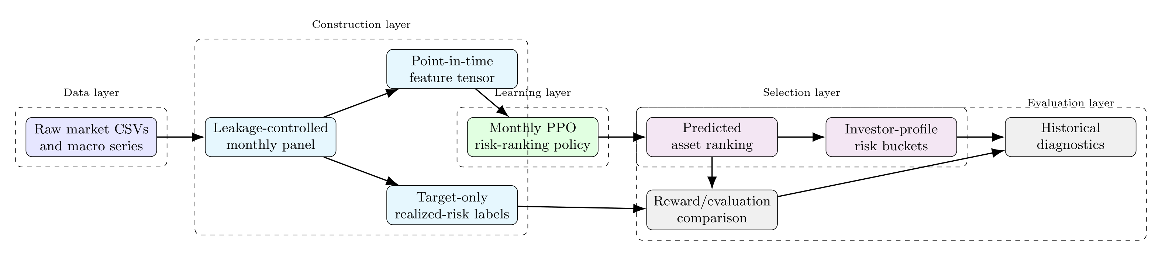
Contribution In One View
Notes:
Talk track
The full pipeline has four linked parts: point-in-time data engineering, monthly predicted risk ranking, profile-specific asset-universe mapping, and historical diagnostic evaluation.
Each part has a separate responsibility. That separation keeps the claims clean and makes the system easier to defend slide by slide.
Transition
The next slide explains the exact prediction the model produces each month.

Slide 15
What does the Model Predict ?
One predicted risk score per active asset
Assets sorted from lower predicted risk to higher predicted risk
Ranking quality matters more than exact score values
Notes:
Talk track
For every active asset in a specific month, the model outputs a predicted risk score. Those scores are then sorted ascendingly, from lower predicted risk to higher predicted risk.
The main goal is ranking quality. What matters most is whether safer and riskier assets are ordered well relative to each other inside that month.
This ranked list becomes the foundation for investor-specific asset selection later.

Slide 16
Methodology

Slide 17
Raw Data Engineering
Inputs include date, price, OHLC fields, and volume
T-bill and bond yield quotes are converted into price proxies
USD/EGP and CPI add macro market context
Notes:
Talk track
The raw financial inputs include date, price, OHLC fields, and volume for each asset. From those inputs, I build a monthly point-in-time panel for the model.
An important detail is that treasury bill and bond series are quoted as yields. So before calculating returns and risk features, those quotes are converted into fixed-maturity price proxies.
I also include macroeconomic context through USD/EGP conversion rate and Consumer Price Index, or CPI, because market conditions influence how risky the active universe is in each month.
Transition
That cleaned daily layer then feeds the monthly state panel used by the model.

Slide 18
Point-In-Time Monthly Panel
Features use only information available up to that month
Assets are not backfilled before they existed
Asset identity stays metadata and is excluded from model inputs
Notes:
Talk track
One row in the panel means one active asset in one month. So the model sees the market as a changing set of asset states.
The point-in-time rule is strict. Features for a month only use information available up to that month, and assets are never backfilled before they truly existed or before reliable data is available.
The panel keeps asset identity as metadata, but the model input itself uses only features. That helps the policy learn behavior patterns instead of memorizing asset names.
Transition
Once the panel exists, the next question is what information each row actually contains.

Slide 19
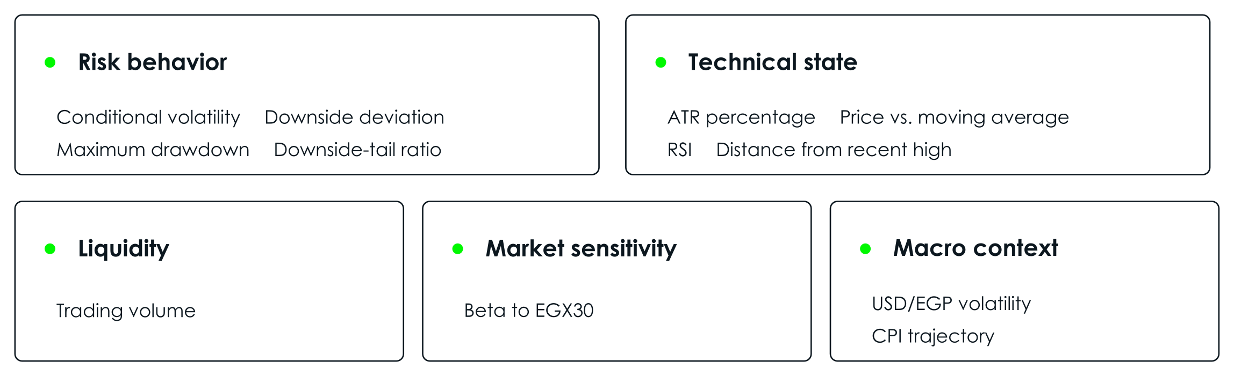
Feature Families
Notes:
Talk track
Rather than presenting the model inputs as one long list, I group them by the type of asset behavior they describe.
Risk behavior captures recent instability and the severity of harmful losses. Liquidity describes how actively the asset trades. Technical state summarizes recent price behavior, including range, trend, momentum, and position relative to previous highs. Market sensitivity describes how strongly the asset moves with the broader equity market. Finally, macro context captures shared currency and inflation conditions affecting every active asset.
Together, these families describe how an asset behaves without revealing its identity to the model.
Transition
These families define the model inputs. The next step is defining the realized risk used in the ordering that the model should learn.

Slide 20
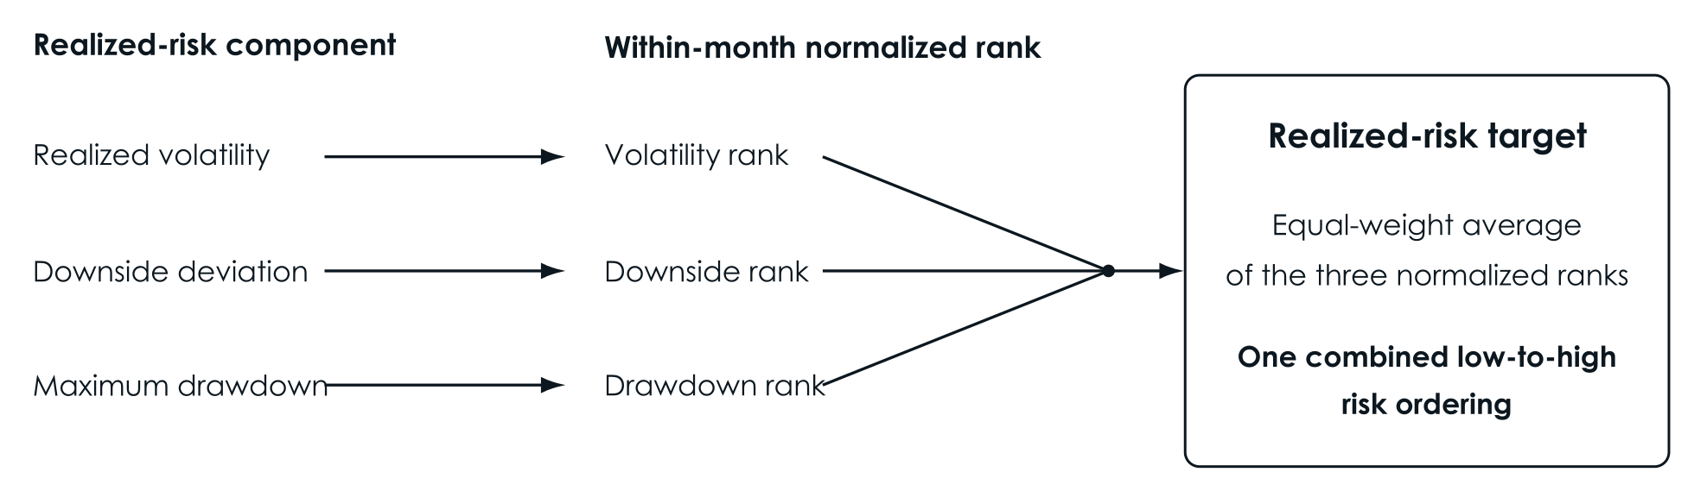
Realized Risk Target
Notes:
Talk track
The realized-risk target combines three complementary risk components: realized volatility, downside deviation, and maximum drawdown.
Each component is rank-normalized within the same month. This means an asset is compared only with the other assets that were actually active at that time, rather than being judged using an absolute scale.
The three normalized ranks are then averaged equally. The resulting realized-risk target defines the low-to-high risk ordering that the PPO model tries to recover.
Transition
Before explaining why I used reinforcement learning, I will quickly define what reinforcement learning means in this project.

Slide 21
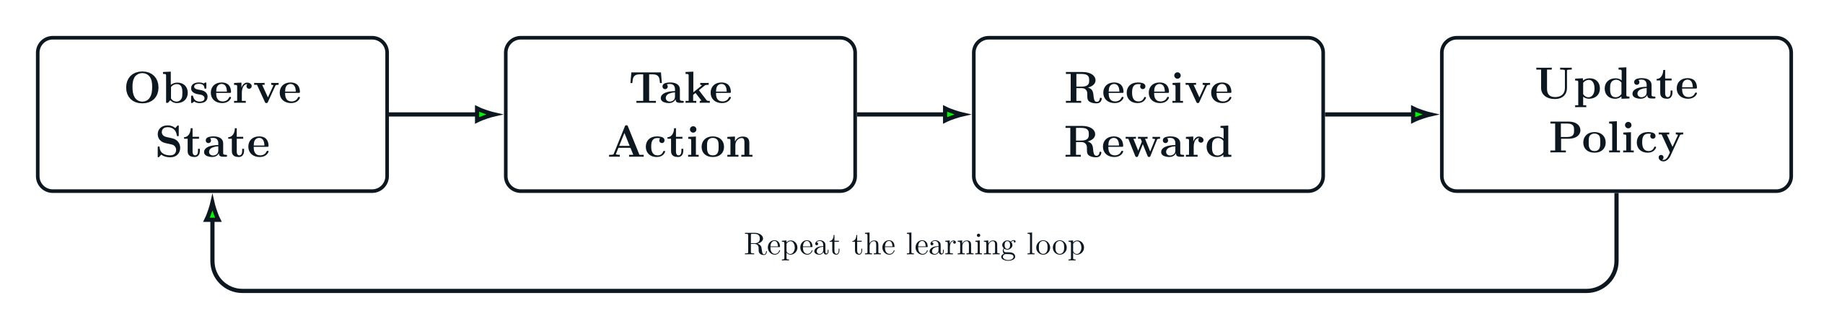
What Is Reinforcement Learning
Notes:
Talk track
Reinforcement learning is a learning setup where a model improves through interaction and feedback. The model observes a state, takes an action, receives a reward, and then updates its policy.
The policy is basically the model's decision rule. The reward function tells the model what behavior should improve. If an action leads to a better reward, the model adjusts its internal policy so similar actions become more likely in the future.
In this thesis, the state is one monthly active asset universe. The action is assigning risk scores to the assets. The reward tells the model how good the final monthly ranking was compared with realized risk. Over training, the model adapts so its future rankings are more likely to receive higher reward.
Transition
With that idea clear, I can explain why this problem fits reinforcement learning.

Slide 22
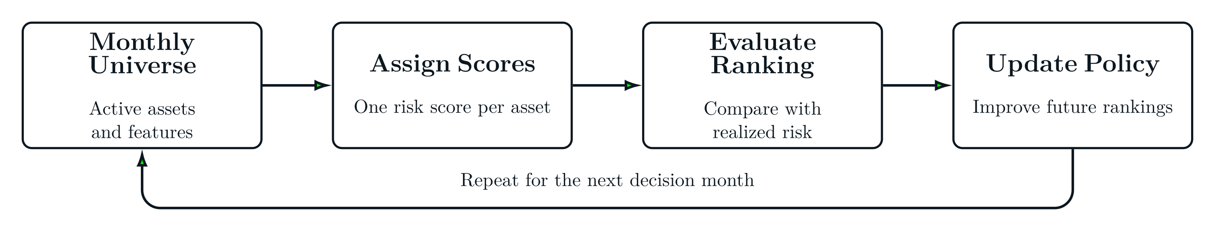
Why Reinforcement Learning
Available assets change from month to month
The model scores a full monthly set, not isolated assets
Reward arrives after the complete universe is ranked
Notes:
Talk track
Reinforcement learning fits this problem for three main reasons. First, the available assets change from month to month. Second, the model scores the full monthly set together rather than treating each asset as an isolated prediction. Third, the reward is calculated only after the complete universe has been ranked.
The figure shows how these ideas form one monthly decision environment. The state is the active asset universe and its features. The action is assigning one risk score to every active asset, and the resulting scores create the predicted monthly ranking.
The predicted ranking is then compared with the realized-risk ranking to calculate the reward. That feedback is used to update the scoring policy, so it can produce better rankings in future decision months.
Transition
Among reinforcement learning methods, I used PPO because it gives a more controlled training update.

Slide 23
Why PPO
Clipping limits unstable policy jumps
Actor-critic structure stabilizes learning
Suitable for month-level reward feedback
Notes:
Talk track
PPO is a policy-gradient reinforcement-learning method, meaning it directly improves the policy that produces the model’s actions. It fits this problem because the actor can assign a continuous risk score to every active asset, instead of choosing from fixed risk categories. These scores can then be sorted to create the monthly asset ranking.
Financial months can differ significantly, and an unusually difficult month could cause the model to change its scoring behavior too aggressively. PPO reduces this risk through clipping, which limits how much the updated policy can move away from the previous policy during one training update.
PPO also uses an actor-critic architecture to make learning more stable. At a high level, one component makes the decisions while another helps evaluate them.
Transition
Before explaining the actor-critic architecture in more details, I first need to define what one PPO decision looks like.

Slide 24
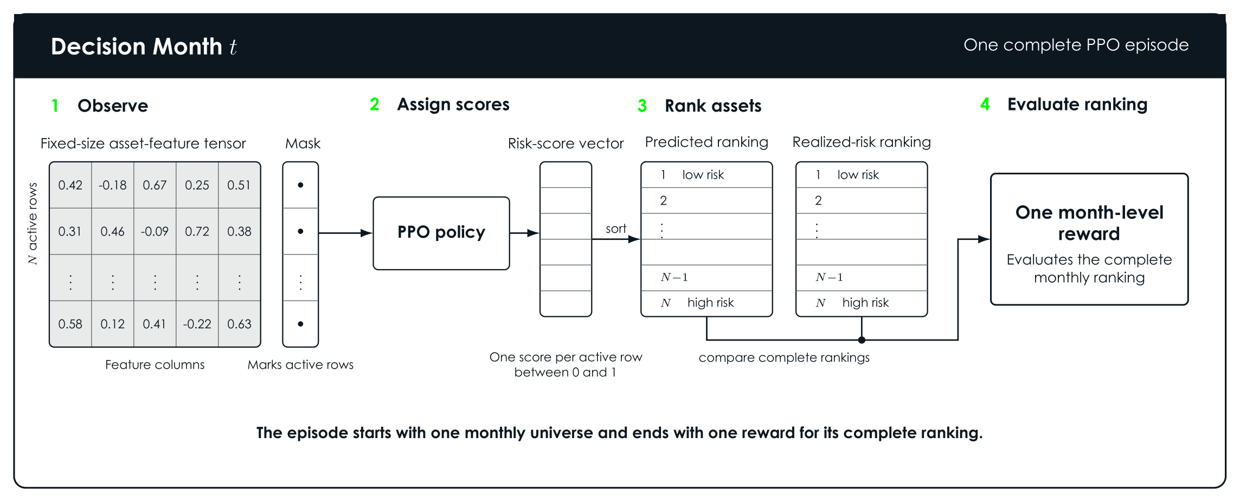
PPO Episode Format
Notes:
Talk track
One PPO episode equals one monthly decision. The observation is a tensor of all asset features, together with a mask that marks which rows are real assets. This setup supports a different number of available assets depending on the decision month.
The action is one continuous risk score for each real asset row, between zero and one. After the model scores the month, the assets are sorted and compared with the realized-risk ordering for that same month.
So the reward is based on how well the full monthly ranking matches reality.
Transition
That episode design depends on handling a changing number of assets cleanly.

Slide 25
Variable Universe & Masking
Padding gives a consistent tensor shape
The mask separates real asset rows from padding rows
Padded rows do not affect actions, learning, or reward calculations
Notes:
Talk track
The practical challenge is that every month has a different number of active assets. A neural network still needs a consistent tensor shape, so the input is padded to a fixed size.
The mask tells the model which rows are real and which rows are just padding. That way, padded rows do not pollute action sampling, learning, or reward calculations.
This is what lets the system work with a changing investable universe in a technically clean way.
Transition
With the monthly decision and masking logic clear, I will explain the actor-critic architecture.

Slide 26
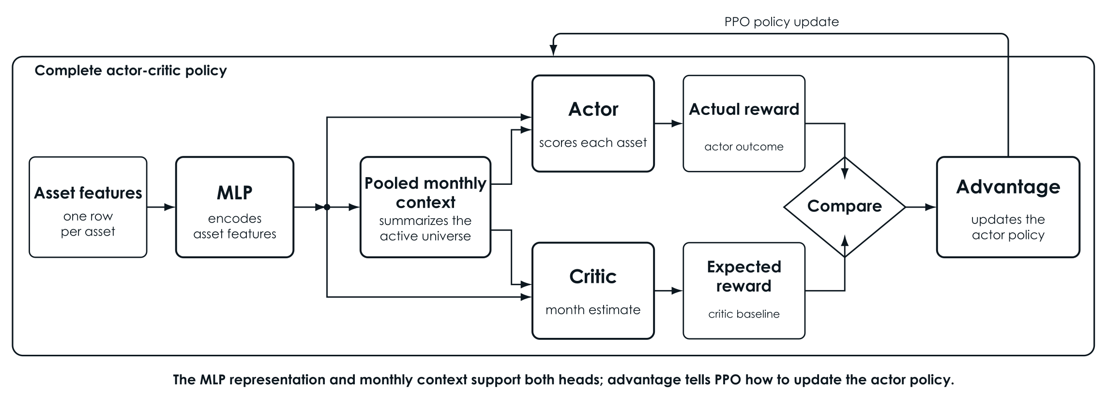
Actor-Critic Architecture
Notes:
Talk track
The architecture has four main pieces. A row encoder reads each asset using the same parameters, then a pooled context vector summarizes the active month.
From there, the actor outputs a risk score per asset, and the critic estimates the expected monthly reward. That critic estimate gives the algorithm a baseline for how good or bad the actual month turned out.
The difference between the actual monthly reward and the critic's expected monthly reward is called the advantage. PPO uses that advantage to decide how strongly the policy should be updated.
This structure is a good fit because the decision mixes asset-level scoring with month-level context.
Transition
The final training signal then comes from the reward function.

Slide 27
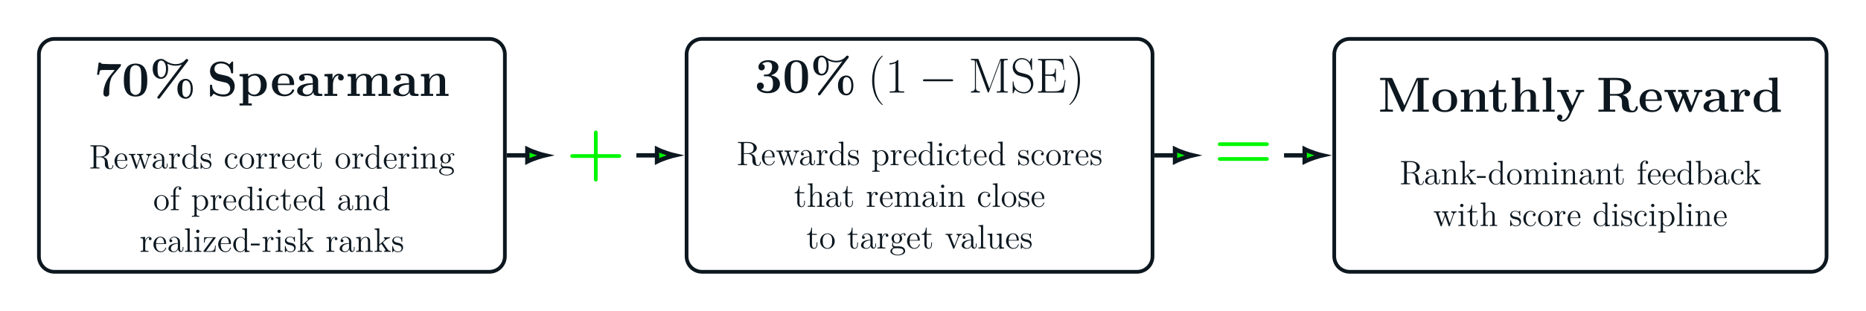
Reward Definition
Notes:
Talk track
The reward is computed after the entire monthly universe is scored. Seventy percent of it measures how close the predicted ranking was to the realized-risk ranking, and thirty percent measures how close the predicted score values were to the target values.
The first part uses Spearman rank correlation because the thesis is mainly a ranking problem. The second part uses MSE to discourage the model from placing all assets too close together, where a very small score change could easily flip the ranking.
So the reward keeps the ranking objective central while still giving the scores some shape.
Transition
Once the model produces a ranked list, I can map that list into profile-specific asset universes.

Slide 28
Profile-Specific Asset Universes
Conservative: lowest 30% predicted-risk assets
Balanced: 20% to 80% predicted-risk band
Aggressive: highest 30% predicted-risk assets
Notes:
Talk track
After ranking, the predicted positions are converted into rank percentiles. These percentiles are then used to form three profile-specific asset universes.
The conservative asset universe uses the lowest 30 percent of predicted-risk assets. The balanced asset universe uses the middle 20 to 80 percent band. The aggressive asset universe uses the highest 30 percent of predicted-risk assets.
The overlap is intentional because some assets can reasonably fit two neighboring investor profiles depending on where they sit in the ranked distribution.
Transition
With the full method defined, the next step is to show how I tested it.

Slide 29
Experiments

Slide 30
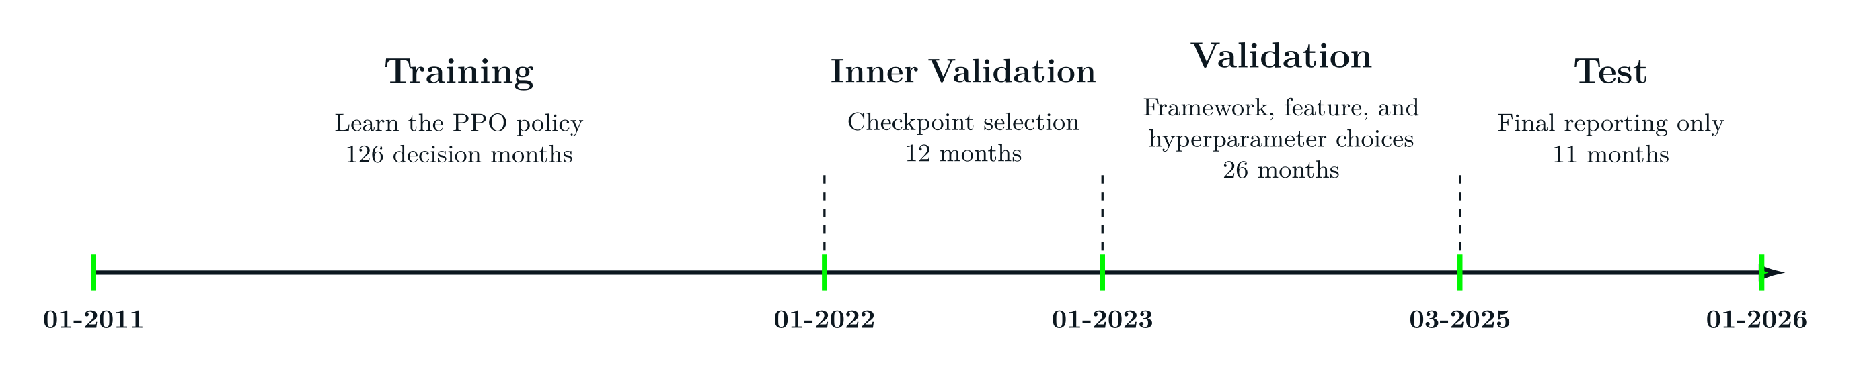
Chronological Split Design
Notes:
Talk track
The evaluation follows a strict chronological split to control leakage. Training covers 2011-01 to 2021-12, and this is where the PPO policy learns from historical months.
Inner validation covers 2022-01 to 2022-12, and it is used for intermediate model-selection checks. Validation covers 2023-01 to 2025-02, and it guides the final framework, feature, and hyperparameter choices. Test covers 2025-03 to 2026-01, and it is held back for final reporting only.
Transition
Before feature tuning, I first had to decide which PPO framework made the most sense.

Slide 31
Framework Selection
Compared one-month versus three-month feature windows
Evaluated the inclusion of pooled active-universe context
Evaluated the addition of Daily price variants
Notes:
Talk track
Several formulations were compared before locking the final framework. The goal was to understand which input structure actually fits the ranking problem, while keeping the base feature set fixed.
I tested whether the model should look at only the most recent month or a three-month feature window. I also tested whether adding pooled context from the whole active universe in that month improved the model's performance.
I also explored variants that included daily price information more directly, but in these trials that appeared to add noise and did not improve validation performance. The three-month view with active-universe context had the best performance, so it was promoted as the final framework for the next stage.
Transition
After the framework was locked, I moved to feature tuning and hyperparameter tuning phases.

Slide 32
Feature and Hyperparameters
Ran drop-one ablations on the base set to identify which feature families contributed signal
Stress-tested the chosen set across seed configuration, redesigned feature families, and incremental additions before locking the final inputs
Used Optuna validation trials to tune PPO hyperparameters and select the configuration that generalized best
Notes:
Talk track
Feature selection followed a sequential process. I first used drop-one-feature ablations on the fixed feature set, then confirmed promising changes with three-seed runs. After that, I tested redesigned feature-family alternatives and new additions such as the downside-tail ratio.
Hyperparameter tuning came after the framework and feature decisions. I used Optuna, a hyperparameter optimization tool that runs multiple parameter trials, evaluates them on the validation objective, and uses earlier results to suggest better configurations.
The main selection metric was validation reward, with validation Spearman kept as the ranking-quality guardrail.
Transition
Once the model was locked, I evaluated it in two connected stages.

Slide 33
Evaluation Logic
Stage 1
Stage 2
compare predicted ranks with realized risk ranks
compare profile universes with the full active universe
Notes:
Talk track
The first stage evaluates ranking quality directly by comparing predicted risk ranks with realized-risk ranks, mainly using Spearman correlation.
The second stage evaluates what those rankings mean for investor groups by forming conservative, balanced, and aggressive universes and comparing them with the full active universe under the same equal-weight rule.
Equal weighting keeps the focus on universe selection. Return metrics are reported, but the main reading remains risk separation.
Transition
Now I can show the core results.

Slide 34
Results

Slide 35
Ranking Quality
Notes:
Talk track
The promoted model achieved a test reward of about 0.7545 and a test Spearman diagnostic of about 0.669. Those are the main ranking-quality signals at the thesis level.
Another useful detail is that reward stayed positive across all 11 test months. That gives a more stable picture than looking at a single average alone.
So before even forming profile-specific asset universes, the monthly ranking behavior is already meaningful.
Transition
The strongest thesis result appears when those rankings are converted into profile-specific asset universes.

Slide 36
Profile-Universe Risk Separation
Notes:
Talk track
The profile-specific asset universes separated realized risk in the expected order. The full universe mean realized risk was 0.500, the conservative universe was 0.239, the balanced universe was 0.536, and the aggressive universe was 0.688.
The monotonic ordering held in all 11 out of 11 test months. That is the cleanest evidence that the model can produce distinct investor-oriented universes from predicted ranks.
From a financial point of view, the main message is straightforward: the conservative asset universe behaved materially safer, while the aggressive asset universe carried clearly higher realized risk.
Transition
After risk separation, we can look carefully at the return side of the same test window.

Slide 37
Economic Diagnostics
Notes:
Talk track
Using the same equal-weight allocation rule, cumulative return in the test window was 49.59 percent for the full universe, 29.91 percent for the conservative universe, 50.17 percent for the balanced universe, and 86.24 percent for the aggressive universe.
The aggressive universe also carried higher volatility and a deeper drawdown. So the higher return came with visibly higher risk exposure.
That is why I present these numbers as historical diagnostics. They help interpret the selected universes economically, but they do not prove future outperformance.
Transition
That brings us to the baseline comparison.

Slide 38
Baseline Comparison
Notes:
Talk track
The baseline here is the full active universe under the same equal-weight rule. Keeping the allocation rule fixed makes the comparison much cleaner.
Under that comparison, conservative-universe filtering materially reduced realized risk versus the full universe, while aggressive-universe filtering produced higher realized risk and stronger return participation in the short test window.
So the filtering stage itself already changes the opportunity set in a meaningful, investor-specific way.
Transition
With that evidence in place, I can answer the research questions directly.

Slide 39
Conclusion

Slide 40
Research Question Answers
Notes:
Talk track
The promoted model achieved a test reward of about 0.7545 and a test Spearman diagnostic of about 0.669. Those are the main ranking-quality signals at the thesis level.
Another useful detail is that reward stayed positive across all 11 test months. That gives a more stable picture than looking at a single average alone.
So before even forming profile-specific asset universes, the monthly ranking behavior is already meaningful.
Transition
The strongest thesis result appears when those rankings are converted into profile-specific asset universes.

Slide 41
Future Work

Slide 42
Live Data and Forward Testing
Notes:
Talk track
These are possible next steps beyond the thesis scope. One future direction is live forward testing: connecting the pipeline to live market-data APIs, rebuilding the monthly features over time, and monitoring how the selected asset universes behave in real conditions.
That would matter because historical evidence is useful, but forward observation is a stronger test of stability.
Transition
There is also a natural extension on the objective side.

Slide 43
Return-Aware Suitability
Notes:
Talk track
Another possible extension is return-aware suitability. The current thesis objective is risk suitability, but a future version may add return-aware diagnostics or utility logic after the risk-ranked universes are formed.
That would let the system stay investor-aware while exploring richer tradeoffs inside each selected universe.
Transition
I'll close the main talk with the core references behind the framing.

Slide 44
Key References
Notes:
Talk track
These are the five core references most directly supporting the problem framing, the preselection literature, and the baseline context for this thesis.
I keep the slide short during the talk and leave the fuller literature detail to the written thesis and discussion.

Slide 45
Q&A

Slide 46
Thank You

