Slide 1
Generic material
For testing PyroPython

Slide 2
Material
Generic material with known material parameters.
Sample thickness in cone is 2 cm.
Original density of the material is 1000 kg/m³.

Slide 3
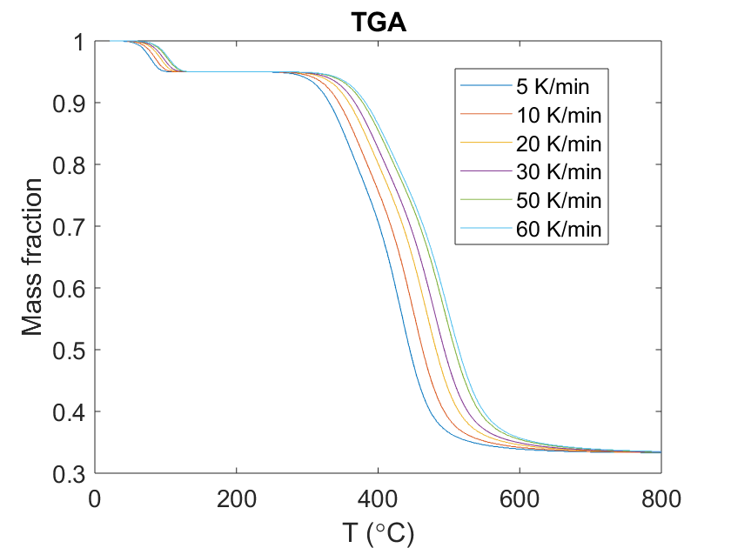
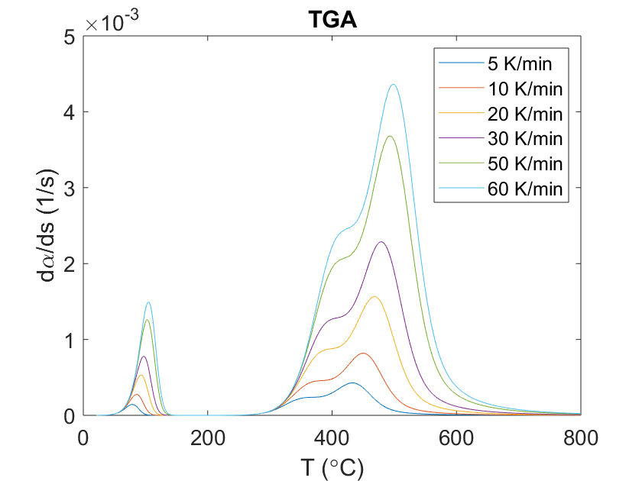
TGA results (in N₂)

Slide 4
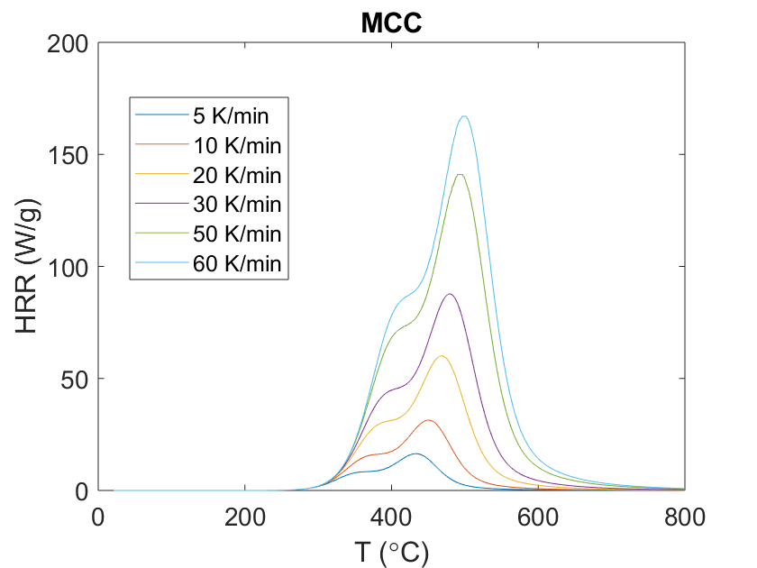
MCC results

Slide 5
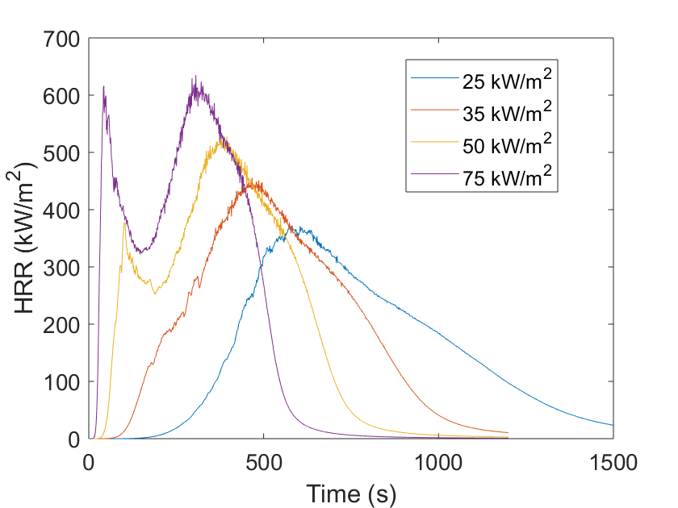
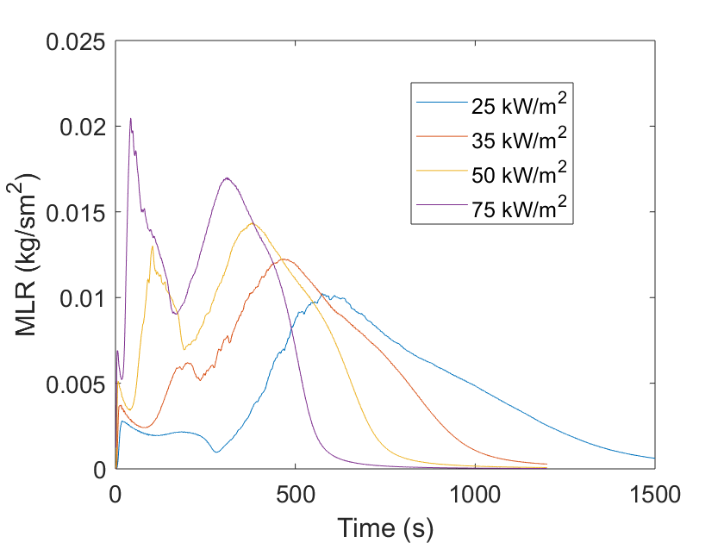
Cone calorimeter results

Slide 6
Experimental data files
TGA / MCC
Cone
Columns:
Time (s)
Temperature (℃)
Mass fraction (-)
Mass loss rate (1/s)
HRR (W/g)
Heat flow (W/g)
Columns:
Time (s)
Surface mass (kg/m²)
Surface temperature (℃)
HRR per unit area (kW/m²)
Thickness (m)
Inside temperature (℃)

