Slide 1
Machine Learning
Ali Akbar ahmadi

Slide 2
Machine learning Algorithms
A machine learning algorithm is a mathematical method to find patterns in a set of data. Machine Learning algorithms are often drawn from statistics, calculus, and linear algebra. Some popular examples of machine learning algorithms include linear regression, decision trees, random forest, XGBoost, Neural Networks, and Deep Learning.
https://www.databricks.com/glossary/machine-learning-models

Slide 3
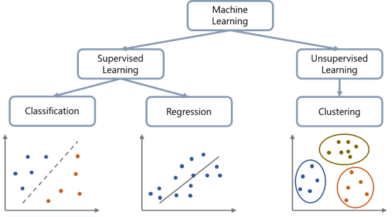
Machine Learning Type
Image from: https://www.gabo.de/bereiche-des-machine-learning/

Slide 4
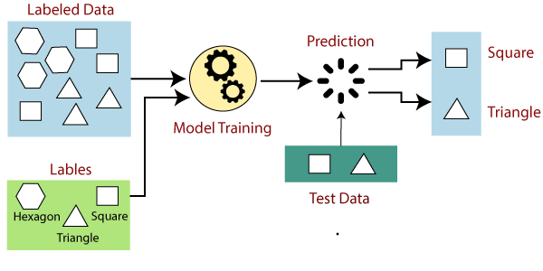
Supervised Machine Learning
Image from: https://www.javatpoint.com/supervised-machine-learning

Slide 5
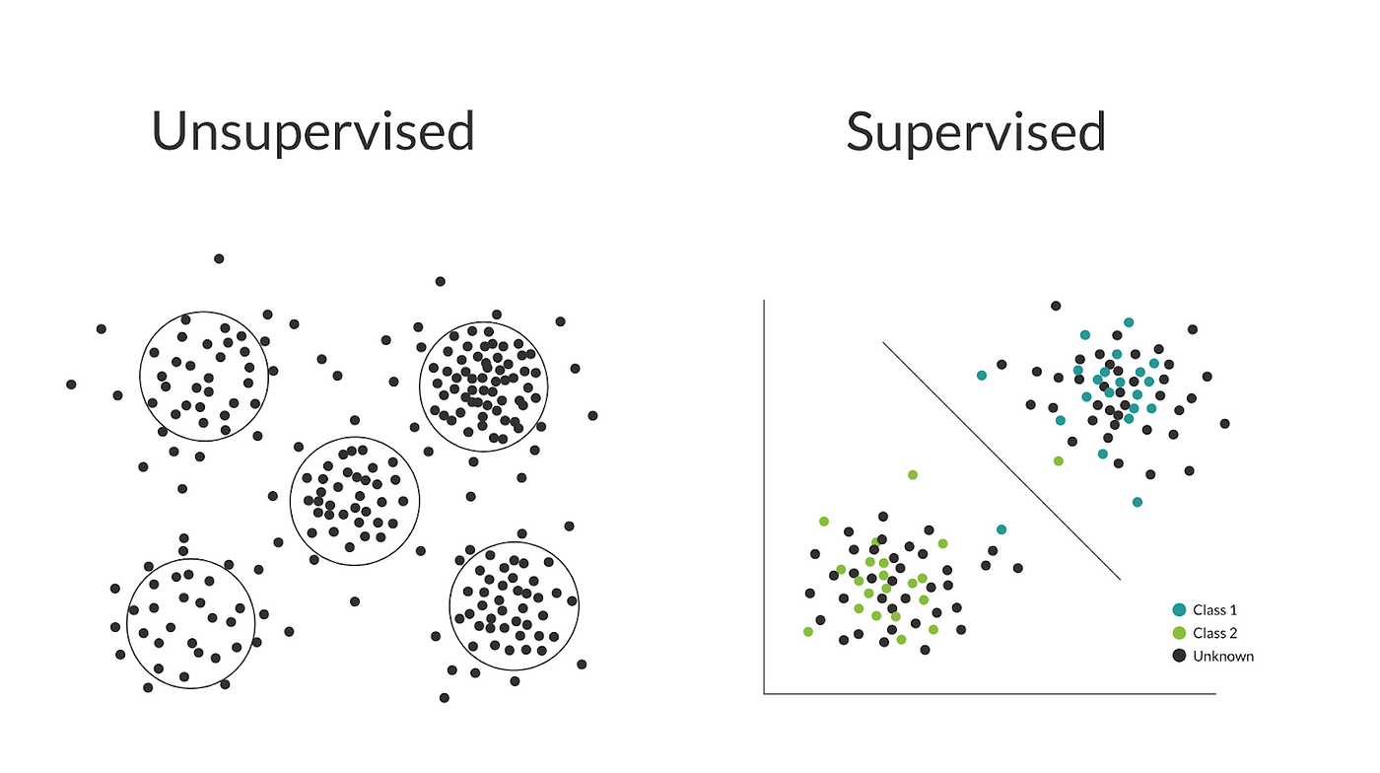
unsupervised Machine Learning
https://techntales.medium.com/mastering-the-basics-understanding-supervised-and-unsupervised-learning-algorithms-0db403af7557

Slide 6
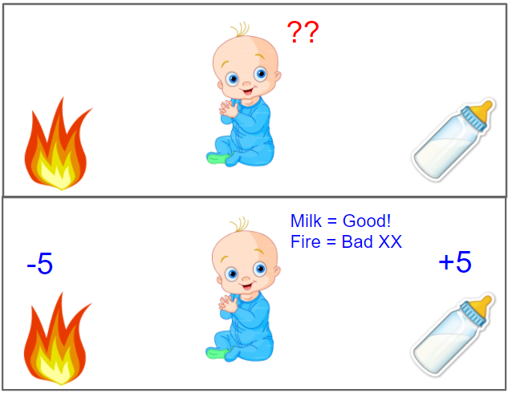
Reinforcement Learning

Slide 7
Supervised ML Examples
Logistic Regression
SVM (Support Vector Machines)
Naive Bayes
Decision Trees
Linear Regression
Random Forest
Boosting algorithms (e.g., Gradient Boosting Machine, XGBoost, LightGBM)

Slide 8
unSupervised ML Examples
K-Means
Hierarchical Clustering

Slide 9
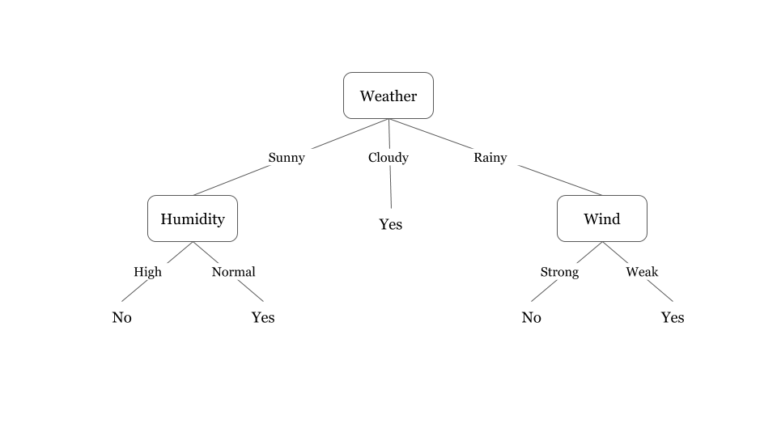
Decision Tree
A Decision Tree is a predictive approach in ML to determine what class an object belongs to. As the name suggests, a decision tree is a tree-like flow chart where the class of an object is determined step-by-step using certain known conditions.
https://www.databricks.com/glossary/machine-learning-models

Slide 10
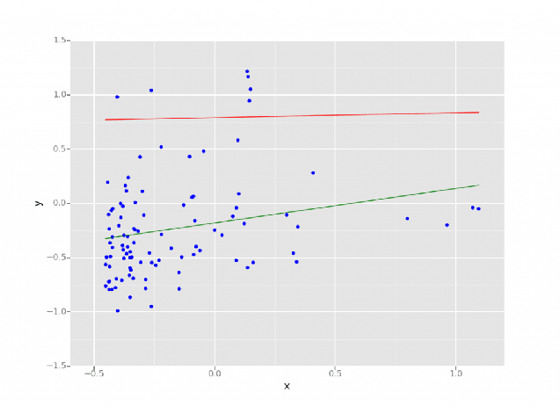
Regression
Regression in data science and machine learning is a statistical method that enables predicting outcomes based on a set of input variables. The outcome is often a variable that depends on a combination of the input variables
https://www.databricks.com/glossary/machine-learning-models

Slide 11
Classifier
Is a Machine Learning model that is used to tag an input a category.
Emails, span or non-spam

