Slide 1


APPLIED AI LAB · SUMMER SEMESTER 2026
Student Assistant
Deutsche Sprache
An AI tutor for real German practice.
Presented by Ali Akbar & Mustafa Khalid
1 / 17

Slide 2








AGENDA
What We'll Cover
Problem & Motivation
Tech Stack & Architecture
1
2
Six Build Phases
Evaluation
3
4
Model Comparison
Challenges and Learning
5
6
Team Contribution
Live Demo
7
8
2 / 17

Slide 3




PROBLEM STATEMENT
Why German Practice Falls Short
Human tutors cost too much
Apps drill words, not talk
Weekly lessons are expensive.
Flashcards skip real conversation.
No instant speech feedback
Speaking up feels intimidating
Learners can't hear their mistakes.
Mistakes feel public, not safe
3 / 17

Slide 4




TECH STACK
Built With Modern AI Tools
Frontend
Backend
AI Models
Infra
React
FastAPI
gemma4-31b-it
LiveKit WebRTC
TypeScript
SQLAlchemy
Qwen3.6-35b
Vite
JWT Auth
Deepgram Nova-3
Tailwind CSS
SQLite
Cartesia Sonic-3
4 / 17

Slide 5

ARCHITECTURE
How It All Connects
CLIENT
React Frontend
Chat · Voice · Feedback UI
BACKEND
FastAPI Backend
Auth · Chat · History
SERVICES
LLM Service
Vocab Service
Auth Service
AI & DATA
gemma4-31b-it
Qwen3.6-35b
Deepgram / Cartesia
SQLite DB
For Comparison Testing
Voice LLM
STT · TTS
Users & history
5 / 17

Slide 6



PHASE 1
Dataset Preparation
Find best open-source German word datasets
Organize words across all CEFR levels
Data cleaning and pre-processing
Export clean JSON with CEFR categorization
6 / 17

Slide 7


PHASE 2
Context-Aware LLM Integration
Integrate the Qwen3.6-35b model
HOW IT WORKS
CEFR level selected A1 · A2 · B1 · B2
Implement CEFR-level selection logic
Qwen3.6-35b level-aware prompt
Validate context-aware vocabulary only
Restricted response only allowed vocabulary
7 / 17

Slide 8

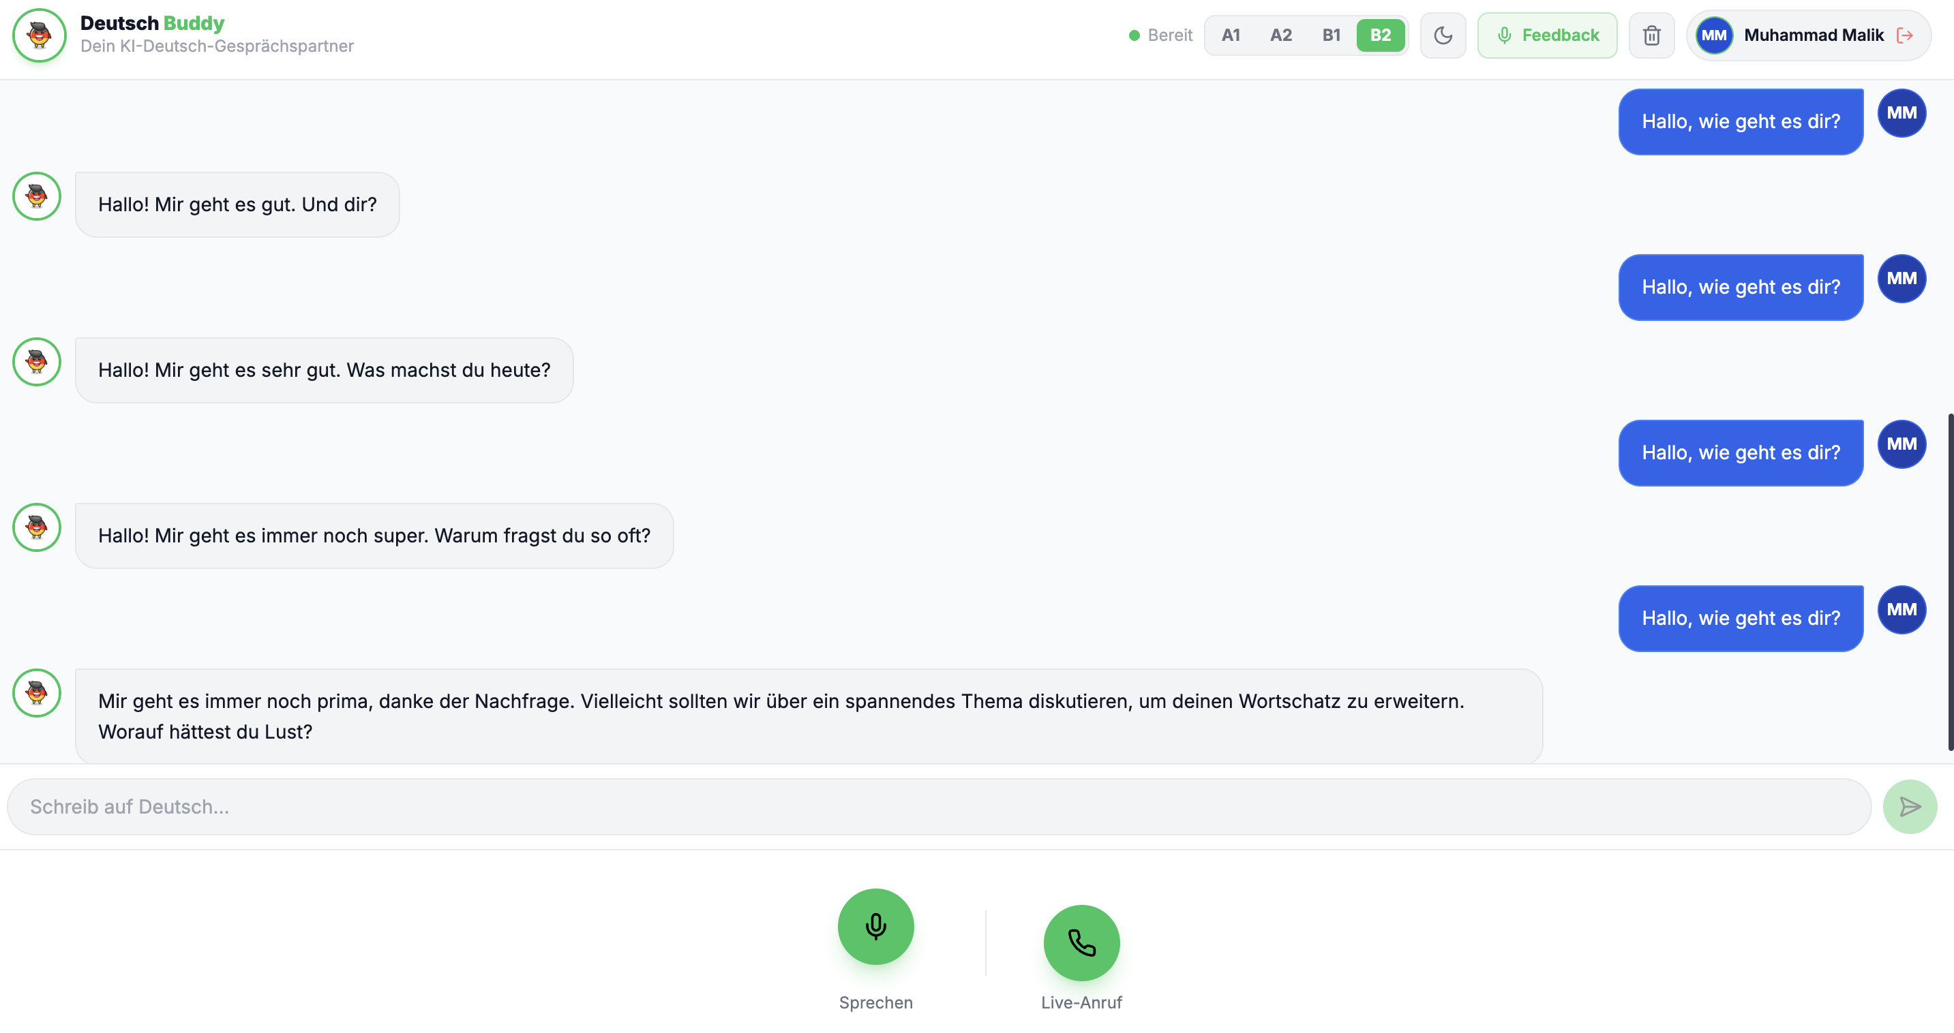



PHASE 3
Chat Interface Feature
Chat UI with CEFR level selector
Connect chat messages to the LLM
Audio talking feature
Inline AI pronunciation feedback
Live SSE streaming with Edge TTS
Text chat with live level switching (A1–B2)
8 / 17

Slide 9
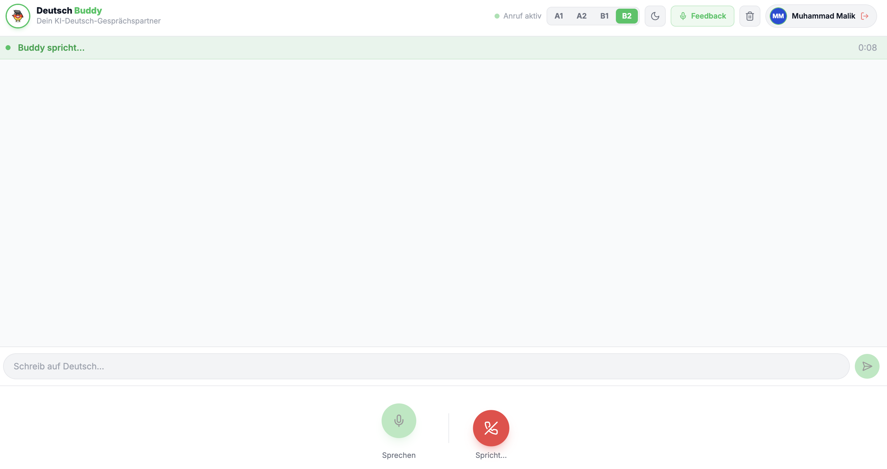




PHASE 4
Real-Time Voice Agent Pipeline
Deepgram Nova-3 streaming STT
Cartesia Sonic-3 real-time TTS
Latency optimized (~1–2s round-trip)
Natural tutor talk via qwen3.6-35b
Live-Anruf: continuous voice-only conversation
STACK
LiveKit WebRTC
Silero VAD
Deepgram Nova-3
Qwen3.6-35b
Cartesia Sonic-3
9 / 17

Slide 10




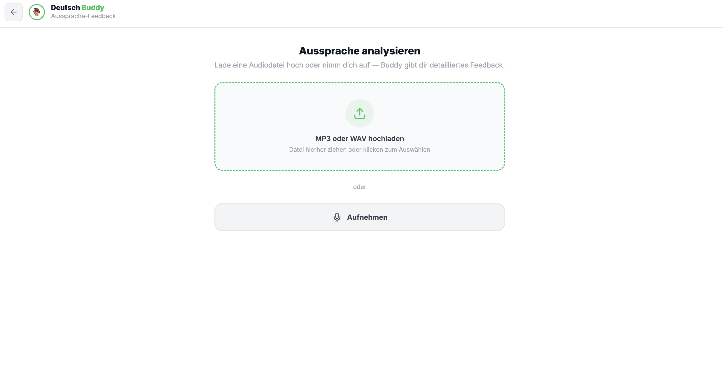
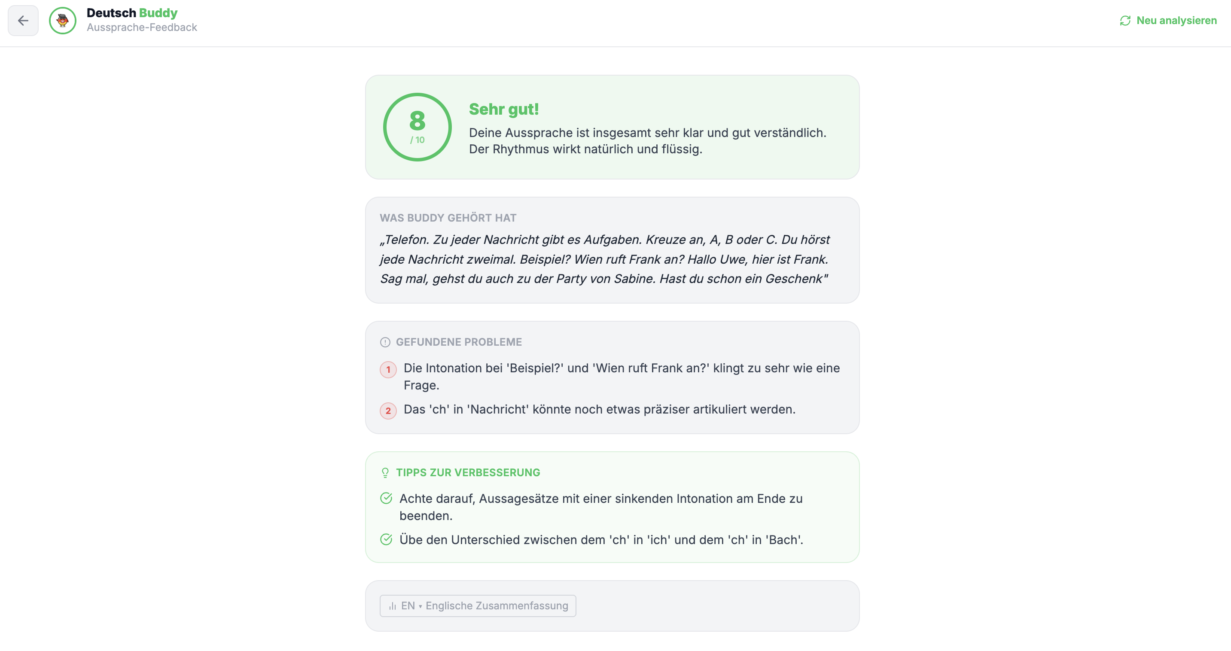
PHASE 5
Pronunciation Feedback Pipeline
Latency < 10s for 1-min+ audio
More user-friendly interface
Audio upload & live transcription
Scoring mechanism for feedback
Upload or record audio
Score, transcript & targeted tips
10 / 17

Slide 11


PHASE 6
Testing & Evaluation
Automated CEFR-Level Evaluation
80 responses checked against CEFR word list.
Cross-validated by two LLM judges.
Human Feedback
Real learners test Deutsch Buddy directly.
They rate clarity, tone, and usefulness.
11 / 17

Slide 12
RESULTS
How We Compare to Other Models
Same 80 prompts — accuracy and response time.
ANALYSIS
Qwen3.6 wins decisively on speed.
About 12x faster than Gemma — 0.66s vs 7.91s avg.
Accuracy dips slightly at
A1/A2, but B1/B2 stay
perfect for every model.
RESPONSE LATENCY
qwen3.6-35b-a3b (ours)
gemma4-31b-it
0.66s
7.91s
min 0.43s · max 1.09s
80 real calls, 52.9s total
min 2.16s · max 27.30s
80 real calls, 632.8s total
12 / 17

Slide 13

CHALLENGES
What We Learned Along the Way
Voice felt slow at first
LLM ignored the level
Switched to LiveKit streaming pipeline.
Injected live CEFR stem lists.
German inflection is tricky
Simplified to direct word matching.
Dictionary coverage has real gaps
Found while auditing our own results.
5 of 80 replies had no matches.
13 / 17

Slide 14

OUR TEAM
Team Contribution
Ali Akbar
Mustafa Khalid
Live Voice, Voice Chat & Deployment
Text Chat, Feedback & Testing
Live Voice Call — Live-Anruf pipeline
Text Chat — CEFR-adaptive streaming
Voice Chat — Sprechen mode + transcription
Pronunciation Feedback — scoring & tips
Deployment — production build & infra
Testing — CEFR accuracy & user feedback
15 / 17

Slide 15

LIVE DEMO
Let's See It In Action
Text Chat
Live-Anruf
Pronunciation Feedback
CEFR-level replies, streamed live.
Real-time spoken conversation.
Scored tips after every recording.
Switching to the live application now.
16 / 17

Slide 16
CONCLUSION
Danke.
Questions & Discussion
Thank you, Ali Akbar & Mustafa Khalid
17 / 17

