Slide 1

Machine Learning Approach to Human Emotions and Personality Type Prediction From Social Media Posts Using Sentence Transformers.
Machine Learning Approach To Predict
Personality Type
From
Social Media Posts Using
Sentence Transformer

Slide 2
Presented By:
Supervised Under:
Risha Asfara - 18.02.04.001
Rasel Ahmed – 19.01.04.093
Tahira Ferdousi - 19.01.04.123
Md. Ali Akber – 19.01.04.129
Mrs. Raqeebir Rab
Assistant Professor
Department of CSE
Ahsanullah University of
Science and Technology

Slide 3





Introduction
Background Study
Table Of
Contents
Methodology
Result

Slide 4

Introduction

Slide 5


Introduction
Motivation
What is MBTI
What is Text Classification
What is Machine Learning
Problem Statement
Proposed Methodology

Slide 6
Introduction: Motivation
1
Helps to grow
personally and
professionally
2
Prominent model in different domains
3
Determine the relationships between personality and mental health

Slide 7
Introduction :
What is machine learning
What is text classification
Problem statement

Slide 8
Background Study

Slide 9
Background Study: What is MBTI(Myers-Briggs Type Indicator)?
Intuition
Vs
Sensing
Feeling
Vs
Thinking
Introversion
Vs
Extraversion
Perception
Vs
Judgement

Slide 10
Background Study: Classical Algorithms for Text Classifications
Logistic Regression | Support Vector Machine | Decision Tree | Random Forest
A supervised model and predictive analytic approach based on the concept of probability | Supervised linear model used to solve classification and regression issues | A hierarchical decision support model that employs a tree-like description of decisions and potential outcomes | Multiple decision trees are used in Random Forest, an ensemble learning technique, to create predictions
Implement when the dependent variable (target) is categorical | Goal is to establish decision boundaries that provide the largest possible divergence between the two groups | Can handle both category and numerical information and are simple to understand | It can manage large amounts of data, minimize overfitting, and provide reliable predictions

Slide 11
Background Study:
Hyperparameters
SVM Hyperparameters | Hyperparameter-tuning with Bayesian Optimization
Kernel Regularization parameter Gamma (kernel coefficient) Degree (polynomial kernel) | Choosing suitable hyperparameter configurations iteratively based on prior observations

Slide 12
Background Study:
Handling Imbalanced Data
Lemmatization
It may lead to biased or inaccurate models
Can be handled using oversampling and undersampling
Changes words into lemma form
Reduces inflected words to standard form to improve text data analysis
Tokenization
Involves identifying and separating the text into relevant chunks
Convert unstructured text into a structured format

Slide 13
Literature Review

Slide 14
Literature Review::
Name | Strategy/Method(s) | Dataset | Result
[1] Personality Type Based on Myers-Briggs Type Indicator with Text Posting Style by using Traditional and Deep Learning | Text cleaning, tokenization and lemmatization TF-IDF, “Bag of Words” for machine learning model and “CONV1D” for RNN SVM, Naive Bayes, RNN(with BI-LSTM) | Personal social networking posts from “personalitycafe .com”. | Accuracies: SVM-41.97% Naïve Bayes-41.03% RNN-49.75%
[2] Survey Analysis of Machine Learning Methods for Natural Language Processing for MBTI Personality Type Prediction | Preprocessing, lemmatization and stop words removing "Bag of words”, bigrams, skip grams, part of speech tags, and capital letter count - feature selection technique SVM, Naive Bayes, RNN(with BI-LSTM) | Personal social networking posts from “personalitycafe .com”. | The Naive Bayes 26% accuracy Regularized SVM 33% accuracy Deep learning model 38% accuracy

Slide 15
Literature Review::
Name | Strategy/Method(s) | Dataset | Result
[3] Analysis of Personality Traits using Natural Language Processing and Deep Learning | Data cleaning, stop words removing TF-IDF, CountVectorizer and an Embedding Layer for generating feature Naive Bayes, SVM, Random Forest Classifier and CNN | People’s posts on personality(personality cafe along with their personality types | Accuracies: Naive Bayes - 32.63% Random Forest Classifier - 36.03% SVM - 57.90% CNN - 81.40%
[4] Persona Traits Identification based on Myers-Briggs Type Indicator(MBTI) - A Text Classification Approach | Preprocessing, stemming, lemmatization, tokenization and 1500 most frequent words Uses TF-IDF, EmoSenticNet, LIWC, and ConceptNet for feature vectors SVM, Naive Bayes and a Neural Network | Tweets tagged with 16 MBTI types | SVM gives better result with addition of TF-IDF, EmoSenticNet, LIWC, ConceptNet features and reduction(using SVD) of them

Slide 16
Literature Review::
Name | Strategy/Method(s) | Dataset | Result
[5] A SURVEY ON CLASSIFICATION TECHNIQUES FOR TEXT MINING | KNN, Naive Bayes, SVM, Decision Tree and Logistic Regression models have been analyzed | Unstructured text from variety of sources | SVM outperforms all other algorithms in terms of precision, recall, and F1 measure.
[6] Personality prediction from social media posts using text embedding and statistical features | BERT , Uni-gram , Bi-gram, Post and Word Length Statistics | MBTI dataset kaggle | Use of statistical features improved the overall performance along with BERT embeddings as features

Slide 17
Methodology

Slide 18
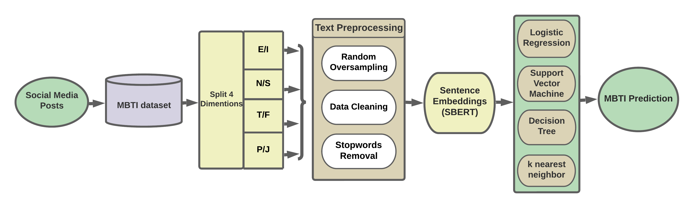
Methodology: Overview
Fig. Proposed Methodology for MBTI Personality Classification

Slide 19
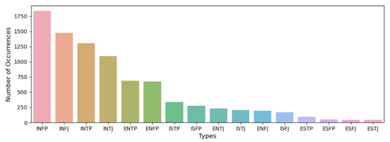
Methodology: Data Collection and Visualization
Includes latest 50 posts written by each user
Contains 8675 rows(each row has two columns)
Acquired from
Kaggle
Fig. Visual Representation of all 16 MBTI types in the dataset

Slide 20
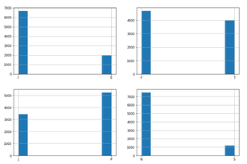
Methodology: Random Oversampling
Methodology: Preprocessing
• Introversion/Extraversion(E) : 6676
• Sensing/Intuition(N) : 7478
• Thinking/Feeling(F) : 4694
• Judging/Perceiving(P) : 5241
Easiest type of oversampling
Random Oversampling
Highly effected on SVM
Fig. Diagram showing the proportions of each "MBTI" dimension

Slide 21
Methodology: Preprocessing
Data Cleaning
Stop Words Removing
Text Data
Tokenization
Lowercased tokens

Slide 22
Methodology: Feature Extraction
Sentence Embedding: SBERT outperforms BERT and takes less time
SBERT Model “ALL-MPNET-BASE-V2”: Generates contextualized sentence embeddings and trained on over 1 billion training data
Tokenization and Embedding Construction: Byte Pair Encoding algorithm tokenized sentences into a series of subwords and is represented by an initial embedding vector.
Integration of Subword Embeddings: contextualized embeddings for all subwords are integrated into 768 dimensional vectors

Slide 23
Methodology: Classification
K-nearest
Neighbor:
n_neighbors=5 weights=‘uniform’ algorithm=‘auto’
SVM :
C=1.0 kernel=‘rbf’ degree=3 gamma=‘scale’
Logistic Regression:
Parameters :
penalty=‘l2’
solver=‘lbfgs’,
C=1.0
Decision Tree:
criterion=‘gini’ splitter=‘best’ max_depth=None
min_samples_split=2

Slide 24
Methodology:
Binary Classification | Regularization | Kernel | Degree for polynomial kernel | Gamma Value
I/E | 100 | Poly | 4 | scale
S/N | 22.09 | Poly | 4 | scale
T/F | 18.04 | rbf | 3 | scale
J/P | 18.67% | poly | 4 | scale
SVM with Hyperparameter Tuning
Fig. Best Hyperparameter combination for SVM

Slide 25
Performance Analysis: Results
Fig. Performance analysis for Extraversion vs Introversion

Slide 26
Performance Analysis: Results
Fig. Performance analysis for Sensing vs Intuition

Slide 27
Performance Analysis: Results
Fig. Performance analysis for Thinking vs Feeling

Slide 28
Performance Analysis: Results
Fig. Performance analysis for Judging vs Perceiving

Slide 29
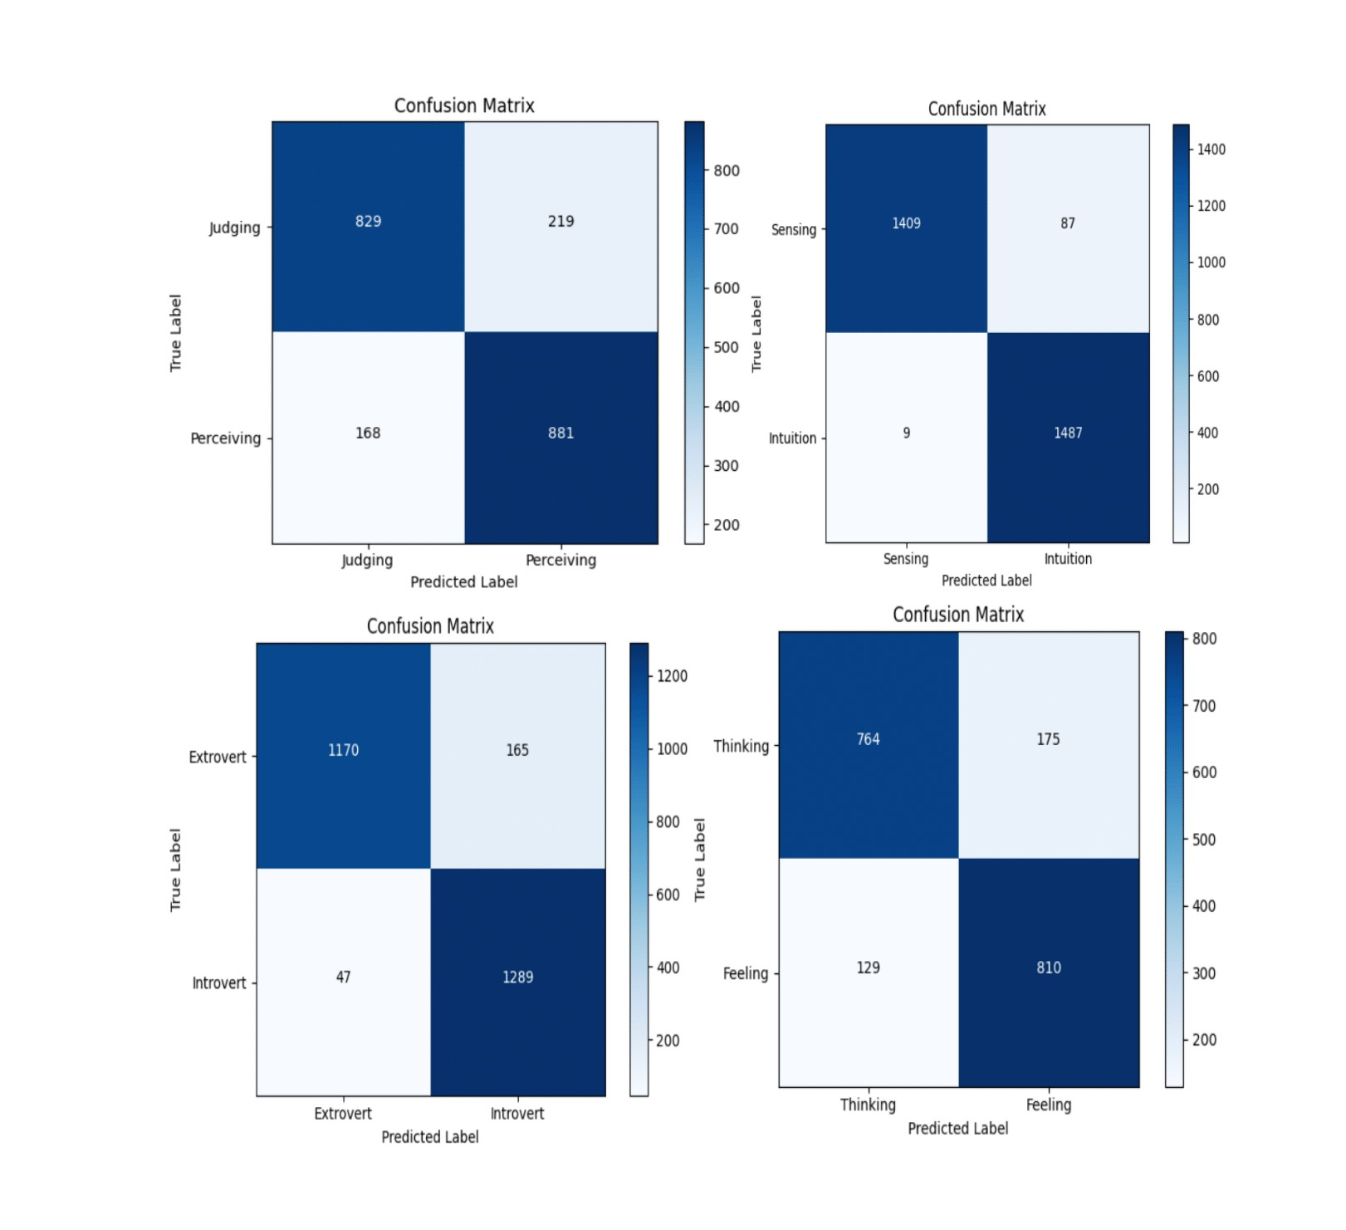
Performance Analysis: Results
Fig. Confusion Matrix for SVM (Hyperparameter tuned)

Slide 30
Performance Analysis: Comparison
Papers | Text Embedding | I/E | S/N | T/F | J/P | Average
[6] | BERT | 83.1% | 88.5% | 84.1% | 78.0% | 83.4%
[6] | BERT+ Statistical Feature vectors (uni +p+e) | 84.6% | 88.8% | 84.5% | 78.7% | 84.2%
[2] | TF-IDF + Count vectorizer | 89.5% | 89.8% | 69.0% | 67.6% | 78.97%
Out proposed model | SBERT | 92.06% | 96.79% | 83.81% | 81.54% | 88.5%
Fig. Accuracy Comparison

Slide 31

Conclusion and Future work:
Outperforms most recent model using BERT (2022)
Implementation of deep learning algorithm may improve our outcomes
Various resources(LIWC, EmoSenticNet, ConceptNet) can be used as feature
Find Co-relation of Human Emotion and Personality

Slide 32
References:
[1] Ontoum, Sakdipat, and Jonathan H. Chan. "Personality Type Based on Myers-Briggs Type Indicator with Text Posting Style by using Traditional and Deep Learning." arXiv preprint arXiv:2201.08717 (2022).
[2] Cui, Brandon, and Calvin Qi. "Survey analysis of machine learning methods for natural language processing for MBTI Personality Type Prediction." Final Report Stanford University (2017).
[3] Pradhan, Tejas, et al. "Analysis of personality traits using natural language processing and deep learning." 2020 Second International Conference on Inventive Research in Computing Applications (ICIRCA). IEEE, 2020.
[4] Bharadwaj, Srilakshmi, et al. "Persona traits identification based on Myers-Briggs Type Indicator (MBTI)-a text classification approach." 2018 international conference on advances in computing, communications and informatics (ICACCI). IEEE, 2018.
[5] Brindha, S., K. Prabha, and Sandeep Sukumaran. "A survey on classification techniques for text mining." 2016 3rd International Conference on Advanced Computing and Communication Systems (ICACCS). Vol. 1. IEEE, 2016.
[6] S. Majima and K. Markov., “Personality prediction from social media posts using text embedding and statistical features,” in 2022 17th Conference on Computer Science and Intelligence Systems (FedCSIS). IEEE, 2022.

Slide 33
THANK YOU

