Slide 1
Support-Vector Machines
In machine learning, support-vector machines (SVMs, also support-vector networks^{[1]}) are supervised learning models with associated learning algorithms that analyze data for classification and regression analysis.

Slide 2
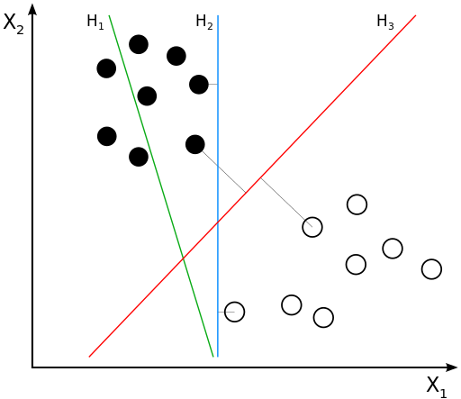
Motivation
Classifying data is a common task in machine learning.
Suppose some given data points each belong to one of two classes, and the goal is to decide which class a new data point will be in.
A data point is viewed as a p-dimensional vector, and we want to know whether we can separate such points with a (p-1)-dimensional hyperplane. This is called a linear classifier
Hyperplane is a (k-1) dimensions plane in k dimensions

Slide 3
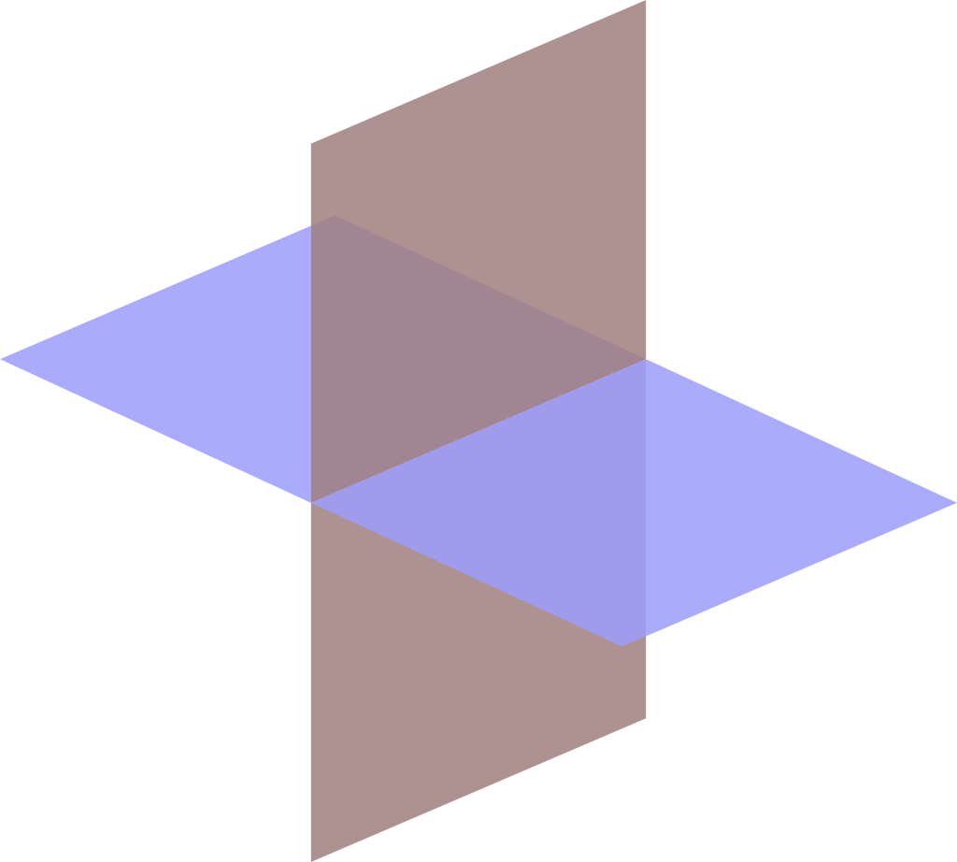
Hyperplane
In geometry, a hyperplane is a subspace whose dimension is one less than that of its ambient space. For example, if a space is 3-dimensional then its hyperplanes are the 2-dimensional planes, while if the space is 2-dimensional, its hyperplanes are the 1-dimensional lines. This notion can be used in any general space in which the concept of the dimension of a subspace is defined.

Slide 4
Definition
A SVM constructs a hyperplane (or set of hyperplanes), in k dimensional space, which can be used for classification or regression
This is considered a good separation: a good separation is achieved by the hyperplane that has the largest distance to the nearest training-data point of any class (so-called functional margin), since in general the larger the margin, the lower the generalization error of the classifier.

Slide 5
higher-dimensional space > finite-dimensional space
Higher dimensional space makes separation easier
To keep the computational load reasonable, the mappings used by SVM schemes are designed to ensure that dot products of pairs of input data vectors may be computed easily in terms of a kernel function k(x, y) selected to suit the problem.
The hyperplanes in the higher-dimensional space are defined as the set of points whose dot product with a vector in that space is constant, where such a set of vectors is an orthogonal (and thus minimal) set of vectors that defines a hyperplane.

Slide 6
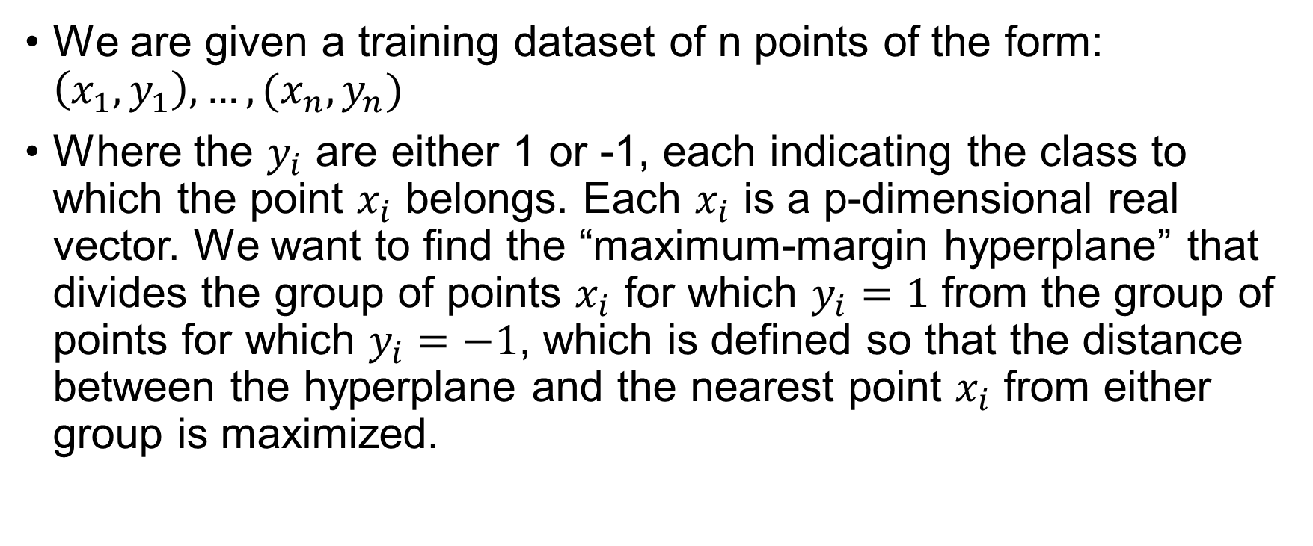
Linear SVM
We are given a training dataset of n points of the form: $\left(x_{1}, y_{1}\right), …, (x_{n}, y_{n})$
Where the $y_{i}$ are either 1 or -1, each indicating the class to which the point $x_{i}$ belongs. Each $x_{i}$ is a p-dimensional real vector. We want to find the “maximum-margin hyperplane” that divides the group of points $x_{i}$ for which $y_{i}=1$ from the group of points for which $y_{i}=−1$, which is defined so that the distance between the hyperplane and the nearest point $x_{i}$ from either group is maximized.

Slide 7
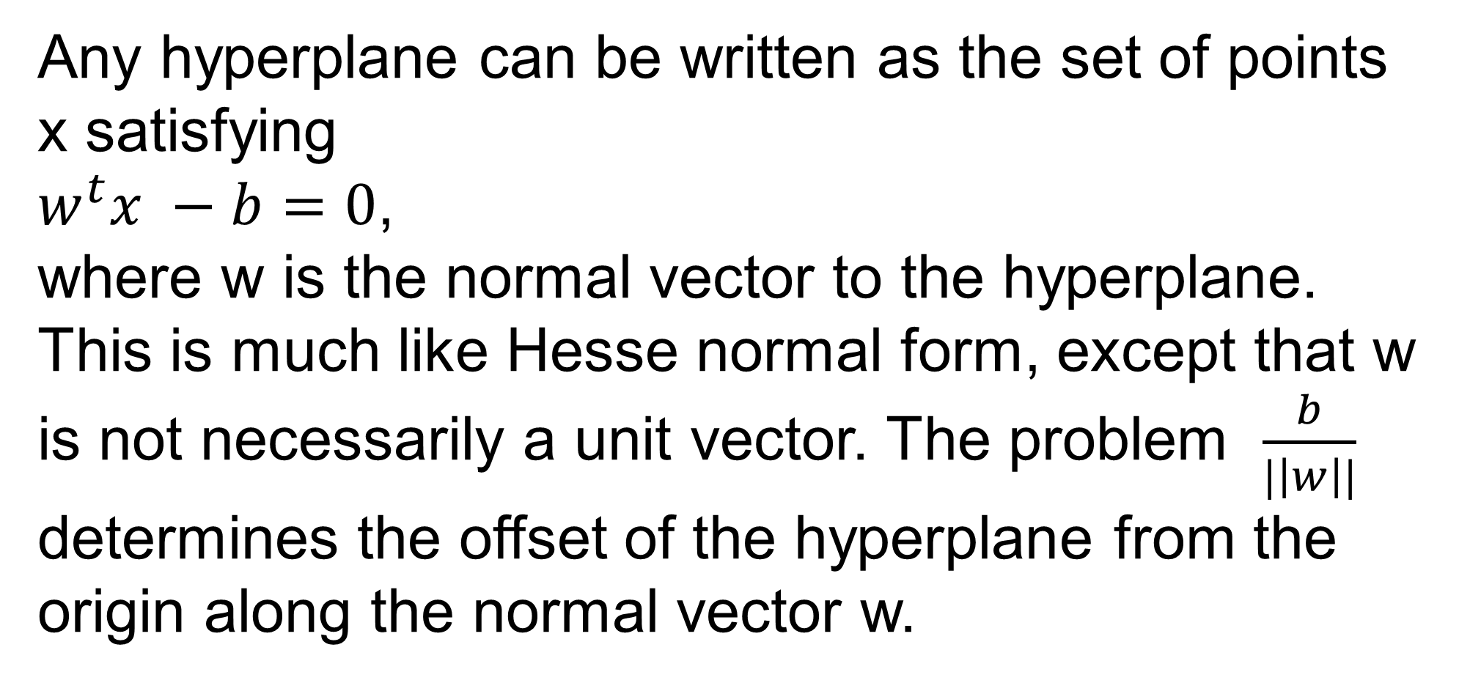
Any hyperplane can be written as the set of points x satisfying
$w^{t}x −b=0$,
where w is the normal vector to the hyperplane. This is much like Hesse normal form, except that w is not necessarily a unit vector. The problem $\frac{b}{|\left|w\right||}$ determines the offset of the hyperplane from the origin along the normal vector w.

Slide 8
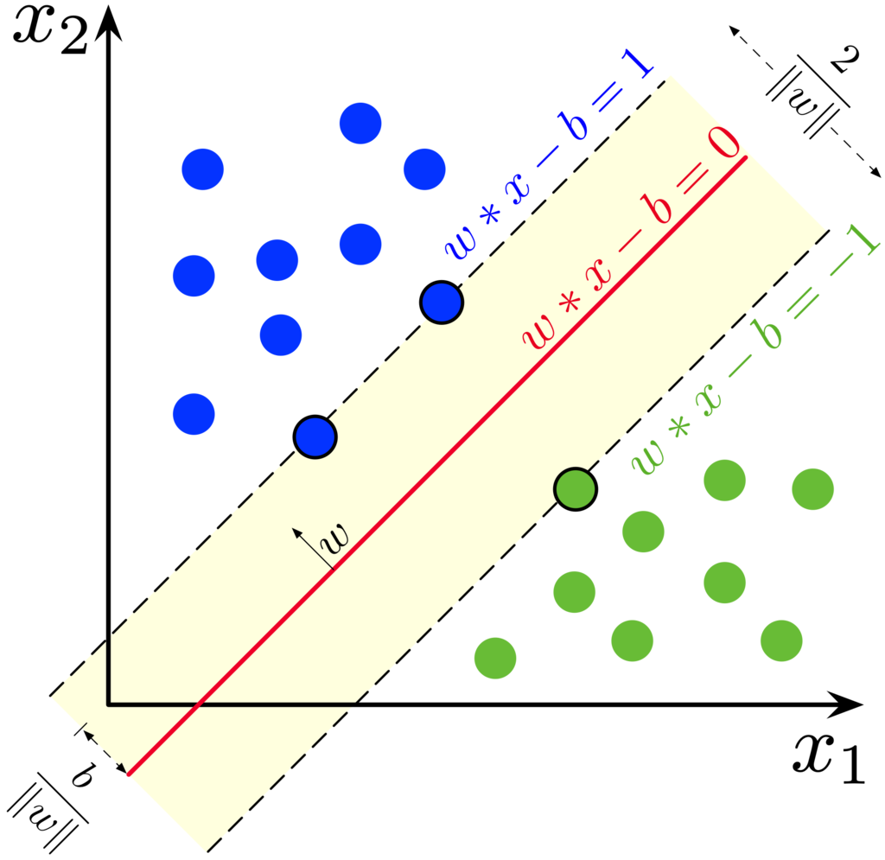
Linear SVM
Maximum-margin hyperplane and margins for an SVM trained with samples from two classes. Samples on the margin are called the support vectors.

Slide 9
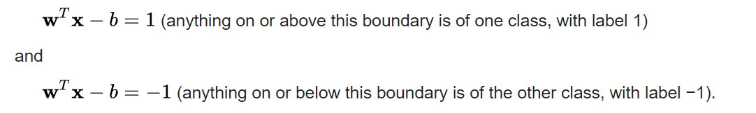
Hard-margin
If the training data is linearly separable, we can select two parallel hyperplanes that separate the two classes of data, so that the distance between them is as large as possible.
The region bounded by these two hyperplanes is called the "margin", and the maximum-margin hyperplane is the hyperplane that lies halfway between them.
With a normalized or standardized dataset, these hyperplanes can be described by the equations

