Slide 1
Global Consensus Control of Lipschitz Nonlinear Multi-Agent Systems

Slide 2

Presented by Ali Alaei Amirkabir University of Technology Dr. Atrianfar Winter 2023

Slide 3
Table of contents
Problem statement
Sufficient condition for the global consensus
Global consensus region
Introducing two step algorithm to determine consensus protocol
Reference
Necessary and sufficient condition for unbounded global consensus region
Numerical examples

Slide 4

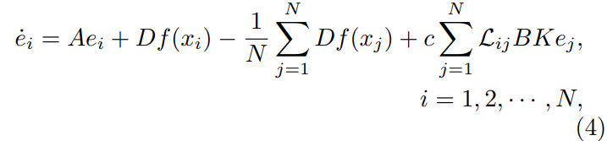
Problem statement

Slide 5
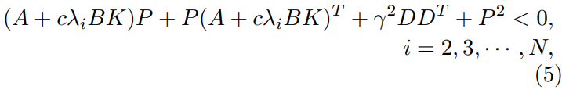
Sufficient condition for the global consensus
Theorem 2. Assume that graph G is connected. Then, the N agents in (1) can reach global consensus under protocol (3), if there exist a matrix P > 0 such that

Slide 6
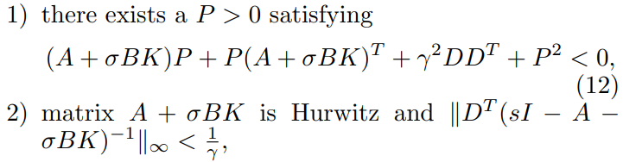
Global consensus region
Definition 1. The region S of the parameter σ ∈ R+, such
that any of the following two statements holds:

Slide 7

Global consensus region
Example 1. The agent dynamics and the consensus protocol are given by (1) and (3), respectively, with
and the Lipschitz constant γ in (2) is equal to $\frac{1}{0.9}$ .

Slide 8
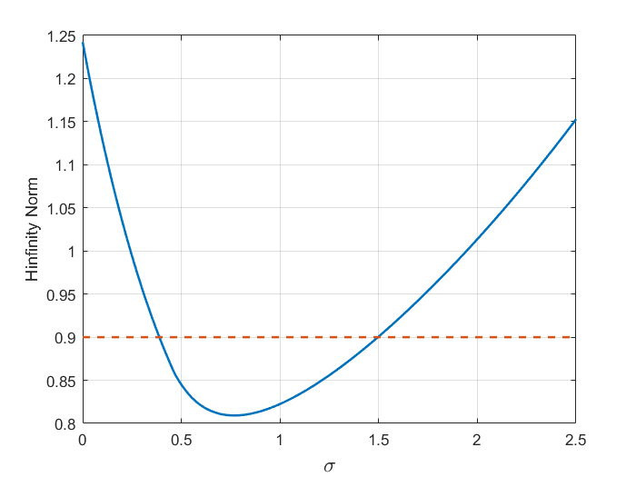
Global consensus region
Fig. 1. The bounded global consensus region
The global consensus region S can be obtained as S = (0.3885, 1.4961).

Slide 9

Necessary and sufficient condition for unbounded global consensus region
Theorem 4. There exists a consensus protocol (3) yielding an unbounded global consensus region for network (4), if and only if there exist a matrix P > 0 and a scalar τ > 0 such that

Slide 10
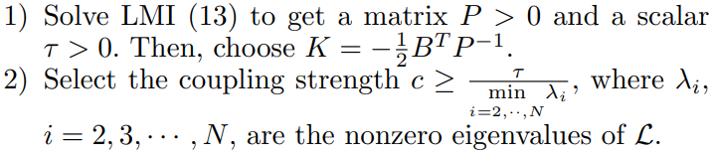
Introducing two step algorithm to determine consensus protocol
Algorithm 1. Assume that graph G is connected. If the condition in Theorem 4 is satisfied, the consensus protocol (3) can be constructed for network (4) to achieve global consensus, as follows:

Slide 11
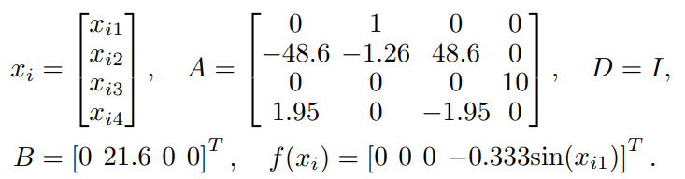
Numerical example
Example 2. Consider a network of 6 single-link manipulators with revolute joints actuated by a DC motor. The dynamics of the i-th manipulator is described by (1), with
Clearly, $f(x_{i})$ here satisfies (2) with a Lipschitz constant γ = 0.333.

Slide 12
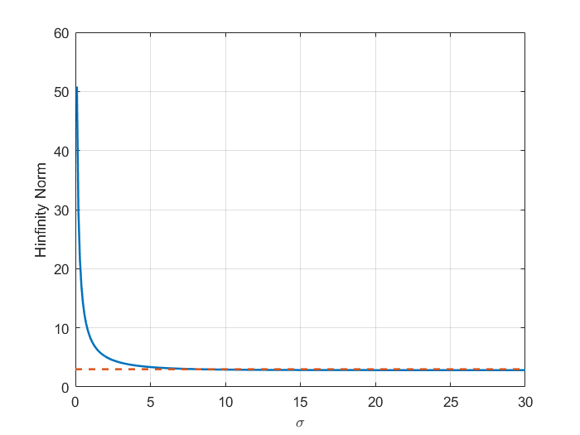
Numerical example
Fig. 2. The unbounded global consensus region.
The global consensus region S can be obtained as S = [8.2, ∞).

Slide 13
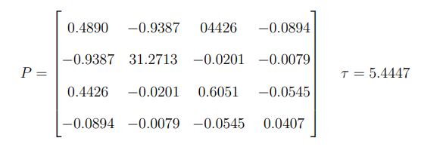
Numerical example
Solving LMI (13) using the LMI toolbox of Matlab gives a feasible solution:
Thus, by Algorithm 1, the feedback gain matrix of (3) is chosen as
K = [ −4.7240 −0.4870 2.8369 −6.6788]

Slide 14
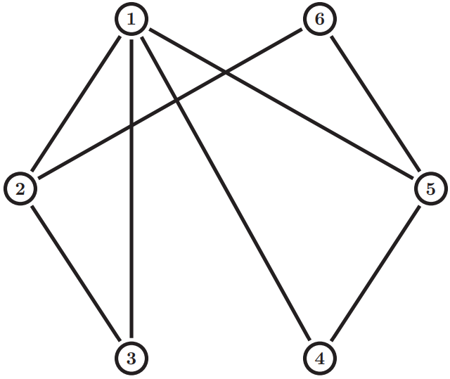
Numerical example
Fig. 3. the communication topology
For the graph in Fig. 3, protocol (3) with K chosen here solves the global consensus problem, if the coupling strength c ≥ 3.9397.

Slide 15
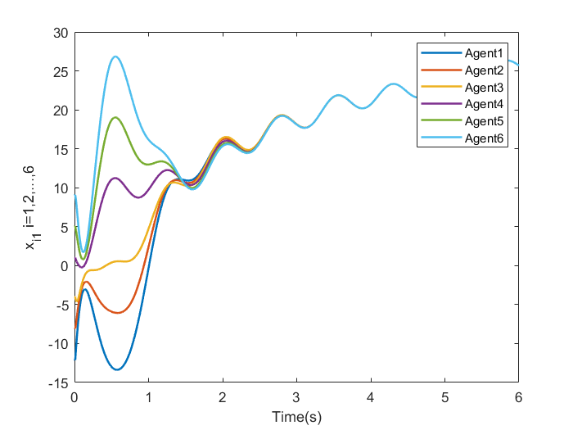
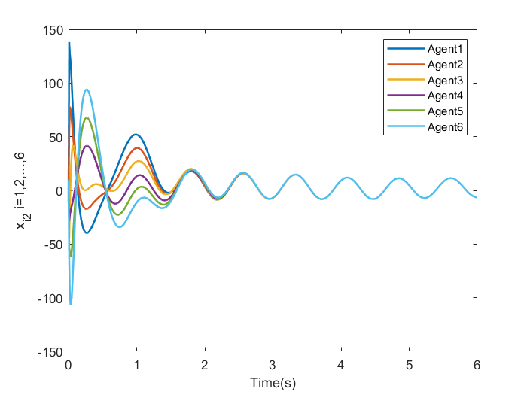
Numerical example
The state trajectories of the 6 manipulators under protocol (3) with K given as above and c = 10 are depicted in Fig. 4,5 from which one can see that the global consensus is indeed achieved.
Fig. 4. The 6 manipulators First and Second states reach global consensus.

Slide 16
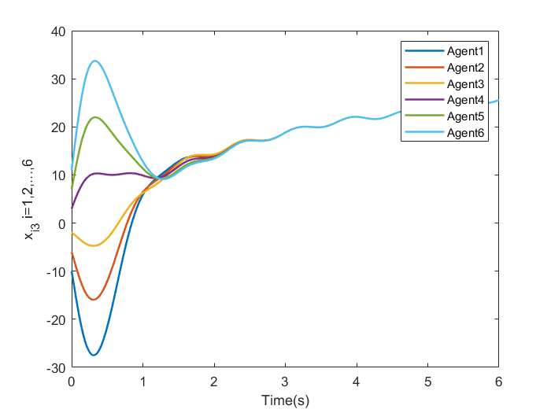
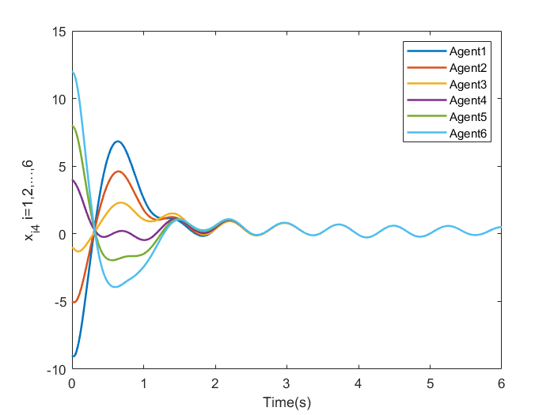
Numerical example
Fig. 4. The 6 manipulators Third and Fourth states reach global consensus.

Slide 17
Reference
[1] Li, Zhongkui, Liu, Xiangdong, and Fu, Mengyin. Global consensus control of lipschitz nonlinear multi-agent systems. IFAC Proceedings Volumes, 44(1):10056–10061, 2011.

Slide 18
Thanks for your attention!

