Slide 2
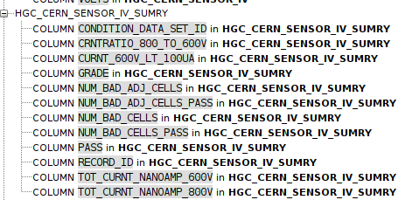
IV_SUMRY Current columns (Oct 26)

Slide 3
CV_SUMRY
<SNSR_THCKNESS>120</SNSR_THCKNESS>
<DEPL_VOLTS>200</DEPL_VOLTS>
<MAX_DEPL_VOLTS>250</MAX_DEPL_VOLTS>
<DEPL_UNIF_VOLTS>200</DEPL_UNIF_VOLTS>
<SNSR_THKNES_UNIF>120</SNSR_THKNES_UNIF>
<DEPL_VOLTS_PASS>PASSED</DEPL_VOLTS_PASS>
<DEPL_VOLTS_UNIF_PASS>PASSED</DEPL_VOLTS_UNIF_PASS>
<C_INT_PASS>PASSED</C_INT_PASS>
<SNSR_THKNES_UNIF_PASS>PASSED</SNSR_THKNES_UNIF_PASS>
<PASS>PASSED</PASS>

Slide 4
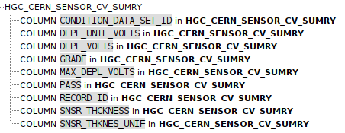
CV_SUMRY Current columns (Oct 26)

Slide 5
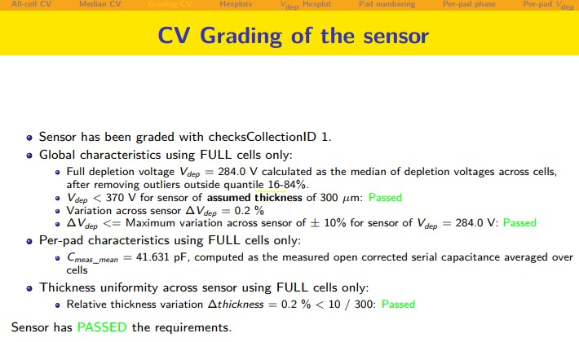
<DEPL_VOLTS>284</DEPL_VOLTS>
<MAX_DEPL_VOLTS>370</MAX_DEPL_VOLTS>
<DEPL_VOLTS_PASS>PASS</DEPL_VOLTS_PASS>
<DEPL_UNIF_VOLTS>0.2</DEPL_UNIF_VOLTS>
<SNSR_THCKNESS>300</SNSR_THCKNESS>
<DEPL_VOLTS_PASS>PASS</DEPL_VOLTS_PASS>
<DEPL_UNIF_VOLTS>0.2</DEPL_UNIF_VOLTS>
<SNSR_THKNES_UNIF_PASS>PASSED</SNSR_THKNES_UNIF_PASS>
<SNSR_THKNES_UNIF>0.2</SNSR_THKNES_UNIF>

