Slide 1
HGC_CERN_SENSOR_IV_SUMRY old and Proposed Columns
Old Columns
Columns we proposed (which now work)
CONDITION_DATA_SET_ID
CRNTRATIO_800_TO_600V
GRADE
NUM_BAD_ADJ_CELLS
NUM_BAD_CELLS
PASS
RECORD_ID
TOT_CURNT_NANOAMP_600V
TOT_CURNT_NANOAMP_800V
CONDITION_DATA_SET_ID
CRNTRATIO_800_TO_600V
CURNT_600V_LT_100UA
NUM_BAD_ADJ_CELLS
NUM_BAD_ADJ_CELLS_PASS
NUM_BAD_CELLS
LIST_BAD_CELLS
NUM_BAD_CELLS_PASS
PASS
RECORD_ID
TOT_CURNT_NANOAMP_600V
TOT_CURNT_NANOAMP_800V
Notes:
Remove GRADES because currently SI testing does not assign grades
LIST_BAD_CELLS: it is critical to keep track of the bad censor cells in the DB – this could just be a comma-separated list of integers
To see the proposed new XML template (which could be derived from the column names above), see next page

Slide 2
HGC_CERN_SENSOR_IV_SUMRY New XML template
<?xml version="1.0" encoding="UTF-8" standalone="yes"?>
<ROOT xmlns:xsi="http://www.w3.org/2001/XMLSchema-instance">
<HEADER>
<TYPE>
<EXTENSION_TABLE_NAME> HGC_CERN_SENSOR_IV_SUMRY</EXTENSION_TABLE_NAME>
<NAME>HGC CERN Sensor IV Summary</NAME>
</TYPE>
<RUN>
<RUN_NAME>Your Run Name</RUN_NAME>
<!-- Enter your timestamp -->
<RUN_BEGIN_TIMESTAMP>2018-05-14 00:00:00</RUN_BEGIN_TIMESTAMP>
<RUN_END_TIMESTAMP>2018-05-14 00:00:00</RUN_END_TIMESTAMP>
<INITIATED_BY_USER>Your Name</INITIATED_BY_USER>
<LOCATION>CERN</LOCATION>
<COMMENT_DESCRIPTION>Your Comments</COMMENT_DESCRIPTION>
</RUN>
</HEADER>
<DATA_SET>
<PART>
<KIND_OF_PART>120um Si Sensor HD Full</KIND_OF_PART>
<SERIAL_NUMBER>XXXXXXXXXXXXXXXXXXX</SERIAL_NUMBER>
</PART>
</PART>
<DATA>
<TOT_CURNT_NANOAMP_600V>7.609905</TOT_CURNT_NANOAMP_600V>
<TOT_CURNT_NANOAMP_800V>0.01653122</TOT_CURNT_NANOAMP_800V>
<CURNT_600V_LESSTHAN_100uA>PASSED</CURNT_600V_LESSTHAN_100uA>
<CRNTRATIO_800_TO_600>PASSED< CRNTRATIO_800_TO_600 >
<NUM_BAD_CELLS>3</NUM_BAD_CELLS>
<LIST_BAD_CELLS>25,100,112</LIST_BAD_CELLS>
<NUM_BAD_CELLS_PASS>PASSED</NUM_BAD_CELLS_PASS>
<PASS>N</PASS>
<NUM_BAD_ADJ_CELLS>5</NUM_BAD_ADJ_CELLS>
<NUM_BAD_ADJ_CELLS_PASS>PASS</NUM_BAD_ADJ_CELLS_PASS>
</DATA_SET>
</ROOT>

Slide 3
HGC_CERN_SENSOR_CV_SUMRY old and Proposed Columns
Columns we proposed (which now work)
Current Columns
CONDITION_DATA_SET_ID
DEPL_UNIF_VOLTS
DEPL_VOLTS_PASS
DEPL_VOLTS_UNIF_PASS
C_INT_PASS
DEPL_VOLTS
MAX_DEPL_VOLTS
PASS
RECORD_ID
SNSR_THICKNESS
SNSR_THICKNESS_UNIF
SNSR_THICKNESS_UNIF_PASS
CONDITION_DATA_SET_ID
DEPL_UNIF_VOLTS
DEPL_VOLTS
GRADE
MAX_DEPL_VOLTS
PASS
RECORD_ID
SNSR_THICKNESS
SNSR_THICKNESS_UNIF
Notes:
Remove GRADES because currently SI testing does not assign grades
To see the proposed new xml template (which could be derived from the column names above), see next page

Slide 4
HGC_CERN_SENSOR_CV_SUMRY Proposed XML template
<?xml version="1.0" encoding="UTF-8" standalone="yes"?>
<ROOT xmlns:xsi="http://www.w3.org/2001/XMLSchema-instance">
<HEADER>
<TYPE>
<EXTENSION_TABLE_NAME>HGC_CERN_SENSOR_CV_SUMRY</EXTENSION_TABLE_NAME>
<NAME>HGC CERN Sensor CV Summary</NAME>
</TYPE>
<RUN>
<RUN_NAME>Your Run Name</RUN_NAME>
<!-- Enter your timestamp -->
<RUN_BEGIN_TIMESTAMP>2018-05-14 00:00:00</RUN_BEGIN_TIMESTAMP>
<RUN_END_TIMESTAMP>2018-05-14 00:00:00</RUN_END_TIMESTAMP>
<INITIATED_BY_USER>Your Name</INITIATED_BY_USER>
<LOCATION>CERN</LOCATION>
<COMMENT_DESCRIPTION>Your Comments</COMMENT_DESCRIPTION>
</RUN>
</HEADER>
<DATA_SET>
<PART>
<KIND_OF_PART>120um Si Sensor HD Full</KIND_OF_PART>
<SERIAL_NUMBER>XXXXXXXXXXXXXXXXXXX</SERIAL_NUMBER>
</PART>
<DATA>
<SNSR_THCKNESS>120</SNSR_THCKNESS>
<DEPL_VOLTS>200</DEPL_VOLTS>
<MAX_DEPL_VOLTS>250</MAX_DEPL_VOLTS>
<DEPL_UNIF_VOLTS>200</DEPL_UNIF_VOLTS>
<SNSR_THKNES_UNIF>120</SNSR_THKNES_UNIF>
<DEPL_VOLTS_PASS>PASSED</DEPL_VOLTS_PASS>
<DEPL_VOLTS_UNIF_PASS>PASSED</DEPL_VOLTS_UNIF_PASS>
<C_INT_PASS>PASSED</C_INT_PASS>
<SNSR_THKNES_UNIF_PASS>PASSED</SNSR_THKNES_UNIF_PASS>
<PASS>PASSED</PASS>
</DATA>
</DATA_SET>
</ROOT>

Slide 5
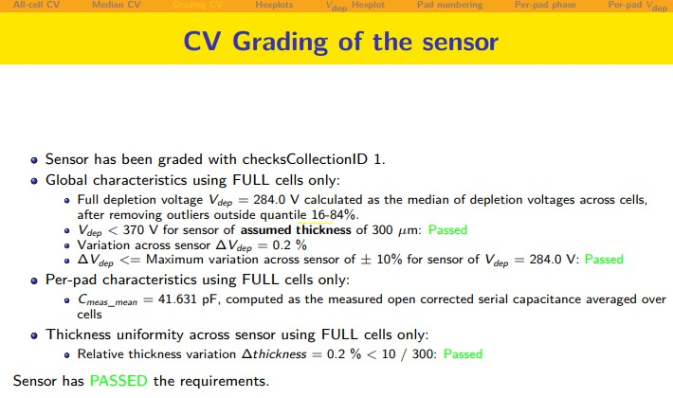
<DEPL_VOLTS>284</DEPL_VOLTS>
<MAX_DEPL_VOLTS>370</MAX_DEPL_VOLTS>
<DEPL_VOLTS_PASS>PASS</DEPL_VOLTS_PASS>
<DEPL_UNIF_VOLTS>0.2</DEPL_UNIF_VOLTS>
<SNSR_THCKNESS>300</SNSR_THCKNESS>
<DEPL_VOLTS_PASS>PASS</DEPL_VOLTS_PASS>
<DEPL_UNIF_VOLTS>0.2</DEPL_UNIF_VOLTS>
<SNSR_THKNES_UNIF_PASS>PASSED</SNSR_THKNES_UNIF_PASS>
<SNSR_THKNES_UNIF>0.2</SNSR_THKNES_UNIF>

