Slide 1
BugBusters: AI-Powered Code Review Tool
Presented by: Ali Ammar

Slide 2
Project Overview
Supports all programming languages
Detects bugs, inefficiencies, bad practices
Provides natural-language suggestions
Built with Spring Boot, JavaFX frontend, and OpenAI API

Slide 3
Motivation
Code review is essential but time-consuming
Many developers struggle with best practices
AI offers fast, consistent, language-agnostic feedback

Slide 4
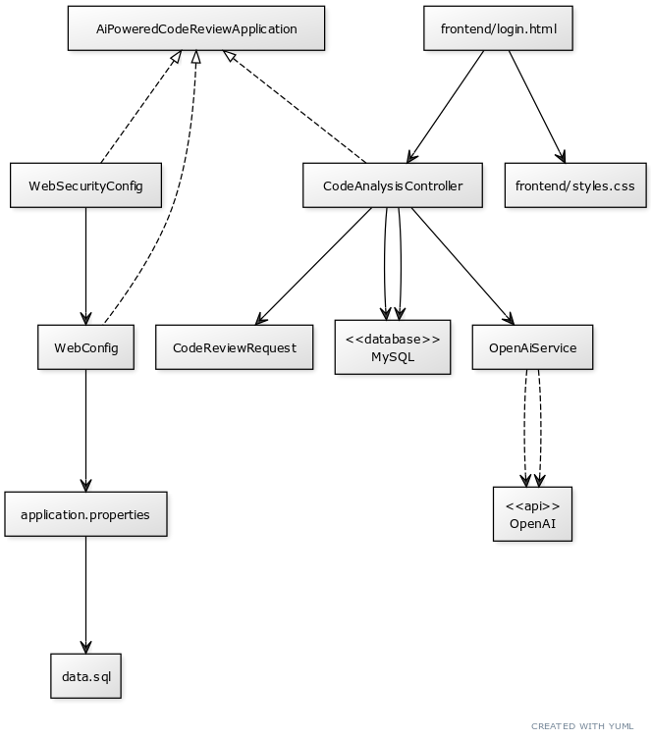
System Architecture
Frontend (GUI)
Backend (Spring Boot)
OpenAI API
MySQL DB
Language-independent Input

Slide 5
Key Features
Input code in any language
Receive structured, plain-English suggestions
Highlights logic, syntax, style, and security issues
User-friendly interface with optional login

Slide 6
Technologies Used
Spring Boot
JavaFX
OpenAI API
MySQL

Slide 7
Challenges Faced
Multi-language input parsing
API rate limits
Managing code formatting for long snippets
Displaying structured feedback clearly

Slide 8
Future Improvements
IDE plugin (VSCode, IntelliJ)
Real-time linting
Fine-tuned models for each language
Team collaboration & GitHub PR reviews

