Slide 1


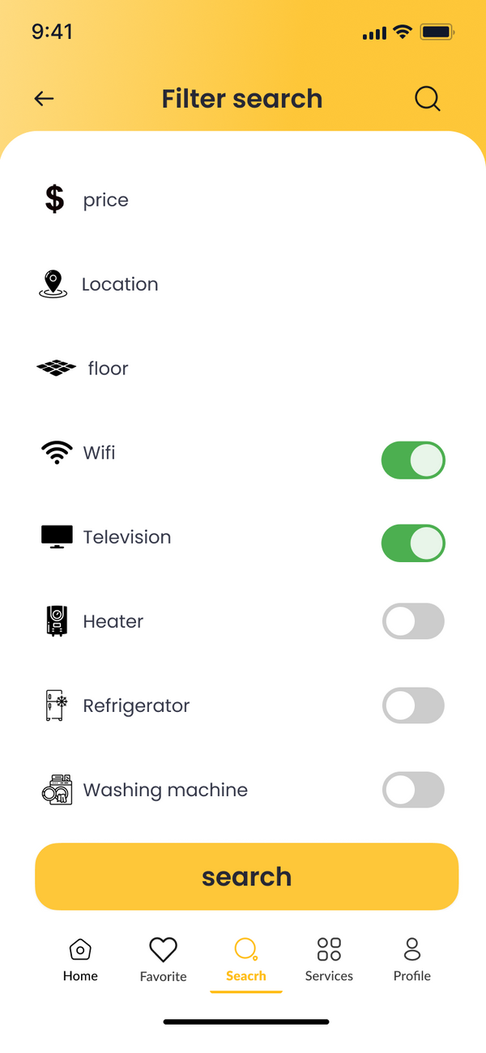
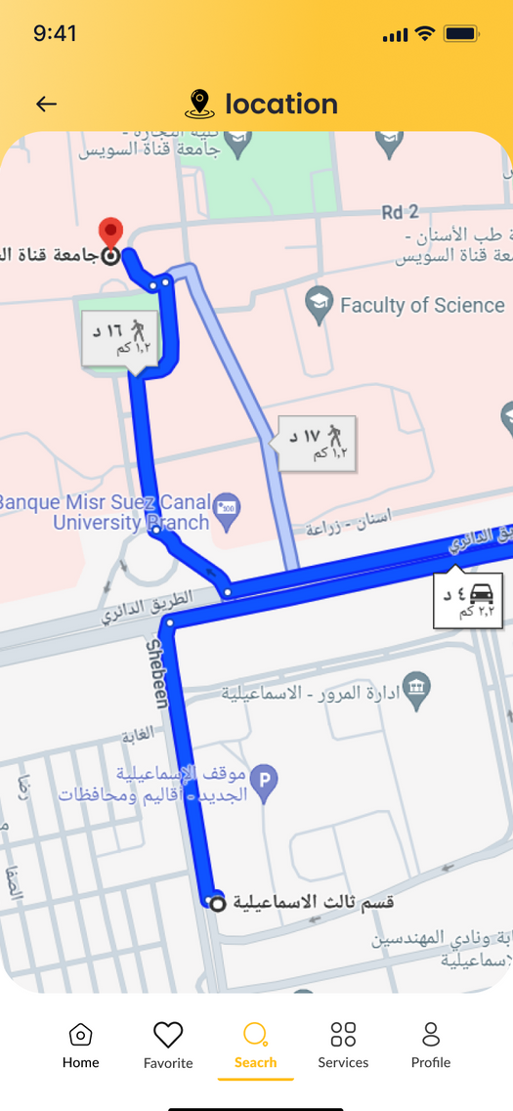

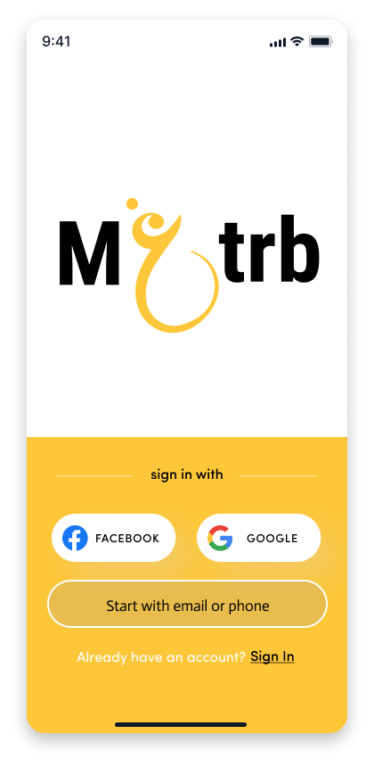

One click
Closer to Your new life

Slide 2



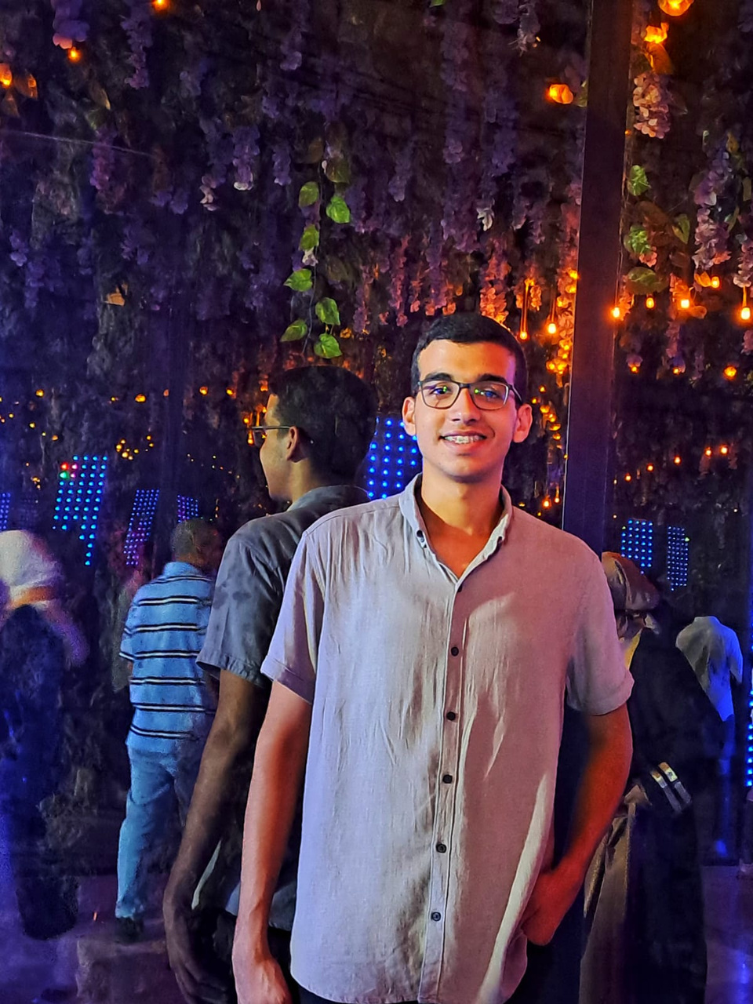








Problems
Endless searches in an unfamiliar city.
20%
Living with a stranger
Students
Getting scammed

Slide 3





Students
Effortless Apartment Search
Rental Owners
Cut Out the Middleman
Save Money
Fill Your Vacancies Quickly
Know Your Neighborhood
Streamline Rentals
Reliable Renters

Slide 4
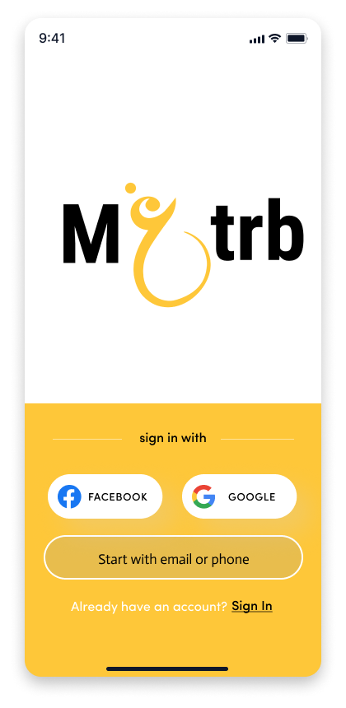
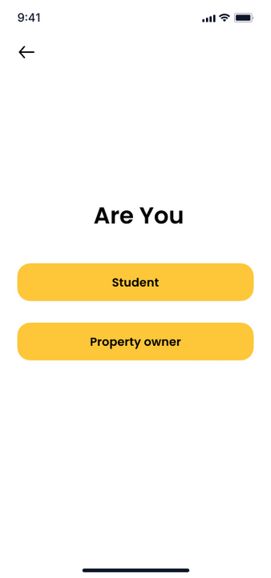
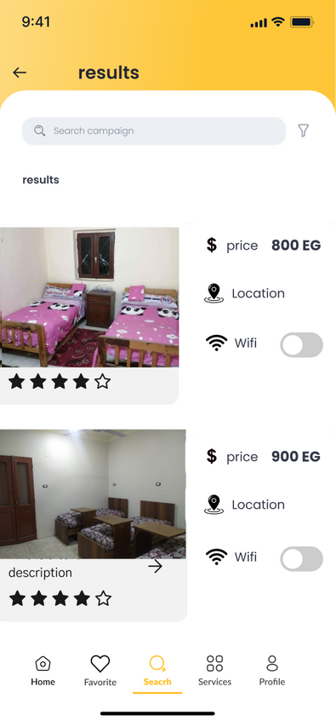
Product

Slide 5

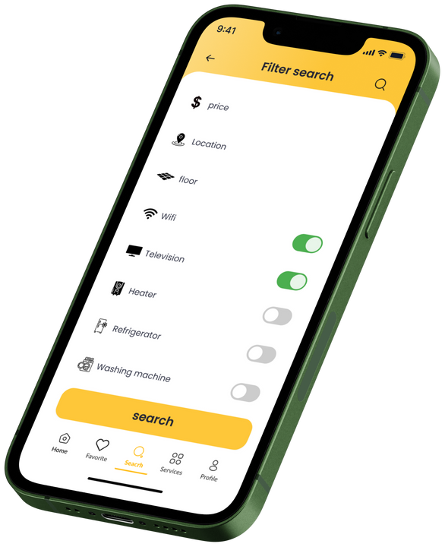





Features
Discover Your Neighborhood
Detailed Search
Explore nearby restaurants, doctors, cafes, laundromats, and co-working spaces, all mapped within the app.
Filter listings based on location, price, amenities, and roommate preferences
Reviews and Ratings
Easy-to-Use Interface
Discounts Galore
Enjoy exclusive discounts on nearby restaurants, cafes, laundry services, and co-working spaces.
Allow students to leave reviews and ratings for apartments and co-working spaces.
The app is designed for a smooth and intuitive experience for both students and rental owners.

Slide 6




All YEAR
Students
Property Owners
Customer Segment
Employees
Seasonal
Pepole who are coming to enjoy the city.

Slide 7






Market Size
750,000
TAM
Out-of-town &
International students
9,000
SAM
Out-of-town &
International students in Ismailia
SOM
800
College Student

Slide 8







Marketing strategy
Brand Awareness
Referral Programs
Print ads: Posters, Billboards, Flyers
Social Media Campaigns
Campaign Launch Event
Promote In-App Services
Target Partnerships

Slide 9
01
Commissions
Mgtrb charges a 10 % commission (percentage of rent) on each successful rental transaction between students and rental owners.
Revenue
STREAMS
02
In-App Ordering & Services
Mgtrb expands its offerings by partnering with local businesses to provide convenient in-app services for students, generating additional revenue streams

Slide 10



Costs
&
App Development Cloud Service
25%
&
620K
12%
Marketing User Acquisition
&
Employees Office
63%
Costs

Slide 11
Financial forecasts
First year
8.1M
635K
15K
800 Student
Second year
28.8M
2.235K
815K
2100 Student
Business volume
Gross profite
Net profite

Slide 12

TIMELINE OF ACTIVITIES
First quarter
Third quarter
Monthly Initiatives
600 Student
1-3
6
7-9
9-12
4-6
300 Student
800 Student
Second Quarter
Fourth quarter

Slide 13


Compatitors
Services | Mgtrb | AIR BNB | Start up in Asyut | Broker
Services for students
Mobile App
customers service

Slide 14

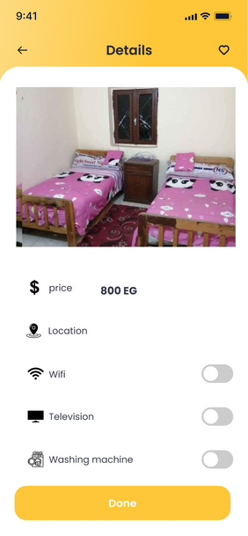
Survey
50 students
95%
Ready to use
Not ready
5%

Slide 15
GET
THE
APP
today

Slide 16
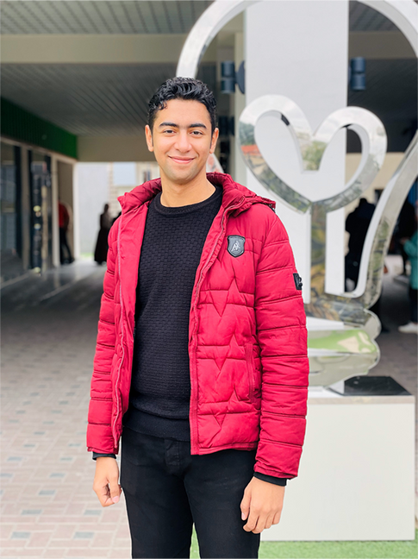
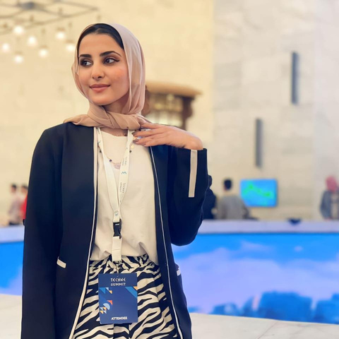

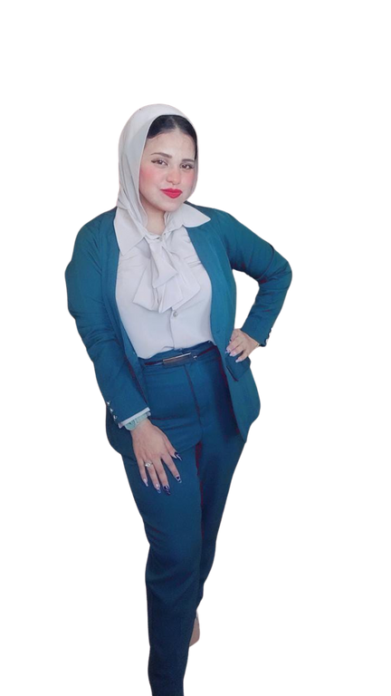
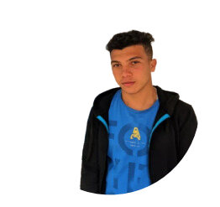

Team
Ali Arabi
Salwa Alaa
Yousef Salah
Marketing & branding
Business development
Sales & Operation
Mgtrb
Mgtrb
Haneen Mohammed
Fahme EId
Software Developer
Software Developer
Mgtrb
Mgtrb

Slide 17




Get in touch with us
Email Address
Phone Number
mgtrb2000@gmail.com
01282010827
Our Website
Location
www.Mgtrb.com
Ismailia, Egypt

